Slide 1
Student name: Marek Czeslaw Florek
Student ID: 2025556
Programme: Certificate in Higher Education Skills for the Workplace
Module: Managing Enterprise in the 21st Century
Module code: BMSW4006
Lecture name: Daminabo Pokubo
Assignment Title:

Slide 2
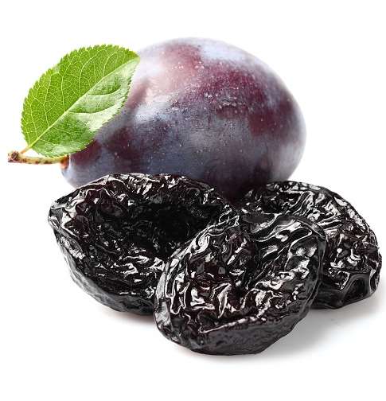
Executive Summary
Business/ Company Overview
Products and Services
Market audit:
Competitors Analysis
SWOT Analysis
PESTLE Analysis
Target Market
Marketing Plan
Management Team

Slide 3
Business/Company Overview
Company for the sale of dried fruits / plums
Location in the center of Birmingham
Start of business on August 1, 2022
Our mission is for a healthier lifestyle

Slide 4
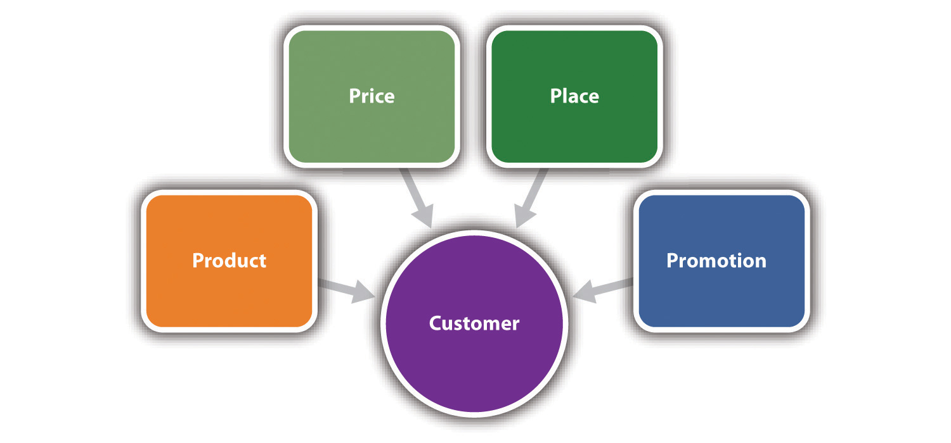
Product and Services
healthy dried fruits / plums
products high in vitamins and minerals
excellent service
friendly staff
high standard of hygiene

Slide 5
Marketing Audit- Competitors Analysis
Market audit is a very valuable tool for tactical and strategic planning for new business (Lupnicka Denisa and Dado Jaroslav, 2013) this tool measures the risk, value, and effectiveness of marketing.
Every company has competition in the market, so as a start-up business it is extremely important to study the market leaders who are close to us and with whom our business must compete. I will present two of these companies located in Birmingham.
Two of the strongest competitors in the industry:
AFG Dried Fruit & Nuts LTD, Birmingham
Watan Dry Fruits Ltd, Birmingham

Slide 6
Market Audit-SWOT Analysis
STRENGTHS: | WEAKNESS:
Great location Quality products Secure suppliers Specialized services At a lower price than the competition | new company starting a business strong competition
OPPORTUNITIES: | THREAT:
product expansion opening new stores more frequent demand for these products merger with a larger company | the war in Ukraine high inflation Covid-19 a new competition with lower prices Changes in consumer trends

Slide 7
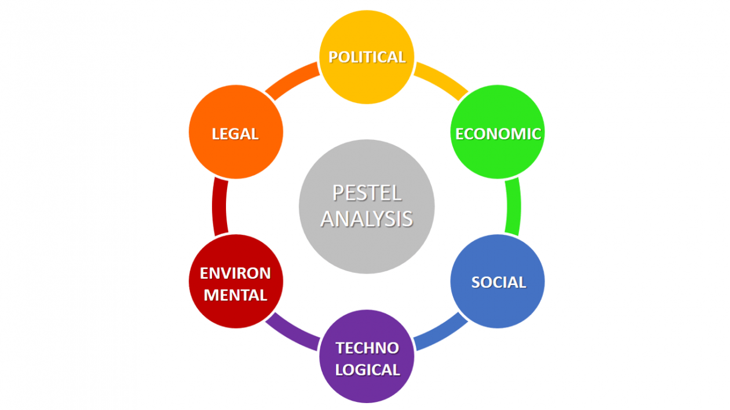
Market Audit-PESTLE Analysis
POLITICAL | Increase the tax Covid-19 pandemic Inflation
ECONOMIC | War between Russia and Ukraine Financially help Competition Economic growth rate
SOCIAL | Internet Financial help
TECHNOLOGICAL | Online service Delivery service
ENVINMENTAL | protective things for health, face masks, disinfection
LEGAL | Health and safety First aid Data protection
Pestle analysis is a widely used tool for external and situational business systems. We have considered all the factors and developed a plan for any emergencies that may arise and developed a training schedule (Nerynaut, 2017).

Slide 8

Target Market
various financial support programs
Social conversation
Surveys
Profit
Healthcare

Slide 9
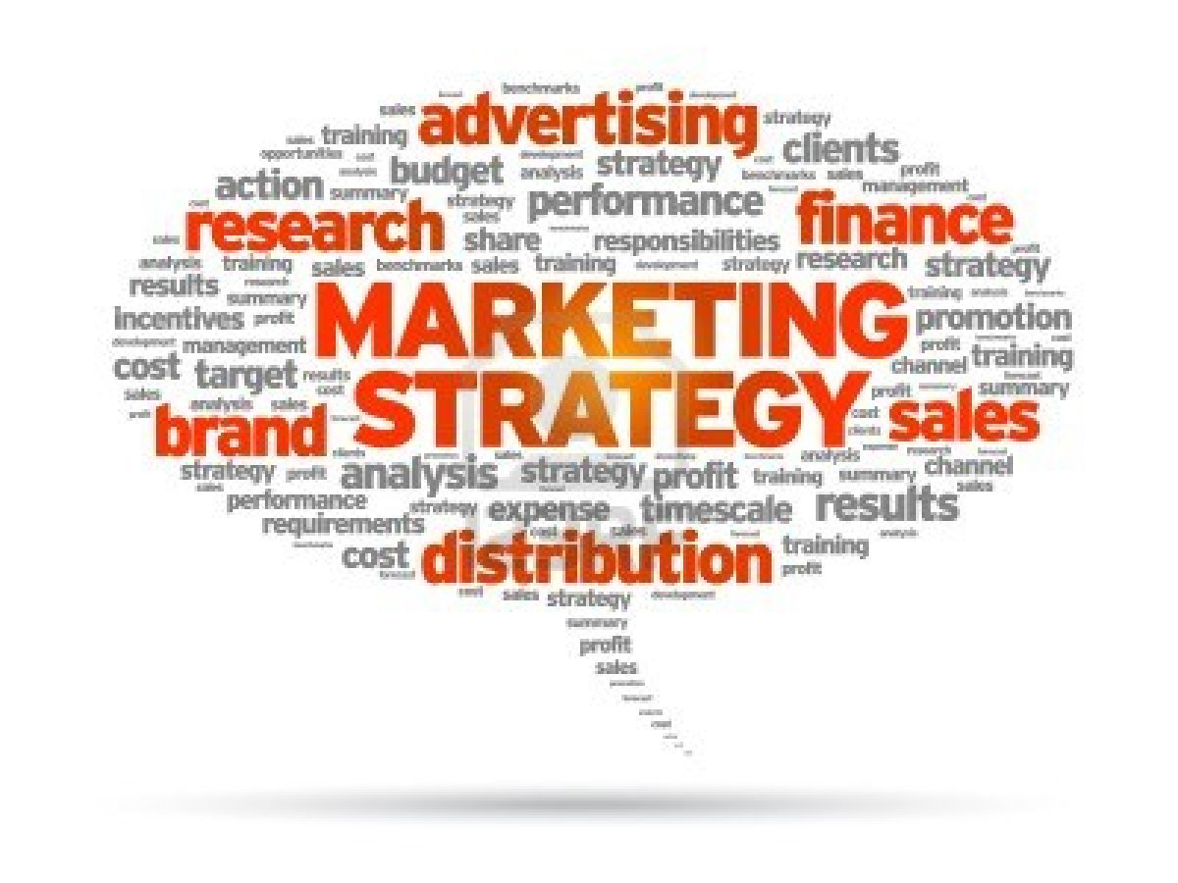



Marketing Plan
to use free advertising in local groups in the area
advertising the company
on the same principle of advertising for people who do not use Facebook
will be used for promotions, advertising and rapid distribution of the store

Slide 10

Management Team
Executive Director
Financial Manager
Team Leader
Advertising
Operation Manager

Slide 11
Management Team-Capital Investment
Expense: | Amount:
Rent | £1500
Website | £1500
Registration | £250
Stocks, products | £21,000
Furniture | £30,000
Internet | £50
Utilities | £900
Total: | £55,200
The monthly costs of the store after opening:
Expense: | Amount:
Rent | £1,500.00
Internet | £30.00
Council Tax | £150.00
Cleaning Service | £200.00
Bills | £900.00
Total: | £2,780.00

Slide 12
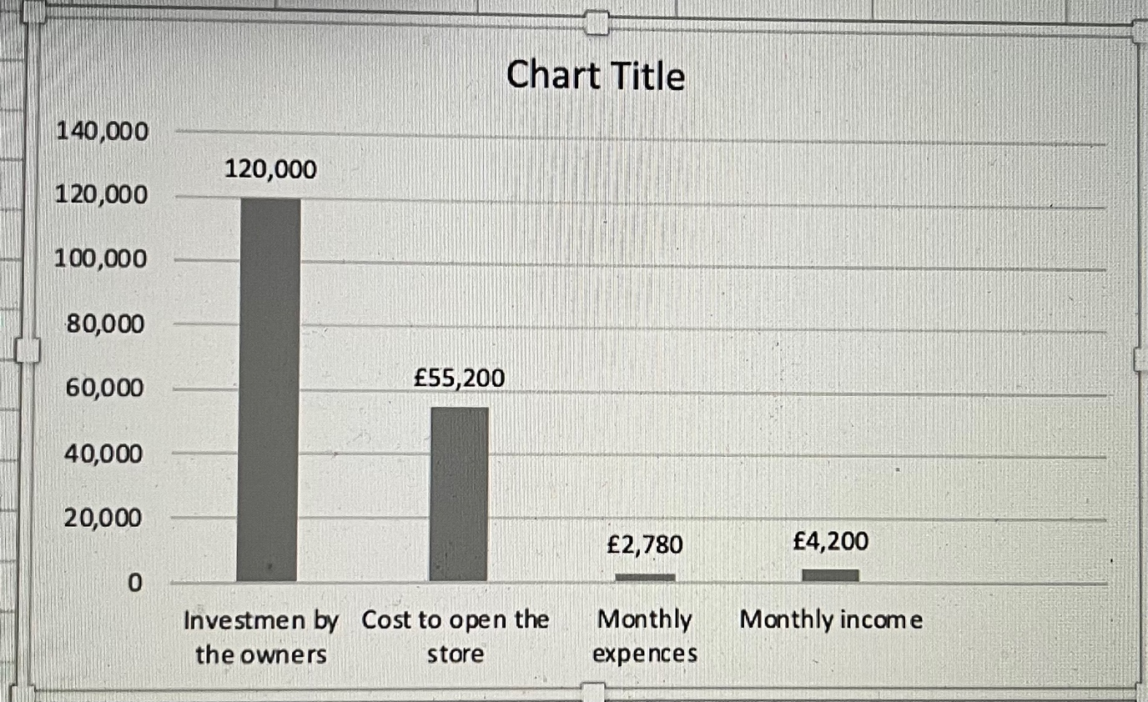

Slide 13
Reference:
CFI (2020) Competitive Intensity. Available at: https://corporatefinanceinstute.com/resources/knowledge/strategy/competitive-intensity/.
(Accessed: 23 June 2022).
Danny Bonvissuto (2020) Plum, What, is a Plum? Available at: https://www.webmd.com/food-recipes/benefits-plums
(Accessed: 20 June 2022).
EIU (2022) Global economic impacts of the Russia-Ukraine war. Available at: https://www.eiu.com/n/global-economic-implications-of-the-russia-ukraine-war/.
(Accessed: 23 June 2022).
Frederic Meunier, Cyraine Coste and Ricardo Maia (2022). How did the COVID-19 pandemic influence the pace of new business formation? Available at: https://blogs.worldbank.org/developmenttalk/how-did-covid-19-pandemic-influence-pace-new-business-formation
(Accessed: 23 June 2022).
Gov.uk (2022) AFG DRIED FRUIT AND NUTS LTD. Available at: https://www.find-and-update.company-information.service.gov.uk/company/12001341/filing-history.
(Accessed: 20 June 2022).
Lupnicka Denisa and Dado Jaroslav (2013). Marketing Audit and Factors Influencing Its Use in Practice of Companies (From an Expert Point of View). Available at: https://www.semanticscholar.org/paper/Marketing-Audit-and-Factors-Influencing.Its-Use-in-Denisa-Jaroslav/e7cfc47981afe0f270065801627e289347647b84
(Accessed: 26 June).
MindTools (2022) SWOT Analysis. Understanding Your Business, Informing Your Strategy. Available at: https://www.mindtools.com/pages/artiche/newTMC_05.htm.
(Accessed: 20 June).
Nerdynant and Rashain, P. (2017). The Pestle Analysis; pp.2
Roya Zeitoune/October 2020
(Accessed: 26 June 2022).
Violeta Radulescu (2012). International journal of Academic research in Economics and Management sciences; 1 (5) pp.222.
(Accessed: 25 June 2022).
Watan Dry Fruits Ltd (2022). About us. Available at: https://watandryfruits.business.site/.
(Accessed: 23 June 2022).

