Slide 1
Framing Therapeutic Practice (ECPR7001)
Relational Depth
With Katie Ruddy

Slide 2
A word of saftey...
Today is experiential with the invitation for self-exploration, look after yourself

Slide 3

Self-care – Support is fundamental to health
How do you look after yourself, how do you, how do you make your ground more solid...
Understanding the client's sense of support that they have in their life...

Slide 4
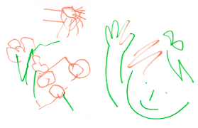
Using lines, shapes and colours capture how you are feeling in this present moment

Slide 5
Relational Depth is...
Here are a few ideas..
A state of profound contact..
Essential to get to the core..
Supports you to navigate shame..
Gets to the heart of people's deepest fears..
Holding curiosity not judgement
The therapeutic relationship as a key agent of change
Therapeutic presence

Slide 6

Pause for reflection exercise...
Think of a time you felt relational depth with a person, a time you felt fully seen, heard, accepted, delighted in, just being who you are...
A moment you feel that no matter what, you can be you in that single moment and can trust you will be seen
What did it feel like..
What was your experience of the other person..
How did you experience the relationship..

Slide 7

Mick Cooper suggests It's like knocking on a client's door...
It's not pushing a client's door open and being too challenging, before the client is ready and moving away from their 'frame of reference
And
It's not standing at the door with no genuine curiosity, never leaning in. This can often leave a client feeling abondoned.

Slide 8

Things to wonder about for yourself...
How much do you allow others in? Not only let someone knock the door, but let them open it, and trust them to see whatever in that single moment is behind it.
Are you able to express from your core what is going on for you?
Notice when you feel something coming up but you push it back down, what interups you?
Learning to tolerate what is you and what isn't you

Slide 9
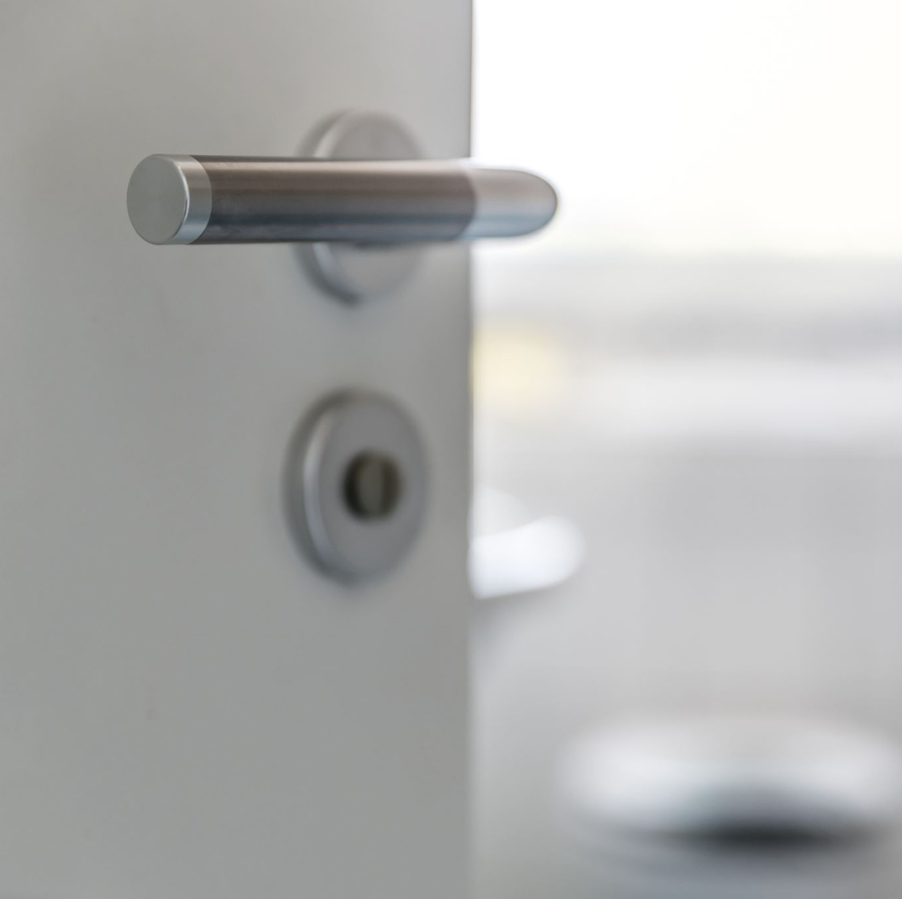
Thinking about clients...
How do we help clients be more receptive to open the door?
Right now in your practice, how able do you feel to fully take in another person?
Notice when you are pulled into rescue and move away from the discomfort or painful experiences or the emotions
Staying with your own experience as well as holding the clients

Slide 10
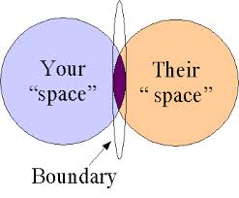
Interpersonal Boundaries...
Reflection – where is my interpersonal boundary and where is the other? How do I stay with my boundary and meet the other person and stay in relation with them?

Slide 11

Personal development group...
Notice the following for yourself...
Being explicit about the implicit
Notice how are you holding yourself back, what you are not staying
Becoming more aware of your personal, interpersonal boundaries. Ask yourself – where is my interpersonal boundary and where is the other. How do I stay with my boundary and meet the other person and stay in relation/contact with them

Slide 12
Reflective exercise (Mick Cooper)...
Take a moment to take a step back and think about what would it be like to live in a world without deep connection?
To feel disconnected from yourself, others and the envrionment

Slide 13
Being in the here and now
Its dynamic, taking in the other person, just as they are, a real openness to the other person

Slide 14

Catching emotions in your skills practice
Learning to catch the moments of awareness
Inviting the client to stay with the emotions, sitting with discomfort
Present moment awareness
Understanding the clients relationship with their emotions

Slide 15

Early relational experiences

Slide 16
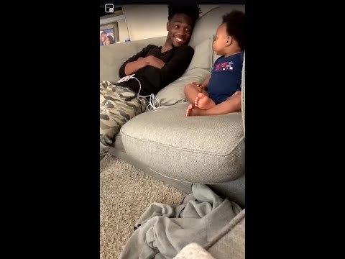
Relational Contact between baby and father

Slide 17
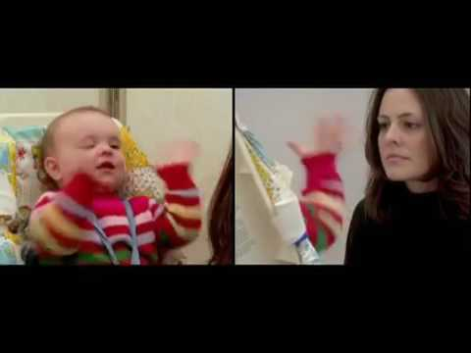
The Still Face Experiment...

Slide 18
Personal Reflection...
How do you feel when people get close, where is too close?
and
What interrupts you making genuine and close contact with others?

Slide 19
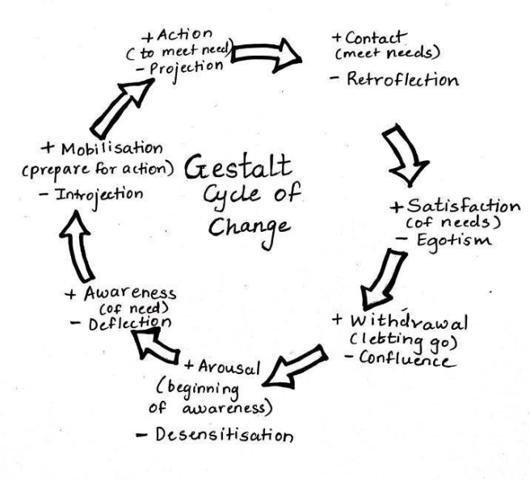
Gestalt Theory and the Interruptions to contact

