Slide 1
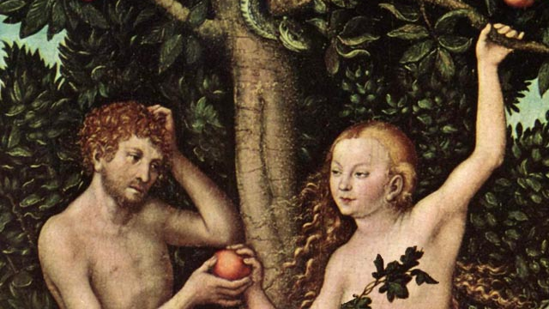
Eve and Popular Culture
CAITLIN VIVIAN
1800517

Slide 2
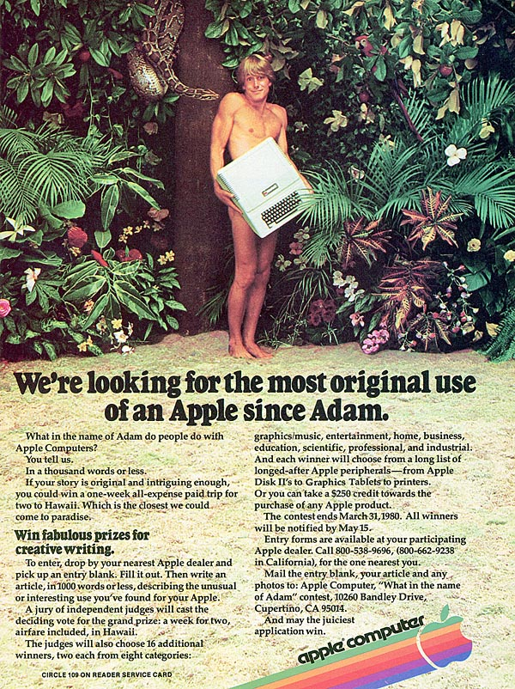
The Bible and Popular Culture
Popular Culture is a term used to describe a culture popular with a particular society, at a point in time. It is usually media related.
The Bible has been a focus point for Pop Culture since the term was first used. The most popular biblical story used is The Creation Story.
Most interpretations of Eve are negative as she is generally viewed as the person who created Original Sin.
However, Adam is viewed as mostly positive.

Slide 3
Neil Gaiman and Terry Pratchett's Good Omens
This depiction of Eve has both positive and negative points.
In this interpretation of Eve, she has no autonomy.
She is still the eats the forbidden fruit and gives it to Adam to taste.
However, the interpretation sympathises with Eve as it suggests it was more the snake’s fault.
The interpretation portrays Eve as critical to survival in a positive light.

Slide 4
Feminist Interpretation of Good Omens
A big factor of Eve’s portrayal in Good Omens is her autonomy or lack of it.
Even the positive portrayal of her being a critical factor in the survival of the human can be criticised,
The angel gives Adam and Eve his flaming sword and his excuse is:
‘Well, she was expecting already and its dangerous out there’
This quote can be turned on its head as from a feminist interpretation, it implies she is weak and needs protecting.
However, she is treated more like main character of Genesis.

Slide 5
Lucifer
This portrayal of Eve is extremely negative.
The show portrays her as ‘the first love of the devil’ and Lucifer’s ex-girlfriend.
It goes as far to say Eve is a bad influence on the newly reformed devil.
Eve in the show, is extremely careless and shown as someone who knows of the consequences, but doesn’t care about them.
The most negative factor of Lucifer’s portrayal of Eve is she is sexualised.

Slide 6
Feminist interpretation of Lucifer
Eve is shown as this careless and carefree figure which is not necessarily true with the Bible.
She is also very sexualised in a different way to the Bible (ie her role as wife to Adam). In contrary, this portrayal of Eve is sexualised in her appearance.
Lucifer also makes Eve the side-line character of the show and the devil’s ex-girlfriend which undermines her importance as a Biblical character.

Slide 7
Bible vs PORTRAYAL
In contrast to Good Omens portrayal of Eve, in the Bible, she makes a conscious decision about eating the forbidden fruit.
She is not sexualised in the Bible at all and doesn’t tempt Adam to eat the fruit.
She is portrayed as not considering the consequences before committing the act.
The Women’s Bible Commentary argues that women, especially Eve, are sexualised in the Bible. However, this is only because of their social roles.
Eve was never the devil’s girlfriend or first love.

Slide 8
Bibliography
Fig 1: Adam and Eve, Fig 2: Adam and The Apple, CultureCreature.com
Good Omens, Ep.1, Season 1, Amazon Prime Video (2018)
Lucifer Trailer Season 4, youtube.com/watch:lucifer_trailer_s4.
The Women’s Bible Commentary, C.A. Newson, S.H. Ringe, J.E. Lapsley, (2014) Revised Edn.

