Slide 1
Construction Technology
CLADDING TO FRAMED BUILDINGS

Slide 2
Cladding - What is it?
Cladding is the application of one material over another to provide a skin or layer. In construction, cladding is used to provide a degree of thermal insulation and weather resistance, and to improve the appearance of buildings.

Slide 3
The choice of cladding materials is vast.
Cladding has a major effect on the structure
  Aesthetic
  Internal performance
  Durability
  Structural frame loading

Slide 4
PERFORMANCE REQUIREMENTS
1. Overall design considerations
2. Conditions required in the building
3. Natural forces
Performance requirements for fabric
Finishes

Slide 5
Overall design considerations
Cladding must perform a number of functions
Stable
Strong
Resistant to elements
Fire resistant
Acoustic and thermal properties
Resist erosion and corrosion
Aesthetic
Thermal expansion/joints
Allow for frame tolerances/movement

Slide 6
Conditions Required in the Building
Daylight
Solar radiation and glare
View
Rain barrier
Ventilation and draughts
Heat loss / cold areas
Security
Noise
Fire proof

Slide 7
Natural Forces
Wind
  Location, Height, Topography
Rain
  Location,intensity, time, associated with wind.
Frost
Chemical and biological degradation
Earthquakes and vibration.

Slide 8
Performance requirements of fabric
Appearance
  Colour, texture, width of joints
Geometry
  Dimensional co ordination, joints, tolerance & fit
Security
Maintenance
Construction
  Handling, storage, ease of fixing

Slide 9
Finishes
Load bearing units – brick, block
Small units to frames – masonry
Large units – metal, PCC, GRC, GRP, composites
Curtain Walling – Any prefabricated framework with an infill of glazing and. or panels of other materials, supported by structural frame.
PCC – Pre-cast concrete
GRC – Glass reinforced concrete (fibreglass)
GRP – Glass reinforced plastic

Slide 10
Curtain Walling

Slide 11
Rainscreen cladding is a form of weather cladding designed to protect against the elements, but also offers thermal insulation. The cladding does not itself need to be waterproof, merely a control element: it may serve only to direct water or wind safely away in order to control run-off and prevent its infiltration into the building structure. Cladding may also be a control element for noise, either entering or escaping. Cladding can become a fire risk by design or material.

Slide 14
Pressure Equalised Rain-screen cladding

Slide 20
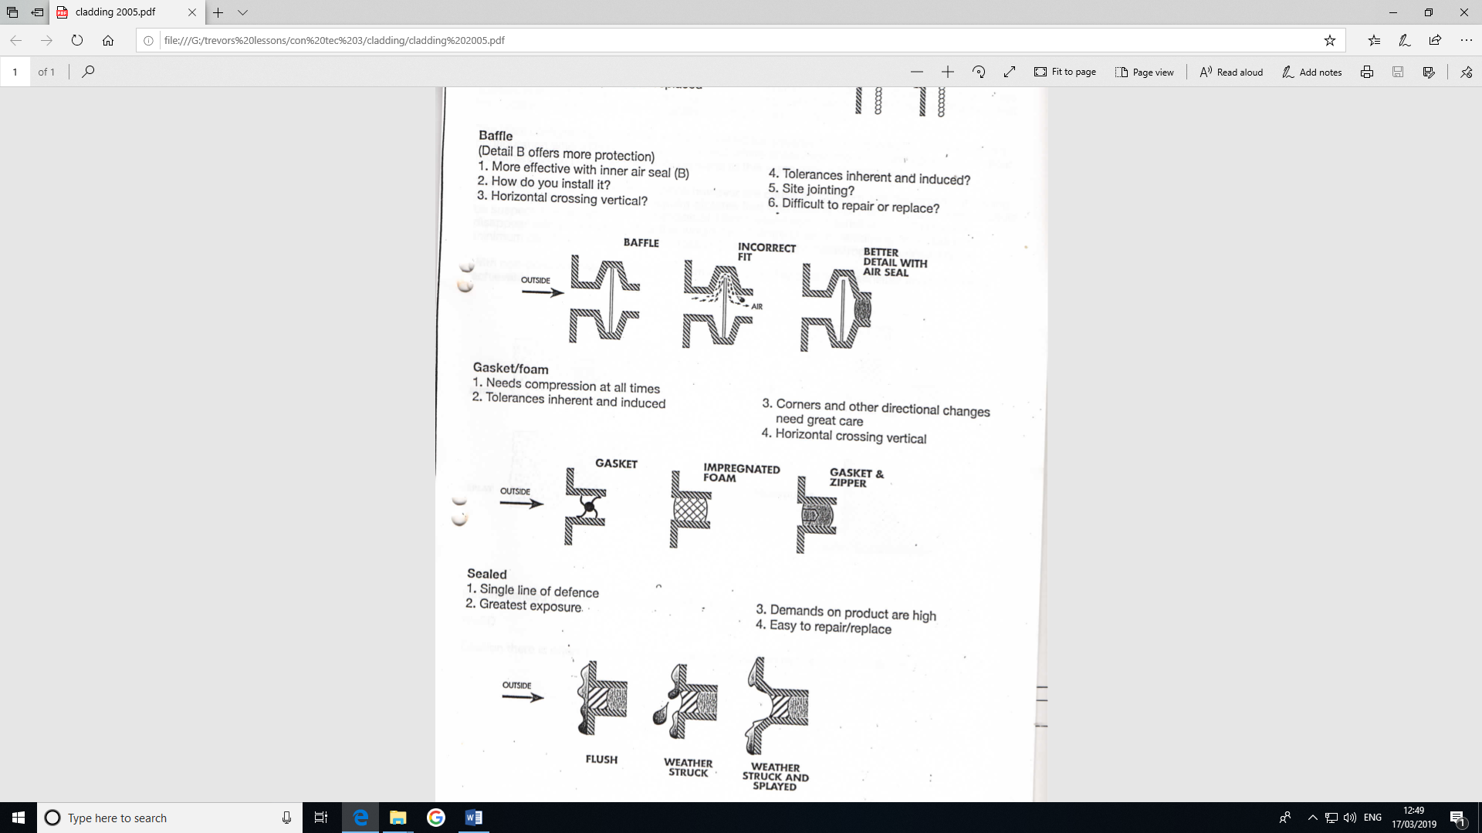

Slide 23
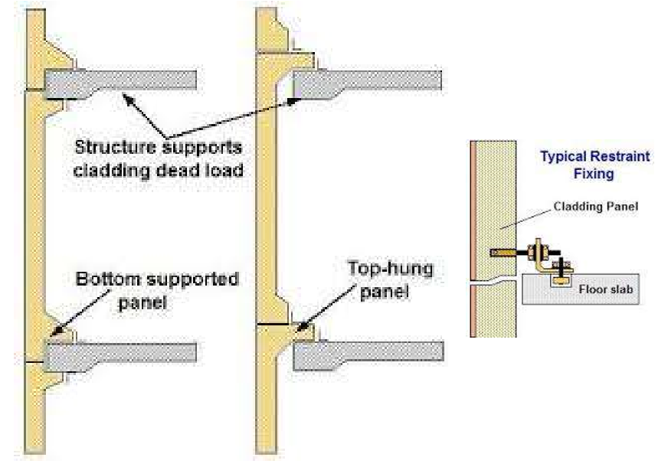
Curtain Walls

Slide 24
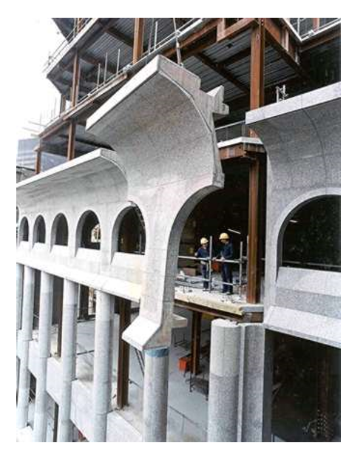

Slide 31
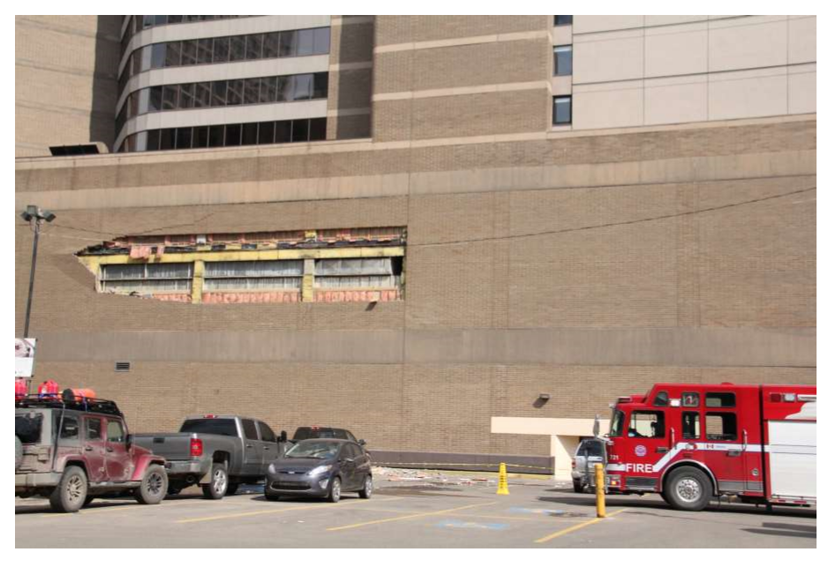
So what can go wrong

Slide 32


