Slide 1

Student name: Maria Blachut
Student number: 2337025
BMHP6029
Psychopathological Classifications and Provisions Component
Acknowledgement of the use of AI tools
I confirm that I have not used any AI tools in the research and creation of this assignment. I confirm that I have not presented any AI generated materials as my own work. I confirm I have copies of my drafts, notes, and other resources I used, which I may be asked to provide in evidence

Slide 2
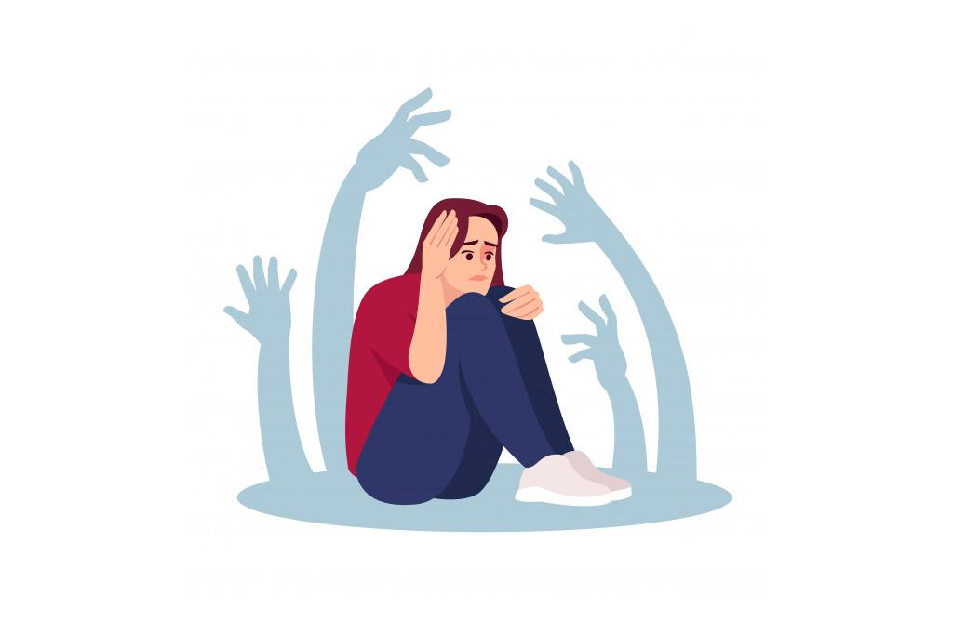

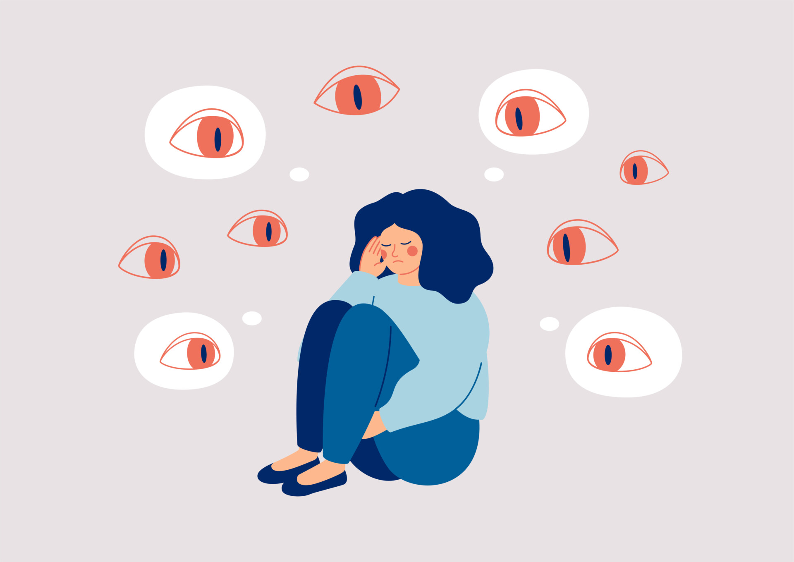
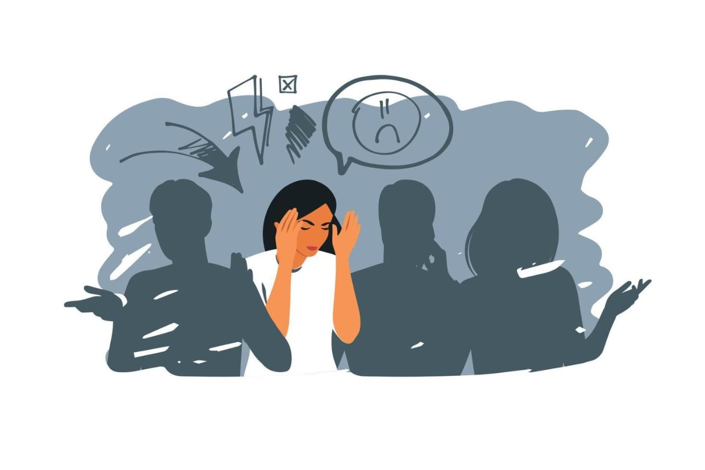
Anxiety or Fear-Related Disorders
Social Anxiety Disorder 6B04
Introduction
Causes
Genetics – Family history of anxiety disorders
Brain chemistry – Imbalance in neurotransmitters (e.g., serotonin)
Personality traits – Shy or highly sensitive temperament
Negative experiences – Bullying, teasing, or humiliation (Varela et al., 2025)
Overprotective parenting – Limited social confidence
Stressful life events – Trauma or major life changes may trigger symptoms (Huhne et al., 2026)
Broad Category
ICD-11, 11,
Chapter 6: Mental, Behavioural and Neurodevelopmental Disorders
Block: Anxiety or Fear related Disorders
Category: 6B04 Soial Anxiety Disorder
DSM-5
DSM-5
Historical Perspectives
Often mistaken for extreme shyness or a personality flaw
People were seen as timid, weak, or antisocial
Limited understanding of it as a mental health disorder
Formally recognized as an anxiety disorder in the late 20th century
Today, it is recognized as a treatable mental health condition (Guo et al, 2021)
Less stigma
How Medical Professionals Viewed It
Initially viewed as a form of shyness or social phobia
Research showed it is a clinical anxiety disorder, not just a personality trait
Now diagnosed using DSM-5 and ICD-11 criteria (Kogan et al., 2016)
Greater awareness has improved early diagnosis and treatment
Treatment (Past and Present)
Past: Limited treatment; advice often focused on "building confidence"
Present: Cognitive Behavioural Therapy (CBT) is the first-line treatment
Anti-anxiety or antidepressant medications (e.g., SSRIs) may be prescribed
Self-help strategies, support groups, and mindfulness can also help (Koszycki et al., 2021)
​
Prevalence of Social Anxiety Disorder in the UK​
Around 1 in 20 adults (≈5%) in the UK experience Social Anxiety Disorder in a given year (NICE, 2024)
Approximately 8–12% of people will experience it at some point in their lives
Usually begins during the teenage years or early adulthood
Affects both men and women, more common women (NIMH, 2024)
It is one of the most common anxiety disorders in the UK
Symptoms of Social Anxiety Disorder
Intense fear of social situations
Fear of being judged or embarrassed
Excessive worrying before social events
Blushing, sweating, or trembling
Fast heartbeat or shortness of breath (Versella, Potter & Heimberg, 2016)
Difficulty speaking or making eye contact
Nausea or upset stomach in social situations
Diagnosis of Social Anxiety Disorder
Assessment by a GP or mental health professional
Discussion of symptoms and medical history
Symptoms have lasted 6 months or more
Symptoms significantly affect daily life
Other mental or physical health conditions are ruled out.
Diagnosis is based on DSM-5 or ICD-11 criteria (WHO, 2019)
Social Anxiety Disorder (Social Phobia)
Intense fear of social situations
Fear of being judged, embarrassed, or rejected (Zhang et al., 2025)
Causes extreme anxiety and discomfort
Leads to avoiding social interactions
Anxiety is greater than the actual situation
Affects daily life, school, work, and relationships (Salari et al., 2024)
Symptoms usually last 6 months or more
.

Slide 3

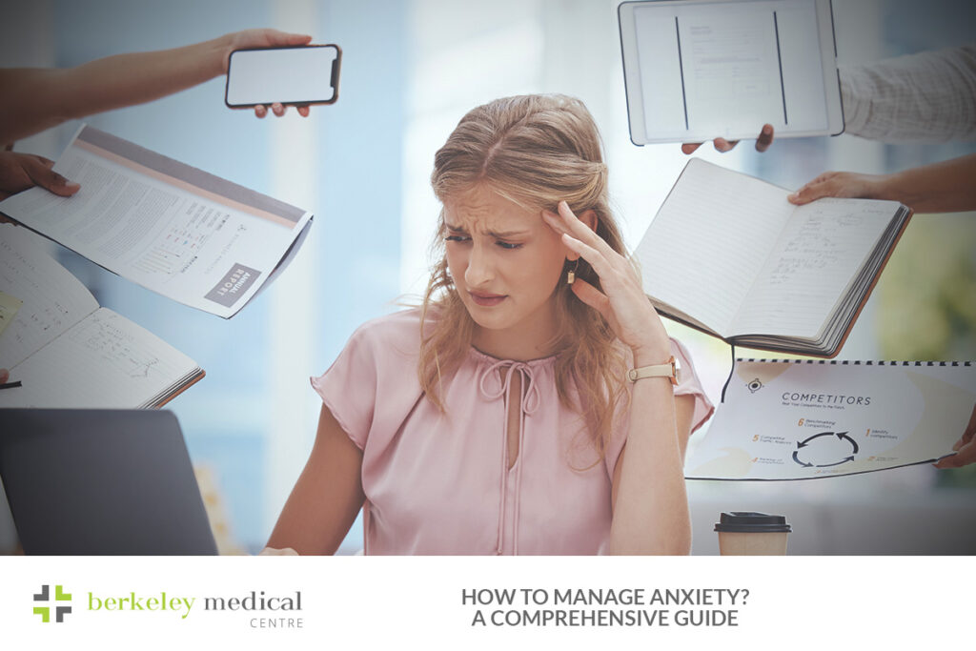
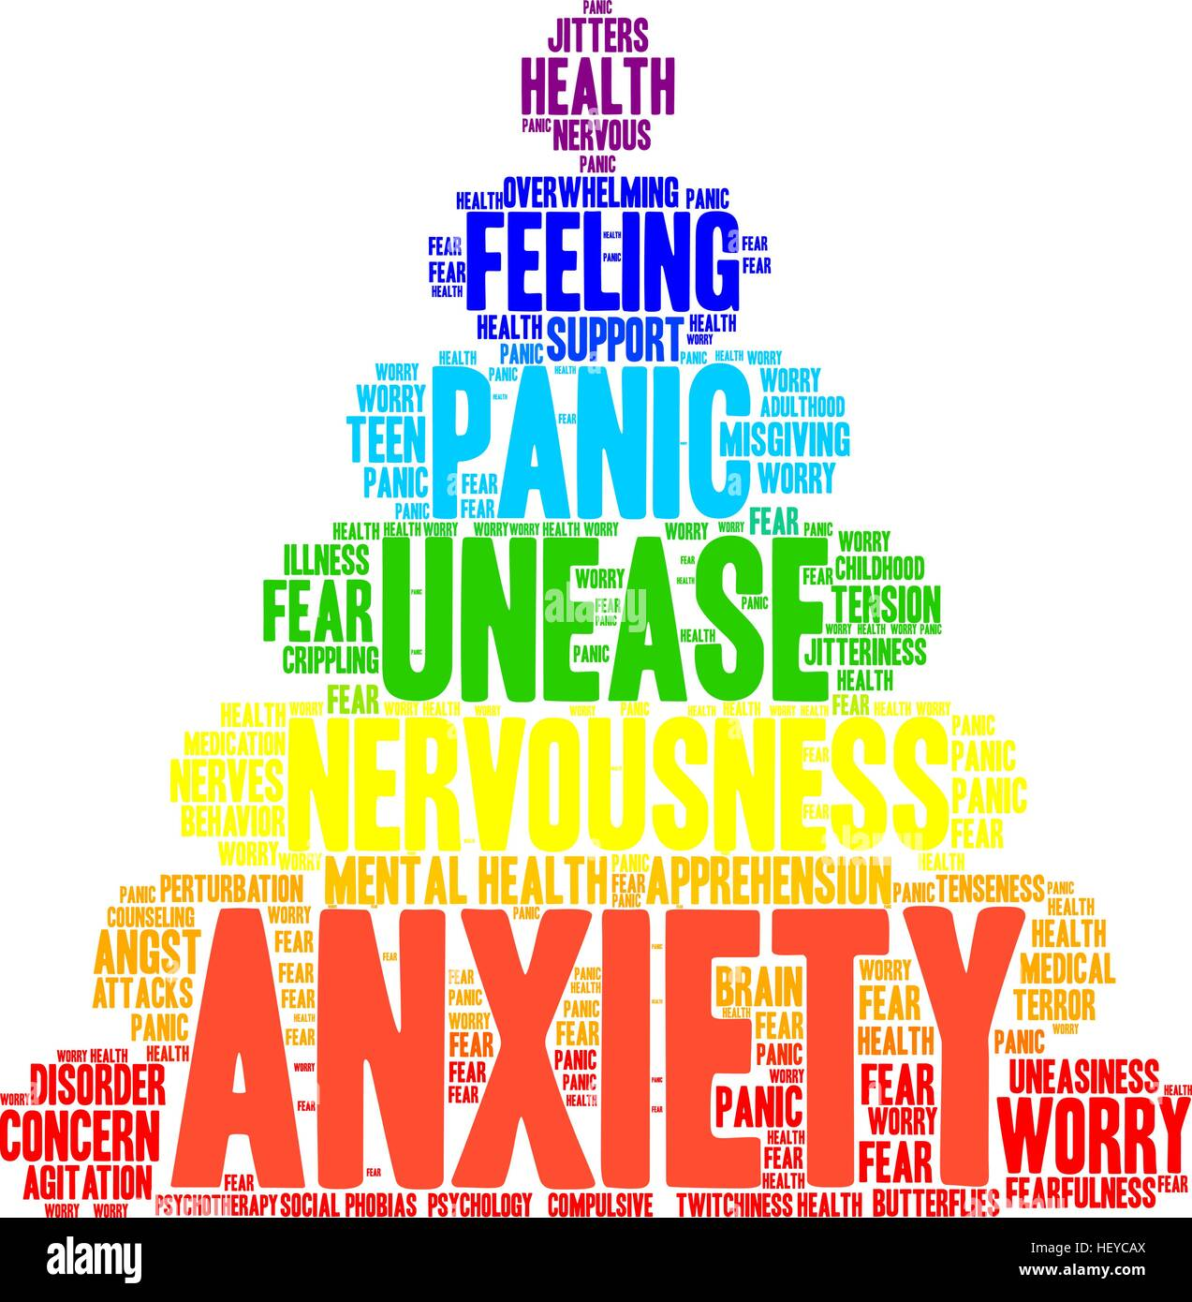

Anxiety or Fear-Related Disorders
Social Anxiety Disorder 6B04
Services and Treatments Available in the UK
Free from NHS
NHS GP – First point of contact for assessment and referral
Talking Therapies (NHS) – Cognitive Behavioural Therapy (CBT) is the main treatment (Hunger et al., 2020)
Medication – SSRIs (antidepressants) may be prescribed if needed
Community Mental Health Services – Support for more severe cases
Support groups and charities – Such as Mind and Anxiety UK.
Self-help resources – Online CBT programs, mindfulness, and coping techniques
Recommendations UK
Conclusion
Social Anxiety Disorder is a common anxiety disorder involving intense fear of social situations (Leichsenring & Leweke, 2017)
It can significantly affect daily life, relationships, education, and work.
Increased awareness has improved understanding, diagnosis, and support
Effective treatments such as CBT, medication, and support services are available
Early help and treatment can improve confidence and quality of life
Seek help from a GP if symptoms affect daily life
Access NHS Talking Therapies for Cognitive Behavioural Therapy (CBT)
Follow the treatment plan and take prescribed medication if recommended
Practice relaxation techniques such as mindfulness and deep breathing
Gradually face feared social situations with professional support
Join support groups or seek help from charities like Mind and Anxiety UK
Maintain a healthy lifestyle with regular exercise, sleep, and a balanced diet (Duncan et al., 2021)
Reach out to trusted family and friends for support
''I know this is hard right now, but I'm here for you...''
''Take your time-theirs is no pressure to be ok right away...''
''You're safe, you're not alone, and we will get through it together...''

Slide 4
References
Duncan, M., Rayward, A., Holliday, E., Brown, W., Vandelanotte, C., Murawski, B., Plotnikoff, R. C.(2021) “Effect of a physical activity and sleep m-health intervention on a composite activity-sleep behaviour score and mental health: a mediation analysis of two randomised controlled trials,” The international journal of behavioral nutrition and physical activity, 18(1). Available at: https://doi.org/10.1186/s12966-021-01112-z.
Guo, S., Deng, W., Wang, H., Liu, J., Liu, X., Yang, X., He, C., Zhang, Q., Liu, B., Dong, X., Yang, Z., Li, Z., Li, X. (2021) “The efficacy of internet‐based cognitive behavioral therapy for social anxiety disorder: A systematic review and meta‐analysis,” Clinical psychology and psychotherapy, 28(3), pp. 656–668. Available at: https://doi.org/10.1002/cpp.2528.
Hunger, C., Hilzinger, R., Klewinghaus, L., Deusser, L., Sander, A., Mander, J., Bents, H., Ditzen, B., Schweitzer, J. (2020) “Comparing Cognitive Behavioral Therapy and Systemic Therapy for Social Anxiety Disorder: Randomized Controlled Pilot Trial (SOPHO‐CBT/ST),” Family process, 59(4), pp. 1389–1406. Available at: https://doi.org/10.1111/famp.12492.
Hühne, V., Santos‐Ribeiro, S., Moreira‐de‐Oliveira, M., Loureiro, C., Menezes, G., Fontenelle, L., (2026) “Traumatic and stressful life events as precipitants of obsessive compulsive disorder and social anxiety disorder,” Journal of traumatic stress, 39(1), pp. 151–158. Available at: https://doi.org/10.1002/jts.70021.
Koszycki, D., Guérin, E., DiMillo, J., Bradwejn, J. (2021) “Randomized trial of cognitive behaviour group therapy and a mindfulness‐based intervention for social anxiety disorder: Preliminary findings,” Clinical psychology and psychotherapy, 28(1), pp. 200–218. Available at: https://doi.org/10.1002/cpp.2502.
Kogan, C., Stein, D. Maj, M., First, M., Emmelkamp, P. M. G., Reed, G. (2016) “The Classification of Anxiety and Fear-Related Disorders in the ICD-11,” Depression and anxiety, 33(12), pp. 1141–1154. Available at: https://doi.org/10.1002/da.22530.
Leichsenring, F. and Leweke, F. (2017) “Social Anxiety Disorder,” The New England journal of medicine. Edited by C.G. Solomon, 376(23), pp. 2255–2264. Available at: https://doi.org/10.1056/NEJMcp1614701.
National Institute for Health and Care Excellence (NICE) (2024) Social anxiety disorder: recognition, assessment and treatment (CG159). Available at: https://www.nice.org.uk/guidance/cg159 (Accessed: 21 July 2026).
National Institute of Mental Health (NIMH) (2024) Social Anxiety Disorder. Available at: https://www.nimh.nih.gov/health/statistics/social-anxiety-disorder (Accessed: 15 July 2026).
Salari, N., Heidarian, P., Hassanabadi, M., Babajani, F., Abdoli, N., Aminian, M., Mohammadi, M. (2024) “Global Prevalence of Social Anxiety Disorder in Children, Adolescents and Youth: A Systematic Review and Meta-analysis,” Journal of prevention (2022 : Print), 45(5), pp. 795–813. Available at: https://doi.org/10.1007/s10935-024-00789-9.
Varela, V., Gavrielidou, K., Savidou, D., Simou, M., Simos, G. (2025) “Childhood Teasing Experiences and Adult Emotional Distress: The Mediating Role of Social Anxiety and Self-Esteem,” Psychiatry international (Basel), 6(2), p. 42. Available at: https://doi.org/10.3390/psychiatryint6020042.
Versella, M.V., Potter, C.M. and Heimberg, R.G. (2016) “Socially-relevant Panic Symptoms in Social Anxiety Disorder,” Journal of experimental psychopathology, 7(4), pp. 564–576. Available at: https://doi.org/10.5127/jep.056416.
World Health Organization (WHO). (2019). International Classification of Diseases for Mortality and Morbidity Statistics (ICD-11): 6B04 Social Anxiety Disorder.
Available from: https://icd.who.int/ (Accessed on 17 July, 2026).
Zhang, P., Yuan, Y., Wang, M., Ding, L., Zhang, J., Qiu, S. (2025) “The relationship between social exclusion and social anxiety among Chinese college students: a chain mediation role of fear of negative evaluation and rejection sensitivity,” Current psychology (New Brunswick, N.J.), 44(8), pp. 7181–7192. Available at: https://doi.org/10.1007/s12144-025-07689-z.

