Slide 1
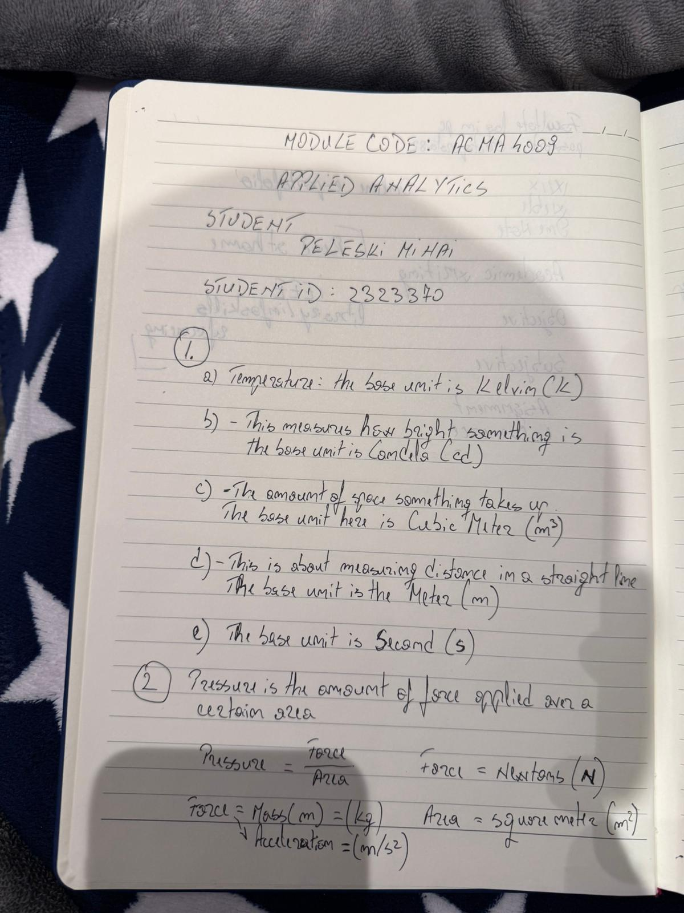
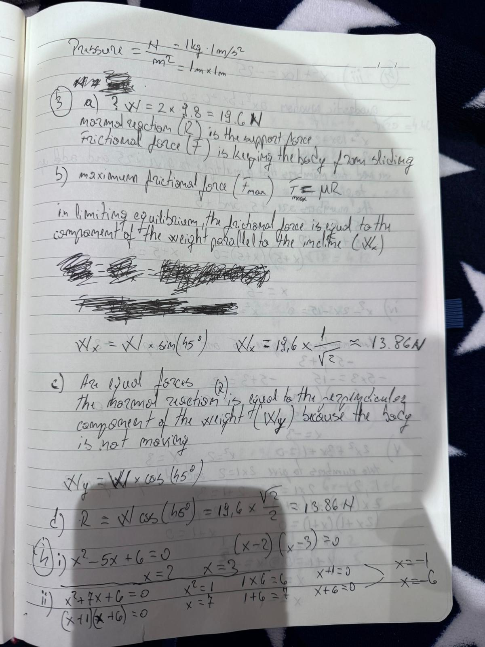

Slide 2
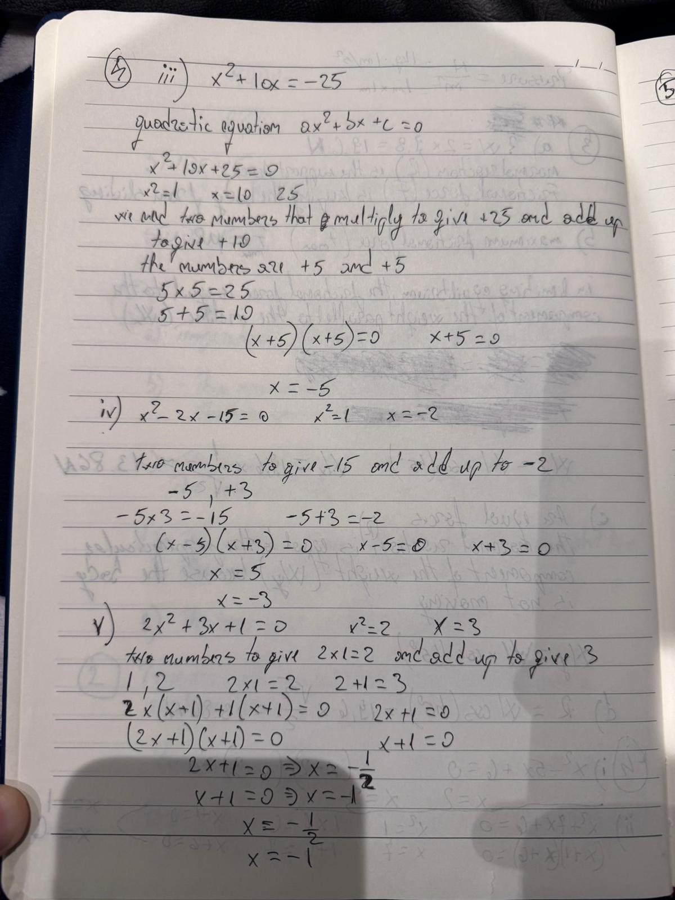

Slide 3
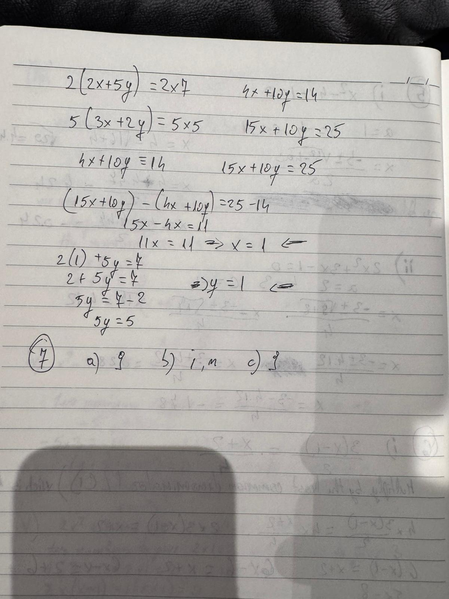
Adsasdfsaf asg as fasf af ewfg sds we sfa asdfqwr qwsf w sasfa fasf as as as afs asd asd as twefzsetgsvgsd fgwet w dgfas asf w s e asf fw es a wa fzsdf wf se sgw

