Slide 1
presentation title

Slide 2
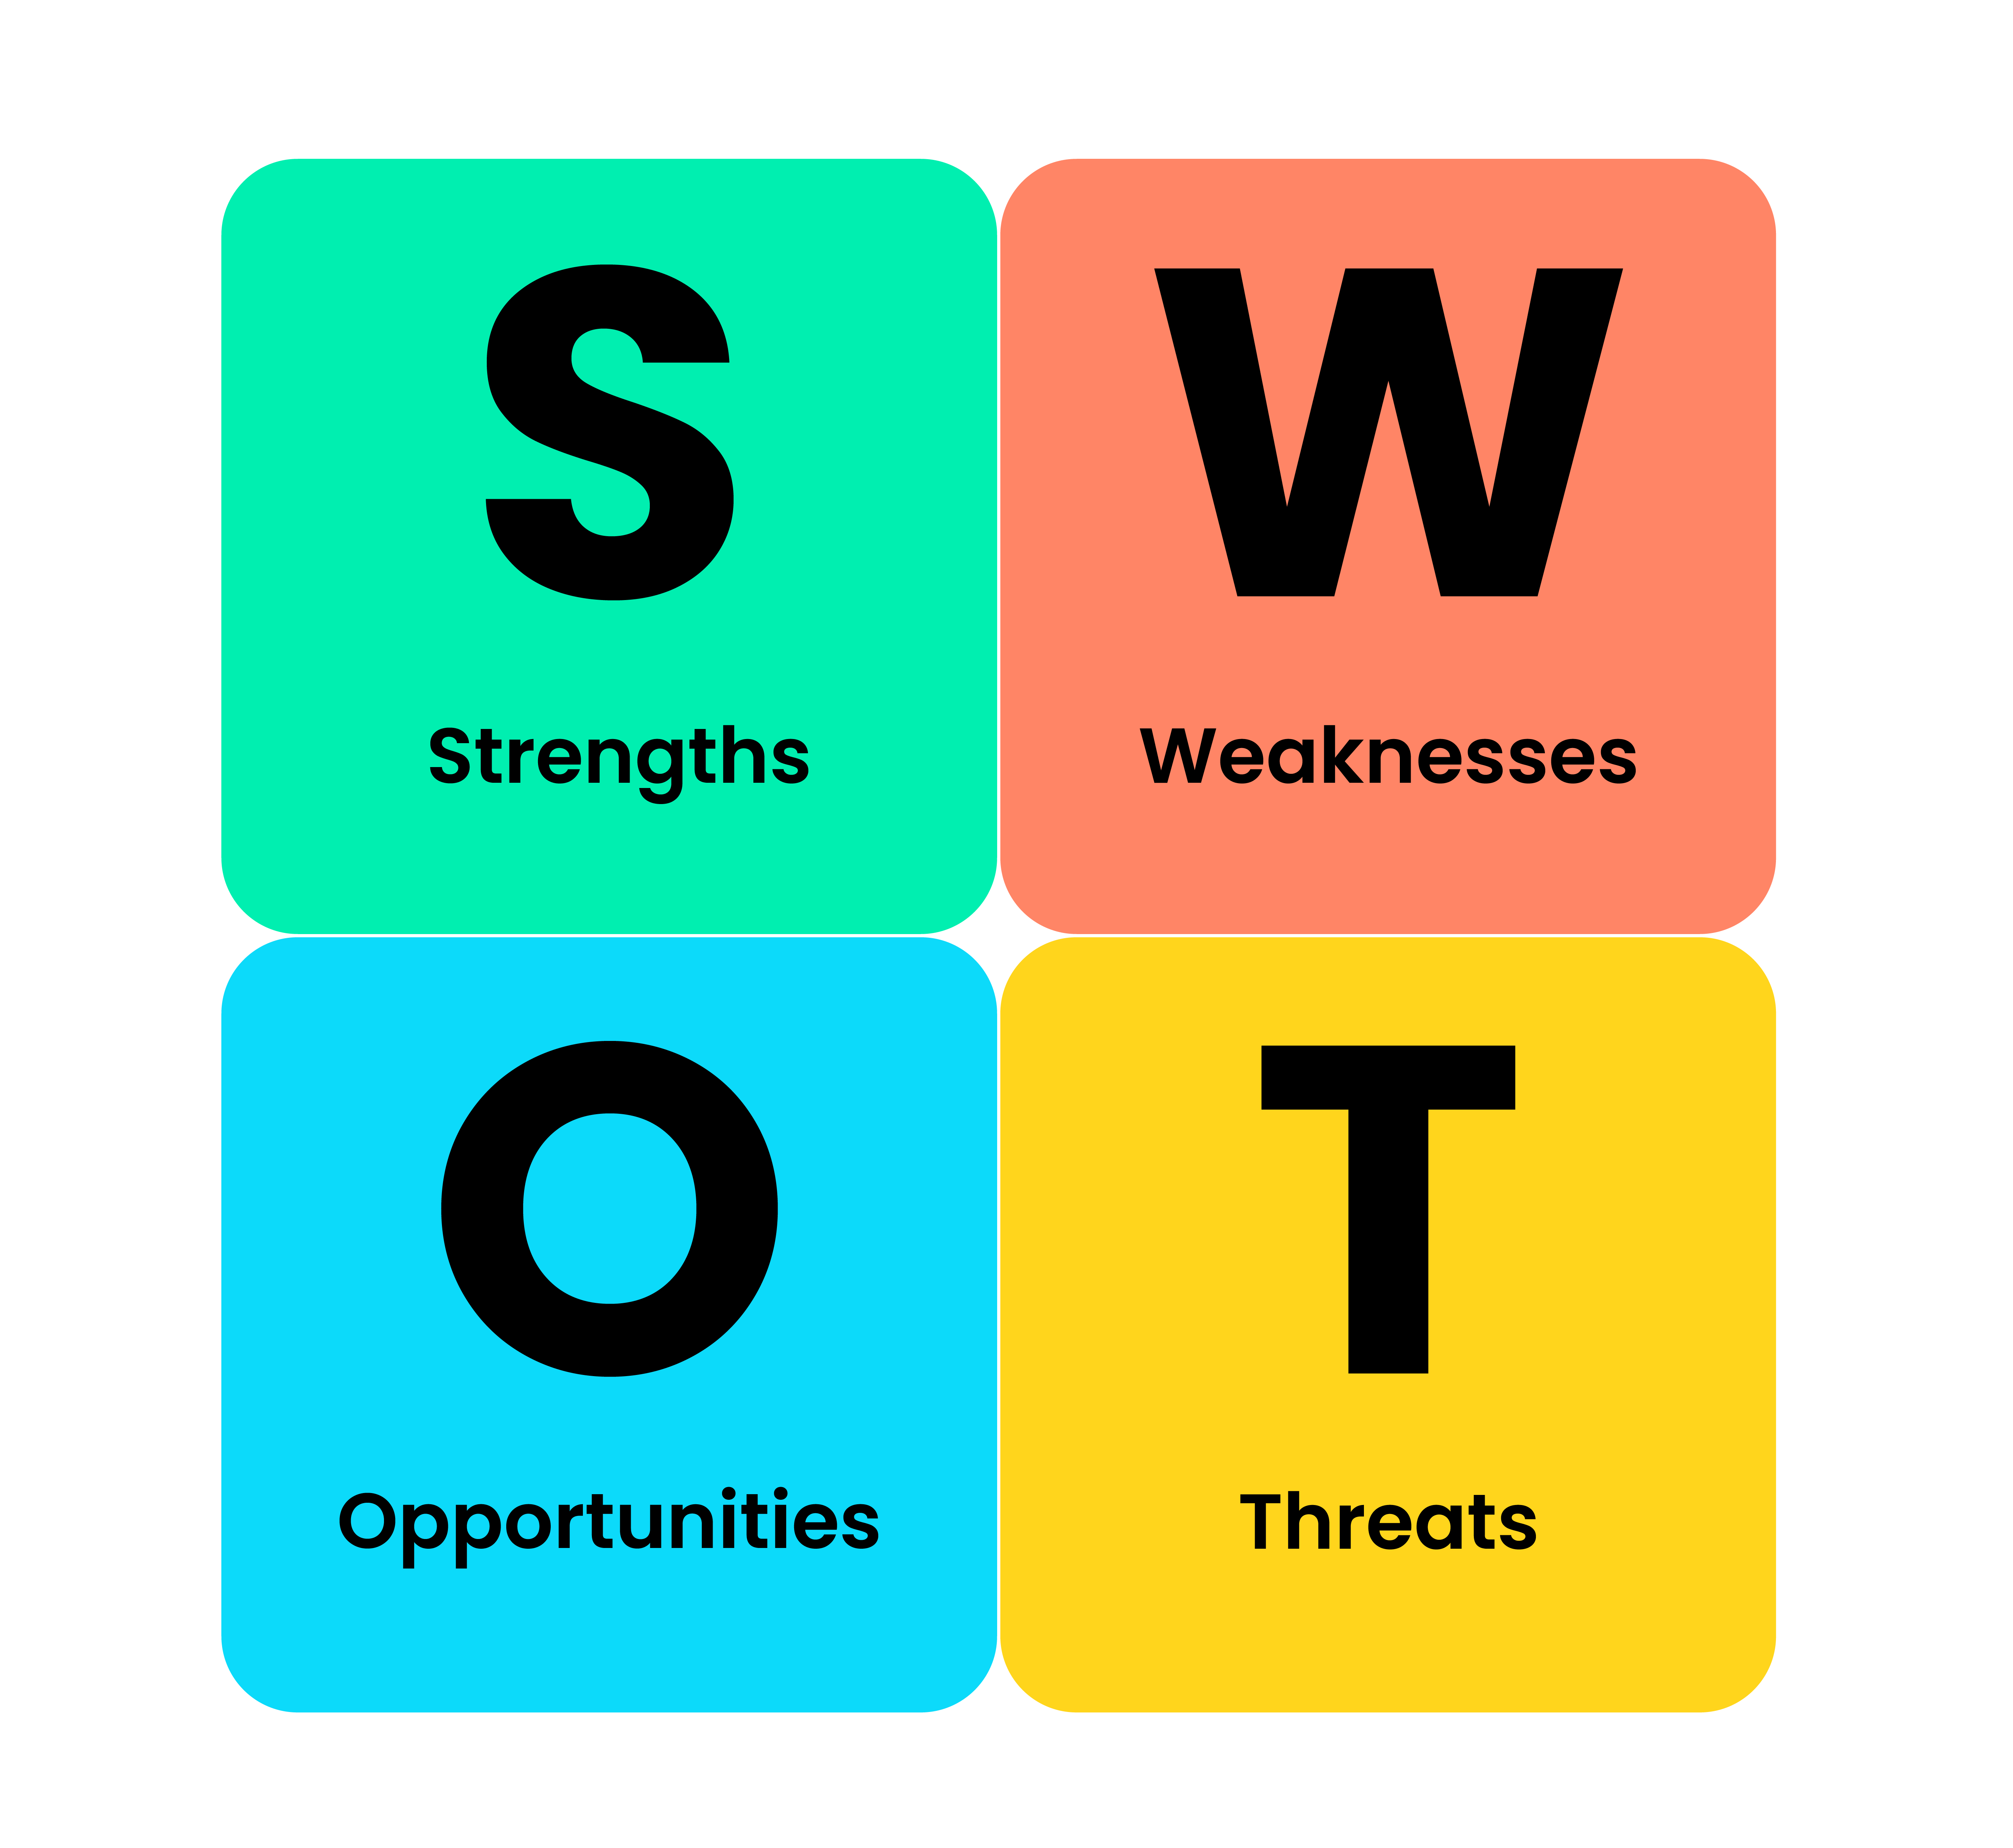
Introduction
Good [morning/afternoon], . My name is Irham Nissa, and today I will be presenting a SWOT analysis to demonstrate how my personal strengths, weaknesses, opportunities, and threats align with the Band 7 Clinical Lead role within the East Neighbourhood Mental Health Team at Birmingham and Solihull Mental Health NHS Foundation Trust.
This analysis will not only highlight the skills and experiences I can bring to this role but also outline my action plan for further professional development, ensuring I am well-prepared for the demands and responsibilities of this position.
The purpose of this SWOT analysis is to align my strengths and areas for development with the key requirements of the Band 7 Clinical Lead role. This position demands a combination of leadership, clinical expertise, and collaborative skills, all of which are essential for the successful delivery of mental health care within the community. I will take you through my analysis, addressing my weaknesses, and highlighting opportunities for growth as well as how I plan to leverage my strength.

Slide 3
Strength
As a Residential Support Worker, I gained valuable leadership and clinical experience that directly aligns with the Band 7 Clinical Lead role. My experience leading teams during shifts and ensuring the delivery of person-centred care has provided me with the skills necessary to guide and manage multidisciplinary teams in the Neighbourhood Mental Health Team.
Furthermore, my hands-on experience assessing mental health needs and developing care plans has deepened my understanding of mental health care needs and evidence-based interventions. This will allow me to fulfil the Clinical Lead role's responsibility to provide mental health triage and implement effective outcome based interventions.
Effective communication was at the core of my role, where I collaborated with various professionals, including social workers, GPs, and families, to ensure comprehensive care for service users. This communication skill is fundamental for the Clinical Lead role, especially when working alongside Primary Care Networks (PCNs) and other team members to ensure that integrated, high-quality care is provided to service users.

Slide 4
weaknesses
One area for improvement is my leadership qualifications. While I have significant leadership experience, I currently lack formal qualifications like a leadership diploma, which is often required for senior roles such as this Clinical Lead position (Cottrell, 2021). To address this, I plan to pursue formal leadership training, particularly through the NHS Leadership Academy programs. Another area I’m focusing on is my limited experience in research and audits. Although I’ve implemented evidence-based practices, I have not led any formal research or audit projects. According to Frohman and Lupton (2020), research and audits are key to advancing clinical practice, and I will actively seek out opportunities to contribute to audits or research projects within my team. Lastly, time management under pressure is something I plan to improve by using productivity tools and delegation strategies to better manage my caseload and leadership responsibilities (Frohman & Lupton, 2020).

Slide 5
Opportunities
There are several exciting opportunities in this role. First, the NHS offers leadership development programs through the NHS Leadership Academy (Cottrell, 2021), which will allow me to formalize my leadership qualifications and develop strategic leadership skills. Additionally, this role provides a chance to work closely with Primary Care Networks (PCNs), facilitating the integration of mental health services within primary care and helping improve patient care outcomes (Frohman & Lupton, 2020). Lastly, the NHS Long-Term Plan is driving significant changes in community mental health services, offering an excellent opportunity for professionals to influence the future of mental health care (BSOL, 2025). I’m eager to contribute to this transformation by engaging in projects and initiatives that shape the future of community mental health care."
Maximizing Opportunities:
"By engaging in leadership development programs (Cottrell, 2021), strengthening my collaboration with PCNs (Frohman & Lupton, 2020), and actively participating in transformation projects (BSOL, 2025), I will accelerate my development and maximise the impact I can have on community mental health care."

Slide 6
Threats
Managing high caseloads while also taking on leadership responsibilities can lead to stress and burnout, especially in such a demanding role (Cottrell, 2021). To combat this, I will prioritise self-care and regularly seek support through supervision and peer networks. Additionally, as mental health policies evolve, it’s important to stay informed. I plan to attend relevant conferences and training sessions (Frohman & Lupton, 2020) to ensure I am up-to-date with the latest policy changes. Lastly, there’s strong competition for leadership roles in the NHS (BSOL, 2025), so I will work on expanding my professional network and contribute to high-impact projects to enhance my visibility and leadership potential.
To overcome my weaknesses, I will leverage my leadership and communication skills. For example, I can apply my leadership experience in daily team activities while also pursuing formal qualifications to enhance my strategic leadership skills (Cottrell, 2021). My clinical expertise will be instrumental in taking part in audits or research projects, allowing me to gain hands-on experience in these areas while contributing to evidence-based practice (Frohman & Lupton, 2020). Finally, my strong communication skills will help me delegate tasks effectively and use time management tools to stay on top of my workload, even under pressure (Cottrell, 2021).

Slide 7
My personal action plan
In the short term (next 3 to 6 months), my first goal is to enrol in leadership training programs. Programs such as those offered by the NHS Leadership Academy will allow me to formally build on the leadership skills I have already developed through my experience. This aligns with the guidance in Cottrell (2021), which emphasises the importance of structured leadership development in the health sector.
Additionally, I plan to actively participate in audits or research projects. While I have practical experience applying evidence-based practices, gaining formal research and audit experience is key to strengthening my clinical leadership skills (Frohman & Lupton, 2020). I will seek opportunities within my current role or volunteer for projects that allow me to build expertise in this area.
Lastly, In the short term I will focus on improving my time management. This is especially crucial for balancing multiple responsibilities as a Clinical Lead. I will use productivity tools and enhance my delegation strategies, which will help manage caseloads and ensure I am making the most efficient use of my time.
In the medium term (6 to 12 months), my goal is to apply for leadership roles within NHS mental health services, specifically roles that will give me experience in overseeing multidisciplinary teams and managing mental health interventions. I plan to explore openings within BSOL (Birmingham and Solihull Mental Health Trust) as they align with my career aspirations and offer the kind of role I want to grow into.
Another medium-term goal is to share audit and research findings with the multidisciplinary team (MDT). I believe that effective communication and collaboration within MDTs are central to improving clinical practice. By sharing insights from audits and research, I can help drive improvements in care delivery.
In the long term (12+ months), my ultimate objective is to secure a senior leadership role within mental health services. This is a clear goal that reflects my desire to have a strategic impact in mental health care, not only within my team but across a broader system. Finally, I aspire to contribute to national mental health policy and innovations. This would involve participating in high-level discussions or r
esearch that shapes the future of mental health care, both locally and nationally.
This action plan will guide me in developing the skills and experience needed to successfully transition into the Band 7 Clinical Lead role, and beyond, as I continue to pursue leadership in mental health services."

Slide 8
Conclusion
This personal action plan demonstrates a clear path for professional growth and development that aligns with both the band 7 clinical role and my long term career aspirations in mental health. By setting achievable goals in the short, medium, and long term, I am committed to ensuring I meet the demands of this role while also making meaningful contributions to the future of mental health care.

Slide 9
Reference List
BSOL (2023) Birmingham and Solihull Integrated Care System: Our strategy for better health and wellbeing. Birmingham and Solihull Integrated Care System (NHS).Available at: https://www.birminghamsolihullics.org.uk (Accessed: 27 September 2025).
Cottrell, S. (2019) The study skills handbook (5th edn). London: Red Globe Press (Accessed 02 October 2025).
Frohman, M. and Lupton, B. (2018) Personal and professional development for health and social care practitioners. London: Routledge
NHS England (2024) Support available for our NHS people. NHS England.
Available at: https://www.england.nhs.uk/supporting-our-nhs-people (Accessed:05 October 2025).
NHS Leadership Academy (2024) Leadership development programmes for health and care. NHS England.
Available at: https://www.leadershipacademy.nhs.uk (Accessed: 12 October 2025).

