Slide 1

Business plan: Greek restaurant Hesperos
Course: Certificate in Higher Education Skills for the Workplace
Module : Managing Enterprise in the 21st Century
Module code : 4006
Student name / ID number:
Madalina Lupu (1911762)
Timurhan Gabriel Avci (1915405)
Andreea Elena (2016917)
George Cuzmin (2016154)
Dragos Zane (2022015)

Slide 2
Greek restaurant
Personal Logo

Slide 3
Business restaurant overview
Greek restaurant Hesperos (morning star) - serves real Greek food and aims to transport you to the Greek islands, where you can experience not only the unique flavors of our cuisine, but also the atmosphere inspired by the same Mediterranean culture.
Executive summery:
Birmingham’s Hesperos Greek Restaurant is a new, luxurious restaurant that focuses on providing premium organic and premium food and beverages of Greek origin. Because people are looking for a healthier lifestyle that includes natural, low-fat, organic foods, our product line fits perfectly with national health trends.

Slide 4
Product and service
The Hesperos Restaurant will offer a full menu of appetizers, salads, soups, sandwiches, entrees and desserts. All products will use 100% natural and organic ingredients. More products on the menu will be highlighted as being lower in fat, cholesterol or sodium.
In addition to a full food menu, Hesperos Restaurant offers beer, wine, coffee, tea and soft drinks.
Notes:
A product is a tangible object that is sold, marketed, or consumed, whereas a service is an intangible entity that is created by one or more individuals. They are, nevertheless, inextricably linked and cannot function without one another.

Slide 5

Mission statement and vision
We hope that by opening this restaurant, we will be able to provide clients with not only the pleasure of eating Greek food, but also feelings of familiarity or happy memories if they have previously visited this place.
Our vision will be expanding online with delivery;
Fulfil our passion and reach our goal;
To provide excellent customer service competitive price.
Notes:
Hesperos Greek restaurant Big Goals

Slide 6
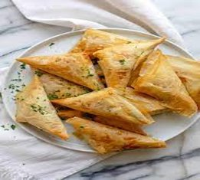
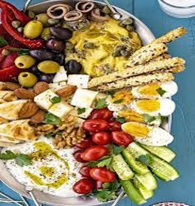
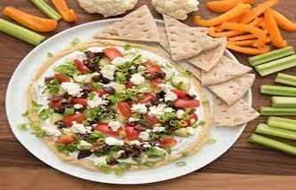
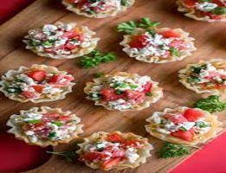
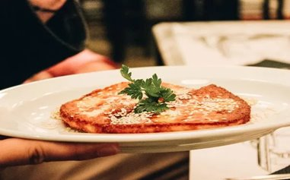
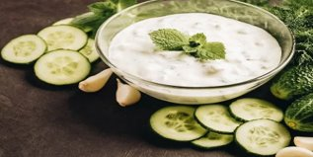
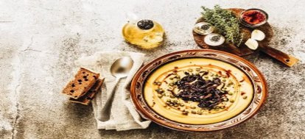
Greek restaurant Hesperos menu
Appetizers
1. Spanakopita
2. Greek meze platter
3. Greek layer dip
4. Feta dip phyllo cups
5. Saganaki
6. Tzatziki
7. Greek fava dip

Slide 7
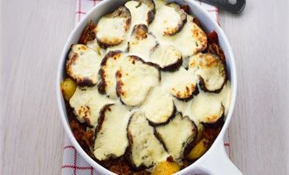
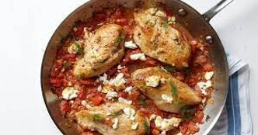
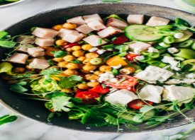
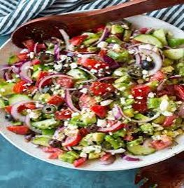
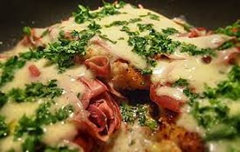
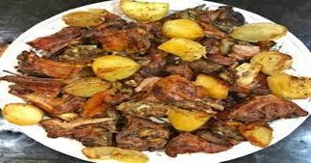
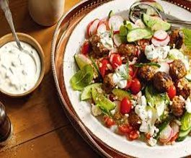
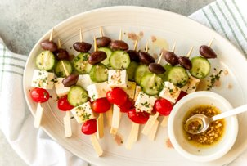
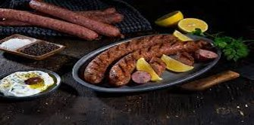
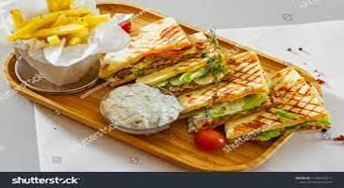
Entrees
Salad
1. Moussaka
2. Chicken with with feta
1. Simple fresh salad
3. Salad skewers
3. Valdostana chicken / beef
4.Arni
2. Greek lamb meatballs
4. Greek style salad
5. Skepasti: pork or chicken
6. Greek lamb pitta with tzatziki sauce

Slide 8
Market audit- competitor’s analysis
The following retailers are located within a 2-mile radius of Hespero providing direct or indirect competition to customers:
Land restaurant, which has been in operation for 15 years, is the city's most prominent local restaurant. It serves a broad variety of food, has live music from local bands, and is a very family-friendly environment. It also boasts a large menu with both healthy and fried options, as well as a popular bar. It does not define itself as a healthy meal option, despite its substantial clientele.
For the past five years, a modern restaurant and coffee shop has been open. Pastries, organic teas and coffees, and prepared sandwiches are also available. While the food is all organic, there is a little selection of items. Because the establishment has only four tables, it focuses to customers who want to get a quick breakfast or some pastries and coffee on their way to work.
Notes:
The audit market's specific set of characteristics—its position in capital market transparency, required demand, and concentrated supply—means that policymakers pay close attention to it.

Slide 9
Market analysis
Type of food | Land restaurant | Modern restaurant | our restaurant
Breakfast | 5£-12£ | 6£-12.95£ | 6£-15.45£
Lunch | 9£-18£ | 7£-12.95£ | 8£-25£
Dinner | 15£-25£ | 17£-27£ | 15£-26.99£
Drinks | 7£-11£ | 9£-14£ | 5£-30£
Notes:
Hesperos Greek restaurant

Slide 10
Marketing and sale plan
Hesperos, a Greek restaurant, will emphasize the company's distinctive value proposition:
Pastries, sandwiches, soups, salads, and other high-quality organic foods are available.
Providing a handy location with options for dining and bundling
Delivering exceptional client service
Promotion strategy:
The restaurant Hesperos incorporates a variety of advertising and sales initiatives. The restaurant's success strategy involves the following aspects:
Adding a reservation link to Google Business
Work on presentation of dishes so they can be instagrammable
Improve SEO local discovery online
Use the restaurant marketing frame
Focus on loyalty
Collect and use guest data
Notes:
Hesperos Greek Restaurant

Slide 11
Swot analysis
Strengths New & refreshing Greek Staff Highly enthusiastic team Experienced management team Outstanding customer service | Opportunities High exposure location Loyal returning customers Bringing a new taste of Greek food in Birmingham
Weaknesses Competitors provide a lower selling prices. Design with a high cost Authenticity, not particularly Greek Location often exposed by different events that block the street | Threats Competitors is in the area Competitors provide a lower selling prices. Bad reviews Quality of products Slower growth due to the inability to rise funds
Notes:
Hesperos Greek Restaurant

Slide 12
Political | Economical | Social | Technological | environmental | Legal
Governmental stability; Partnership collaboration local; Tax policy The emphasis was on disclosing information about each dish's calories and nutrients. | Inflation rate; Consumer discretionary income; Wages; rent; taxes; food; maintenance costs are all factors to consider. | strong demand for fresh and authentic Greek-style flavor; Food that is vegan or gluten-free has a high value. | Ordering and delivery apps for mobile devices Using a smartphone to accept payments; Manage the company fund and profit on the latest software. | Opportunity to bring Greece and Mediterranean culture | food safety and hygiene standards
Notes:
Pestel analysis is very important for the new restaurant to see all the criteria that can affect and how to improve the restaurant to run smooth.

Slide 13
Management Team
Chief operating officer (COO)
Mr Timurhan Gabriel Avci duty is to manage the business's day-to-day administrative and operational functions, reporting to the CEO.
Chief Financial office (CFO)
Andreea Elena Ion The function includes overseeing all financial transactions of the organization, tracking cash flow and financial planning, keeping track of the financial situation of the restaurant.
Chief executive officer (CEO)
Mrs Madalina Iuliana Lupu will be in charge of significant company decisions and will serve as the principal point of contact for the board of directors.
Marketing officer (CMO) Mr George Cuzmin is responsible for sales, pricing, communication, publication promotion.
Marketing officer (CMO) Mr Dragos Zane is in charge of the restaurant's market strategy and fresh supplies.
Notes:
We chose to share the responsibility in how to do what we know best and enjoy because we are all partners and want the best for the business. As a result, the restaurant will thrive, and we will be able to do what we wanted.

Slide 14

TARGET MARKET
Our target market is the group of people who are most likely to buy what we're selling - in this example, diners. Our restaurant's target demographic is a subset of the greater dining market. A combination of factors is used to select target markets:
-age
-income
-location
-family status
Consider yourself a private detective. The work will never be completed. You are always looking for new ways to improve your customer service.
Ask about their lifestyle and what they like and dislike about the restaurant.
Notes:
Restaurant target customer marketing focuses on a lucrative market category established through demographics, customer input, and experience. Everything we do in the restaurant is based on the target client, from the advertisements to the cuisine on the menu to the way the servers welcome the guests.

Slide 15
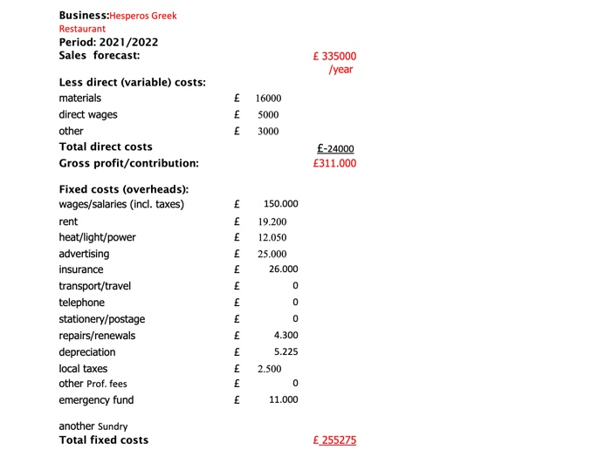
Notes:
Hesperos Greek restaurant

Slide 16
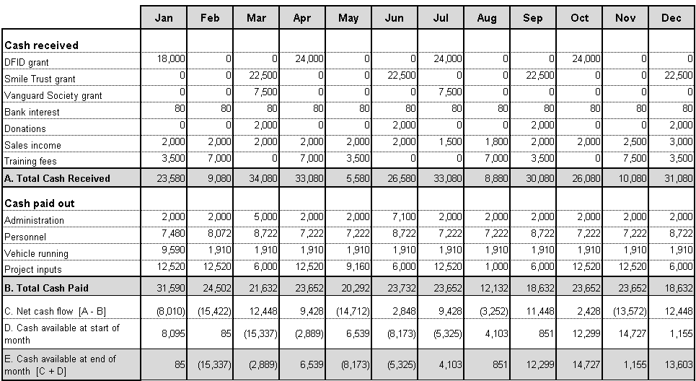
Hesperos Greek Restaurant cashflow forecast
2021-2022
Notes:
Hesperos Greek Restaurant

Slide 17
Reference
Guest Innovations, I., 2021. Restaurant Target Marketing. [online] Rezku. Available at: <https://rezku.com/blog/restaurant-target-marketing> [Accessed 18 November 2021]
Howandwhat.net. 2021. [online] Available at: <https://howandwhat.net/pestel-analysis-restaurant-industry/> [Accessed 11 November 2021].
Home.binwise.com. 2021. SWOT Analysis for Restaurant: Guide & Example. [online] Available at: <https://home.binwise.com/blog/swot-analysis-restaurant> [Accessed 11 November 2021].
https://spreadsheetsforbusiness.com/restaurant-financial-projections-business-plan-example/
McKeever, M., n.d. How to write a business plan.
Restaurantowner.com. 2021. SERVICE: The Real Product of Your Restaurant - You Know It, So Do Your Customers. [online] Available at: <https://www.restaurantowner.com/public/SERVICE-The-Real-Product-of-Your-Restaurant-You-Know-It-So-Do-Your-Customers.cfm> [Accessed 12 November 2021].
Notes:
Hesperos Greek Restaurant

