Slide 1
Feminist Perspective
Week 2, Bible: Contemporary Perpsectives
Dr Jessica M Keady
j.keady@uwtsd.ac.uk

Slide 2
Definition of Terms
Patriarchy / patriarchal
A social system in which the father is the head of the family, clan or tribe (literally, ‘under the authority of the father’), and men have authority over women and children.

Slide 3
Definition of Terms
Androcentrism / androcentric
A perspective centred on males or dominated by masculine interests.

Slide 4
The Bible as a Patriarchal and Androcentric Text
Male characters ‘control’ the narratives. Their lives and experiences shape a narrative’s framework.
1315 male names are listed in the Hebrew Bible (OT), but only 111 female names.
Many more women appear in the text but are nameless and identified in terms of their relationship to fathers or husbands
- ‘daughters of Lot’
- ‘the daughter of Jephthah’
- ‘the wife of Manoah’

Slide 5
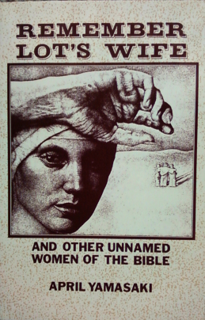
The Bible as a Patriarchal and Androcentric Text
Women are often minor characters in the story.
Patriarchal narratives: God reveals himself as the ‘God of Abraham, the God of Isaac, and the God of Jacob’ (Exodus 3:6).
Emphasis on narratives and settings with a masculine orientation (life of the tribe, war, kingship, cult).

Slide 6
The Hebrew Bible as a Patriarchal and Androcentric Text
Physical weakness is a feminine trait
‘The warriors of Babylon have given up fighting, they remain in their strongholds; their strength has failed, they have become women’ (Jer. 51:30).
‘On that day the Egyptians will be like women, and tremble with fear’ (Isa. 19:16).

Slide 7
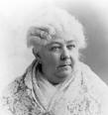
Early ‘Feminist’ Voices:
Elizabeth Cady Stanton
The Woman’s Bible (1895, 1898) - an ‘expurgated’ text of the Bible which sought to dismantle society’s sexism and to demolish Christian androcentrism.
The biblical laws relating to women are ‘from the obscene minds of a barbarous age’ (Cady Stanton).

Slide 8
Second Feminist Wave: 1960s and 1970s
Civil rights movement in the States, struggles against colonialism, rediscovery by women of their ‘feminist voice’.
Mary Daly, The Church and the Second Sex (1968); Beyond God the Father: Toward a Philosophy of Women’s Liberation (1973): calls for the abandonment of patriarchal religions in favour of a woman-centred spirituality.

Slide 9
Definition of Feminism
‘A critical and constructive stance that claims for women the full humanity accorded to men, insisting that women be represented equally in all attempts to describe and comprehend human nature and that they be full participants in the assignment and regulation of social roles, rights and responsibilities’ (Phyllis Bird, Escaping Eden, page 124).

Slide 10
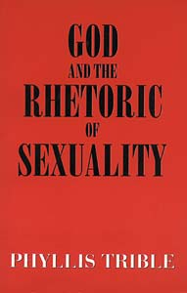
The Contribution of Phyllis Trible
God and the Rhetoric of Sexuality (1978): an attempt to ‘recover old treasures and discover new ones in the household of faith’.
A careful examination of the Hebrew Bible does not necessarily lead to rejection, but to a more variegated ‘appreciation’ of the biblical testimony about women.

Slide 11
Feminist Biblical Hermeneutics: Strategies
Reinterpretation of familiar biblical texts about women in order to challenge traditional (androcentric) readings. For example, see Phyllis Trible’s work on Genesis 1-3.
The aim is to recover and reclaim the biblical texts from patriarchal domination.

Slide 12
Feminist Biblical Hermeneutics: Strategies
Recovery of biblical texts and figures that have been marginalized in traditional readings of the Bible.
The Dictionary of Named and Unnamed Characters: 205 entries for named women in the HB and NT, 600 entries for unnamed women (‘daughter of..’, ‘wife of…’).

Slide 13
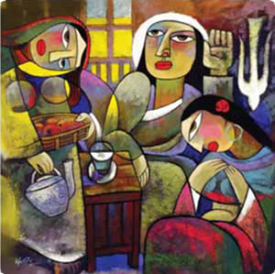
Feminist Biblical Hermeneutics: Strategies
Resisting androcentric tendencies in biblical texts: How are women’s stories narrated by males?
How do they reinforce patriarchal values and endorse women’s inferior status?
Biblical texts are examined with a ‘hermeneutic of suspicion’, a reading ‘against the grain’.

Slide 14
Feminist Biblical Interpretation: Tools and Methods
Historical Criticism: a quest for the world behind the text.
Literary Criticism: examination of the literary structures and techniques within the text.
Cultural Criticism: the reader analyses what is in front of the biblical text.

Slide 15
Historical Criticism
Biblical authorship and historical setting/audience of biblical texts.
Search for authorial meaning (what was the intention of the author).
Carol Meyers, Discovering Eve: Ancient Israelite Women in Context (1988): movement from an egalitarian to a more secondary status for women in ancient Israel.
Can we ‘trust’ what the biblical authors say? Importance of external evidence (archaeological data, ancient Near Eastern documents).

Slide 16
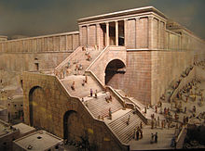
Historical Criticism
Acknowledgement that texts are varied in form and content (narratives, poems, laws, prophecies).
No uniform and static picture of the lives of women in Israel and the first-century Mediterranean world.
Portraits/images of women belonging to different periods and social circles.

Slide 17

Literary Criticism
Appreciation of structural patterns, stylistic devices in order to highlight the role of female characters in biblical literature.
How do female characters act in contrast to male characters?
When are they present or absent, heard or voiceless?
What kind of dialogue is created for women?
Whose perspective is advanced?
What about gaps, ambiguities, sequences?

Slide 18
Cultural Criticism
What is the relationship between the text and the reader?
Can one speak of an objective, value-neutral, ‘true’ reading of a text?
Concern with social context (especially those who are marginalized) and power struggles in the formation of culture.
Study of a range of ‘cultural artefacts’ in different time periods and geographical locations: films, art, newspapers, internet, oral history.

Slide 19
Cultural Criticism
How has the Bible shaped culture and how has culture shaped the interpretation of biblical texts?
‘Cultural Criticism is a joint critical study of texts and readers, perspectives and ideologies with a focus on the flesh-and-blood reader: always positioned and interested; socially and historically conditioned and unable to transcend such conditions’ (Fernando Segovia, Reading from this Place, Volume 1: 28-29).

Slide 20
What is a Feminist Reading?
Is it a (re)assessment of female biblical characters and feminine images?
What about narratives/texts where women are absent or play no part in the social or religious agenda?
Why did such questions not matter then?
Why do they matter now?

Slide 21
What is a Feminist Reading?
Step 1: Exegetical analysis (historical description) - a study of the texts in their ancient contexts.
Step 2: Feminist analysis, including a study of gender relations and a critique of values, expectations, relationships.

Slide 22
What is a Feminist Reading?
Can the historical/exegetical and feminist analytical tasks be separated? Thimmes notes four interrelated elements:
Feminism
Experience
Cultural location
Reading/Interpretation
Feminist hermeneutics interprets biblical texts in order to effect social, political and economic change.

Slide 23
The Story of Eve: A Case Study

Slide 24
Portrayal of Eve in Biblical Texts
Genesis 1:27, 2:4b-4:2a: explanation of the origins of creation and humanity.
II Corinthians 11:3: ‘But I am afraid that as the serpent deceived Eve by its cunning, your thoughts will be led astray from a sincere and pure devotion to Christ.’
I Timothy 2:11-13: ‘Let a woman learn in silence with full submission. I permit no woman to teach or to have authority over a man; she is to keep silent. For Adam was formed first, then Eve; and Adam was not deceived, but the woman was deceived, and became a transgressor.’

Slide 25
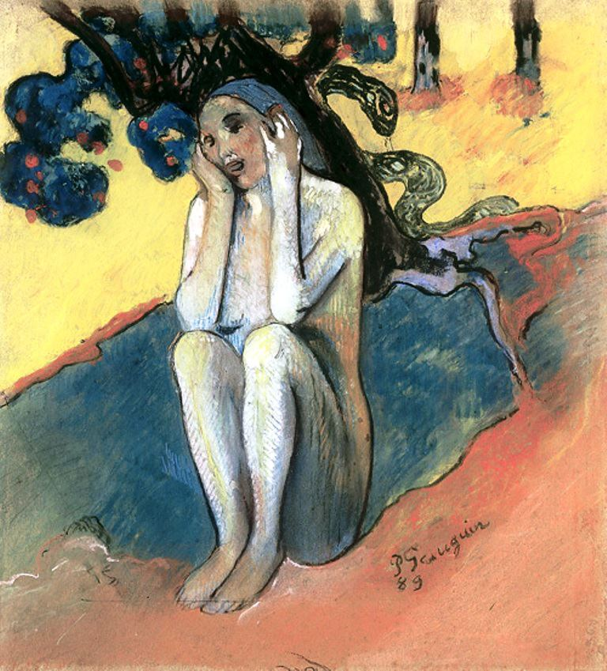
The ‘Afterlife’ of Eve
‘No biblical character has been more misunderstood or more maligned than the woman of the Garden’.
(Trevor Dennis, Sarah Laughed, page 8).
Gaugin, Human Miseries and Eve (1888)

Slide 26
The ‘Afterlife’ of Eve
Mary Daly, Beyond God the Father
The story of Eden should be rejected as a personification of patriarchy.
David Clines, What does Eve do to help?
The text of Genesis 2-3 is totally male-oriented and, as a result, should be abandoned in favour of biblical passages that proclaim a message of salvation to all humanity.

Slide 27
A New Reading of Genesis 1-3
An attempt to ‘depatriarchalize’ (Phyllis Trible) the creation narratives by focusing on the form and structure of the text, as well as its content.
Specific details in the text need to be examined anew.
How have certain key terms in the original (Hebrew) text been translated by generations of scholars and translators?

Slide 28
Two Creation Accounts in the Hebrew Bible
Genesis 1:1-2:4a - the Priestly author or ‘P’ (sixth century BCE).
Genesis 2:4b-3:24 - the Yahwistic author or ‘J’ (tenth or ninth century BCE).

Slide 29
Creation of Humankind
‘So God created humankind in his image,
in the image of God he created them;
male and female he created them’
(Genesis 1:27 New Revised Standard Version).
Humankind Hebrew: ’adam (cf. ’adamah = soil/dust) > ‘one from the soil/dust’ > ‘earth-creature’ (Trible.
No suggestion of sexual hierarchy or the absence of the divine image (imago Dei) in the female.
Their unity is highlighted; both together are blessed by God and receive a command to multiply and to fill the earth (1:28).

Slide 30
Account 2: God Creates the First Woman (Gen. 2:4b-25)
A narrative about two individuals (one male, one female) who are created by God and are able to converse with God.
Women’s inferiority has been argued on the basis of the following features of Genesis 2:
God created the female after the male.
She was created from the rib of the male.
Her role was to help her husband.

Slide 31
1. The Creation of Woman after the Man
‘Then the Lord God formed man (ha-’adam) from the dust of the ground, and breathed into his nostrils the breath of life, and the man became a living being’ (Genesis 2:7).

Slide 32
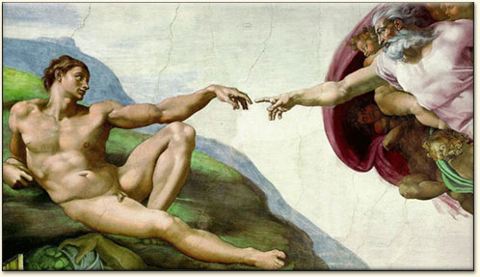
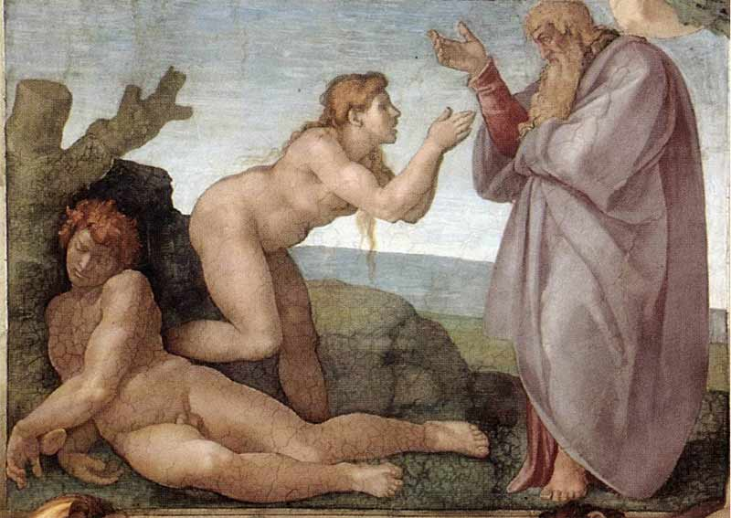
1. The Creation of Woman after the Man
‘The Creation of Adam’ and ‘The Creation of Eve’
Michelangelo, Sistine Chapel, The Vatican, 1510.
‘Adam’s perfection far excelled hers in all real dignity’
(John Milton, Paradise Lost I0:150-151).

Slide 33
1. The Creation of Woman after the Man
Genesis 2:7 - sexual hierarchy and subordination of women?
No claim that temporal priority = male superiority over the female.
No suggestion made by later interpreters that humanity is inferior because of the temporal priority of the creation of the animals.

Slide 34
2. The Creation of Woman from the Side of the Man
‘So the Lord God caused a deep sleep to fall upon the man, and he slept; then he took one of his ribs and closed up its place with flesh. And the rib (sela‘) that the Lord God had taken from the man he made into a woman and brought her to the man’ (Genesis 2:21-22 New Revised Standard Version).

Slide 35
2. The Creation of Woman from the Side of the Man
The word sela‘ is traditionally rendered as ‘rib’. Elsewhere the same Hebrew word is used for:
The sides of the tabernacle (Exodus 26:26)
The side of the Temple (Ezekiel 41:11)
The side of the ark of the covenant (Exodus 25:12)
The side or slope of a mountain (II Samuel 16:13).
Could the author of Genesis 2 also be thinking that God took one of the male’s sides rather than an (insignificant) rib in order to create the woman?

Slide 36
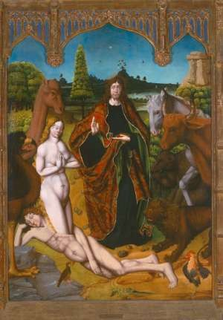
2. The Creation of Woman from the Side of the Man
The Creation of Eve
15th century Spanish altarpiece by Fernando Gallego.

Slide 37
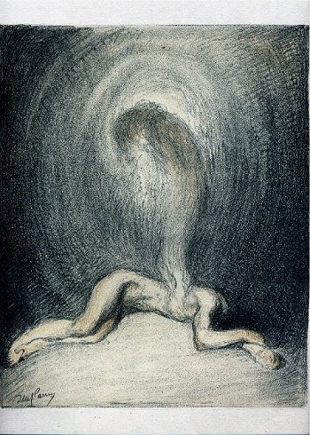
The Creation of Woman from the Side of the Man
The Creation of Eve
20th century lithograph from a French Bible.

Slide 38
2. The Creation of Woman from the Side of the Man
Does the author of Genesis 2 intend to use the creation of the woman from the man’s body as evidence of her inferiority? Is man inferior to dust?
Side/rib and dust are the raw materials from which God gives life to the man and the woman.
Man is incomplete until the woman is created, while the emphasis is on partnership rather than hierarchy.
‘This at last is bone of my bones and flesh of my flesh; this one shall be called Woman, for out of Man this one was taken’ (Gen. 2:23).

Slide 39
3. The Woman as Helper
‘Why did God bother to create woman? She is of no use to the man when it comes to physical labour (Genesis 2:18) and her only role is to conceive and bear children’.
Augustine of Hippo, A Literal Commentary on Genesis 9:5.
‘Then the Lord God said, “It is not good that the man should be alone; I will make him a helper as his partner’ (Genesis 2:18 NRSV).
God as the helper who offers support to his people (see Exod. 18:4; Deut. 33:7; Ps. 121:2).

Slide 40
To Conclude
The meaning of Eve in Hebrew ‘living, life giver’
“The prominence of Eve comes not only from her role in the Garden of Eden narrative, but also from her frequent appearance in art, theology and literature.” (Alice Ogden Bellis, Women in Scripture, p. 79).

Slide 41
Eve is not called a sinner in the Genesis 2-3 account (the word sin does not appear in the HB until the Cain-Abel narrative).
Another misconception is that Eve tempts or seduces Adam.
Views of The Fall / The Fall of Man are “entrenched in Western notions of Eden, making it difficult to see features of Eve and her role that form part of the narrative” (idem, p. 80).

