Slide 1

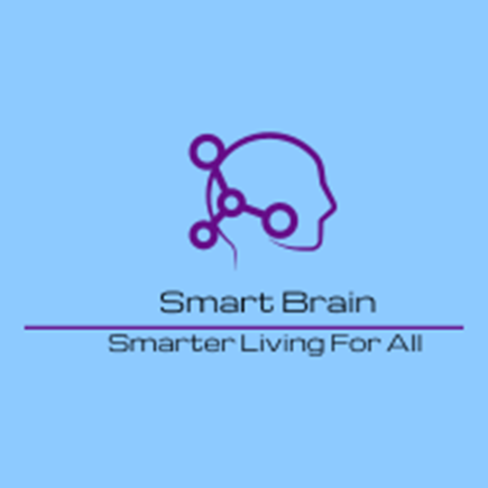
Smart brain
Matthew Howells (1702520)
Data And Information Systems
Initial Team Pitch:
Wed. 4th of December.

Slide 2


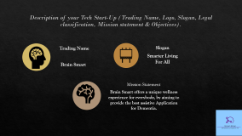
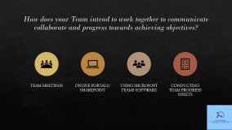
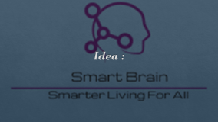
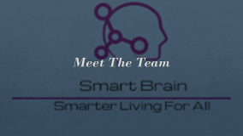
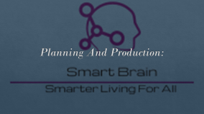
Contents Page

Slide 3
Meet The Team

Slide 4
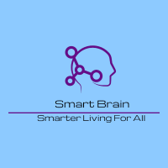
What is the product idea?
Presented research has identified a gap in the marketplace with regards to support for dementia sufferer's.
The product idea is a digital device that can support individuals 24 hours a day, 365 days a year.
To accomplish we will implement an application to provide audio prompts to users. The idea is to make this process as simple as possible.

Slide 5
Idea :

Slide 6
Market:

Slide 7
Business:

Slide 8
Planning And Production:

Slide 9
Business:

Slide 10
Team-working & Management:
MH

Slide 11
Description of your Tech Start-Up (Trading Name, Logo, Slogan, Legal classification, Mission statement & Objectives).
Trading Name
Brain Smart
Slogan
Smarter Living For All
Mission Statement
Brain Smart offers a unique wellness experience for everybody, by aiming to provide the best assistive Application for Dementia.

Slide 12
How does your Team intend to work together to communicate collaborate and progress towards achieving objectives?
Team meetings
Online Portals/ SharePoint
USING Microsoft Teams Software
Conducting Team progress sheets

Slide 13
Conclusion
Overall dimenture remains a growing problem where individuals continue to require help during their everyday living . This assistance can cost a lot of money to maintain. Our Unique product aims to help balance this assistance while improving peoples lifestyle.

Slide 14
Reference list
MH, RW, KM
1. https://www.alzdiscovery.org/cognitive-vitality/blog/can-hearing-aids-help-prevent-dementia
2. Lin FR, Ferrucci L, An Y et al. (2014) Association of hearing impairment with brain volume changes in older adults. Neuroimage 90, 84-92.
3. Luengo-Fernandez R, et al(2015) https://www.dementiastatistics.org/statistics/cost-and-projections-in-the-uk-and-globally/
4. Alzheimer’s Research UK calls for global dementia commitment after WHO sounds the alarm. https://www.alzheimersresearchuk.org/alzheimers-research-uk-calls-global-dementia-commitment-sounds-alarm/
5. https://apolitical.co/solution_article/robots-boost-dementia-patients-cognitive-skills-independence/

