Slide 1

Applied anthropology
How anthropology can be used

Slide 2
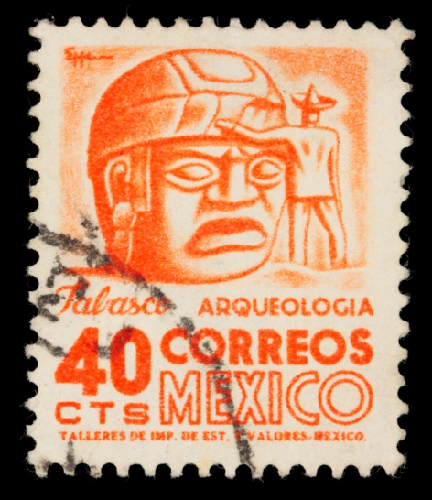
Today’s class
What is applied anthropology?
Special features of the role
Examples –
  Australian aboriginal groups
  Nestlé
  Tree planting in Kenya and Peru
  Kerula, Indian community plant initiative
Use of knowledge/ misuse of knowledge

Slide 3


What is applied anthropology?
Pure v applied anthropology
Applied =
  Problem-orientated research
  Anthropological knowledge and data that is applied to find a solution to a social problem

Slide 4

Why apply anthropology?
Pure anthropology = theory based knowledge
Anthropologists began to
  Question previous role – ‘handmaiden of colonialism’
  Question knowledge ownership
  Question the anthropological role
Notes:
Hand maidens of colonialism – EP and Nuer

Slide 5

Why anthropology?
Special features:
  Participant observation
  Holism
  Regional expertise
  Emic view
  Cultural relativism
  Link between 2 cultures

Slide 6
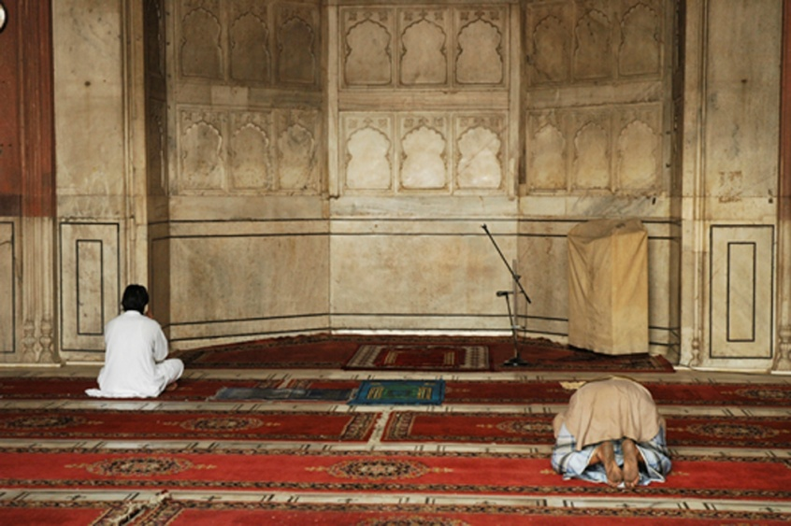
Participant observation
Immersion in the culture
Doing the tasks
Living as others live
Learning the language
Creates a deeper, personal understanding of cultural realities

Slide 7

Holism
The holistic viewpoint sees experience ‘in the round’ taking into account all perspectives (history, economic etc)
Holism demands acknowledgement of interconnections between parts

Slide 8

Regional expertise
Anthropologists have cultural knowledge that most policy makers do not
Despite specialisms they are still area experts

Slide 9
Emic view
Using the ideas and beliefs of the local people as foundational the anthropologist can provide important information to planners and developers

Slide 10

Cultural relativism
The idea that:
  All cultures are qualitatively different
  No culture has the prerogative on correct behaviour
  All cultures are only able to be understood from ‘the inside’
  That all cultures have their own intrinsic logic
Encourages tolerance for all perspectives

Slide 11
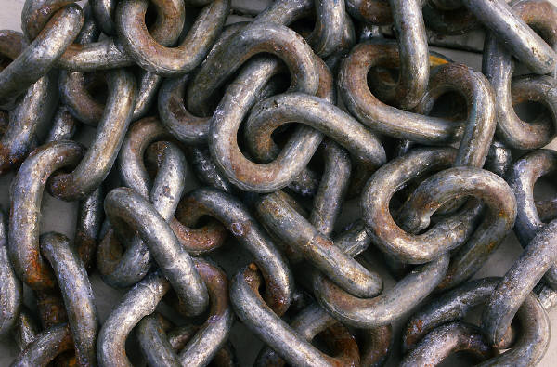
Link between cultures
Topical expertise and examples might be applicable to other situations

Slide 12
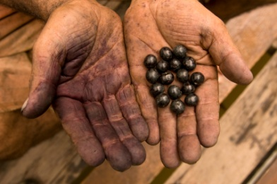
Examples of roles
Evaluator: considers value/worth of policy decisions
Planner: active participation in planning
Impact assessor: works out consequences of changes
Trainer: teaches others in cross cultural situations
Advocate: supports and speaks for
Expert witness: culturally relevant info in judicial cases
Cultural broker: liaison between parties
Policy researcher: provides info for policy makers
(Adapted from Ferraro,2008: 55)

Slide 13

Example –
Nestlé’s marketing of formula baby milk in the 3rd world caused dramatic increase in infant illness during the 1970s-80s
Despite scientific evidence of abuse they continued
Penny Van Esterik’s (1989) research
data played a vital role in changing
Nestlé’s strategy

Slide 14
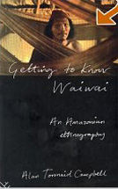
Example: dying out
The Wayapi people in Campbell’s book
Getting to Know Wai Wai (1980)

Slide 15

Narby : Ashanika, Peru
Development of the Amazon, including pharmaceutical interest sparked concerns regarding ownership
Narby aimed to establish indigenous peoples’ ownership by establishing their rights through their knowledge
Books:
1995. The cosmic serpent: DNA and the origins of knowledge e
2001. Shamans Through Time: 500 Years on the Path to Knowledge
2005. Intelligence in nature

Slide 16
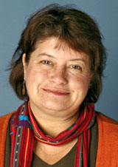
Example: land rights
Australian Aboriginal lands
Book:
  Strang, V. 1997, Uncommon Ground: cultural landscapes and environmental values, Oxford, New York: Berg
http://www.aaanet.org/pdf/upload/51-2-Veronica-Strang-In-Focus.pdf

Slide 17
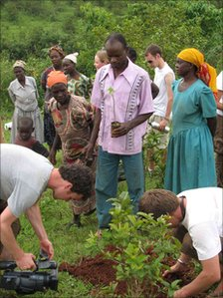
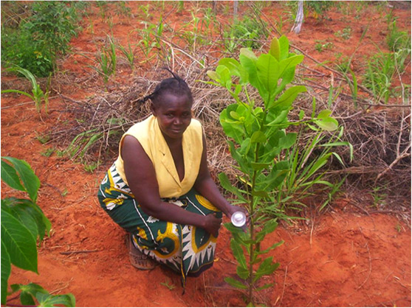
Community Carbon Link
Tree planting initiative
Focused through non-profit org -Treeflights
Links communities through planting trees for carbon absorption
Linked to Giriama in Kenya and the Ashaninka in Peru

Slide 18
3 films –tree planting in Kenya
Latest film from Bore
School project with PrimateHandshake
School project in Lampeter

Slide 19
Kerula ‘tree knowledge’
Film: Plants and their secrets part 2

Slide 20
Summary
Today we looked at what applied anthropology is
How anthropological knowledge is used
How can it help
Some ethnographic examples

