Slide 1
Biomimicking into the future

Slide 2
What Is Biomimicry in Design?
"Design in nature is but a concatenation of accidents, culled by natural selection until the result is so beautiful or effective as to seem a miracle of purpose." – Michael Pollan
By definition, biomimetics is the emulation of materials, structures, systems and processes modelled on biological entities. Fairly convoluted for a fundamentally simple concept.
Biomimicry is learning from and then emulating nature’s forms, processes, and ecosystems to create more sustainable designs.

Slide 3
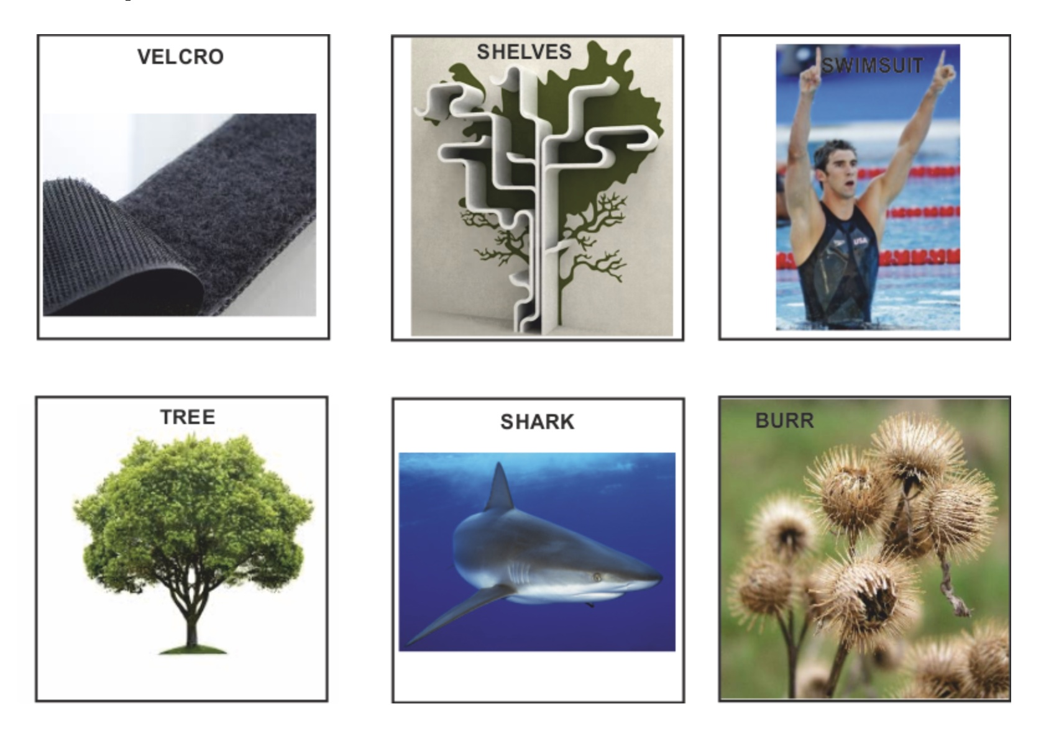

Slide 4
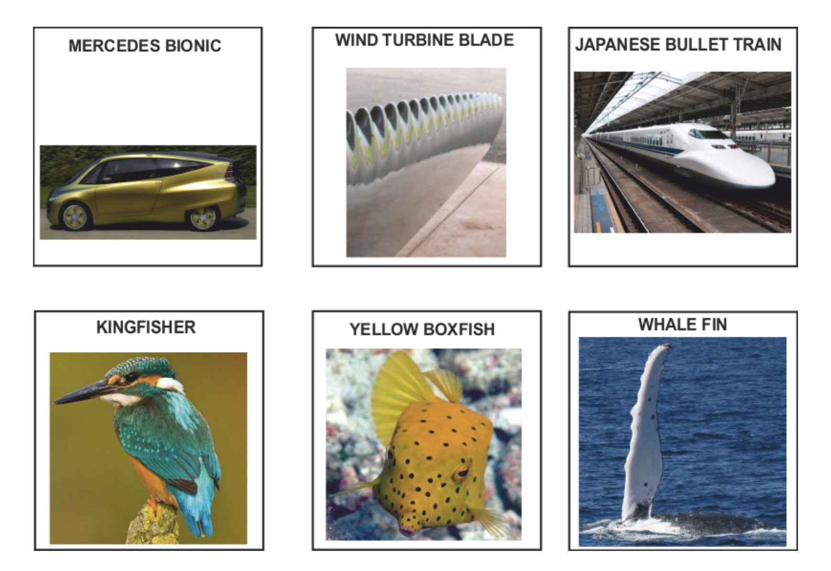

Slide 5
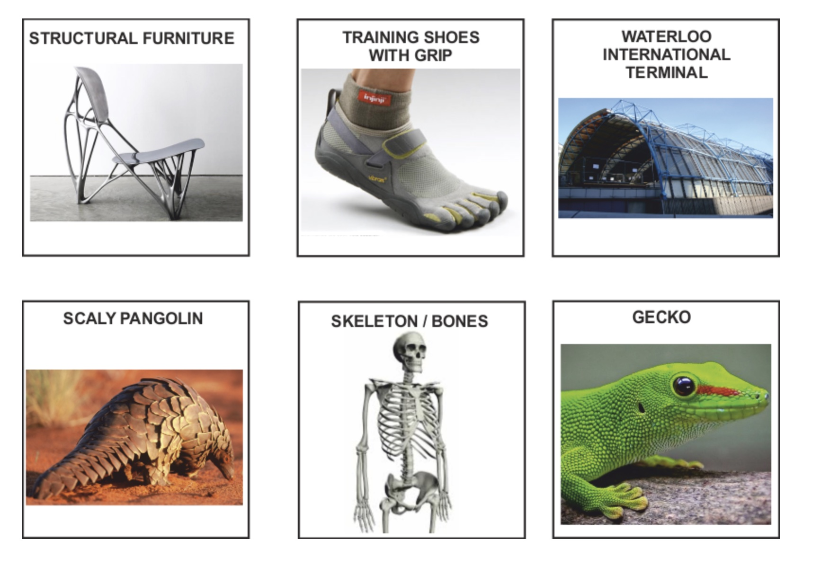

Slide 6
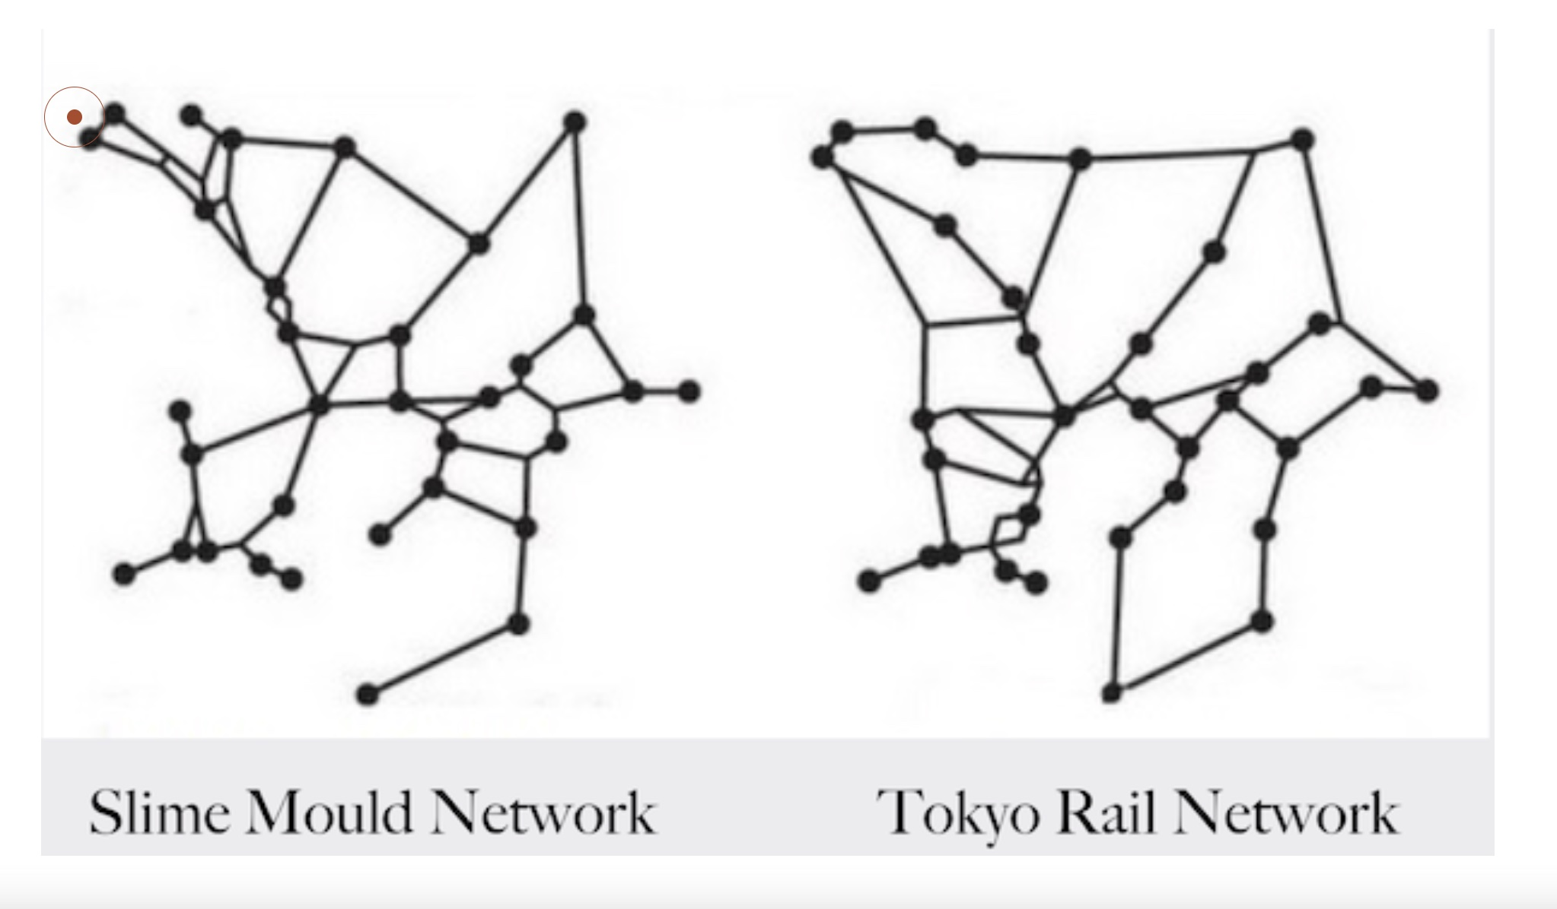

Slide 7
“We’re blanketing ourselves in boringness, which sounds minor, but is actually a major mental health issue.”
THOMAS HEATHERWICK

Slide 8
Biomimetic Painting Challenge:
Task: Create a painting inspired by the beauty and patterns found in nature, emphasizing biomimetic principles.
Guidelines: Select a specific natural element, such as a plant, animal, geological formation, or natural phenomenon, as the focal point of your painting. Study the intricate patterns, textures, colors, and forms found in the chosen natural element. Use this as inspiration to create a painting that captures the essence of the natural world while incorporating biomimetic principles.
Consider how the painting can reflect the harmony, balance, and sustainability present in the chosen natural element. Your artwork should celebrate the beauty and complexity of nature and convey a message of environmental awareness and appreciation. This challenge encourages artists to draw inspiration from the natural world and apply biomimicry principles to their painting practice. By immersing themselves in the patterns and forms found in nature, artists can create captivating and thought-provoking artworks that highlight the interconnectedness between art, science, and the environment.

Slide 9
Biomimetic Transportation Design Challenge:
Task: Develop a transportation vehicle or component inspired by biological locomotion or structural adaptations.
Guidelines: Choose a specific animal, plant, or natural phenomenon related to movement or structural efficiency. Use this as a starting point to design a transportation vehicle (such as a car, bicycle, aircraft, etc.) or a specific component (like a wing, propeller, or wheel) that mimics the efficiency, agility, or aerodynamic properties found in nature.
The design should integrate principles of biomimicry to improve performance, reduce energy consumption, or enhance the overall sustainability of the transportation solution. These product design challenges encourage participants to leverage biomimicry principles to create innovative, sustainable, and nature-inspired solutions in the realm of packaging and transportation design. By drawing inspiration from the natural world, designers can develop products that are not only functional and aesthetically appealing but also environmentally responsible and efficient.

Slide 10
Biomimetic Writing Challenge:
Task: Write a piece of literature inspired by elements of nature and biomimicry, emphasizing the interconnectedness between humans and the natural world.
Guidelines: Choose a specific aspect of nature, such as a plant, animal, ecosystem, or natural phenomenon, and explore its characteristics, behaviors, and significance. Use this as inspiration to create a work of fiction, poetry, or non-fiction that integrates biomimetic themes.
Consider how the piece can reflect the resilience, adaptability, and beauty found in the natural world, while also conveying a message about sustainable coexistence and the importance of learning from nature. Your writing should evoke a sense of wonder, appreciation, and environmental consciousness. This challenge encourages writers to draw inspiration from the natural world and incorporate biomimicry themes into their creative work. By weaving elements of nature and sustainability into their writing, authors can craft compelling narratives and imagery that resonate with readers and prompt reflection on humanity's relationship with the environment.

Slide 11
Biomimetic Ceramics Design Challenge:
Task: Create a ceramic piece inspired by natural forms, textures, or structures, incorporating biomimetic principles.
Guidelines: Select a specific natural element, such as a plant, animal, geological formation, or natural pattern, as the inspiration for your ceramic design. Study the organic shapes, textures, and functional properties found in the chosen natural element. Use this as a basis to design a ceramic piece that reflects the beauty, resilience, and sustainability found in nature.
Consider how the piece can mimic the structural efficiency, aesthetic appeal, or functional properties of the natural element, while also embracing sustainable material choices and production methods. Your ceramic artwork should embody the harmony between art, nature, and sustainability. This challenge encourages ceramic artists to draw inspiration from the natural world and apply biomimicry principles to their ceramic creations. By exploring the organic shapes and patterns in nature, artists can produce ceramic pieces that not only showcase artistic excellence but also convey a deeper connection to the environment and the principles of sustainable design.

Slide 12
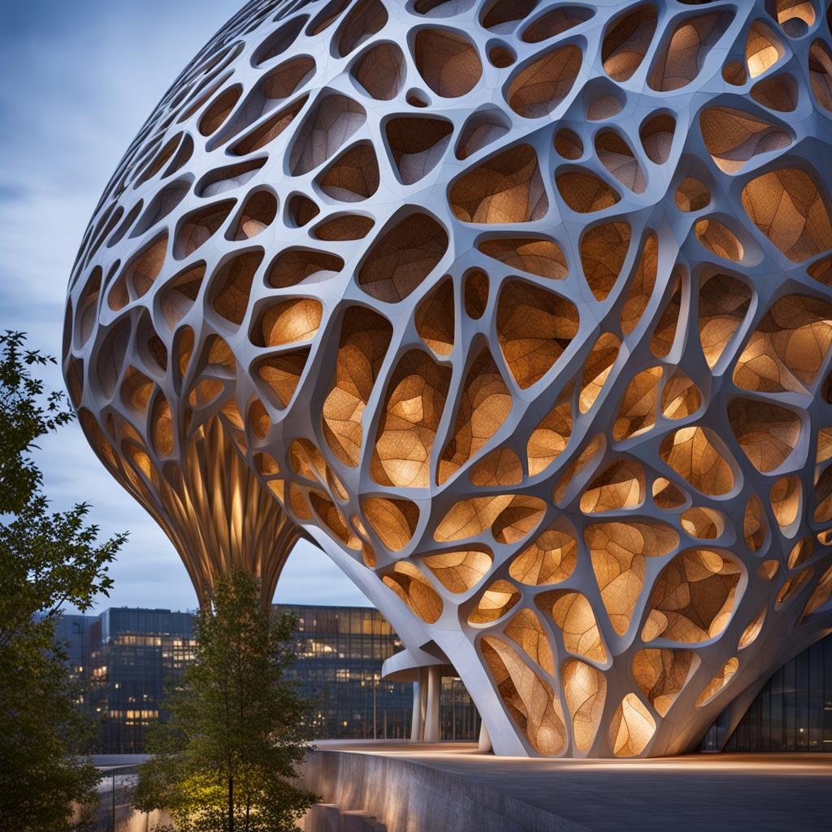
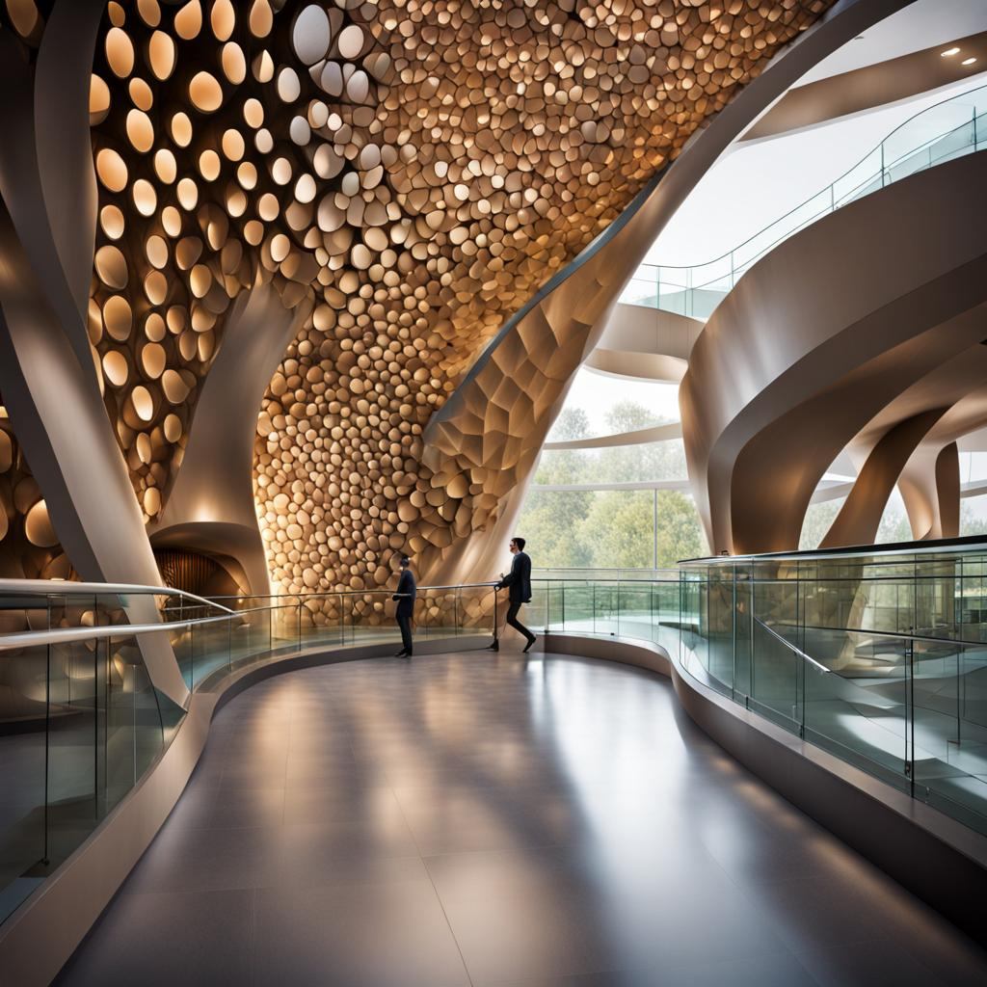

Slide 13
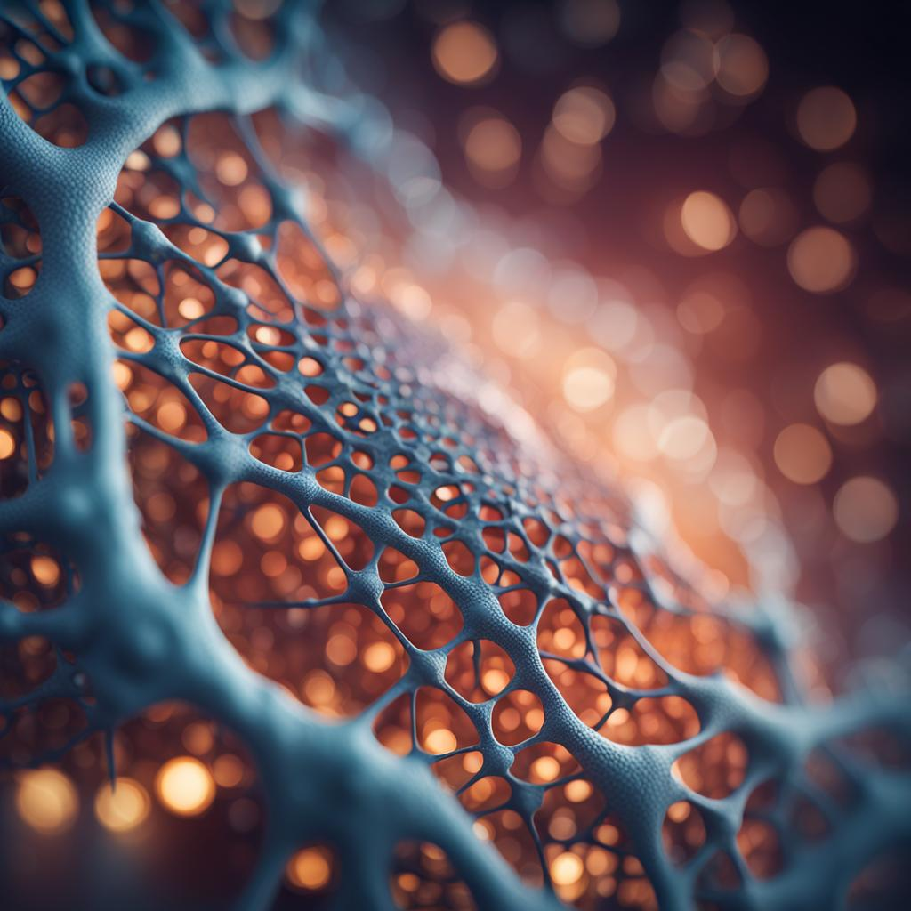
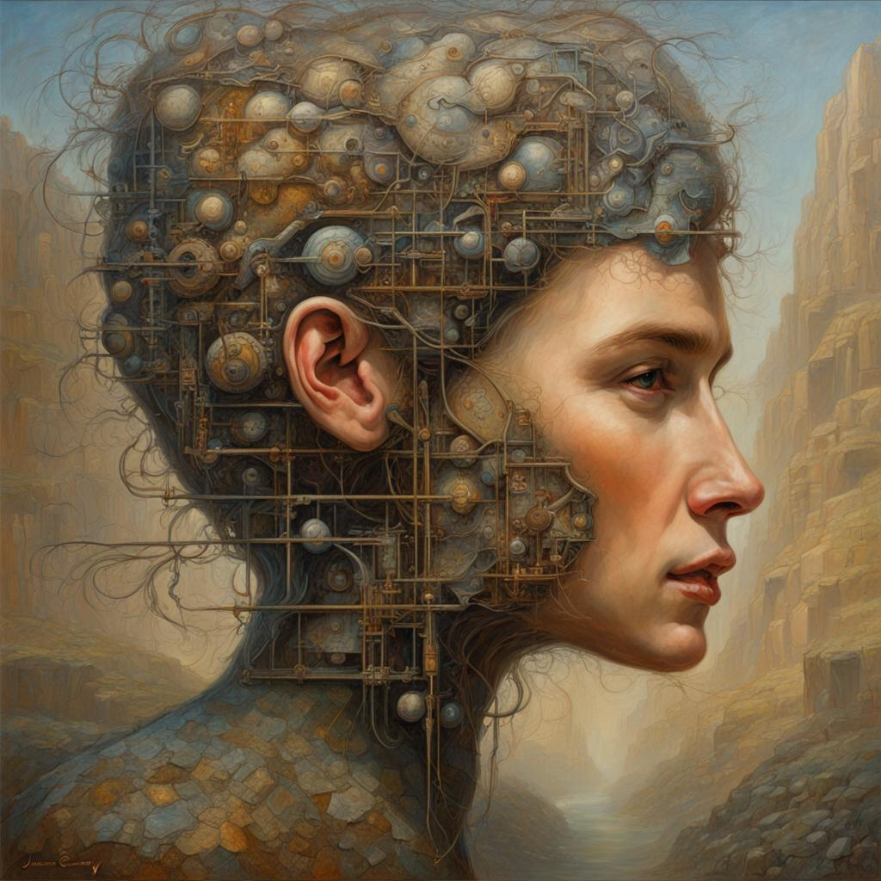

Slide 14


