Slide 1

Name: Mariama Aliu Sal
Student Number: 2127362
Module code: BMHP6020_BIRM
Module name: Independent Project
Term 3: Chapter 3 poster
Lecturer name: Joanne Davies

Slide 2
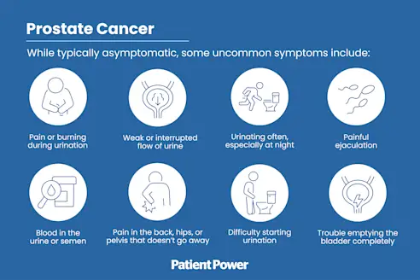
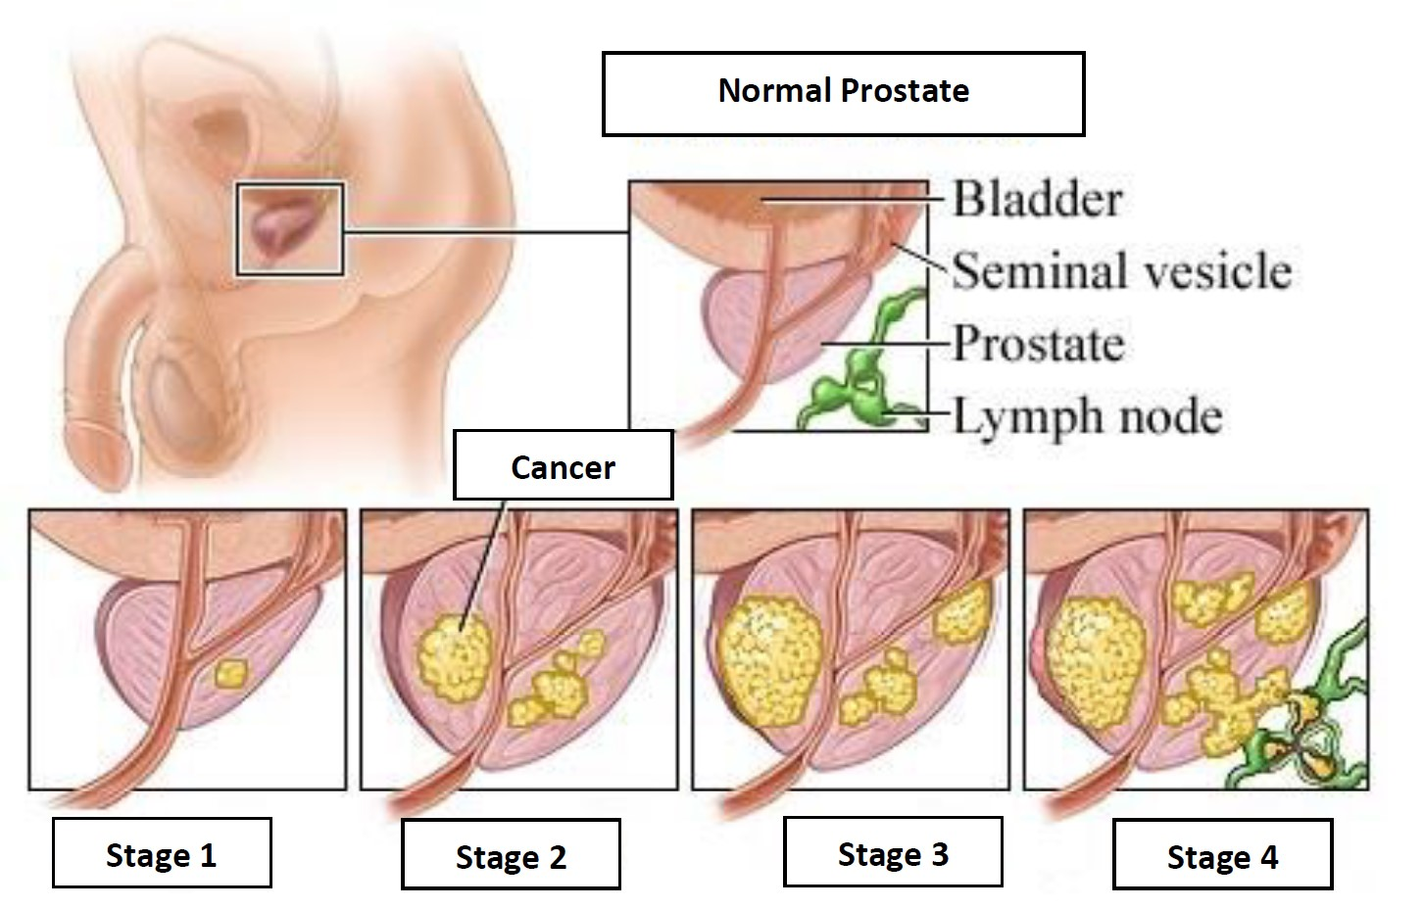
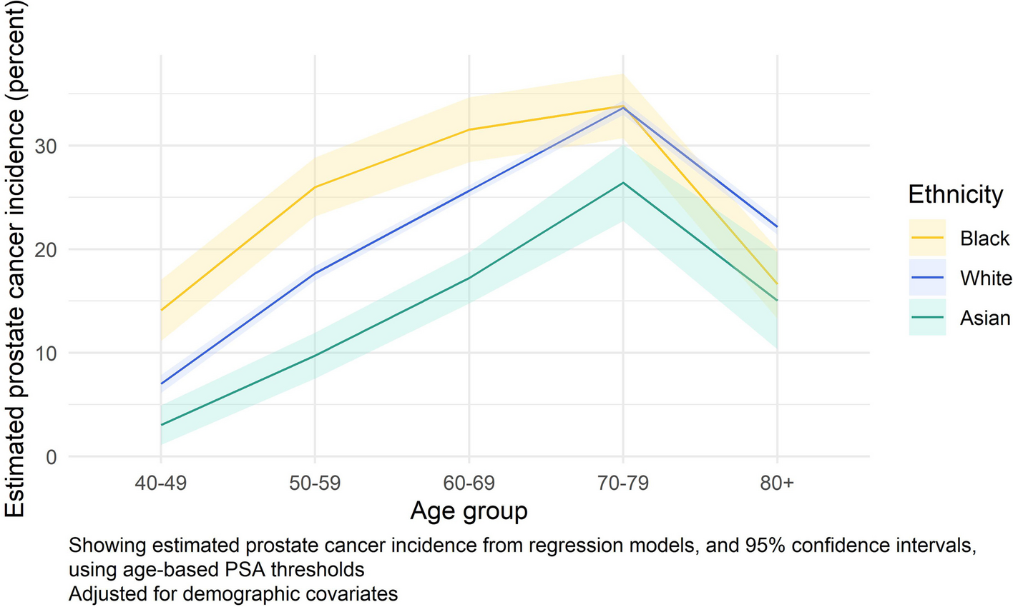
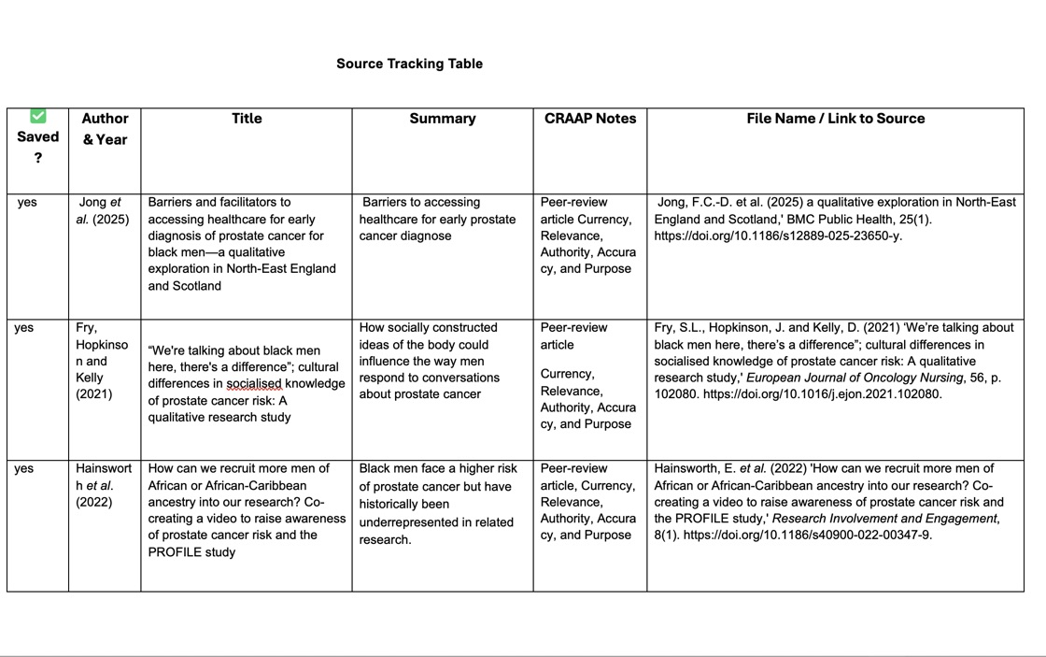
What are the prostate cancer outcomes among black men in the UK?
Introduction
Aim
Search Strategy
The methods chapter offers a comprehensive overview of the research process, detailing each step of the study. It covers the research design, sampling techniques, and data collection methods (Tabuena, Hilario and Buenaflor, 2021).
This research aims to determine and explain why black men are more affected by prostate cancer than any other demographic group in the United Kingdom (Jones and Chinegwundoh, 2016).
This comprehensive approach involved utilising multiple academic databases, including Google Scholar, the University of Wales Trinity Saint David (UWTS) library database, and PubMed (Allmark and Machaczek, 2018).
Searches used keywords like “prostate cancer," "Black men," "UK," "health disparities,” and “United Kingdom " (Liadi et al., 2023).
To improve search quality and select high-calibre studies, Boolean operators (AND, OR, NOT) were used strategically, enabling precise filtering of relevant articles (Lowe et al., 2020).
Searching for Information
Symptom
Prostate cancer stages
To guarantee the quality of the sources, only peer-reviewed journal articles and authoritative reports from reputable health organisations, such as the NHS and Cancer Research UK, were considered (Bergengren et al., 2023).
Knowing the symptoms of prostate cancer allows individuals to identify when it is time to seek medical help.
Understanding the stage of prostate cancer is essential for both patients and doctors to measure how advanced and widespread the disease is.
Figure 1: A diagram of prostate cancer symptoms ( Modglin and Martini, 2024)
Figure 2: A diagram of prostate cancer stages (Bakir, 2025)
Visual Aid
Graph
Below is the source tracking table
Figure 3: A diagram of prostate cancer chart (Down et al., 2024)

Slide 3
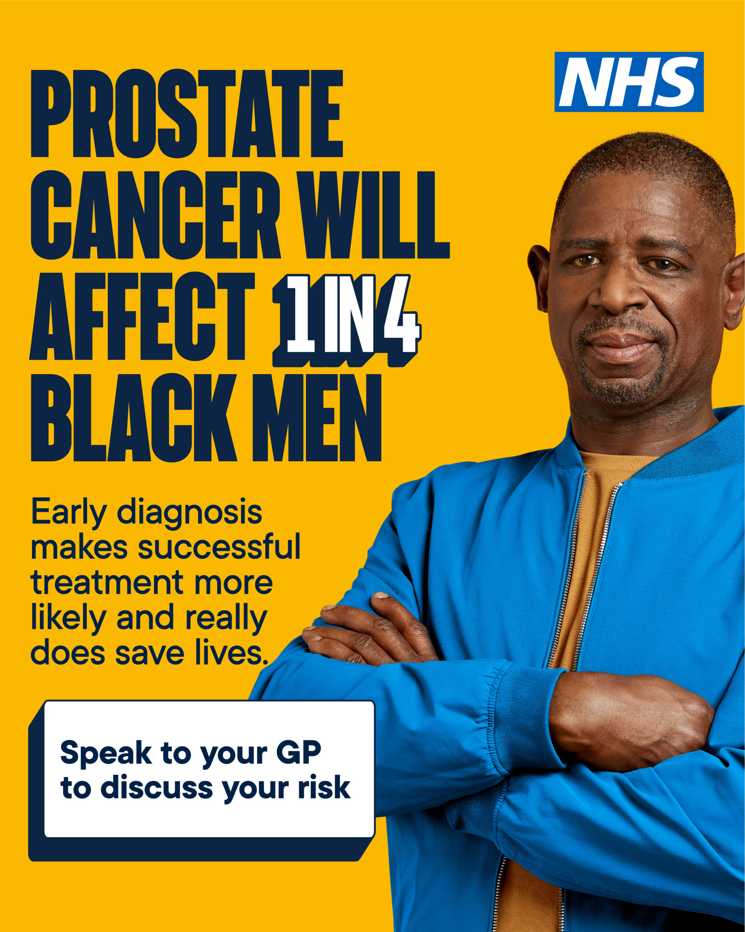
Campaign
Research Validation and Analysis
Inclusion Criteria
Exclusion Criteria
Public awareness campaigns improve understanding and outcomes while upholding core ethical principles such as fairness, respect, and community well-being.
To ensure the accuracy and dependability of secondary research findings, the CRAAP test was used as a structured method to assess data source quality. This method includes five key Currency, Relevance, Authority, Accuracy, and Purpose (Fielding, 2019).
This research investigates disparities in prostate cancer outcomes among Black men in the UK, analysing factors like socioeconomic status and healthcare access (Murphy et al., 2024).
This research will focus specifically on Black men residing in the United Kingdom, intentionally excluding other ethnicities and genders to maintain a clear and defined target population (Atakere and Baker, 2016).
Figure 4: Prostate cancer awareness campaign (Greater Manchester Cancer Alliance NHS Foundation Trust, 2025)
Ethical Considerations
Respect for Intellectual Property
Privacy and Confidentiality
Compliance with Laws and Regulations
This research will adhere to the University of Wales Trinity Saint David (UWTSD) Integrity and Ethics policies by correctly referencing all sources in Harvard style, avoiding plagiarism (University of Wales Trinity Saint David, 2024).
While conducting research, prioritising privacy and confidentiality is of utmost importance. All data collected will be handled with care, stored securely, and only accessible to authorised personnel, such as the lecturer. (Nurmi et al., 2018).
This study emphasises the importance of trustworthy, accurate data sources for research. Verifying the credibility of sources like academic journals, government reports (Noble and Smith, 2015).
Secondary research ethics involve guiding principles for responsible data use, emphasising source integrity, transparency, and respecting intellectual property rights (Herington, Li and Pisani, 2024). Researchers should critically assess data reliability and validity to prevent misrepresentation and bias. Furthermore, ethical standards include proper citation of original sources and following institutional guidelines (Beck, 2019).
Conclusions
This study shows that secondary research is vital, and ongoing efforts to raise awareness and reduce inequalities are key to better health and fairness.

Slide 4
References
Ahmed, I. and Ishtiaq, S. (2021) 'Reliability and Validity: Importance in medical research,' Journal of the Pakistan Medical Association, 71(10), pp. 2401–2406. https://doi.org/10.47391/jpma.06-861.
Allmark, P. and Machaczek, K. (2018) 'Realism and Pragmatism in a mixed methods study,' Journal of Advanced Nursing, 74(6), pp. 1301–1309. https://doi.org/10.1111/jan.13523.
Atakere, D.K. and Baker, T.A. (2016) 'Immuned by Race: Ethnic Identity, Masculinity, and Attachment as Predictors of Cancer Screening among Black Men,' Psychology, 07(07), pp. 1023–1033. https://doi.org/10.4236/psych.2016.77103.
Beck, C.T. (2019) Secondary qualitative data analysis in the health and social sciences. https://doi.org/10.4324/9781315098753.
Bergengren, O. et al. (2023) '2022 Update on Prostate Cancer Epidemiology and Risk Factors-A Systematic Review,' European Urology, 84(2), pp. 191–206. https://doi.org/10.1016/j.eururo.2023.04.021.
Down, L. et al. (2024) 'Association between patient ethnicity and prostate cancer diagnosis following a prostate-specific antigen test: a cohort study of 730,000 men in primary care in the UK,' BMC Medicine, 22(1). https://doi.org/10.1186/s12916-024-03283-5.
Fielding, J.A. (2019) 'Rethinking CRAAP: Getting students thinking like fact-checkers in evaluating web sources,' College & Research Libraries News, 80(11), p. 620. https://doi.org/10.5860/crln.80.11.620.
Greater Manchester Cancer Alliance NHS Foundation Trust, (2025). Campaign resources - urological cancers. Available at: https://gmcancer.org.uk/cancer-type/prostate-cancer/ (Accessed: 21 October 2025).
Hainsworth, E. et al. (2022) 'How can we recruit more men of African or African-Caribbean ancestry into our research? Co-creating a video to raise awareness of prostate cancer risk and the PROFILE study,' Research Involvement and Engagement, 8(1). https://doi.org/10.1186/s40900-022-00347-9.
Herington, J., Li, K. and Pisani, A.R. (2024) 'Expanding the role of justice in secondary research using digital psychological data.,' American Psychologist, 79(1), pp. 123–136. https://doi.org/10.1037/amp0001190.
Jones, A.L. and Chinegwundoh, F. (2016) 'ecancermedicalscience,' Ecancermedicalscience, 8, p. 455. https://doi.org/10.3332/ecancer.2014.455.
Lowe, M.S. et al. (2020) 'Boolean redux: Performance of advanced versus simple boolean searches and implications for upper-level instruction,' The Journal of Academic Librarianship, 46(6), p. 102234. https://doi.org/10.1016/j.acalib.2020.102234.
Modglin, L. and Martini, A., (2024). Prostate Cancer Symptoms: Signs to Watch For. Available at: https://www.patientpower.info/prostate-cancer/symptoms (Accessed: 21 October 2025).
Murphy, A. et al. (2024) 'Understanding and addressing prostate cancer disparities in diagnosis, treatment, and outcomes among Black men,' Cancer Control, 31, p. 10732748241275389. https://doi.org/10.1177/10732748241275389.
Noble, H. and Smith, J. (2015) 'Issues of validity and reliability in qualitative research,' Evidence-Based Nursing, 18(2), pp. 34–35. https://doi.org/10.1136/eb-2015-102054.
Nurmi, S.-M. et al. (2018) 'Privacy of Clinical Research Subjects: An Integrative Literature review,' Journal of Empirical Research on Human Research Ethics, 14(1), pp. 33–48. https://doi.org/10.1177/1556264618805643.
Tabuena, A.C., Hilario, Y.M.C. and Buenaflor, M.P. (2021) 'Overview and exemplar components of the research methodology on the research writing process for senior high school students,' SSRN Electronic Journal . https://doi.org/10.2139/ssrn.3802722
.
University of Wales Trinity Saint David, (2022). Research Integrity and Ethics. Available at: https://www.uwtsd.ac.uk/research/research-integrity-and-ethics (Accessed: 21 October 2025).

