Slide 1
Week 12
Preparing for Completion
(see Chapter 17)

Slide 2
Aims: to understand ……
Steps to be taken by S’s between exchange and completion
Steps to be taken by B’s conveyancer between exchange and completion – including pre-completion searches, and
Drafting the Transfer

Slide 3
Preparing to complete on a SALE
Where the Seller’s mortgage to be paid off
  Obtain up to date repayment figure and undertaking to be handed to the Buyer’s conveyancer on completion promising to discharge the mortgage
Approving TR1 and obtain Seller’s signature
  Return a copy of the transfer to B’s conveyancer
  Returned with replies to Completion Information and Undertakings Form ( TA13)
  Seller must execute ( sign) the transfer before completionStage C – prior to exchange of contracts
Completion Preparations
  Arrangements for handing over keys
  Arrangements for completion itself (collecting documents to be handed over)
  Agreeing the mechanics of completion with B’s conveyancer
Sending the seller client a financial (completion) statements and itemised bill including:
  The sale price
  All deductions
    Costs and disbursements
    Mortgage redemption payment
    Estate agent’s fees
  Net amount due to the client

Slide 4
Buyer’s conveyancer raises standard form requisitions
Standard Form in duplicate ( usually TA13 Completion Information and Undertakings which must be used if using the Protocol)
Matters dealt with in the form:
  Vacant possession
  Deeds and documents
  Where completion takes place
  The method of completion
  Amounts payable on completion
  Bank account details
  Arrangements for discharging existing mortgages
When Seller’s conveyancer replies and gives undertakings ( eg to discharge the mortgage) the firm is bound.

Slide 5
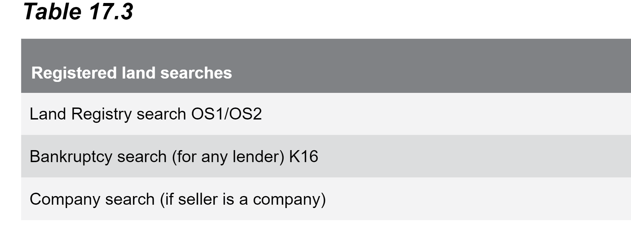
Preparing to complete on a PURCHASE
Traditionally about 10 days before completion date, PRE-COMPLETION searches:

Slide 6
HMLR Search
Enquires as to whether any new register entries since date when official copies issued
Search via post : Form OS1 for purchase of whole of land
      Form OS2 for purchase of part of land
Can also be made via DX or online via the portal
Result of search forwarded to B’s conveyancer in the form of an official search certificate
Official Search Certificate provides protection:
  Entries existing at time of search will bind Buyer but they will be entitled to compensation if not revealed
  Priority period of 30 working days after the search and B will not be bound by any entries made after the date of the search ( as long as application for registration made within 30 days)
Search will be made in the name of the Buyer if no mortgage but in name of Lender if there is a mortgage ( if the latter the search also protects the Buyer)

Slide 7
Bankruptcy Search
If Buyer needing a mortgage and conveyancer is acting for Lender also then B’s conveyancer carried out a bankruptcy search against the Buyer
Form K16
Search result given in form of certificate which has a ‘protection ends on’ date
Completion must take place before this date or a fresh K16 search will be required

Slide 8
Company Search
Applicable when the Seller is a company ( development company/ asset management company etc)
B’s Lender will require a company search to ensure company is still in existence, or in the process of being wound up due to insolvency procedures etc.
Search is done with Companies House and the Companies Register
This provides information only – it does not provide a certificate or priority period protection ( ie against something that happens after the search has been carried out)

Slide 9
The Completion statement
See example in your manual
Provides a financial statement of what will be required from B to complete

Slide 10
Steps for the Buyer’s conveyancer if there is a Lender
Check title is acceptable
Request mortgage funds
Complete documentation
Carry out pre-completion searches for Lender
Submit Certificate of Title to Lender (section 15.18 of text)
Ensure Mortgage Deed is signed by B if not already done
Ensure B signs the Land Transaction Return ( required to be sent to HMRC post completion)

Slide 11
Buyer’s conveyancer drafts the purchase deed –
( unless done at an earlier stage)
  Draft Purchase deed sent to S’s conveyancer in duplicate at same time as procedural requirements form ( TA13)
Transfer drafted in duplicate (TR1 when transferring the whole of land) and sent to Seller
Buyer’s conveyancer engrosses the transfer deed ( engross = produced as a final copy of good quality paper)
Buyer client may need to sign engrossed transfer deed if entering into covenants or if joint buyers. Eg indemnity covenant to indemnify sellers against future claims for breaches of existing covenants ( Box 11)
Joint buyers are entering into a declaration of their joint ownership within the transfer deed ( Box 10) confirming the status of their joint ownership as joint tenants or tenants in common
Declaration of trust can also be made by using form JO and if buyers have signed a JO they don’t need to execute the transfer for that reason.
However, it is good practice for all buyers to sign
Signatures to the deed must be witnessed.
Seller ALWAYS needs to execute the transfer and it will be sent to their conveyancer for the seller to sign before completion.

Slide 12
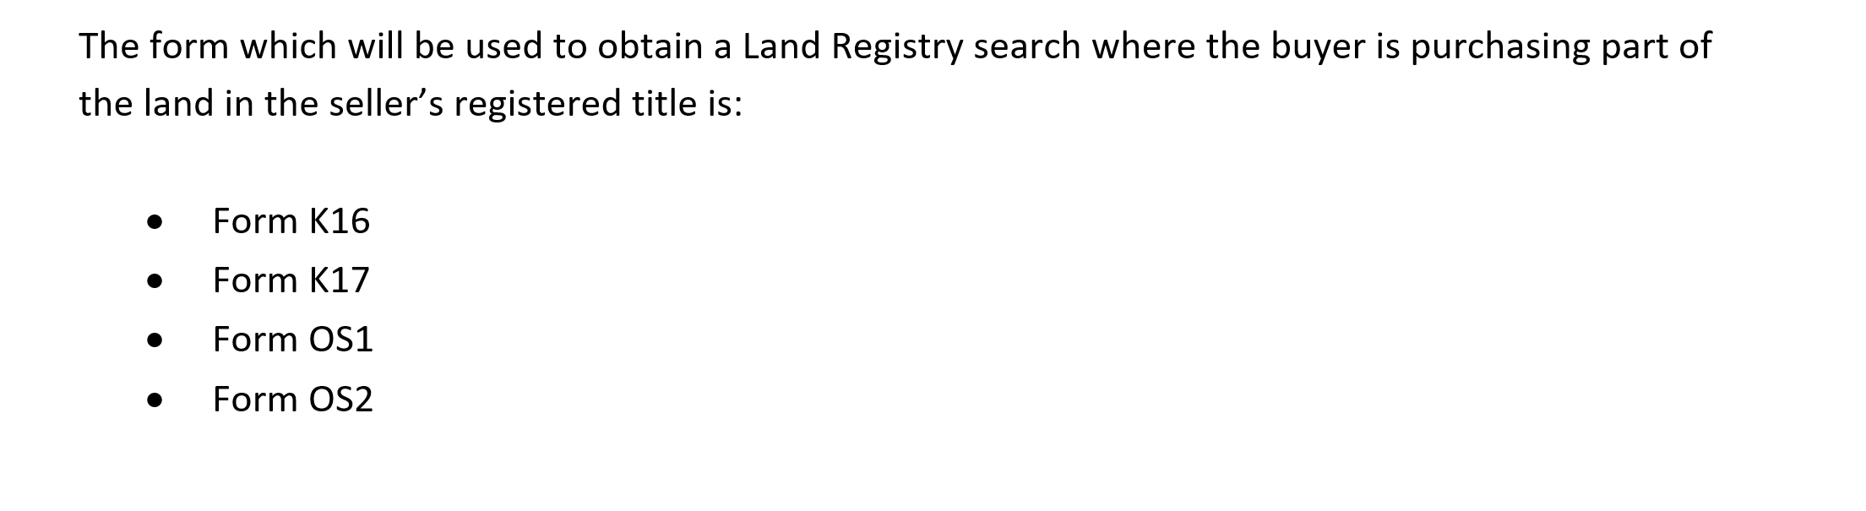
Sample question from Section A

Slide 13
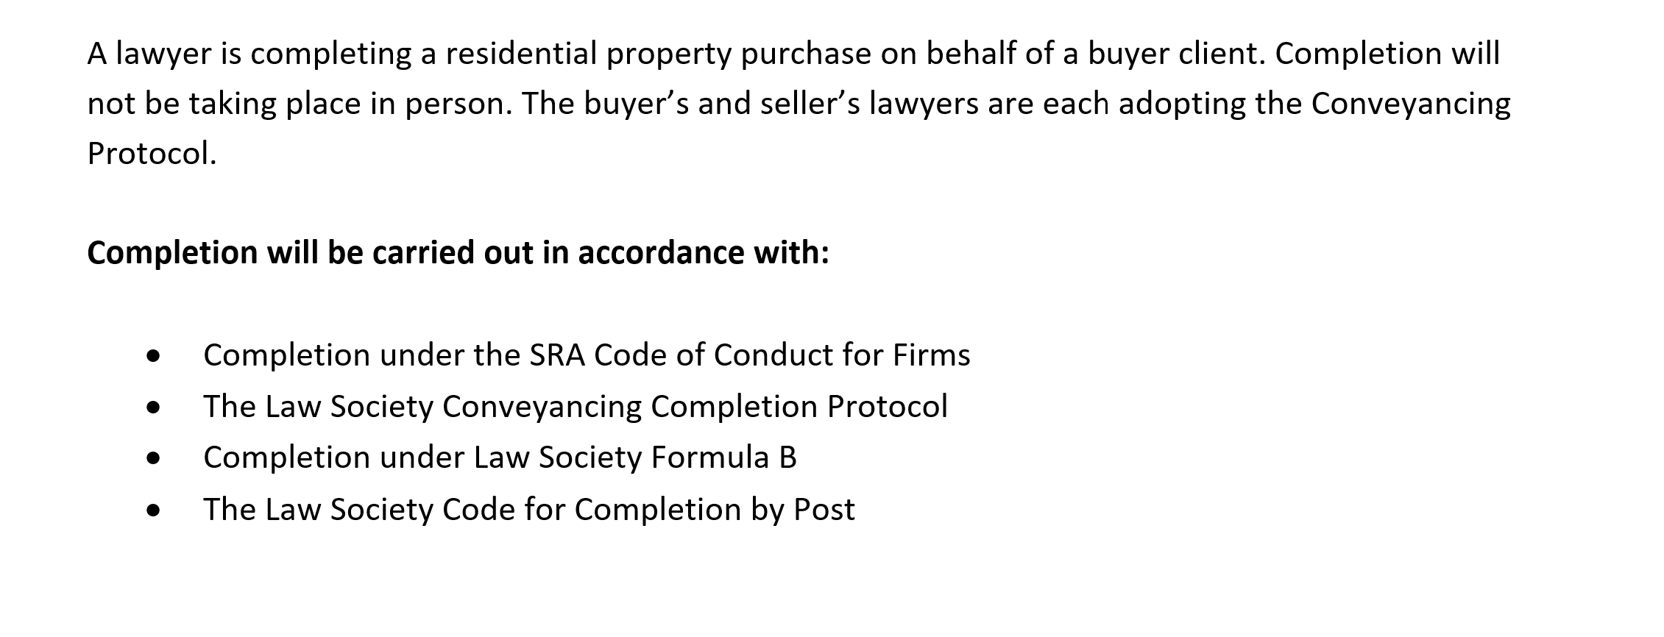
Sample question from section A

Slide 14
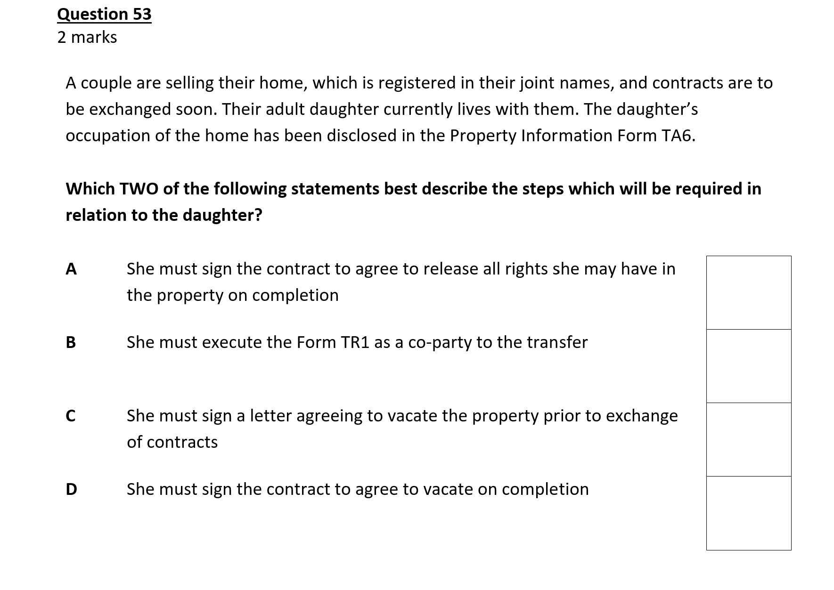

Slide 15
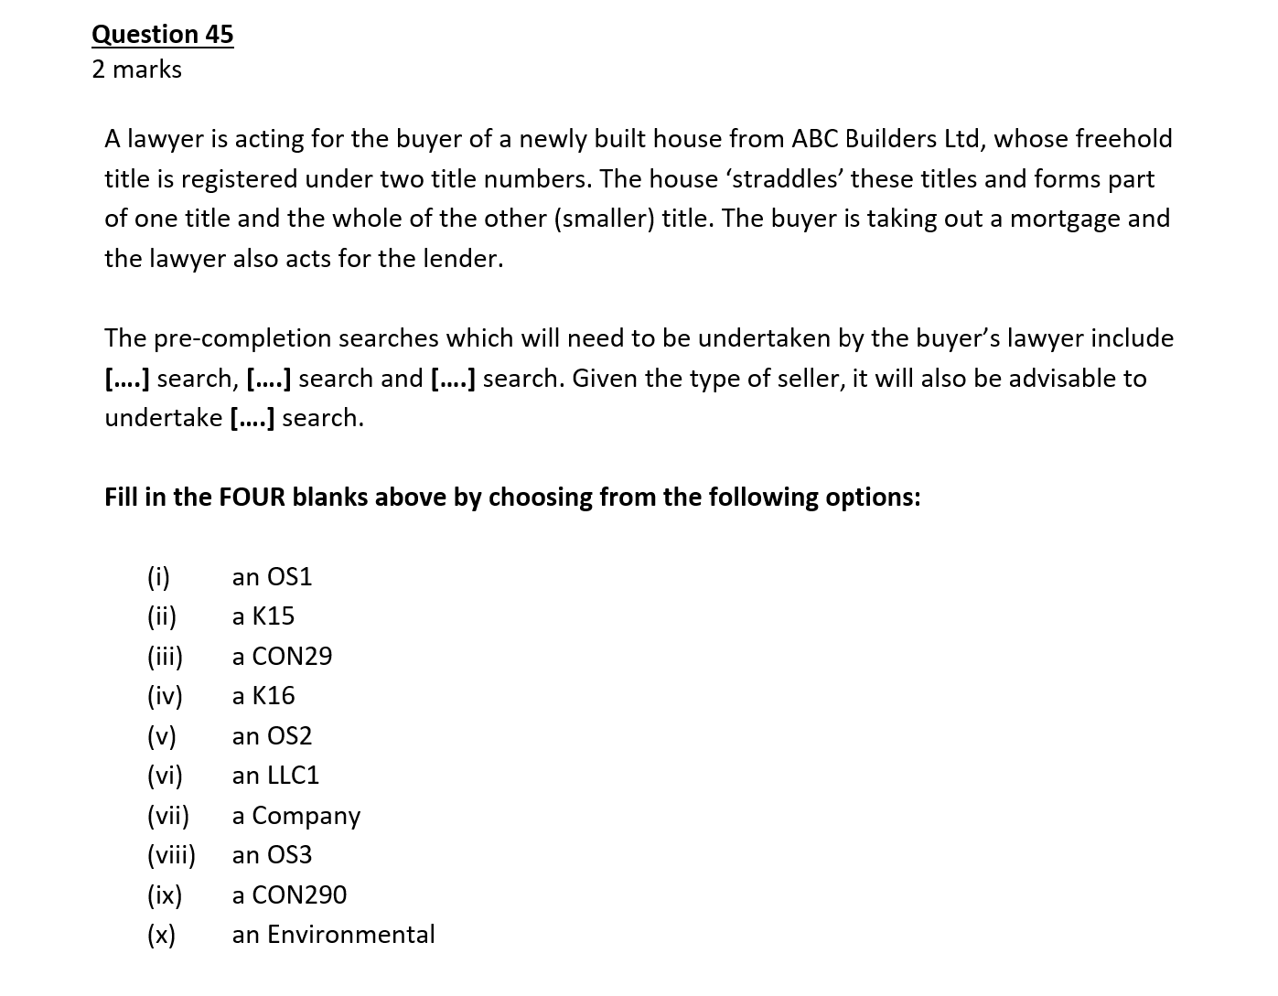

Slide 16


