Slide 1
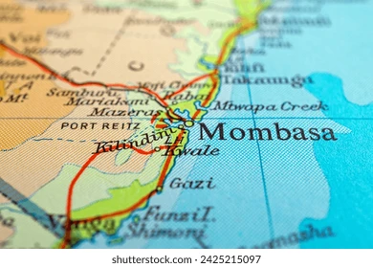
Coast General Hospital Oxygen Disruption (Mombasa, Kenya, 2025)
Student Name: Krina Bharatbhai Patel
Student Number: 2430442
Supervisor: Dr Fahad Khan
Programme: MSc / Level 7 Public Health And Social Care Practice
Module: Lchs7006 – Quality Assurance And Service Improvements (Component 1)

Slide 2
Background
Location: Coast general teaching and referral hospital, Mombasa -672-bed tertiary hospital. (Nation Africa, 2025)
Incident Date: 2 April 2025. (Nation Africa, 2025)
Event: Hospital causing the interruption of oxygen supply during a planned replacement of the main oxygen plant. (Citizen Digital, 2025)
Cause: Interim stoppage of oxygen supply without the turnover of the backup supply. (Citizen Digital, 2025)
Impact: 3 patients with oxygen deficiency (case of the elderly and ICU) were killed; a number of others were under threat. (Nation Africa, 2025)
Emergency Response: Delayed manual cylinder delivery; suspended maintenance. (Citizen Digital, 2025)
System Weaknesses: The absence of a tested backup system, vague maintenance planning, lack of good communication between the operators of the plant and the clinical staff.
Aftermath: Mombasa Governor commissioned an independent investigation; Commission on Administrative Justice (CAJ) gave a 7 day notice of accountability. (Citizen Digital, 2025; Kenya News Agency, 2025)
Notes:
In April 2025 in Mombasa, Coast General Teaching and Referral Hospital, there was a serious supply of oxygen interruption during a planned maintenance of the central oxygen plant. The incident took a duration of more than 30 minutes and resulted in the death of three patients two in ICU and one in the newborn unit who were also on oxygen support. The malfunction was detected with a faulty compressor and the absence of a system of automatic switchover to backup cylinders. The personnel was forced to swap the supplies manually, which would cost the lives of certain patients. The Commission on Administrative Justice (CAJ) and Mombasa County Government investigations showed a very poor maintenance regime, vague emergency response policies and lack of a recent check of the oxygen plant. This accident supported the idea of the direct influence of infrastructure deficit on patient safety.

Slide 3
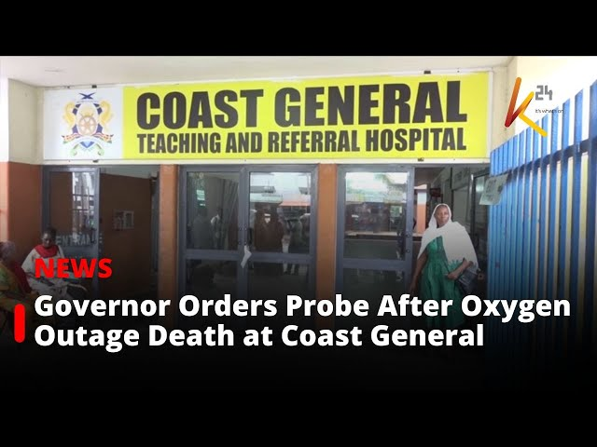
Summary of Case Study
Systemic Effects and Theory Critical Failures.
1. Maintenance Failure: Oxygen plant failed to turn on back up. (Citizen Digital, 2025)
2. Infrastructure Gap: No automatic switch over to oxygen supply. (CAJ, 2025).
3. Human Factor: The lack of coordination between clinical staff and engineers. (Citizen Digital, 2025)
4. Policy Deficit: No protocol of high-risk technical maintenance approved. (CAJ, 2025).
5. Delay in Communication: Delays by Wards; no alerts in the real-time system. (Citizen Digital, 2025)
6. Impact on Patient Safety: 3 avoidable deaths of ICU patients. (Nation Africa, 2025)
7. Governance Response: CAJ inquiry and Governor taskforce established. (Citizen Digital, 2025; Kenya News Agency, 2025)
8. Operational Disruption: Alteration of elective procedures and overload of ICU. (CAJ, 2025).
9. Systemic Learning: Understanding the importance of risk assessment prior to the maintenance of plants. . (Citizen Digital, 2025)
Notes:
This slide is a summary of the series of failures that contributed to the tragedy. The cause was a maintenance-based interference of the central oxygen supply - the equipment failure, which was aggravated by the absence of system redundancy and low-quality preventive maintenance. The staff was not trained on how to deal with an oxygen supply emergency and there was no effective channel of communication that could be used to alert clinical units real-time. This led to interruption of patient care and three deaths were registered. The CAJ inquiry discovered later that the hospital had no maintenance records on file and had missed its two most recent technical inspections. In its turn, the county government ordered all the public hospitals to survey and certify their oxygen systems within 60 days.

Slide 4
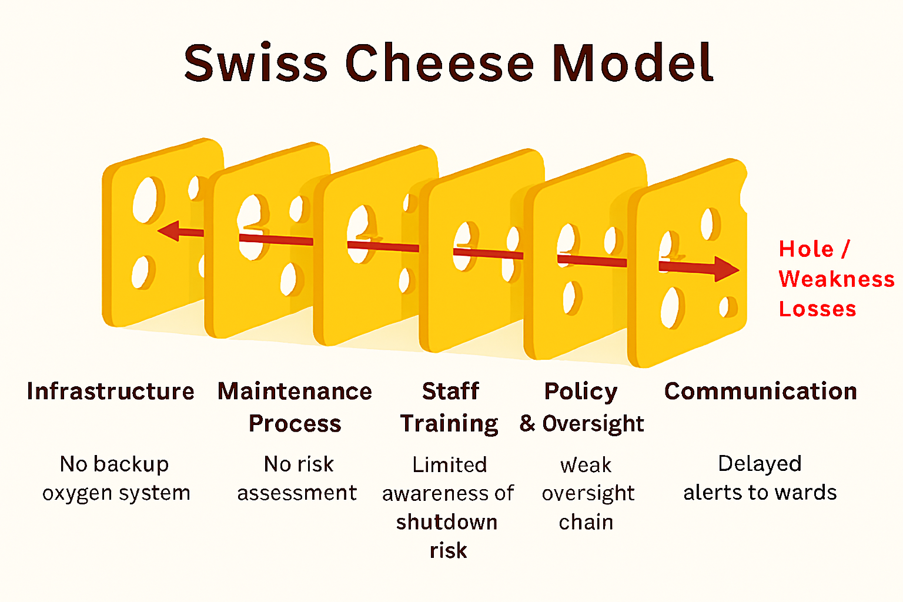
Swiss Cheese Model – Layers and Holes Leading to Disaster
System Layer | Hole / Weakness | Description
Infrastructure | No backup oxygen system | Maintenance halted primary supply; backup unavailable (Nation Africa, 2025).
Maintenance Process | No risk assessment | Maintenance conducted while ICU was occupied (Citizen Digital, 2025).
Staff Training | Limited awareness of shutdown risk | Clinical teams not informed of planned system downtime. (CAJ, 2025).
Communication | Delayed alerts to wards | No automated or real-time warning from plant operators. Citizen Digital, 2025).
Leadership & Governance | Weak oversight chain | No duty officer authorised maintenance approval or risk sign-off. (CAJ, 2025).
Policy & Regulation | Infrequent safety audits | No recent audit of oxygen infrastructure (CAJ, 2025).
Notes:
Applying the Swiss Cheese model by Reason, we can understand that a number of small weaknesses in the system came together to produce a lethal result. To start with, the infrastructure layer was breached - the oxygen plant had old valves and did not include an automatic backup. Second, training of the staff was not properly divided; technicians and clinicians did not know how to tend to emergency supply manually. Third, there was poor leadership and governance. The top management could not be contacted instantly and formal incident command structure was not in place during the crisis. Lastly, external safety verification had not been done as oversight and policy audits had been omitted. These vulnerabilities in several layers of protection were coordinated in the most optimal manner so that the failure turned into a crisis of life in addition to being a maintenance problem.

Slide 5
Benchmark / Policy Context
System Weaknesses Compared to Standards
Indicator | Standard Requirement | Hospital Performance (Pre-Incident) | Policy Notes
Backup System | Continuous oxygen supply with dual source(WHO Hospital Safety Index, 2023) | No automatic switch-over in place | WHO Hospital Safety Index (2023)
Maintenance Policy | Risk-assessed and scheduled downtime(WHO Hospital Safety Index, 2023) | Maintenance performed during peak hours | No local enforcement guideline. (CAJ, 2025)
Communication Protocol | Central alert to all clinical areas(WHO 2023) | Manual notification only | Absence of digital alert integration(Nation Africa, 2025)
Audit & QA | Annual technical audit required(CAJ, 2025). | None since 2022 | CAJ report (2025). (CAJ, 2025)
Emergency Preparedness | Simulation drills every 12 months(Kenya Health Safety Unit, 2023) | None recorded since 2021 | County Health Safety Unit (2025)
KPI Example (Oxygen System Uptime) | Target ≥99% continuity(WHO 2023) | 92% pre-incident (estimated from logs) | Post-incident target: 100% reliability. (CAJ, 2025)
Notes:
Prior to the incident, the performance of Coast General in safety and maintenance was far below the national and international levels. WHO Hospital Safety Index would indicate that oxygen system must include two supply lines, automatic switching as well as real time monitoring of oxygen systems should have alarms as this Coast General did not have. Preventive maintenance records were old fashioned, and the system audit last check was done more than two years ago. Employees had never been drilled on the emergency workings of oxygen systems, although such exercises are a fundamental course of safety in the requirements of health facilities in Kenya. Such failures prove the inequalities of adherence to infrastructure and safety standards create a vulnerability to disastrous failures in hospitals.

Slide 6
Summary of Component Two
Fishbone Analysis:
Root cause in five areas, including People (loopholes in training), Methods (poor planning in maintenance), (Citizen Digital, 2025).
Machines (old oxygen plant), Management (lack of oversight), Environment (poor communication) (Citizen Digital, 2025).
This model suggests that healthcare organizations should be structured to enhance the quality of care provided to patients.
Donabedian Model (Structure - Process -Outcome):
Structure: Old oxygen production system; no automated backup (Citizen Digital, 2025).
Process: Repair done without any formal risk evaluation or communication standards (Citizen Digital, 2025).
Outcome: Three avoidable deaths; instigated systemic safety reform(Nation Africa, 2025; CAJ 2025).
Model Excluded - 5 Whys: Rejected because it is too simple; not applicable to complex multi-factor hospital failures.
Notes:
Using the Fishbone and Donabedian models, one can show that there are evident connections between infrastructure, procedural, and managerial failures. This integrated solution assists in enhancing quality assurance

Slide 7
References
Nation Africa. (2025, April 3) Three die after oxygen supply cut at Coast General Hospital [online]. Available at: https://nation.africa/kenya/counties/mombasa/three-die-after-oxygen-supply-cut-at-coast-general-hospital-4989690 (Accessed: 19 October 2025). Nation Africa
Kenyanews (2025, April 4) Governor Nassir orders a probe after patients’ death [online]. Kenya News Agency. Available at: https://www.kenyanews.go.ke/governor-nassir-orders-a-probe-after-patients-death/ (Accessed: 19 October 2025). Kenya News
Citizen Digital. (2025, April 10) Ombudsman gives Coast General Hospital seven days to explain deadly oxygen supply cut [online]. Available at: https://www.citizen.digital/article/ombudsman-gives-coast-general-hospital-seven-days-to-explain-deadly-oxygen-supply-cut-n360779 (Accessed: 19 October 2025). Citizen Digital
Eastleigh Voice. (2025, April 10) Mutabasi, R. ‘Commission demands answers as three die due to alleged oxygen disruption at Coast General Hospital’ [online]. Available at: https://eastleighvoice.co.ke/coast/136745/commission-demands-answers-as-three-die-due-to-alleged-oxygen-disruption-at-coast-general-hospital (Accessed: 19 October 2025). The Eastleigh Voice News
Kenyans.co.ke. (2025, April 6) ‘Mombasa Governor Waives Medical Bills of 100 Patients Two Days After Three Patients Die in Hospital’ [online]. Available at: https://www.kenyans.co.ke/news/110725-mombasa-governor-waives-medical-bills-100-patients-two-days-after-three-patients-die?page=344 (Accessed: 19 October 2025). Kenyans

Slide 8
Unitaid. (2025, October 2) ‘Building oxygen access from the ground up: an update on the East African Program on Oxygen Access’ [online]. Available at: https://unitaid.org/news-blog/building-oxygen-access-from-the-ground-up-an-update-on-the-east-african-program-on-oxygen-access/ (Accessed: 19 October 2025). Unitaid
Stop Pneumonia. (2025, May 25) Kenya Medical Oxygen Roadmap 2025-2030 [online PDF]. Available at: https://stoppneumonia.org/wp-content/uploads/2025/05/Kenya-Medical-Oxygen-Roadmap-FApproved-Copy.pdf (Accessed: 19 October 2025). stoppneumonia.org
Donabedian, A. (1988) ‘The quality of care: How can it be assessed?’, Journal of the American Medical Association (JAMA), 260(12), pp. 1743-1748.
Reason, J. (2000) ‘Human error: Models and management’, BMJ, 320(7237), pp. 768-770.
Ishikawa, K. (1982) Guide to Quality Control, Asian Productivity Organization, Tokyo.
World Health Organization. (2023) Hospital Safety Index: Technical manual, 2nd edn, WHO Press, Geneva.
Ministry of Health Kenya. (2024) National Health Infrastructure Maintenance and Safety Guidelines, Government Printer, Nairobi.

