Slide 1

INTRODUCTION
PREPARATION, IMPLEMENTATION, PILOTING, LIVE, RESPONSE

Slide 2
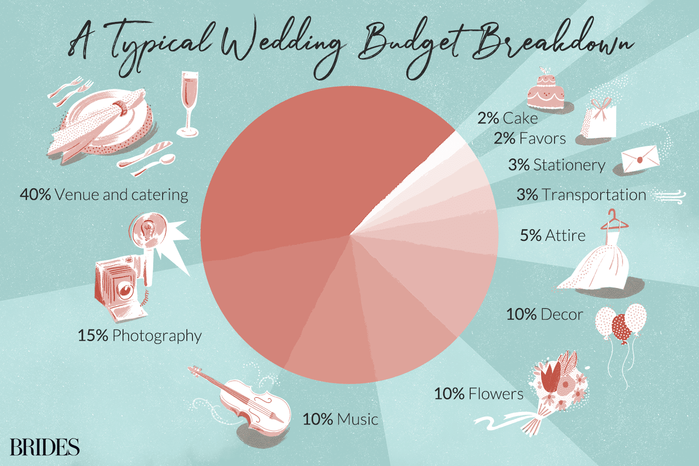
BUDGETING

Slide 3

MEHNDI

Slide 4
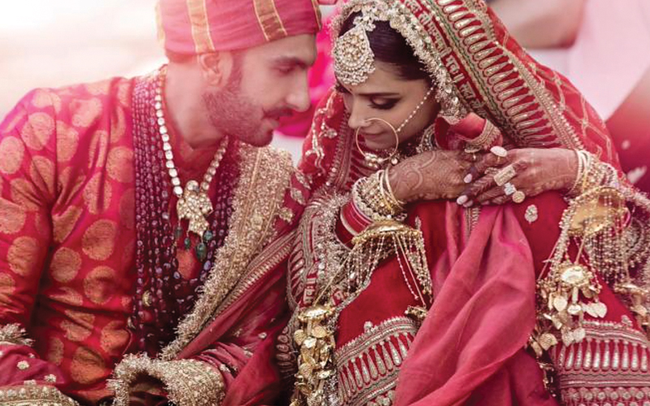
WEDDING

Slide 5
THANK YOU!
I hope you enjoyed my work and presentation, thank you for a great term and all the lectures!

