Slide 1
Health, Wellbeing and Lifestyle
Student Name : Ingke Terry
Student number: 2515265
Word count: 2207

Slide 2
AI Statement
I confirm that I have not used any AI tools in the research and creation of this assignment. I confirm that I have not presented any AI generated materials as my own work. I confirm I have copies of my drafts, notes and other resources I used, which I may be asked to provide in evidence.

Slide 3
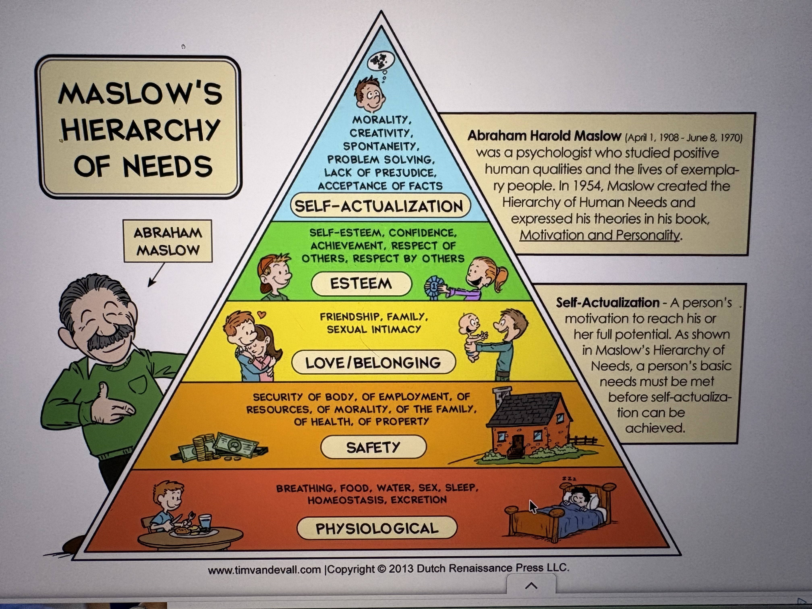
Intoduction
This Poster shows what health, wellbeing and lifestyle are and how they are interconnected with each other. It will also show why all three are important. Dahlgren and Whiteheads model of Health (1991) shows how health, wellbeing and lifestyle are interconnected by outside factors such as age, sex, constitutional, individually chosen lifestyles, social and community networks, living and working conditions, general socio-economic, cultural and environmental conditions. Maslows Hierachy (1943) also shows the connections between health, wellbeing and lifestyle and how they all have an effect on a persons life and where they are at.
Health
What is Health? There are several different ways to describe Health. Randa T. (2023) describes the medical model of health as just the physical body and how illness and disease just need to be treated and the physical body would be healthy. So basically, the absence of physical illness and disease. Yet the World Health Organisation (1948) states that the definition of health is “A state of complete physical, mental and social wellbeing and not merely the absence of disease or infirmity”. This statement has a more holistic approach which goes beyond traditional medicine, by recognising that a healthy state requires physiological, psychological and social resources. The statement of the WHO is consistent with the biopsychological model, which is a holistic framework that states that health and illness are determined by the complex interaction of biological, psychological, and social factors according to Engel, G. (1977) This then argues that just treating the physical body is insufficient. A person can have a healthy body, yet research shows that physical health and mental health are interlinked. Baron, M. (2025) explains that physical exercise release endorphins which boost mood and reduce stress. Baron, M. (2025) also says that Nutrition fuels the brain, diets high in processed foods can increase anxiety and depression, while balanced diets support mental clarity. In the same article it states that sleep plays a crucial role in emotional regulation. Without it stress and irritability increase. This then shows that mental health influences physical health. The Mayo Clinic (2023) explains how the bodies reaction to stress releases adrenaline and cortisol, which changes the immune system response and if the body is constantly reacting to stress this can cause: Anxiety, depression, digestive problems, headaches, muscle tension and pain, heart disease, heart attack, high blood pressure, stroke, sleep problems, weight gain, memory and focus problems.
Looking at these statements, it then makes sense to prevent as many stresses as possible, by working together with parents and practitioners to give children the best start in life. It is a Childs right, according to the UNCRC (Article 27), to a standard of living that is good enough to meet their physical and social needs and support their development. Poverty is a real issue in many countries; this includes the UK. The Child Poverty Action Group (2025) states that 4.5 million children lived in poverty in 2024. That means 33% of all children in the UK. Poverty influences what kind of food children are given, what sort of experiences they have and so much more. This effects childrens developments at all ages and stages. Nutritious meals, according to Rayner, M. (2014), should have;
33% of Fruit and Vegetables
33% of bread, rice, pasta or potato
12% of meat, fish, eggs, beans or other sources of protein
15% of milk and dairy
8% of food or drinks high in sugar
The problem with this standard can be that families do not know how to budget their finances and therefor nutrition is not their top priority but filling their children’s bellies as best as they can. Schools and nurseries often include nutritious meals in their budgets so children of families in poverty get at least those meals even if other foods are given at home. Most schools at this day and age provide breakfast clubs and free school meals up to a certain age.

Slide 4
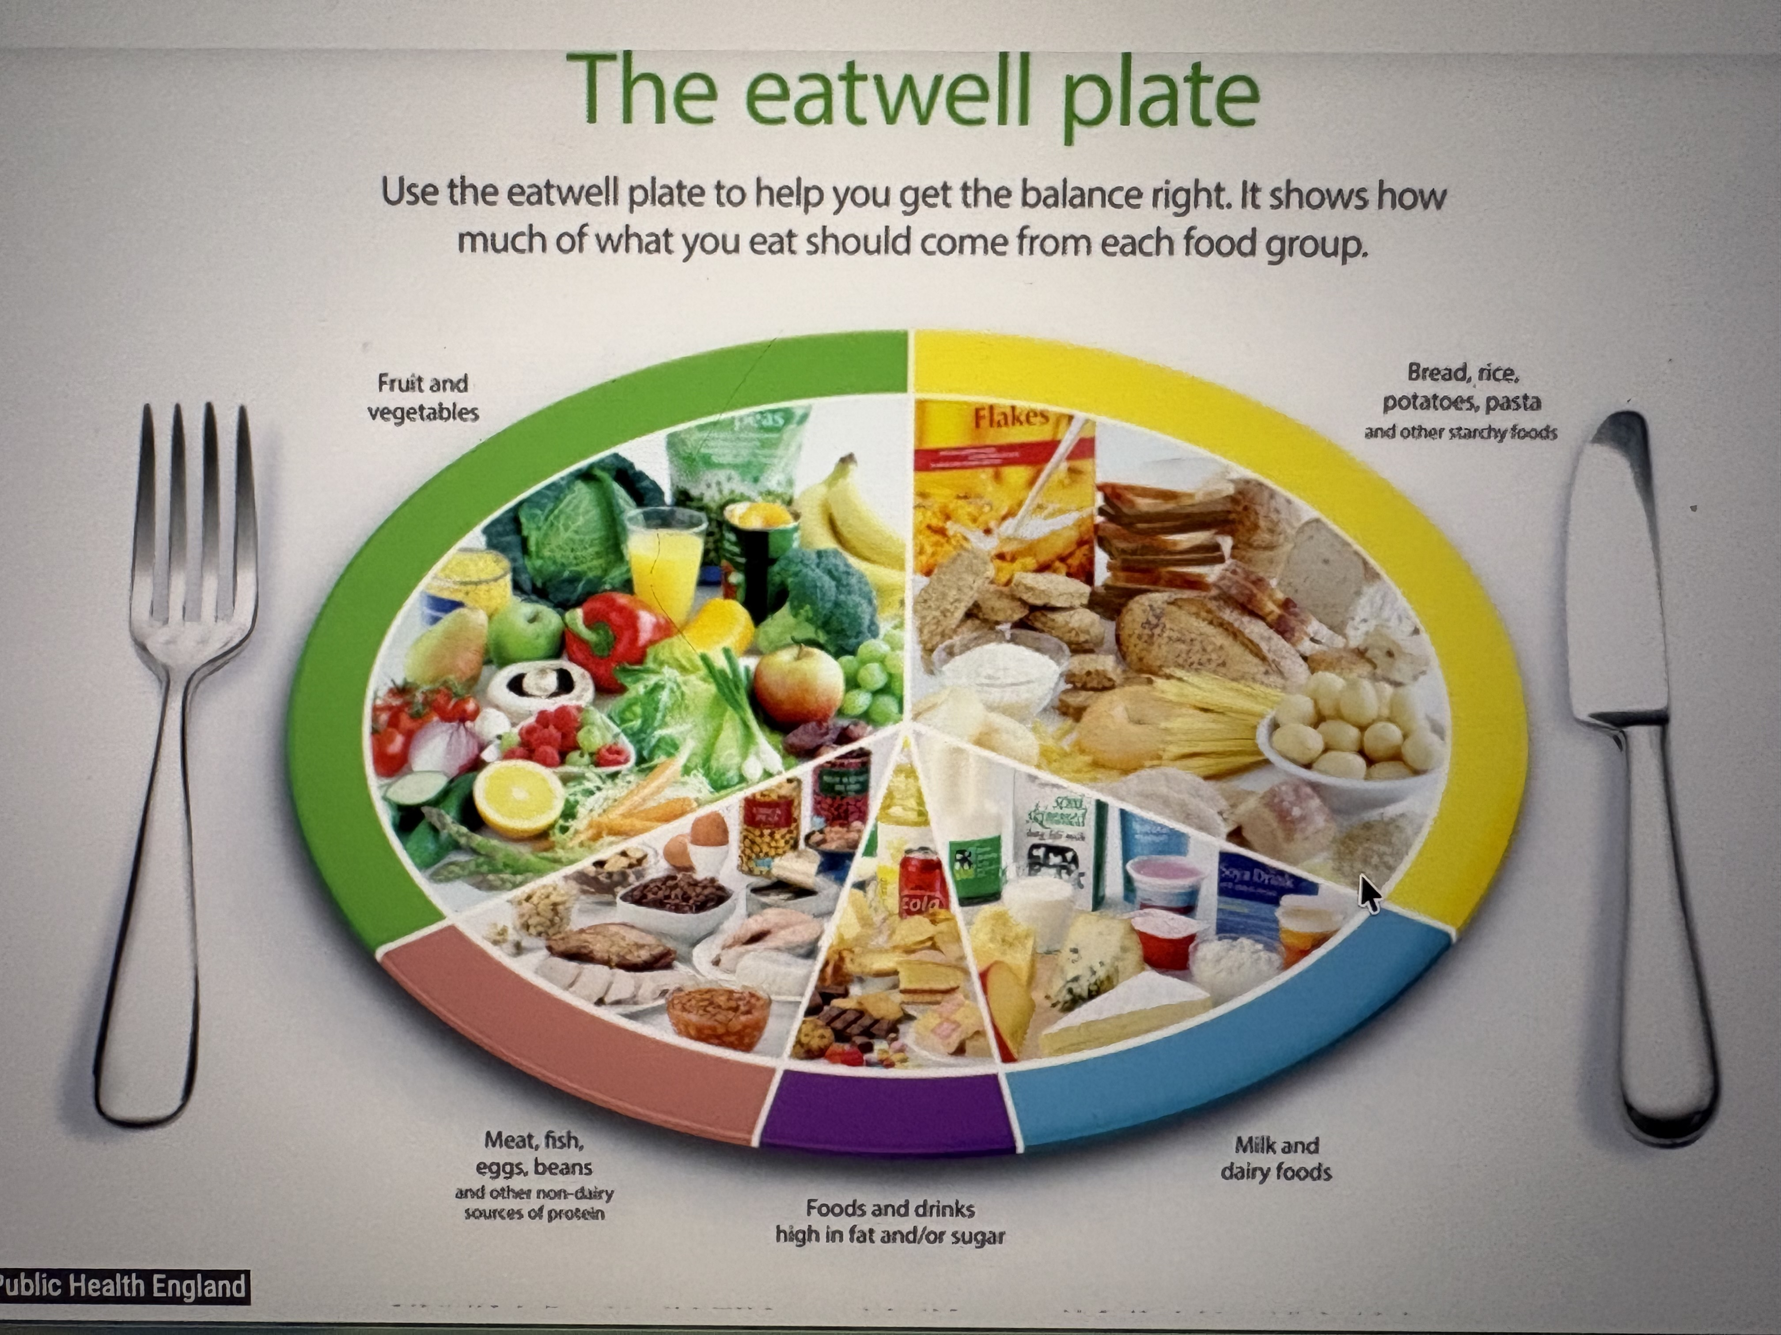
Well-being
True Wellbeing act as a daily resource to empower individuals and societies to thrive, be resilient and navigate life’s challenges, describes the World Health Organisation (2021). The Cambridge Dictionary (2023) defines it as “the state of feeling healthy and happy”. The University of Colorado says there are 8 dimensions of wellbeing. Emotional wellness which is related to the persons feelings and emotions. Physical wellness which is related to the persons physical health and body. Educational and occupational wellness which is related to the persons academics, jobs and career. Social wellness which is related to the persons relationships and community. Spiritual wellness which is related to the persons sense of purpose, meaning and spirituality. Intellectual wellness which is related to the person’s mind. Environmental wellness which is related to the natural world, built environment and natural resources around a person. And also, financial wellness which is related to a person’s finances.
All these areas of wellbeing interact with each other just like Bronfenbrenner states in his ecological model. Financial wellbeing means a person eats well, has stable, housing, can afford resources to keep fit, can pay for health insurance, schooling, out of school activities, has a job and is part of a working community, which leads to relationships, possible career change and maybe even a promotion. Having a stable environment creates a stable and healthy mind. For children this stability is even more important. Changes such as the change of a school or moving house can create instabilities and this in turn create stress in a child. Stress means children will not be able to learn according to Dr. Capanna-Hodge, R. (2025). Children’s executive Functions do not fully develop until 28 years of age.
Guetzkow, M. et al (2025) talks about health inequalities due to the difference between socio economic groups, depending on area and county, ability and health. The Marmot review (2020) sets out certain areas that need attention in the UK. the likes of giving every child the best start in life, enabling all children, young people and adults to maximise their capabilities and have control over their lives, create fair employment and good work for all, ensure a healthy standard of living for all, create and develop healthy and sustainable places and communities and strengthen the role and impact of ill health prevention. Quoting city council on this review “A Marmot approach demands that we resource and deliver services at a scale and intensity proportionate to the degree of need; just focusing on one group of disadvantaged individuals or one geographical area will not deliver change!”
Childcare providers follow policies of inclusion and equality to promote children’s mental wellbeing. They celebrate different cultures at different times of year to help children understand that it is ok to be different, that they are accepted and find their belonging to a group. Children learn that they all have a place in this world and have the same rights no matter what background skin colour, religion, family compilation or country they are from. The UNCRC states in Article 13 that every child has the right to express their thoughts and opinions and to access all kinds of information as long as it is within the law. Article 14 states that every child has the right to think and believe as they choose and to practice their religion as long as they are not stopping other people from enjoying their rights. Article 15 says that every child has the right to meet with other children and join groups and organisations. Article 30 states that children have the right to learn and use the language, customs and religions of their family, whether or not these are shared by the majority of the country they live. Children learn from a very young age what acceptance is through attachment. Keller, H. (2016) talks about Bowlby’s attachment theory and states that early emotional bond with primary caregivers are evolutionary necessities, as their consistent, sensitive care provides a secure base from which children explore from.

Slide 5


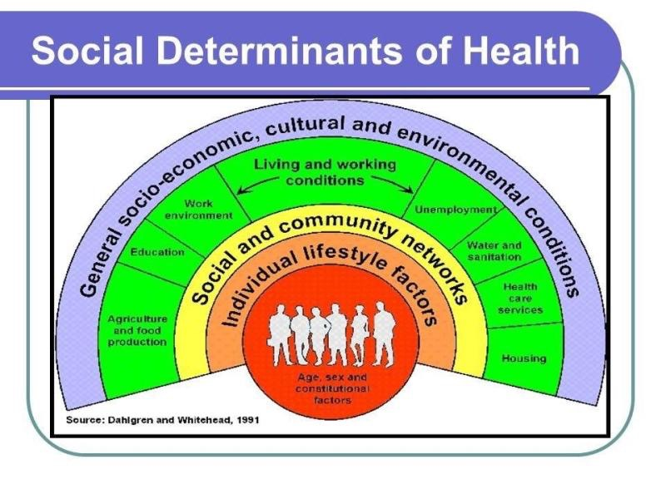

Lifestyle
The Oxford Dictionary (2023) says the meaning of lifestyle is a style or way of living (associated with an individual person or society etc) especially the characteristic manner in which a person lives (or chooses to live) his or her life. The theories of Weber and Bourdieu viewed lifestyle as an expression of social class, Brivio, J. et al (2023) says. And Mantarazzo coined the concept of pathogenic behaviours to encapsulate the notion of risky lifestyles (Brivio, J. et all 2023). George Louis de Buffon (1707-1788) said “the style is the man himself”. David Chaney (2012) states “In the modern world our lifestyle helps to define our attitudes and values as well as show our wealth and social position”. It is however the parents who have those attitudes, values and social positions, whether they are good or bad. And children do not have much choice but to be in this lifestyle together with the parents. These Lifestyles can vary from drugs and alcohol misuse and therefore not a good lifestyle to really good living conditions and plenty of health and wellbeing. There are also different cultural backgrounds and differences on how the family lives and who is in it. Family structures vary from culture to culture. The Nuclear Family is just both parents and the children which is very common in the USA and most European cultures. The joint or extended family which includes multiple generations living under the same roof and is common in Asian, African and middle eastern cultures. Single parent and stepfamilies (blended families) which either consist of one parent and the children or two parents who bring children from past relationships together. This type of family is becoming more common in the USA and European cultures. Matrifocal families where the mother serves as the household head and is more common in certain African and Caribbean communities. And patrilocal families, where a married couple resides with the husband’s family which are standard in many south Asian and middle eastern societies. Lifestyles can depend on abilities. People with physical disabilities or illnesses may not be able to take part in the way or to the same extent in community groups as access is complicated or non-existent. More about this in the Video. Access may not be as easy due to lack of transport or where people live. Lifestyles vary tremendously around the World. Sanitation and running hot and cold water are normal in the richer countries, but this is sadly not the case in the third world countries. This makes hygiene and cleanliness a lot harder. A lot of families in the third world countries still do not have running water today and are very fortunate if there is a clean water source in their village otherwise it’s a daily walk to the closest water source , which may not be clean but full of parasites and bacteria that cause children as well as parents to become ill. Different countries have different laws around society. Marriages in the UK are by choice, yet in turkey they may be arranged by the parents and in certain Asian countries you cannot marry into a different tier then the one your family is in. It is against the law. All these differences can bring challenges for children and families as they may not be aware of these laws. Some normal cultural things in one country may be illegal and classed as child abuse in the Uk. Some of these are Femal genital mutilation, hitting children, child labour, child marriages and even ear piercing without the childs consent. In the UK we have laws to help with safeguarding children and practitioners are constantly updated with these laws. Some of them are the childrens Act, Childrens Comissioner for wales act 2001, Safeguarding vulnerable Group Act 2006, Wales Safeguarding Procedures 2019, IICSA 2018, Section 74 of the serious crime act 2015 (FGM reporting) and a few more.
Conclusion
Looking at health, wellbeing and lifestyles and how they are all connected with each other in so many ways show that just covering one is not enough. Children deserve and have the right to be heard according to the UNCRC. This includes their home life and how they feel about their home life. They should also be heard in the settings and need to be shown that they are part of this world, and they can make good choices for themselves. To have better outcomes for children and give them the tools to become people in a working, kind and understanding society that accepts everyone and is willing to work together to make this a better world for future generations. Maybe the Diederichsen Frame work and the 4 Core Pathways of health in connection with the Policy entry points can make a difference to those who struggle in either of those 3 areas.

Slide 6
Reference list
Brivio, F., Viganò, A., Paterna, A., Palena, N. and Greco, A. (2023). Narrative Review and Analysis of the Use of ‘Lifestyle’ in Health Psychology. International Journal of Environmental Research and Public Health, [online] 20(5), p.4427. doi:https://doi.org/10.3390/ijerph20054427.
Cambridge Dictionary (2023). well-being. [online] @CambridgeWords. Available at: https://dictionary.cambridge.org/dictionary/english/well-being#google_vignette.
Chaney, D. (2012). Lifestyles. Routledge.
CPAG (2025). Child poverty statistics – new record high and further breakdowns. [online] Cpag.org.uk. Available at: https://cpag.org.uk/news/child-poverty-statistics-new-record-high-and-further-breakdowns.
Dr. Roseann Capanna-Hodge (2025). The Real Reason Your Child Is Struggling in School (and How to Fix It at Every Age). [online] YouTube. Available at: https://www.youtube.com/watch?v=-43xkGNS1rU [Accessed 27 Jun. 2026].
EVS.Institude (2024). Family Structures and Their Roles Across Different Cultures • Environmental Studies (EVS) Institute. [online] Environmental Studies (EVS) Institute. Available at: https://evs.institute/environment-and-society/family-structures-roles-different-cultures/#google_vignette.
Freud, A. (2023). 5 Steps to Mental Health and Wellbeing. [online] www.annafreud.org. Available at: https://www.annafreud.org/resources/schools-and-colleges/5-steps/.
Gibson, K. (2018). ‪Every nurse, midwife, practitioner & carer needs to get serious about prevention, protection & promotion of health & wellbeing. [online] LinkedIn. Available at: https://www.linkedin.com/posts/kenny-gibson-mbe-rn-qicn-19190893_every-nurse-midwife-practitioner-carer-activity-6383577164738105344-WCut [Accessed 6 Jun. 2026]. Photo taken from this page.
Gueltzow, M., Bijlsma, M.J. and van Lenthe, F.J. (2025). Beyond associations: From theory to interventions in health inequalities research using causal inference. Annals of Epidemiology, [online] 112, pp.1–7. doi:https://doi.org/10.1016/j.annepidem.2025.10.001. priority_highIssue numberclose
Hayes, N., O’toole, L. and Halpenny, A.M. (2017). Introducing Bronfenbrenner A Guide for Practitioners and Students in Early Years Education. London Routledge Ann Arbor, Michigan Proquest.
Keller, H. (2016). Attachment. A pancultural need but a cultural construct. Current Opinion in Psychology, 8(8), pp.59–63. doi:https://doi.org/10.1016/j.copsyc.2015.10.002.
Marmot, M., Allen, J., Boyce, T., Goldblatt, P. and Morrison, J. (2020). Health Equity in England: the Marmot Review 10 Years on. [online] The Health Foundation. Available at: https://www.health.org.uk/reports-and-analysis/reports/health-equity-in-england-the-marmot-review-10-years-on-0.
Mayo Clinic Staff (2023). Chronic stress puts your health at risk. [online] Mayo Clinic. Available at: https://www.mayoclinic.org/healthy-lifestyle/stress-management/in-depth/stress/art-20046037.
McCann ad agency network (2020). Abraham Maslow - Hierarchy of Needs | Media Studies Guide. [online] Media Studies. Available at: https://media-studies.com/maslow/.
z

Slide 7
NSPCC (2024). History of Child Protection in the UK. [online] NSPCC Learning. Available at: https://learning.nspcc.org.uk/child-protection-system/history-of-child-protection-in-the-uk.
Oxford Dictionary (2023). lifestyle, n. meanings, Etymology and More | Oxford English Dictionary. Oed.com. [online] doi:https://doi.org/10.1093//OED//2949463690.priority_highVolume numberclosepriority_highIssue numberclose
Public Health England (2017). Social Determinants of Health. [online] gov.uk. Available at: https://www.gov.uk/government/publications/health-profile-for-england/chapter-6-social-determinants-of-health.
Randa PHD, T. (2023). Medical model | EBSCO. [online] EBSCO Information Services, Inc. | www.ebsco.com. Available at: https://www.ebsco.com/research-starters/health-and-medicine/medical-model.
Rayner, M. (2014). Official healthy food guide hasn’t changed in 20 years: five things…. [online] Oxford Martin School. Available at: https://www.oxfordmartin.ox.ac.uk/blog/official-healthy-food-guide-hasnt-changed-in-20-years-five-things-that-need-updating.
Research gate (2016). Figure 1 Dahlgren and Whitehead (1991) model of the determinants of health. [online] ResearchGate. Available at: https://www.researchgate.net/figure/Dahlgren-and-Whitehead-1991-model-of-the-determinants-of-health_fig1_303321662.
Roberts, A. (2023). The Biopsychosocial model: Its Use and Abuse. Medicine, Health Care, and Philosophy, 26(3), pp.1–18. doi:https://doi.org/10.1007/s11019-023-10150-2.
University of Colorado (2024). 8 Dimensions of Wellness. [online] Health & Wellness Services. Available at: https://www.colorado.edu/health/programs/health-wellness-summit/8-dimensions-wellness.
Welsh Government (2026). Child Poverty Strategy for Wales: progress report 2025 [HTML] | GOV.WALES. [online] GOV.WALES. Available at: https://www.gov.wales/child-poverty-strategy-wales-progress-report-2025-html#188864 [Accessed 6 Jun. 2026].
World Health Organization (1948). Constitution of the World Health Organization. [online] World Health Organization. Available at: https://www.who.int/about/governance/constitution.
World Health Organization (2021). Promoting well-being. [online] World Health Organization. Available at: https://www.who.int/activities/promoting-well-being.
z

