Slide 1

Media and its effect on the public’s perception of the Police

Slide 2
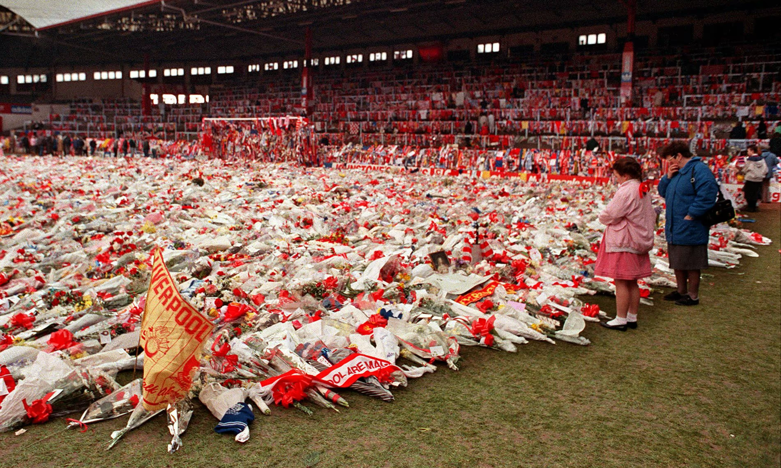
Hillsborough disaster
15th April 1989 at the Hillsborough Stadium.
Liverpool V Sheffield United at 3pm.
Not long after kick off the game was stopped.
Liverpool fans in the standing section were forced to pull themselves over the surrounding fences due to a crush of fans.
97 people, including a women and a child perished.
House of Commons, 2012
The Guardian, 2021

Slide 3
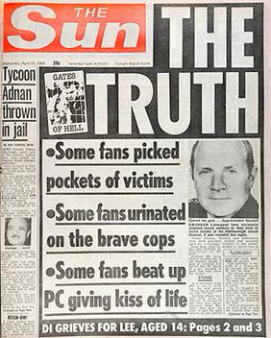
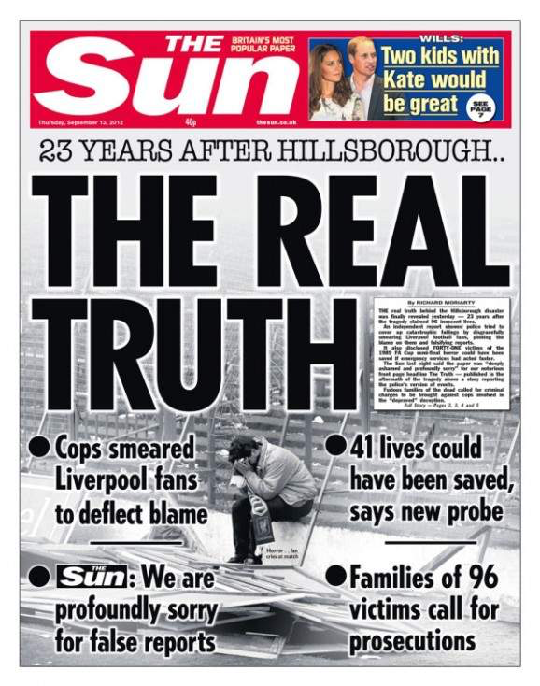
The media
The Sun, 1989
The Sun, 2012

Slide 4
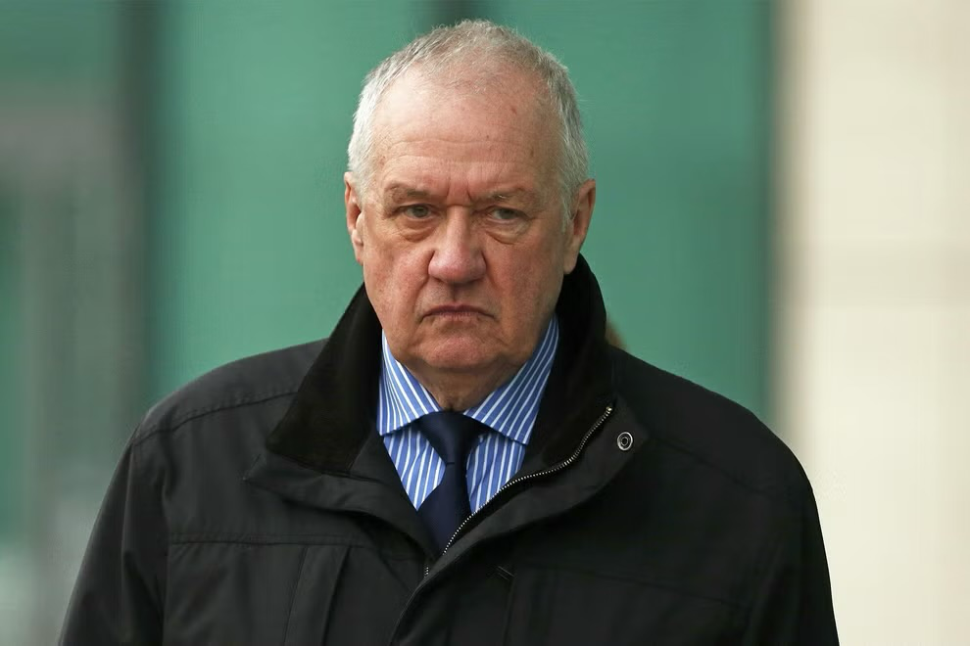
The Police
“Hillsborough trial: Police Chief ‘lied about fans forcing Hillsborough gate’” BBC, 2019.
David Duckenfield was found not guilty of gross negligence regarding the incident after a retrial. CPS, 2019.
National Police Chiefs Council, 2023 stated “I am deeply sorry for the tragic loss of life, and for the pain and suffering that the families of the 97 victims experienced on that day and in the many years that have followed.”
Independent, 2017

Slide 5
London Bridge Attack 2017
3rd June 2017, on London Bridge 8 people were killed due to 3 rogue individuals drove a van into civillians and proceeded stab innocent people as per Sky News (2022).
“A police officer has told how he fought off the three London Bridge attackers with his baton”. The Guardian, 2017

Slide 6
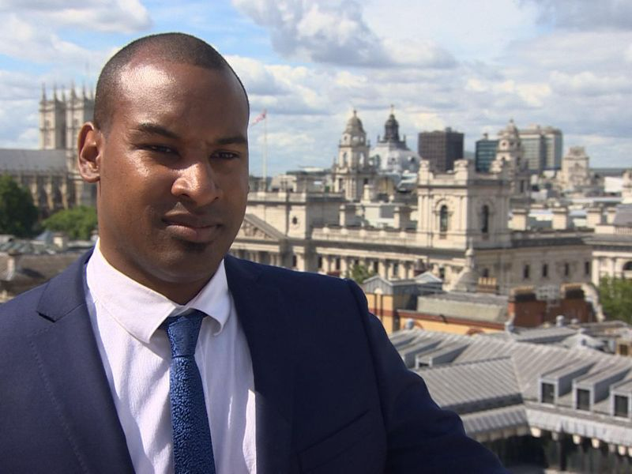
Police Bravery
PC Wayne Marques received the George Medal for his bravery during the London Bridge attacks along with PC Charles Guenigault who was not on duty during the incident. Sky News, 2018
Very positive reflection of the police.
Inspire people to become a police officer.
Sky News, 2018

Slide 7
Public Safety
“Public safety fears over 800 Police Scotland staff cuts” The Herald, 2023.
Will the public be safe?
Will the police be stretched too thin on the streets?
Will crime rise?
Will the police be able to answer all 999 calls?

Slide 8
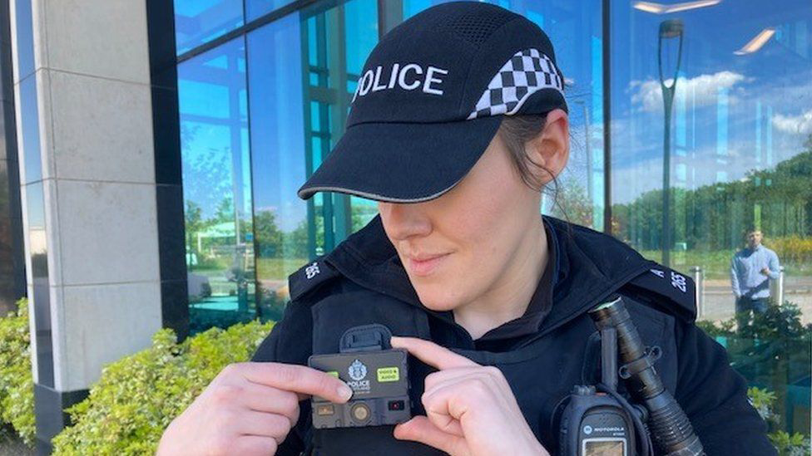
New Technology
“Police widely misusing body-worn cameras” BBC NEWS, 2023
Body worn cameras are meant to be used to assist the police.
Photographic proof of interaction that could be used in a court of law.
Wasting money on technology that isn’t being used correctly.
Money could be spent elsewhere.
BBC News , 2021

Slide 9
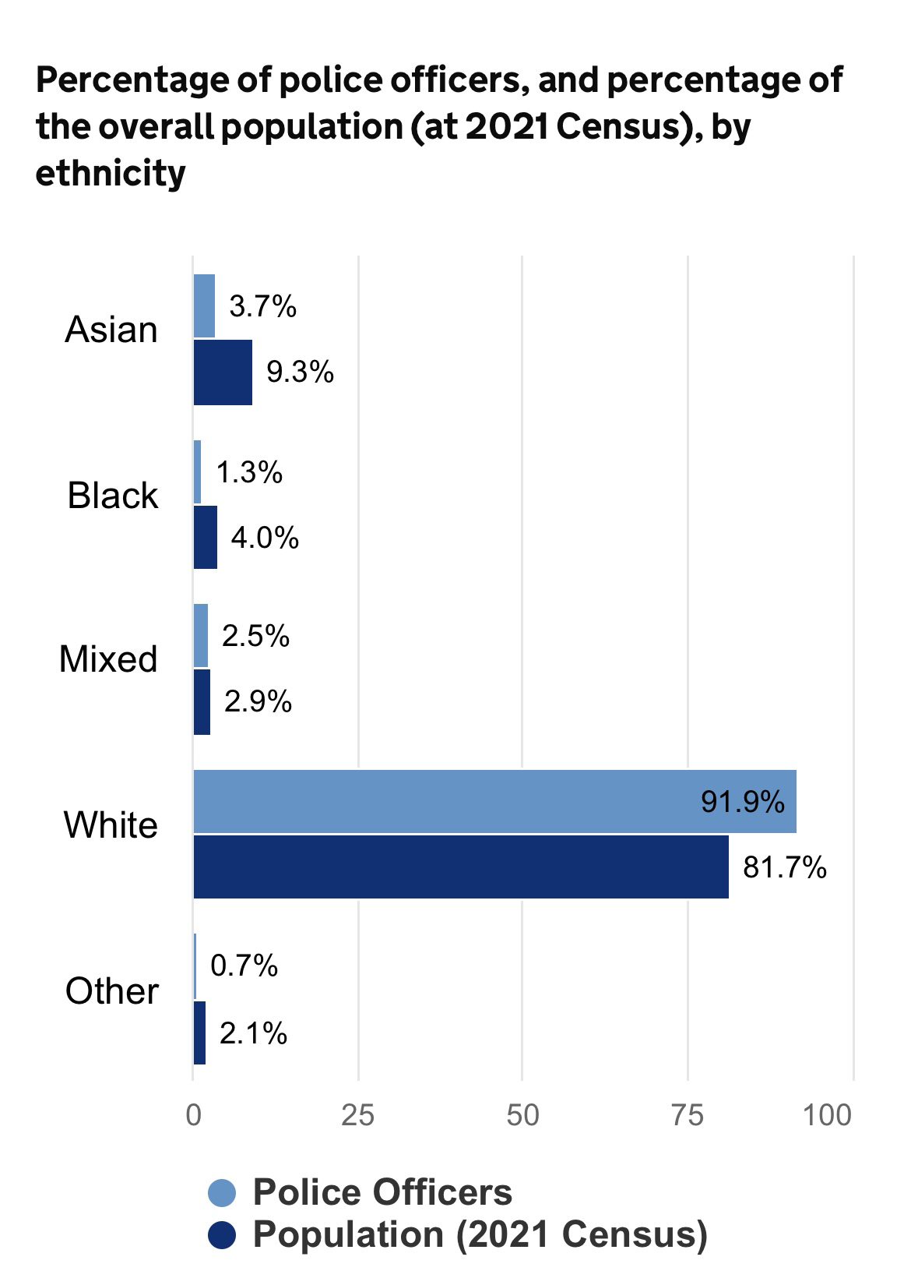
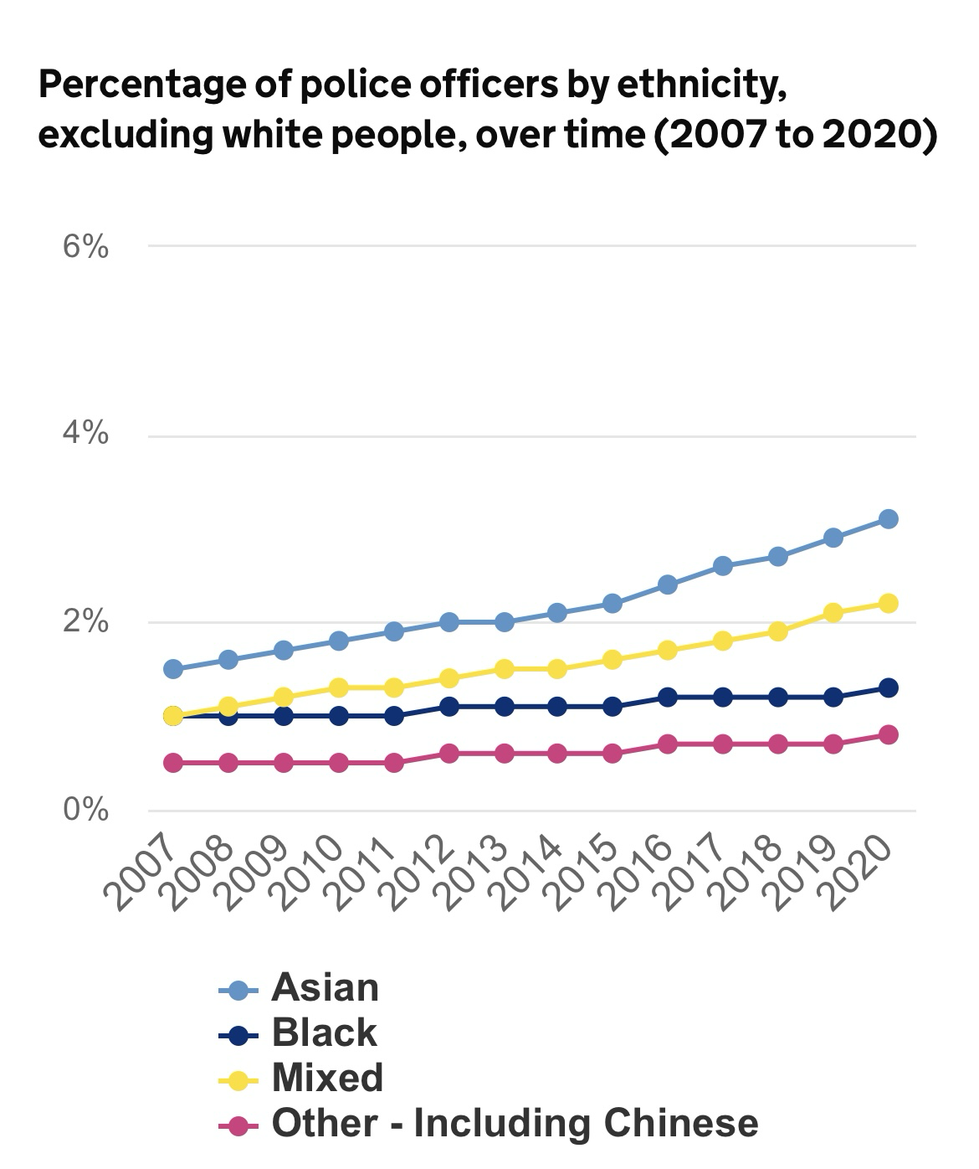
Diversity
“ Revealed: Met Police Will Fail to Fairly Represent London’s Diversity for Decades at Current Rate of Progress” Byline Times, 2023.
“Greater Manchester, police makes diversity pledge after criticism” BBC NEWS, 2023 (A)
Uk Government ,2023
UK Government, 2023

Slide 10
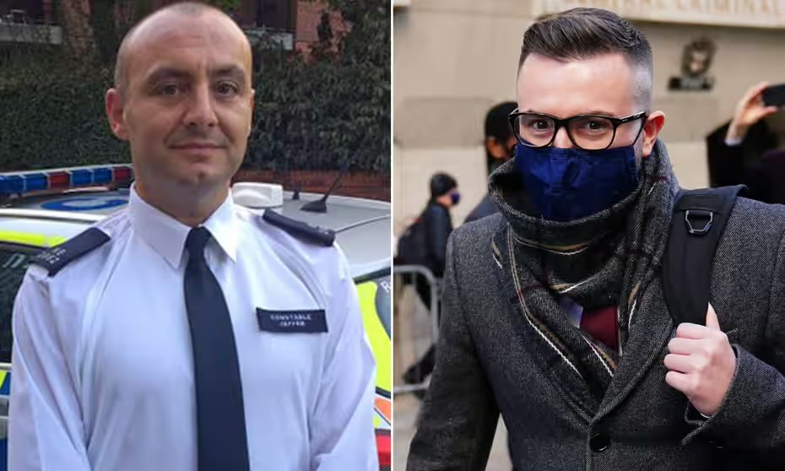
Investigating crime
“Met police officers, plead guilty over photos taken at scene of sisters’ deaths” – the Guardian, 2021 (B).
The former police officers (Deniz Jaffer and Jamie Lewis) both received a 33 month sentence in prison as per BBC News, 2023 (B)
BBC News, 2023 (B)

Slide 11
Conclusion
The press will always need to have a healthy relationship with the police, so it can convey an honest representation of the current state of the Police Service.
The press do have to be a reliable tool regarding information as they do have a sway on the public perception of the police. Regardless if it may get more attention to lie about the reality.

Slide 12
References
BBC NEWS, 2023 ( A) – Greater Manchester police makes diversity pledge after criticism: https://www.bbc.com/news/uk-england-manchester-67583354.amp
BBC NEWS, 2023 ( B) - https://www.bbc.co.uk/news/uk-england-london-64425229.amp
BBC NEWS, 2023( C ) - https://www.bbc.co.uk/news/uk-66809642
BBC NEWS, 2021 - https://www.bbc.co.uk/news/uk-scotland-57309639
BBC NEWS, 2019 –Hillsborough trial: Police chief ‘lied about fans forcing Hillsborough gate https://www.bbc.co.uk/news/uk-england-merseyside-50018985.amp
Byline Times, 2023 - Revealed: Met Police Will Fail to Fairly Represent London’s Diversity for Decades at Current Rate of Progress: https://bylinetimes.com/2023/08/04/revealed-met-police-will-fail-to-fairly-represent-londons-diversity-for-decades-at-current-rate-of-progress/
CPS, 2019 – CPS statement on Hillsborough verdict: https://www.cps.gov.uk/mersey-cheshire/news/statement-hillsborough-verdict
House of Commons, 2012 –Hillsborough The Report of the Hillsborough Independent Panel

Slide 13
References
Independent, 2017 - https://www.independent.co.uk/news/uk/crime/hillsborough-disaster-latest-news-cps-charges-96-victims-football-fans-suspects-david-duckenfield-liverpool-sheffield-warrington-a7811691.html
Sky News, 2022 – London Bridge terror attack: Service held to mark five years since 2017 atrocity -https://news.sky.com/story/amp/london-bridge-terror-attack-service-held-to-mark-five-years-since-2017-atrocity-12627246
Sky News, 2018 - https://www.google.com/amp/s/news.sky.com/story/amp/london-bridge-terror-attack-heroes-among-those-receiving-gallantry-awards-11441311
The Guardian, 2017 - https://amp.theguardian.com/uk-news/2017/jun/28/policeman-fought-london-bridge-attackers-baton-wayne-marques
The Guardian, 2021 (a)- The great betrayal: how the Hillsborough families were failed by the justice system https://www.theguardian.com/football/2021/oct/21/the-great-betrayal-how-the-hillsborough-families-were-failed-by-the-justice-system
The Guardian , 2021 (b)- https://www.theguardian.com/uk-news/2021/nov/02/met-police-officers-plead-guilty-over-photos-taken-at-scene-of-sisters-deaths
The Herald, 2023 - https://www.heraldscotland.com/news/homenews/23592727.public-safety-fears-800-police-scotland-staff-cuts/
The Sun, 1989 – The Truth
The Sun, 2012 – The Real Truth
Uk Government, 2023 – Police Workforce: https://www.ethnicity-facts-figures.service.gov.uk/workforce-and-business/workforce-diversity/police-workforce/latest/

