Slide 1

How Supply Management and High‑End Consumers Help Maintain the Heritage of Wine Producers in Kakheti, Georgia
Module: Developing a Research Proposal
Module code: BMSW5014
Lecturer: Jaliya De Silva
Assignment Title: Developing a Research Proposal
Student Name: Maia vashakmadze
Student Number: 1816795
Submission deadline: 26th June, by 11:59pm.

Slide 2
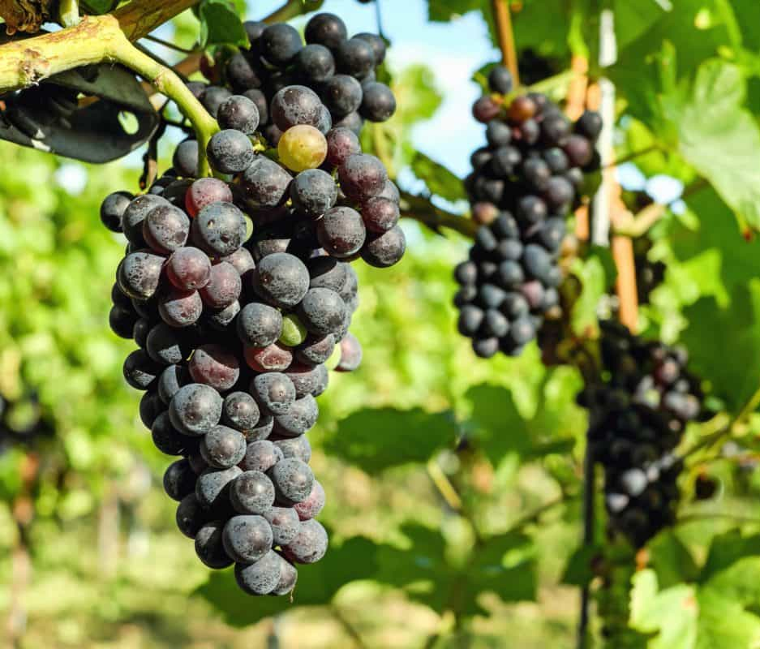
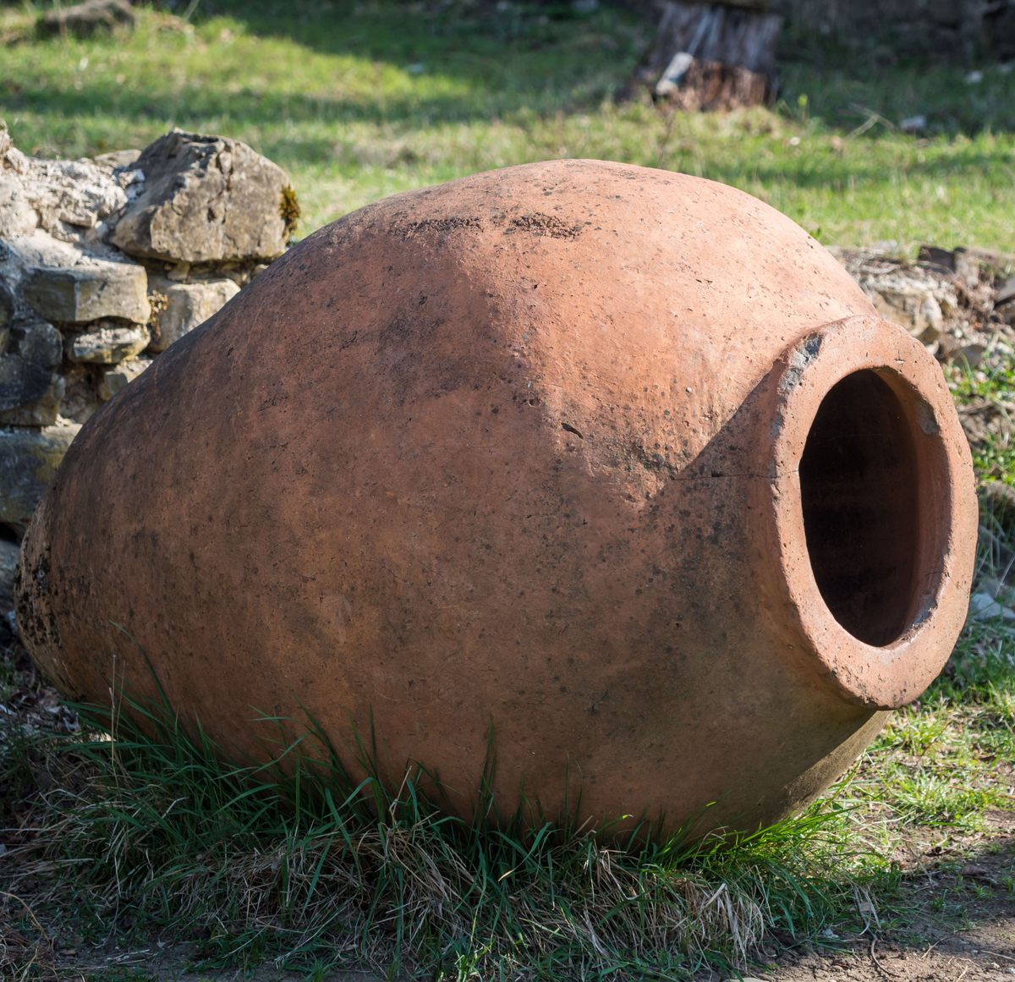
Background
Georgia is recognised as the “cradle of winemaking”, with 8,000 years of tradition. (Maghradze et al., 2016; Harvey & Jordania, 2014).
Kakheti region produces 70% of Georgia’s wine, using the ancient Qvevri method, listed by UNESCO as Intangible Cultural Heritage. (UNESCO, 2013).
Small producers face pressure to adopt faster, cheaper industrial methods; new premium markets offer an alternative path.
Aim & Research Question
Aim: To investigate how supply management and high‑end consumer demand help preserve traditional winemaking heritage. (Rytkönen et al., 2021).
Central Question: How do supply strategies and preferences of premium buyers support the continuation of traditional production in Kakheti?
Importance
Helps businesses balance commercial goals with cultural preservation.
Offers insights for sustainable niche marketing and responsible supply chain management.

Slide 3
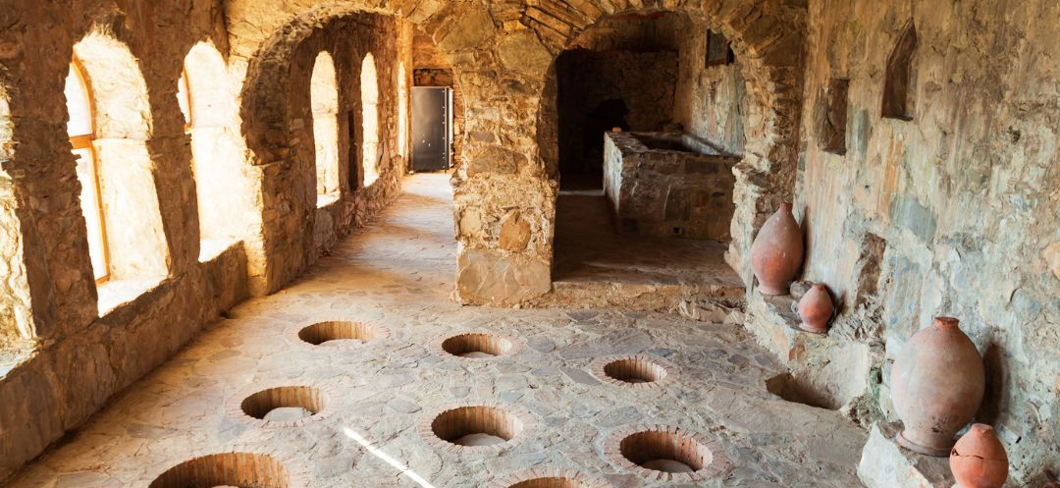
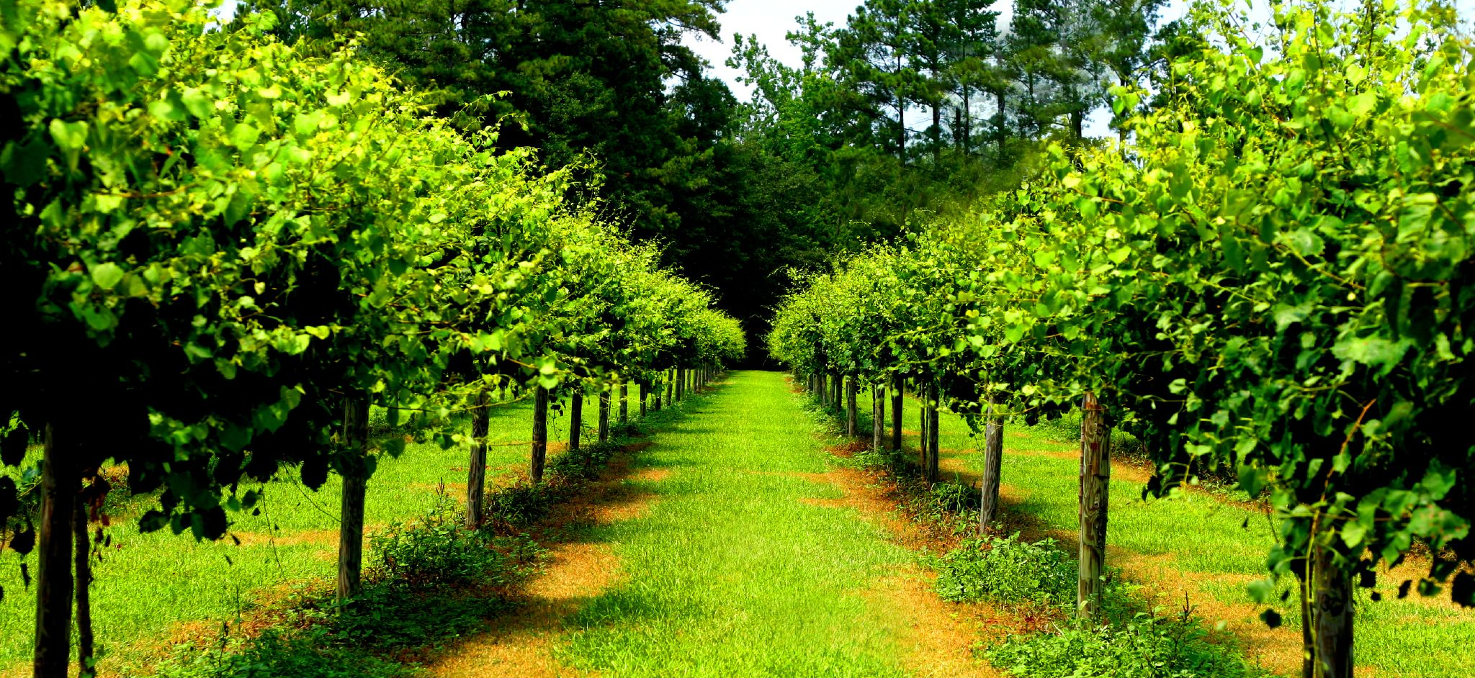
Research Design
Approach: Qualitative research using an inductive approach.
Philosophy: Interpretivist, focusing on understanding meanings and experiences. (Saunders et al., 2019; Creswell & Creswell, 2018).
Data Collection
Semi‑structured interviews: With producers, distributors and market experts. (Kvale & Brinkmann, 2015).
Document analysis: Official reports, industry records and marketing materials. (Bowen, 2009).
Field observation: Visits to vineyards and cellars to observe practices directly. (Kankava, n.d.).
Sampling Strategy
Purposive sampling: Selecting participants with direct knowledge and experience. (Patton, 2015).
Snowball sampling: Using existing contacts to access further industry stakeholders.
Justification: Ensures relevant, detailed insights appropriate for a small‑scale study.
This Photo by Unknown Author is licensed under CC BY-SA

Slide 4

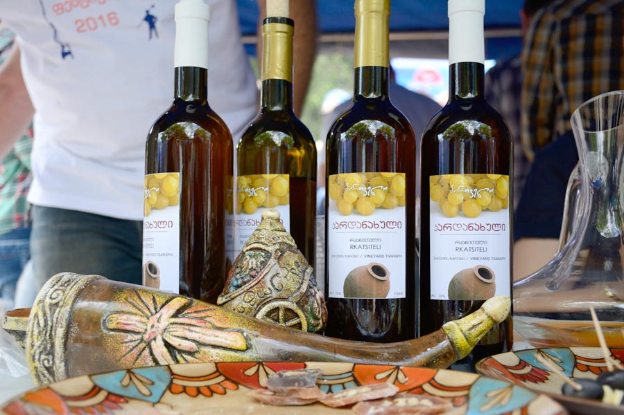
Slide 4: Methodology – Reliability & Validity
Reliability
Using consistent interview guides and clear documentation.
Recording sessions with permission and following the same process for all participants. (Bryman, 2016).
Keeping detailed field notes to ensure consistency.
Validity
Triangulation: Cross‑checking information from interviews, documents and observation.
Using open‑ended questions to explore topics in depth.
Focusing directly on the link between supply practices, consumer demand and heritage.
Outcome: Ensures the study measures exactly what it intends to investigate. (Rytkönen et al., 2021).
This Photo by Unknown Author is licensed under CC BY-SA

Slide 5
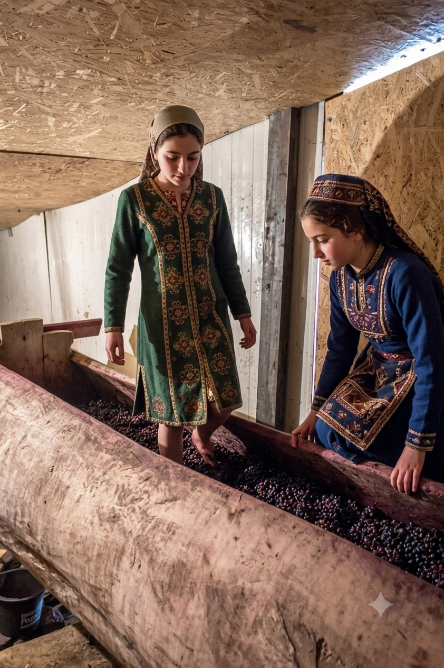
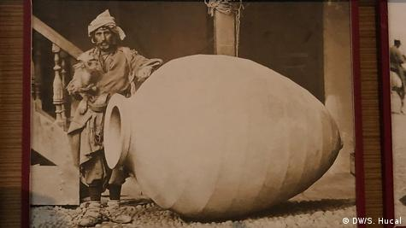
Informed Consent
All participants will receive clear information about the study’s purpose, use of data and their rights. (Saunders et al., 2019).
Written or verbal consent will be obtained before any data collection begins.
Confidentiality & Anonymity
No real names or business details will be published; codes will be used instead.
All data will be stored securely and only accessed by the researcher. (Bowen, 2009).
Protection & Compliance
No information will be shared that could harm participants or their businesses.
The study will follow university ethical guidelines and UK GDPR regulations.
Participants may withdraw at any time without penalty. (Creswell & Creswell, 2018).

Slide 6

Limitations
Time constraints: Study completed in 6 weeks, limiting sample size. (Kankava, n.d.).
Geographic focus: Limited to Kakheti, so findings may not apply to other regions. (Shtaltovna & Feuer, n.d.).
Small sample: Qualitative insights cannot be statistically generalised. (Bryman, 2016).
Recommendations for Future Research
Extend the timeline to include more producers and regions.
Combine with a survey of high‑end consumers for broader data.
Compare results with other traditional wine‑producing areas. (Stanco et al., 2020).
Conclusion
This study uses a qualitative approach to explore how supply management and premium markets support heritage. (Rytkönen et al., 2021).
Ethical standards are strictly followed to ensure fair and responsible research.
Findings will provide useful insights for producers, distributors and policymakers.

Slide 7
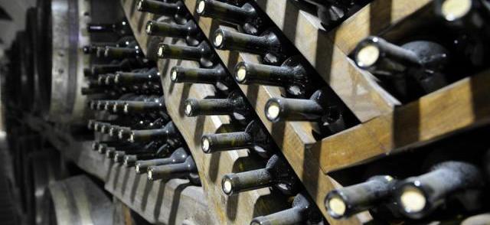

Slide 7: References
Bhaskar, R. (1978) A Realist Theory of Science. Brighton: Harvester.
Bowen, G.A. (2009) ‘Document analysis as a qualitative research method’, Qualitative Research Journal, 9(2), pp. 27–40.
Bryman, A. (2016) Social Research Methods. 5th edn. Oxford: Oxford University Press.
Creswell, J.W. and Creswell, J.D. (2018) Research Design: Qualitative, Quantitative and Mixed Methods Approaches. 5th edn. London: Sage.
Kvale, S. and Brinkmann, S. (2015) InterViews: Learning the Craft of Qualitative Research Interviewing. 3rd edn. London: Sage.
Maghradze, D., Tkemaladze, M. and Khvedelidze, A. (2015) ‘Traditional winemaking in Georgia: Current status and challenges’, Journal of International Wine Marketing, 27(1), pp. 45–62.
Rytkönen, P., Vigerland, L. and Borg, E. (2021) ‘Tales of Georgian wine: storytelling in the Georgian wine industry’, Journal of Wine Research, 32(2), pp. 117–133.
Saunders, M., Lewis, P. and Thornhill, A. (2019) Research Methods for Business Students. 8th edn. Harlow: Pearson.
UNESCO (2013) Traditional Georgian Qvevri Wine‑Making. Paris: UNESCO Intangible Cultural Heritage List.
This Photo by Unknown Author is licensed under CC BY

