Slide 1
Factors promoting change
We’re going to look at number of visual images, discussing in class what each of them shows about the transition from subsistence to cash economy and how they may relate to each of Susana Narotzky’s four phases of economic activity:
Production
Distribution and Exchange
Consumption
Social Reproduction

Slide 2
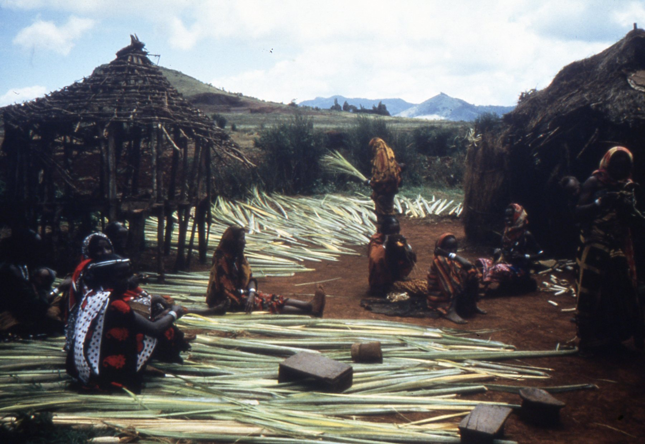
Factors promoting change

Slide 3
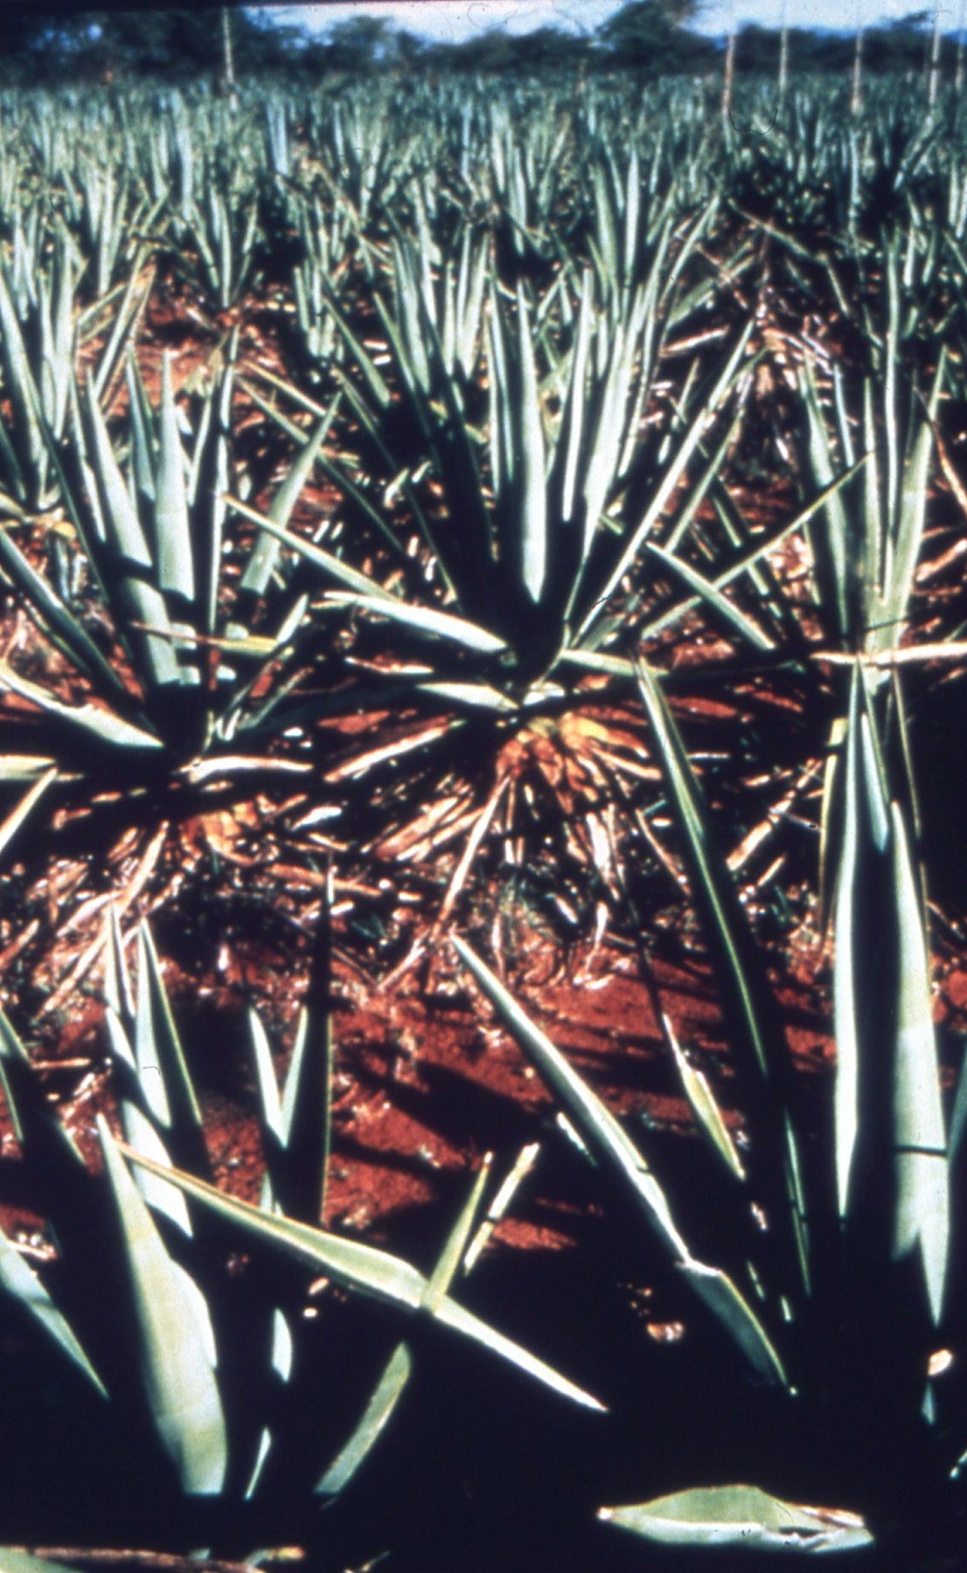
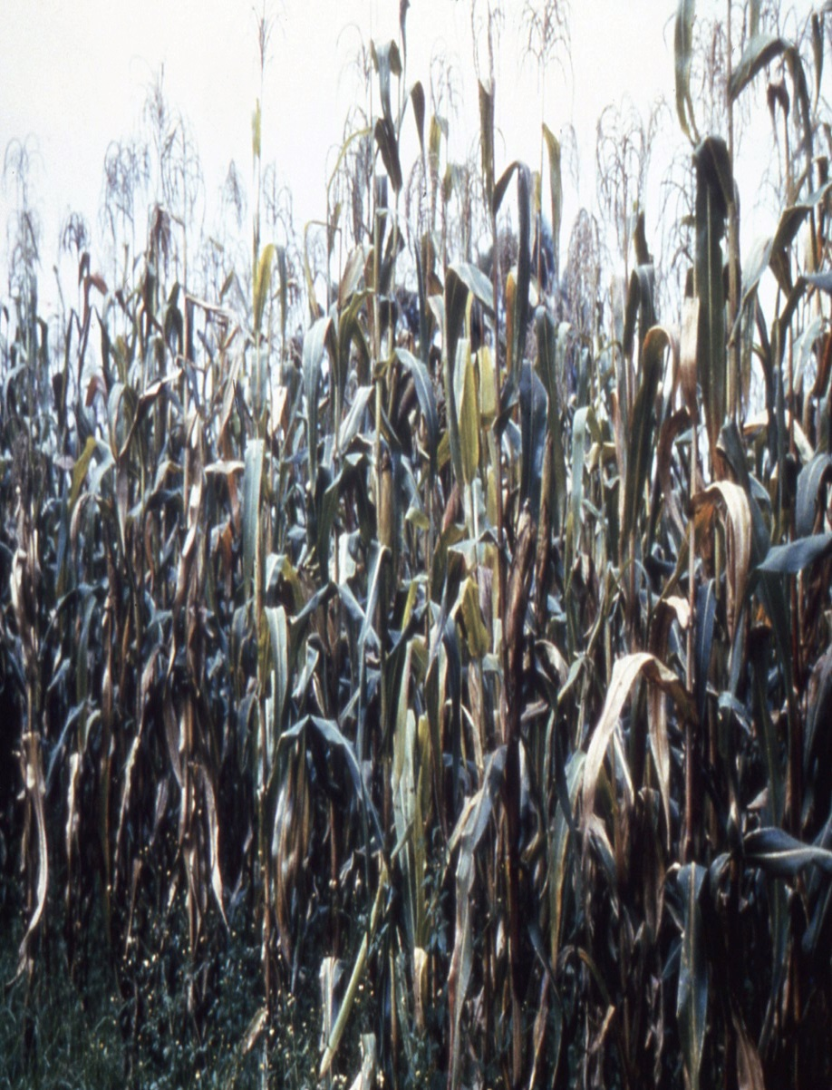
What’s growing?

Slide 4
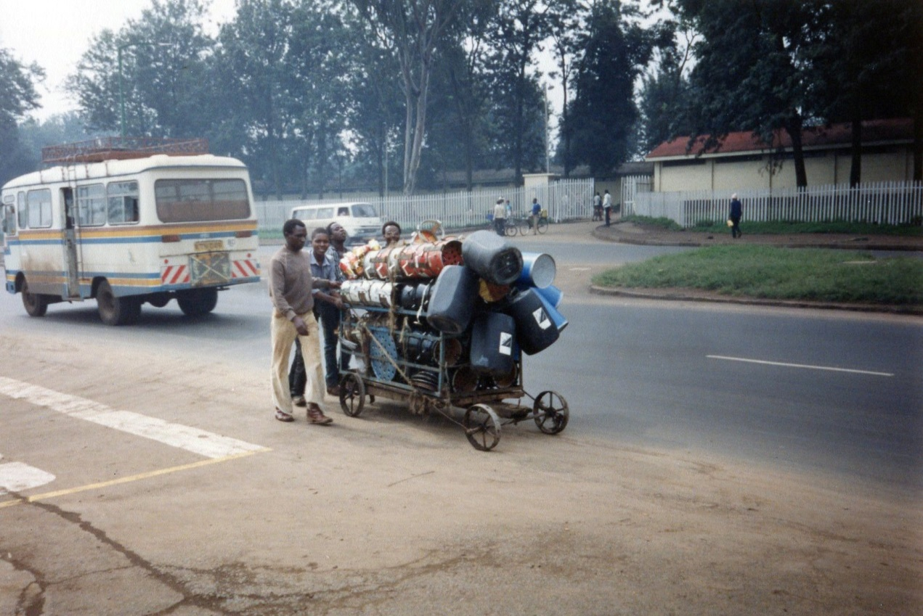
What’s happening?

Slide 5
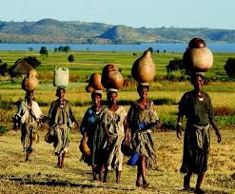
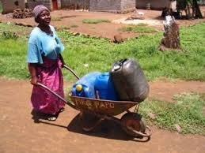
Carrying water

Slide 6
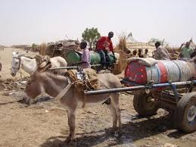
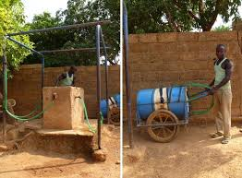
Carrying water…

Slide 7
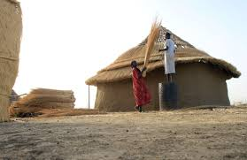
Building a house

Slide 8
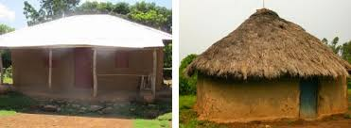
Old style or new style?

Slide 9
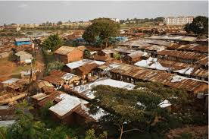
Moving to the city

Slide 10
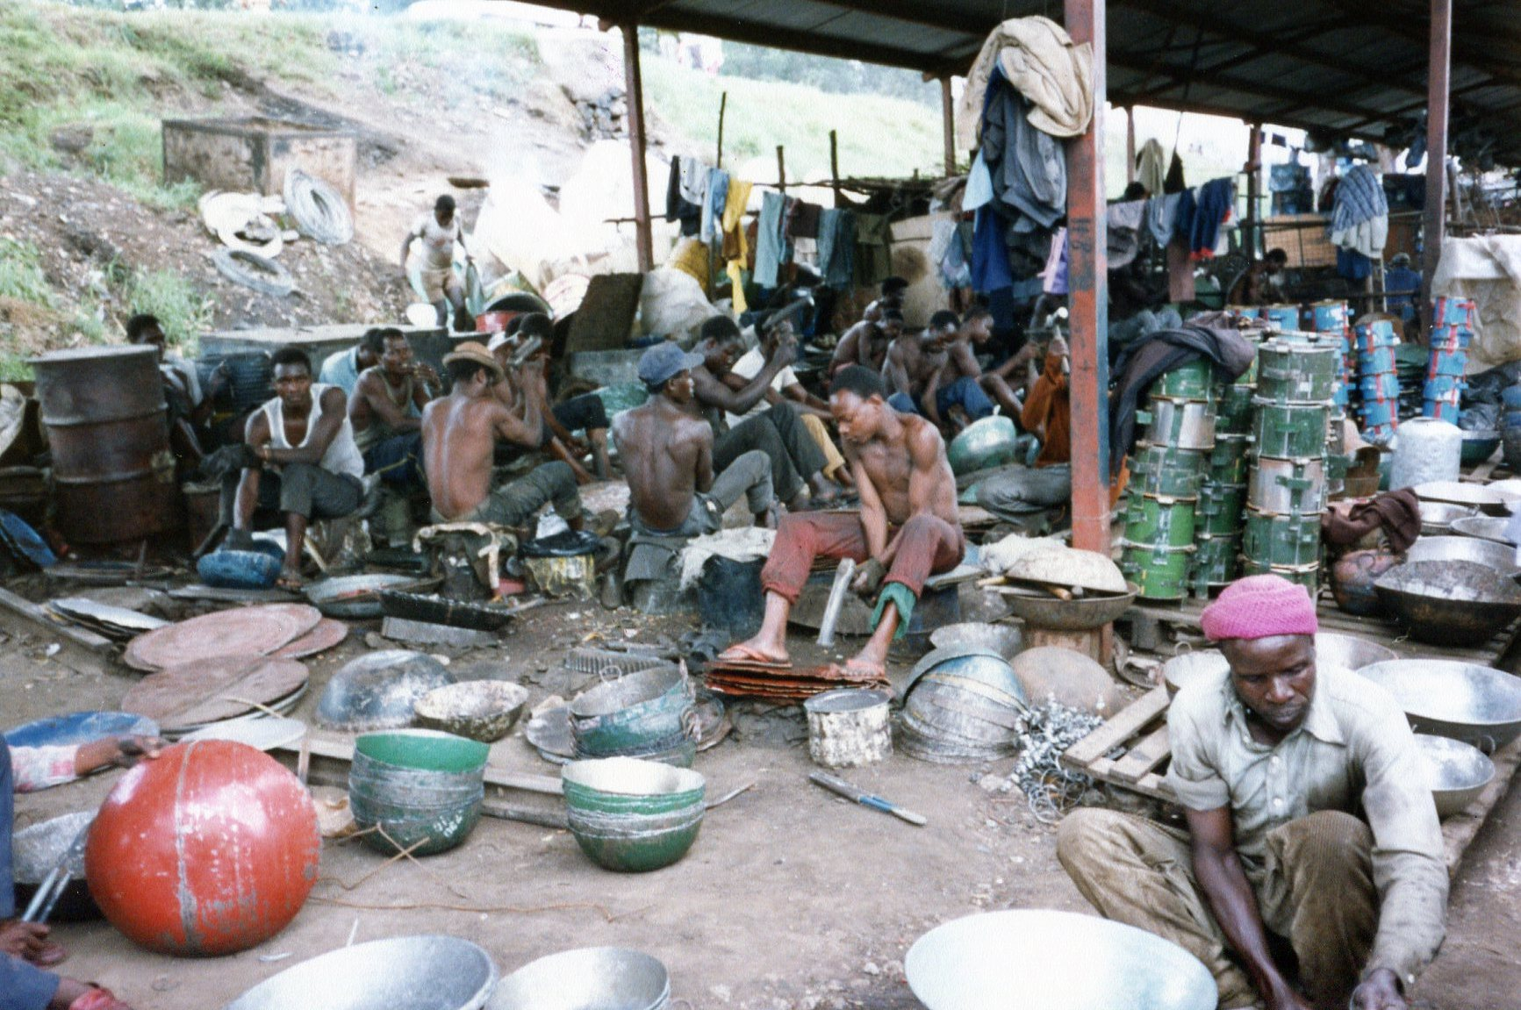
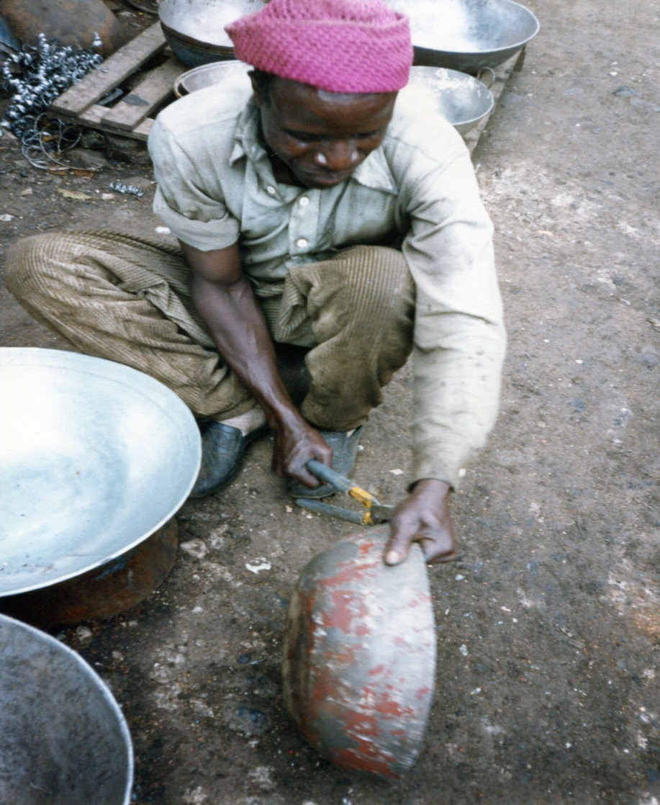
Making a living

Slide 11
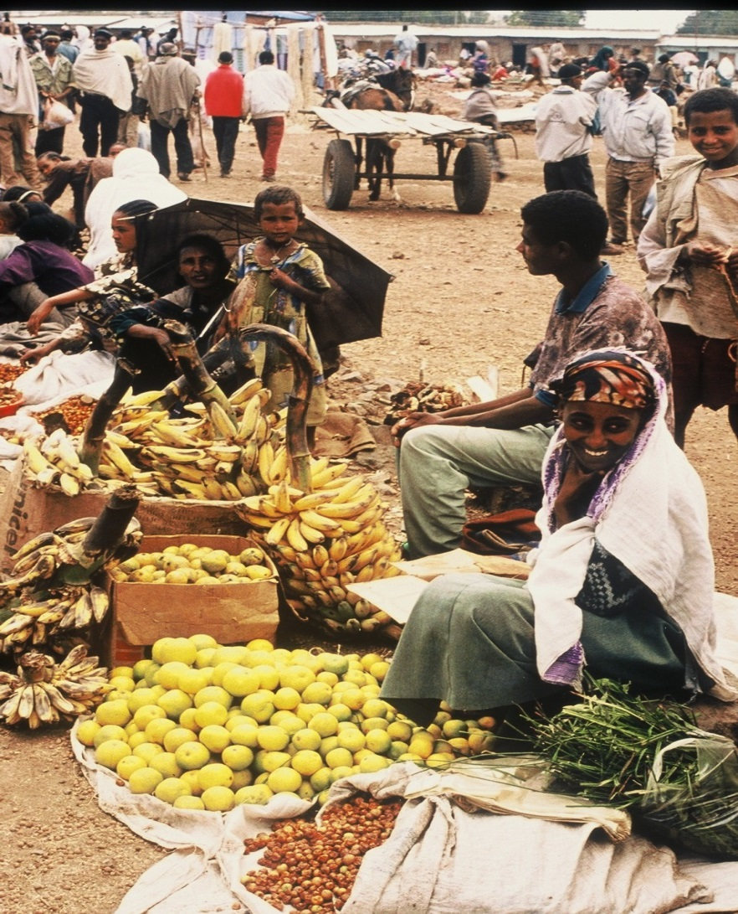
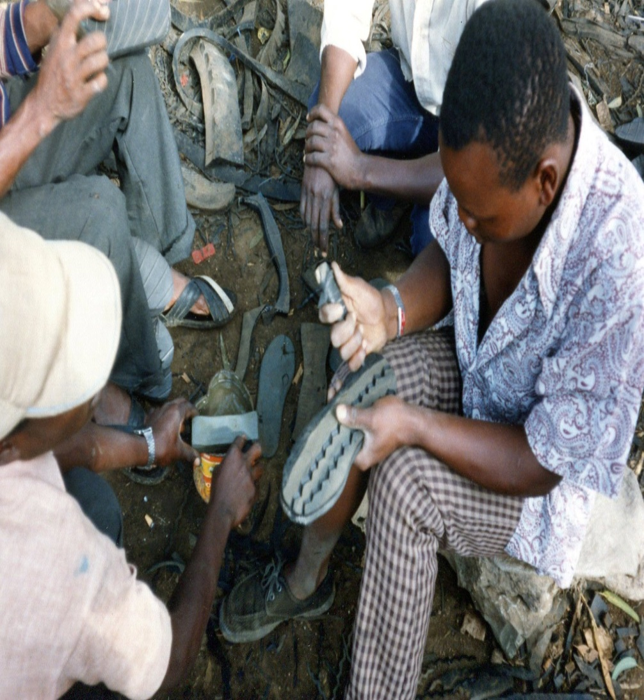
Selling food, making shoes…

Slide 12
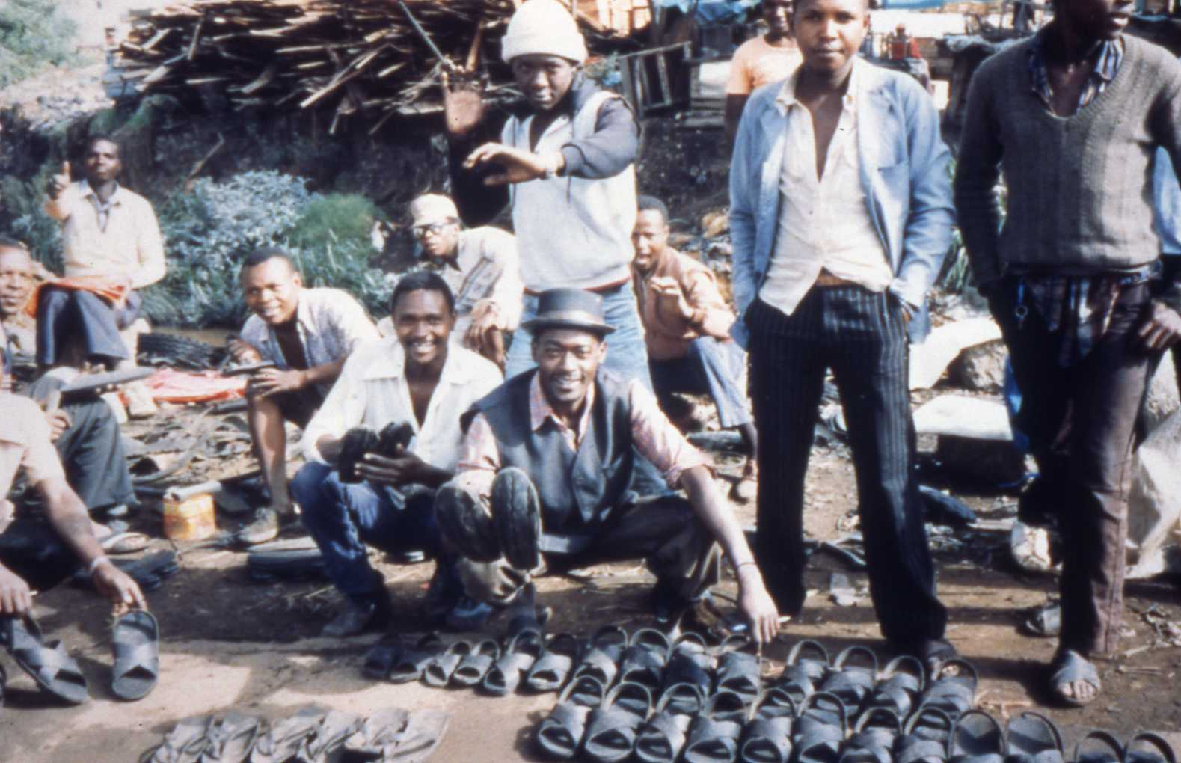
Shoes for sale…

Slide 13
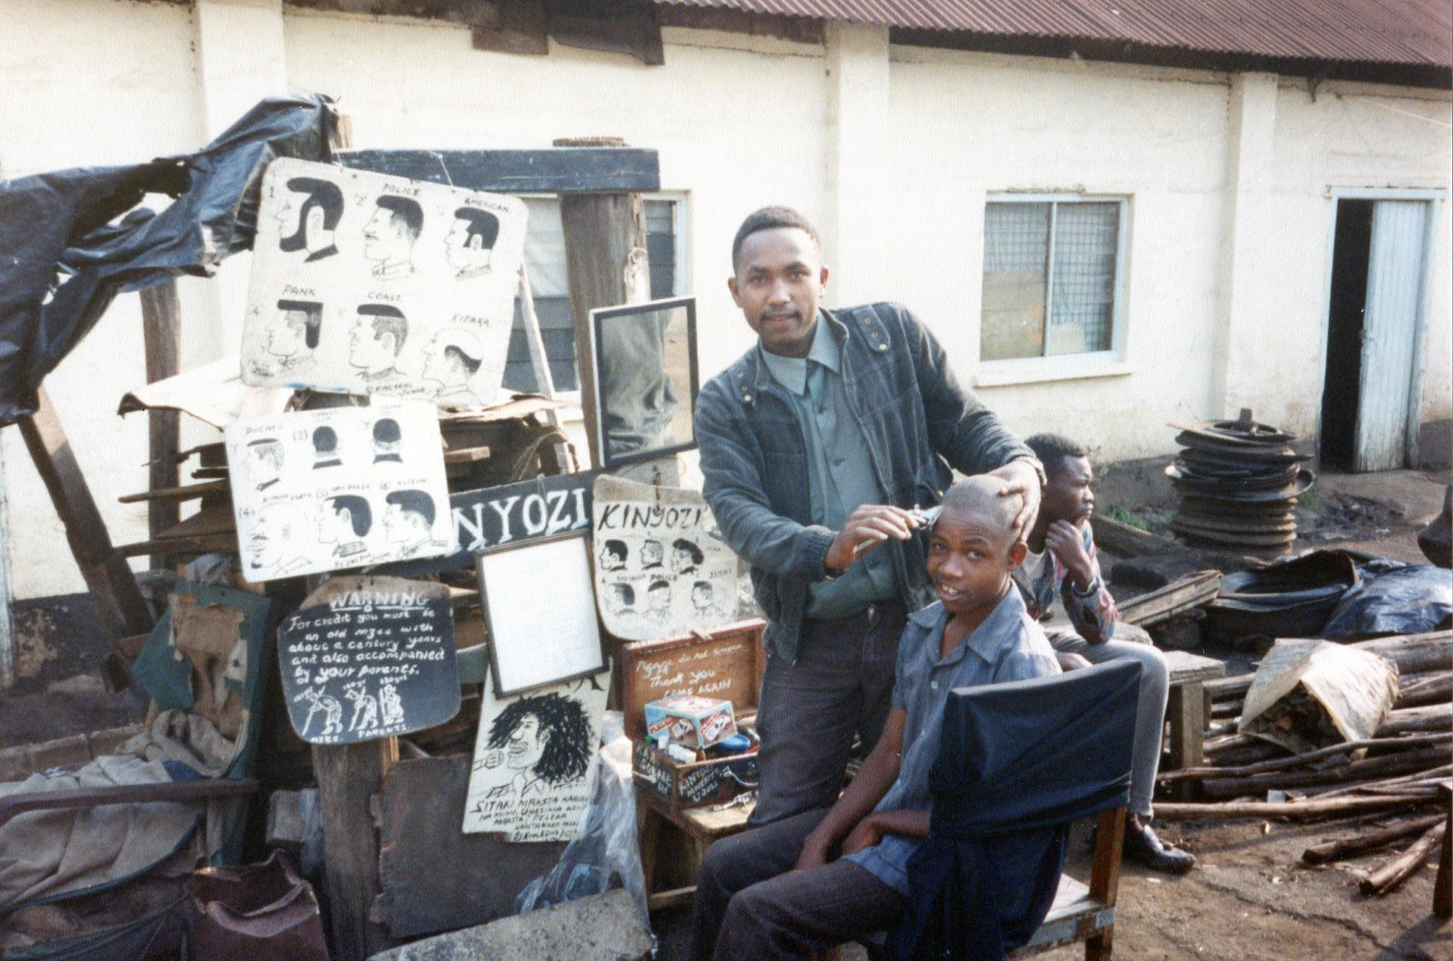
Services for sale…

Slide 14
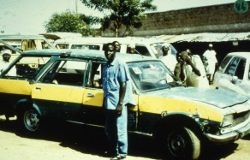
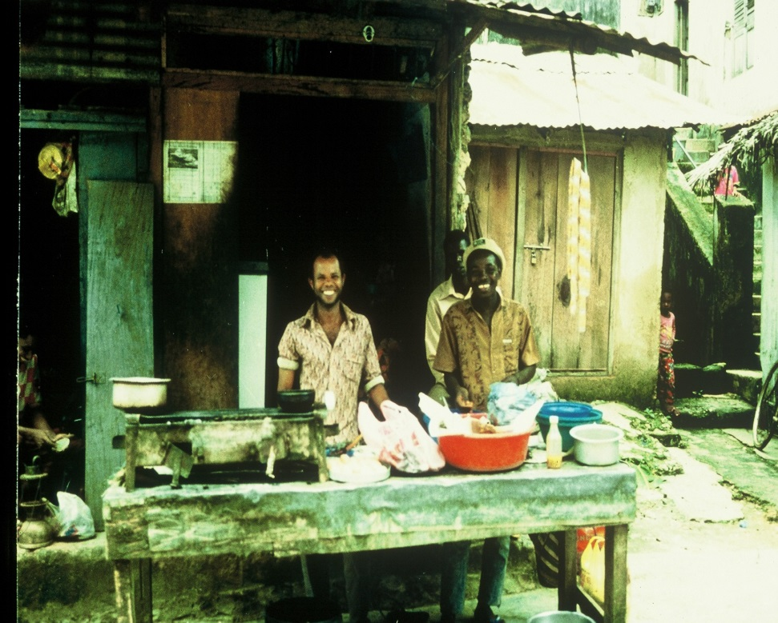
Transport, fast food…

Slide 15
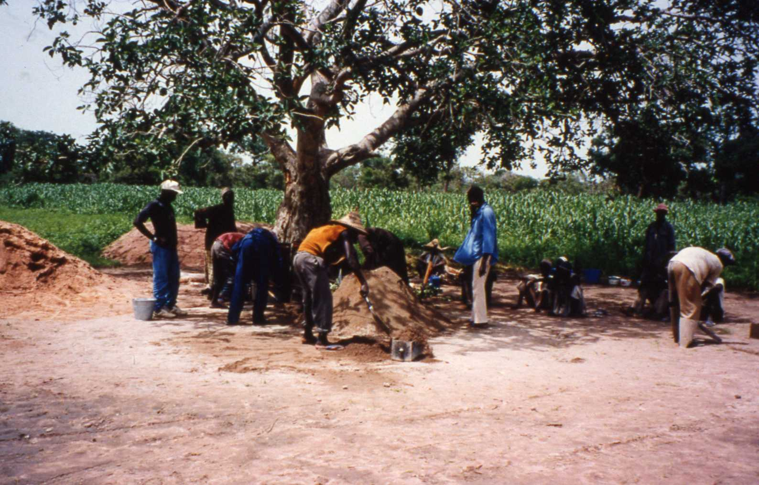
Employment…

Slide 16
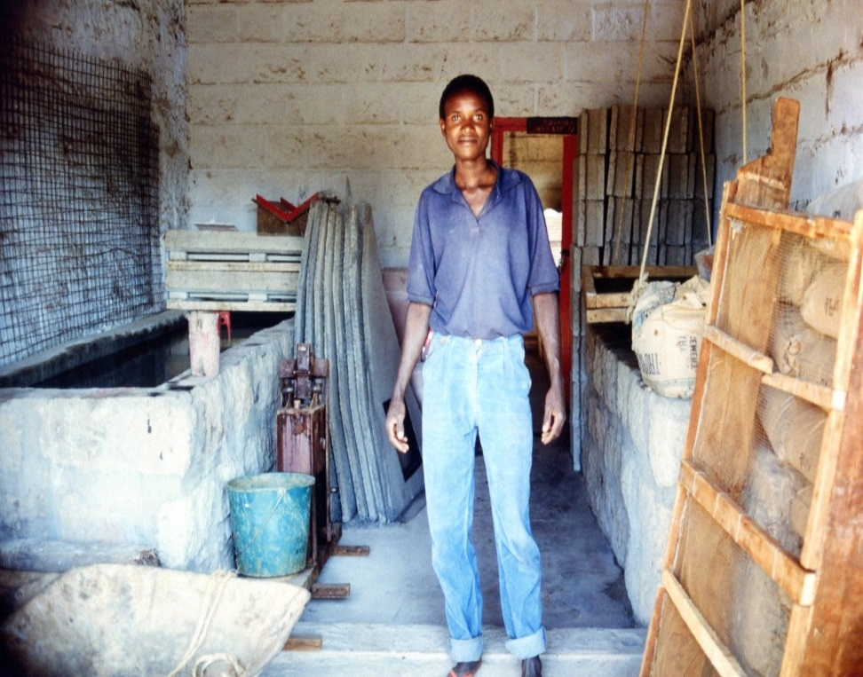
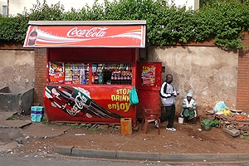
Small business/“micro-enterprise”

Slide 17
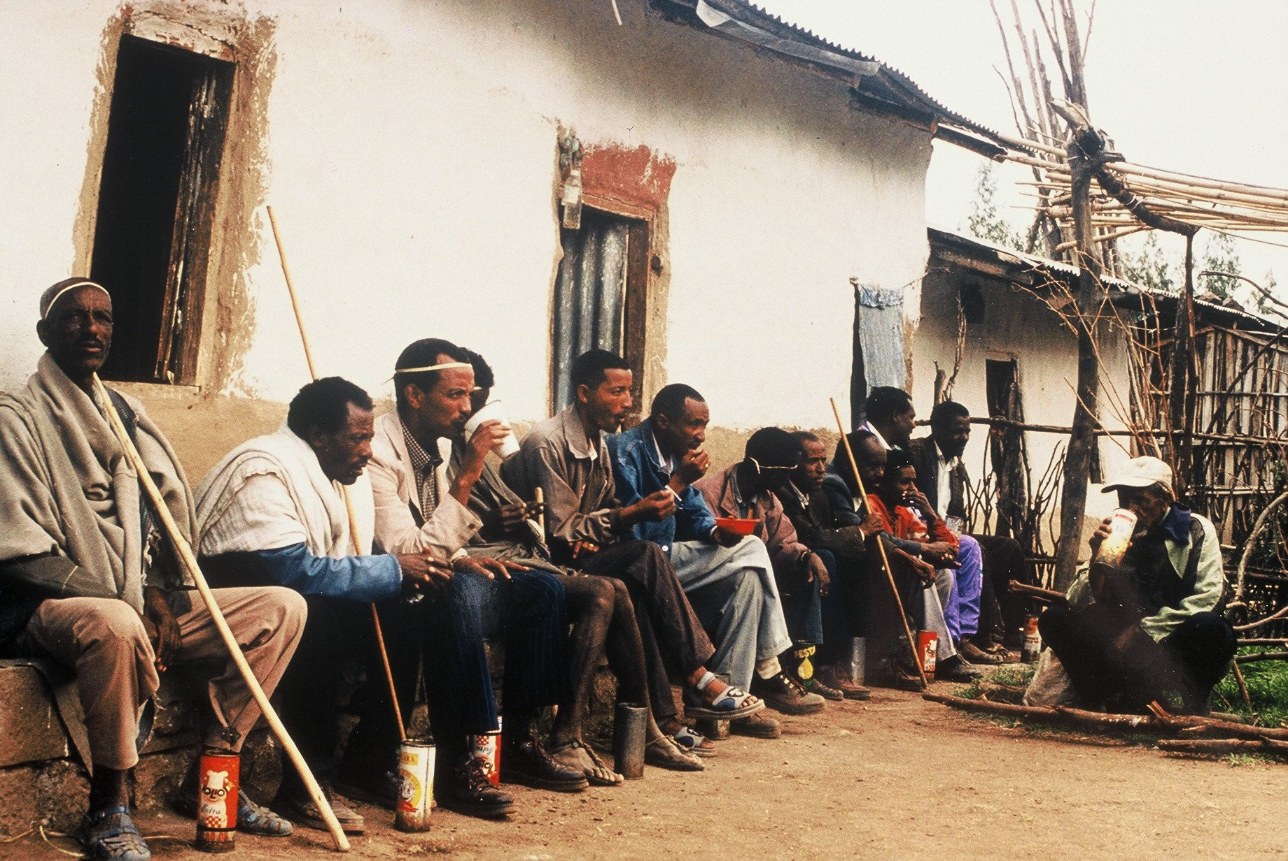
Running a bar…

Slide 18


Sending the kids to school…

Slide 19
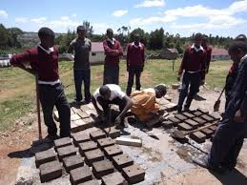
…or to a “youth polytechnic”

Slide 20
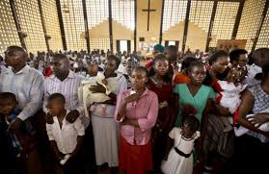
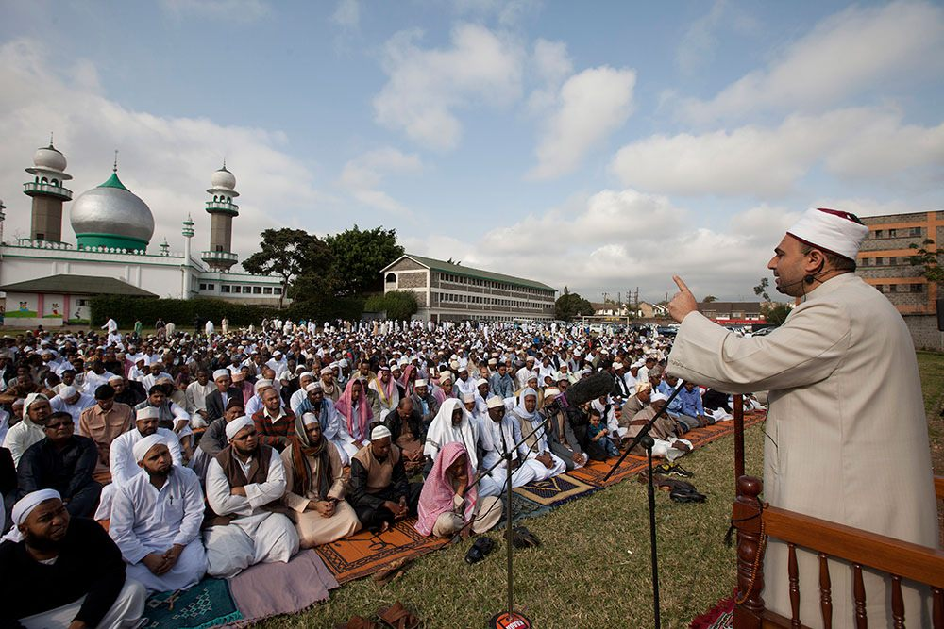
Gathering to worship

Slide 21
Hundreds of factors are promoting change in people’s lives…
What are they?
?

Slide 22
Factors promoting change?
From rural to urban
From subsistence to cash
From old-style to “modern”
From traditional to transitional
Human factors and non-human factors
Factors under local or national control and those which feel bigger than locality or nation

