Slide 1
The makers of law

Slide 2
Learning objectives
By today’s session you will understand:
  The Monarchy
  The UK Parliament’s personnel and functions
  The UK Judiciary's personnel and functions
  The UK Government’s personnel and functions
  Parliamentary sovereignty
  The separation of powers
  Rule of law

Slide 3
tHE UK monarchy
The UK Monarchy are the highest level of authority within the UK (and other countries that are not independent from the UK)
Every UK institution is governed by the monarchy as they are the head of state. Everything is done in their name:
  Parliament open up by announcing the ‘king’s speech’
  In criminal cases such as R v Bleau 1975 – this is pronounced ’the crown against Bleau’
  The government work for the crown. The Prime Minister is technically elected by the monarchy

Slide 4
The uk parliament (Legislator)
The UK Parliament is the supreme law-making body.
They are made by the House of Commons and the House of Lords.
Located in Westminster in London, they have control over the UK countries and their legislators (Scottish Parliament, The Senedd, Northern Ireland Assembly)
They have this control by making acts of parliament / primary legislation.

Slide 5
The house of commons
Established in the 14th century
Currently has 650 seats which represent a constituency (area of the UK) which are seated by Members of Parliament (MPs) who are elected democratically via elections. The MPs have the task of making legislation, authorizing national expenditure and taxations, and criticize and scrutinize government.
MPs are voted into parliament via the ‘first past the post’ election system. Here the winning MP is the politician who gets the highest number of votes in their constituency.

Slide 6
The house of commons
There are various restrictions in restricted persons who can qualify being a MP:
  Below the age of 18
  Aliens (not citizens of the UK, Ireland, or a ‘qualifying commonwealth citizen’)
  Members of the House of Lords
  Undischarged bankrupts
  Convicted persons of ‘corrupt or illegal practices’
  Persons listed under the House of Commons Disqualification Act 1975

Slide 7
House of commons
Task: https://members.parliament.uk/members/Commons
Use this link to find:
  Who is your MP?
  Which party do they represent?
  What is their area of concern?

Slide 8
The house of lords
The House of Lords dates back to the 13th century and is made up of three main peers:
    Hereditary peers
    Life peers
    Lords Spiritual
Hereditary peers – These peers are permitted to sit in the House of Lords because of their birth right. These will usually be ‘Earls’ and ’barons’. Before the House of Lords Act 199 approximately 700 peers were entitled to sit in the House of Lords.
Life peers – Appointed by the Life Peerage Act 1958 by the crown on the recommendation of the Prime Minister. These are peers in ‘prominent professions’ such as former MPs, former senior army officers, scientists etc.
Lords Spiritual – Only the UK and Bhutan give seats to spiritual leaders. In the UK this will include the Archbishop of Canterbury and Bishops of the Church of England.
These peers are unelected. They have similar roles as those in the House of Commons as they have legislative functions such as creating legislation and scrutinizing parliament.

Slide 9
The house of lords
Disqualification from the House of Lords:
  Persons under the age of 21
  Aliens
  Judges (following s.23 Constitutional Reform Act 2009)
  Members of the House of Commons or members of the European Parliament
  Persons convicted of serious crimes
  Members who have previously been expelled from the House of Lords

Slide 10
The role of the monarch in parliament
The monarch as head of state formally opens each session of parliament with the King’s speech. This will explain what the government intends to introduce during the parliamentary session. Although this is not written by the monarch themselves, it’s written by the government on behalf of the monarch.
After law is passed through parliament, the monarch must give their royal assent. A constitutional convention which in practice, the monarch does not refuse.

Slide 11
The judiciary
The Judiciary of the UK hear legal cases which are overseen by judges.
The role of a judge is to decide the outcome of the case before them.
In civil cases the judge will hear the facts of the case and then declare who is liable. Consequently, that judge will award the successful party damages/orders.
In criminal cases the jury hear the facts and decide whether the defendant is guilty. Consequently, the judge will decide the punishment.
When a decision is made the judge(s) will state their reasoning behind the decision. This reasoning is referred to as case law which barristers/solicitors will use in future cases to argue their client’s case.

Slide 12
The judicial personnel (criminal)
The personnel for the judiciary depends on the court.
The Magistrates Court – The Magistrates Court have three lay magistrates who sit in the court. They are assisted by the legal adviser who give them information on the law.
The Crown Court – The Crown Court have ‘Circuit Judges’ or ‘recorders’ who decide the case on the facts.

Slide 13
The judicial personnel (civil)
Tribunals – Tribunals are held by specialist judges in the area of law the case is about. For example, employment cases will be heard by specialist judges who have experience in employment law
County Court – The County Court is run by District judges
The High Court – The High Court is made up of different divisions, but all divisions are seen by the High Court Judges

Slide 14
The judicial personnel (appeal courts)
The Court of Appeal – Cases are heard by Lord or Lady Justices of Appeal. They are normally referred to as Lord or Lady Justice.
The Supreme Court – Task - https://www.supremecourt.uk/about/biographies-of-the-justices.html use this link to view the Lord Justices that hear Supreme Court cases. From this list, what stands out about the characteristics of the Lord Justices.

Slide 15
The executive
Broadly speaking, the Executive are the bodies that deal with creating and implementing government’s policy
There are six branches of the Executive:
The Monarch
The Prime Minister
The Cabinet
The wider government
The civil service
‘Other public bodies’

Slide 16
The executive law makers
The Executive are a huge part of the UK legal system.
The Prime Minster, his cabinet and government minister’s role is to establish policies which they want to turn into acts of parliament. They also make collective decisions on expenditure within the UK.
Government ministers such as the Secretary of States role is to create secondary legislation. Eg, government ministers used secondary legislation to implement lockdown regulations throughout the Covid-19 pandemic.

Slide 17
Parliamentary sovereignty
The UK Parliament is the sovereign institution in the UK. Everyone must abide by the acts of parliament that they create.
A.V Dicey defined this as meaning ‘parliament has, under the constitution, the right to make or unmake any law whatever, and, further that no person or body is recognized by the law as having a right to. override or set aside the legislation of parliament.’
In essence, Dicey states that parliament is the supreme law-making body of the UK. No body can disobey their laws or alter them. They have the power to create and repeal any laws.
In theory, parliament could abolish the monarchy, mandate citizens to wear fedoras or as Sir Leslie Stephan once said, legislate for the killing of all blue-eyed babies. However, although parliament has this legal compacity, politically this would cause revaluations and would not be enforceable.
Reflection – think about COVID-19, if parliament tried to legislate mandatary vaccinations, politically do you think that this law would be enforceable?

Slide 18
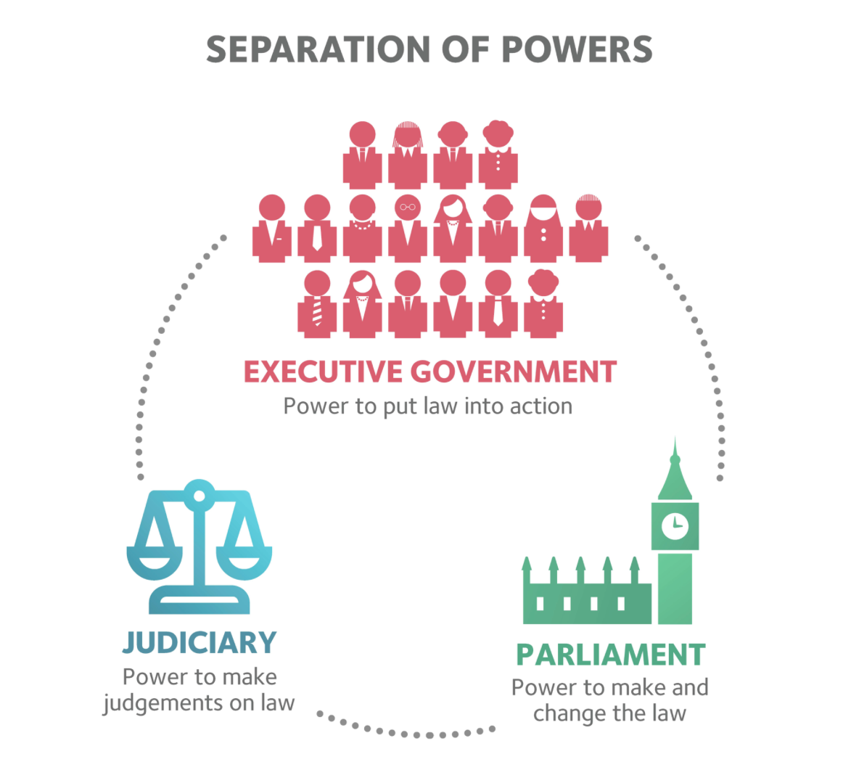
Separation of powers
The separation of powers is a key element within the UK constitution. It denotes that the executive, parliament and judiciary should be separate to prevent tyranny and to provide accountability to each branch through checks and balances.
Historically, when the King or Queen had all three of these powers, they could act with impunity. Think about Henry VIII, he had all these powers during his reign. As he had all these powers, nobody could provide accountability and prevent him from abusing his powers.

Slide 19
Rule of law
The rule of law in the UK constitution has no definitive definition. The rule of law is how the law is made, applied and shown towards their citizens. T.R.S Allen defines the rule of law as being ‘a corpus of of basic principles of values, which together lend some stability and coherence to legal order.’ There are two theories which underpin the rule of law principles.
Joseph Raz’s formal theory of the rule of law:
The law should be made in accordance with stated processes;
Law should be prospective and not retrospective;
Laws should consist of open, general and clear rules;
There should be an independent judiciary;
There should be access to the courts in order to protect legal rights and enforce the law.
In short, Raz’s rule of law cares about the effectiveness of law disregarding the content of the law.
In comparison to Lord Bingham’s substantive rule of law:
The above points but it includes the fundamental of human rights. The content of the law must also be good, if not, then the rule of law is not being met.

Slide 20
summary
The UK parliament has two sections: The House of Commons and the House of Lords. Their job is to establish acts of parliament.
The Judiciary’s role is hear legal cases before them. Where they establish a decision, this decision becomes part of the ‘common law’.
The Executive’s law-making role is to establish policies which they want to turn into law and to govern the UK expenditure.
Parliament sovereignty is the concept that the UK Parliament is sovereign. They are free to make whatever laws they want
The separation of power is the concept that all three UK institutions are separate to prevent tyranny and allow accountability.
The Rule of Law is separated by two theories from Joseph Raz and Bingham on how the laws in the UK should be created and applied.

