Slide 1

Name :ALIYA
Student ID: 2323993
Lecturers Name: Neal Haddon
BSc (Hons) Health and Social Care
BMHP6029 Component 1
Psychological Classifications and Provisions

Slide 2
SCHIZOPHRENIA: A CRITICAL EXAMINATION OF HISTORICAL AND CONTEMPORARY CLASSIFICATION AND PROVISION
INTRODUCTION
Persistent disruptions in perception, thought, self-experience, and behaviour are symptoms of schizophrenia, which is categorised as a primary psychotic disorder under ICD-11 (WHO, 2024). Understandings of schizophrenia have been influenced by changing medical theories, social anxieties, and political priorities, even though it is frequently presented as a neurobiological illness (Freeborn, 2025).
CLASSIFICATION AND DIAGNOSTIC POWER
ICD-11 defines schizophrenia through symptoms including delusions, hallucinations, disorganised thinking and negative symptoms, and removes previous subtypes due to limited validity (Yasin, 2025). This reflects progress toward greater diagnostic utility.
However, schizophrenia lacks a definitive biological marker, raising concerns regarding construct validity (Gaebel et al., 2023). Critics argue psychiatric diagnosis may medicalise social distress and reinforce professional power (Valle, 2024). Thus, classification is not purely scientific but embedded within cultural and institutional contexts.
HISTORICAL PROVISION: CONTAINMENT AND CONTROL
From the 18th century onwards, individuals diagnosed with schizophrenia were frequently confined to asylums, reflecting fear and moral judgement (Shmukler, 2024). Treatments such as insulin coma therapy and psychosurgery prioritized behavioral control over autonomy (First et al., 2023). Foucault (1961) argued that psychiatric institutions functioned as mechanisms of social regulation. Historical provision therefore illustrates how care was shaped by social control rather than therapeutic partnership.
COMMUNITY CARE AND THE PRIVATIZATION
Antipsychotic drugs made privatization and community-based services possible (Hanlon, 2025). The goal of UK initiatives like Care in the Community was to encourage integration. But reforms were frequently underfunded, which led to service gaps and homelessness (Yamin and Malca, 2025). Black people are substantially more likely to be detained under the Mental Health Act, and racial disparities in compulsory detention still exist (NHS Digital, 2022).These disparities show that structural power relations, rather than just clinical need, are reflected in provision.

Slide 3
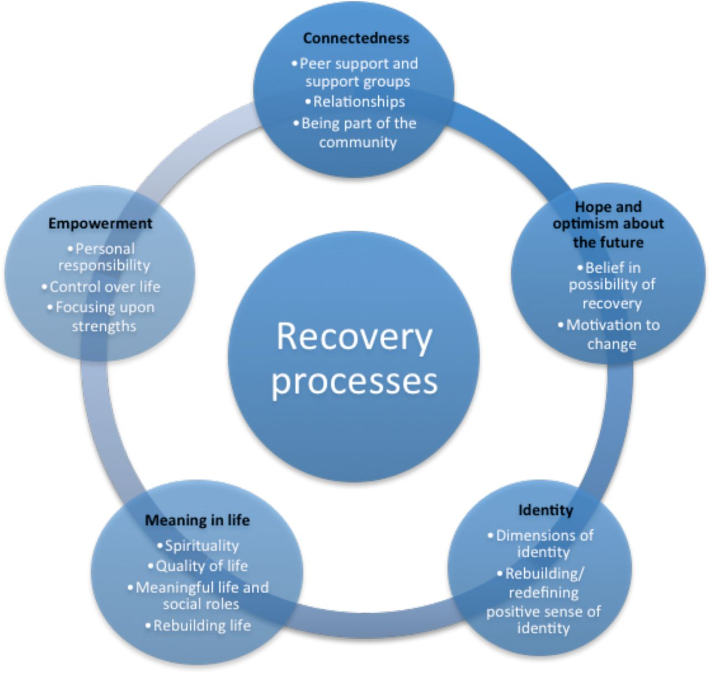
CONTEMPORARY APPROACHES: RECOVERY OR MEDICALISATION?
Modern treatment combines medication, psychological therapies and early intervention services (Reichert et al., 2025). The recovery model promotes empowerment and social inclusion. Yet concerns remain regarding long-term antipsychotic use and pharmaceutical influence (Clark et al., 2024). Stigma continues to shape public attitudes, reinforcing marginalisation (Hackmann et al., 2022).
Despite progress, biomedical frameworks remain dominant.
Figure 1.Recovery model diagram. Source: (Rodríguez et al, 2023).
SOCIAL CONTEXT AND FUTURE DIRECTIONS
Research shows that trauma, poverty and social disadvantage can increase the risk of psychosis (Hackmann et al., 2022), so schizophrenia should not be viewed only as a medical condition. Future policy should promote trauma-informed and culturally competent services, reduce the use of compulsory detention, and involve service users in decisions about their care (Torales et al., 2025). Greater investment in housing and social support is also essential. Without tackling these wider inequalities, past patterns of disadvantage will continue in modern mental health services (Jantzi and Moulin, 2025).
CONCLUSION
The development of treatment for schizophrenia reflects larger changes in medical understanding and societal norms. Even though ICD-11 and recovery-oriented models are advancements, ongoing discussions about inequality, medicalization, and validity are still crucial.
Integrating clinical, social, and structural viewpoints is necessary for a socially just approach.

Slide 4
REFERENCES
Clark, L.A., Cuthbert, B., Lewis-Fernández, R., Narrow, W.E. and Reed, G.M., (2024). Three approaches to understanding and classifying mental disorder: ICD-11, DSM-5, and the National Institute of Mental Health’s Research Domain Criteria (RDoC). Psychological Science in the Public Interest, 18(2), pp.72-145.
First, M.B., Gaebel, W., Maj, M., Stein, D.J., Kogan, C.S., Saunders, J.B., Poznyak, V.B., Gureje, O., Lewis‐Fernández, R., Maercker, A. and Brewin, C.R., (2023). An organization‐and category‐level comparison of diagnostic requirements for mental disorders in ICD‐11 and DSM‐5. World Psychiatry, 20(1), pp.34-51.
Freeborn, A., (2025). Testing psychiatrists to diagnose schizophrenia: Crisis, consensus, and computers in post-war psychiatry. History of the Human Sciences, 38(2), pp.18-39.
Gaebel, W., Kerst, A. and Stricker, J., (2023). Classification and diagnosis of schizophrenia or other primary psychotic disorders: changes from ICD-10 to ICD-11 and implementation in clinical practice. Psychiatria Danubina, 32(3-4), pp.320-324.
Hackmann, C., Balhara, Y.P.S., Clayman, K., Nemec, P.B., Notley, C., Pike, K., Reed, G.M., Sharan, P., Rana, M.S., Silver, J. and Swarbrick, M., (2022). Perspectives on ICD-11 to understand and improve mental health diagnosis using expertise by experience (INCLUDE Study): an international qualitative study. The Lancet Psychiatry, 6(9), pp.778-785.
Hanlon, N., (2025). Relational justice pedagogy in social care education: key insights from critical perspectives on intellectual disability. International Journal of Social Pedagogy, 14(1).
Jantzi, C. and Moulin, V., (2025). The new ICD-11 diagnosis of personality disorder in forensic psychiatry. Frontiers in Psychiatry, 16, p.1630512.
NHS Digital (2022) Mental Health Act Statistics, Annual Figures. Available at: https://digital.nhs.uk/data-and-information/publications/statistical/mental-health-act-statistics-annual-figures [Accessed: 20th February 2026].

Slide 5
Reichert, R.A., da Silva, E.A., De Micheli, D., Noto, A.R., Skinstad, A.H. and Galduróz, J.C.F., (2025). Substance use disorders: History, theoretical models and diagnostic criteria (ICD-11 e DSM-5-TR). In Neuropsychology and Substance Use Disorders: Assessment and Treatment (pp. 3-49). Cham: Springer Nature Switzerland.
Rodríguez, A., Smith, J. and Brown, L. (2023) ‘Conceptual framework for personal recovery in mental health among children and adolescents: a systematic review and narrative synthesis protocol’, BMJ Open, 11(3).
Shmukler, A.B., (2024). The evolution of approaches to schizophrenia diagnostics: from Kraepelin to ICD-11. Consortium Psychiatricum, 2(2), p.65.
Torales, J., Torres-Romero, A.D., Ventriglio, A., Castaldelli-Maia, J.M., Caycho-Rodríguez, T., Hualparuca-Olivera, L., Barrios, I. and O’Higgins, M., (2025). From DSM-IV to the future: three decades of evolution in psychiatric classification and what lies ahead. International Review of Psychiatry, pp.1-10.
Valle, R., (2024). Schizophrenia in ICD-11: Comparison of ICD-10 and DSM-5. Revista de Psiquiatría y Salud Mental (English Edition), 13(2), pp.95-104.
World Health Organization, (2024). Clinical descriptions and diagnostic requirements for ICD-11 mental, behavioural and neurodevelopmental disorders. World Health Organization.
Yamin, A.E. and Malca, C.G., (2025). Institutional Corruption in the Political Economy of Global Mental Health: Challenges for Transformative Human Rights Praxis. Health and Human Rights, 27(2), p.165.
Yasin, S., Adeel, M., Draz, U., Ali, T., Hijji, M., Ayaz, M. and Marei, A.M., (2025). A CNN-Transformer fusion model for proactive detection of schizophrenia relapse from EEG signals. Bioengineering, 12(6), p.641.

