Slide 1
Microbial lifestyles and the Winogradsky Column

Slide 2
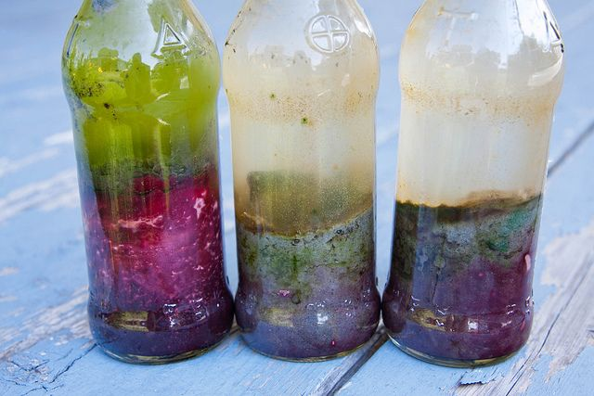
Summary of the Winogradsky column experiment
A method to study otherwise inaccessible organisms
Re-creates the conditions needed for bacterial growth
Saturated earth is supplemented with sulphur an carbon, sealed and incubated in the light
Bacterial growth responds in patterns or zones reflecting the substrate and aerobic concentrations

Slide 3
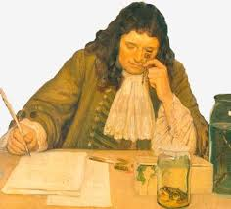
What is Microbiology?
The study of organisms invisible to the human eye
Antoni van Leeuwenhoek (1632 – 1723)
“The Father of Microbiology”
Started to explore microbes with his microscope
Called microbes animalcules “tiny animals”
Unicellular and multicellular microbes from natural environments
First to document microscopic observations of bacteria, protozoa, spermatozoa, red blood cells, muscle fibres and blood flow in capillaries
Believed his findings were proof of the wonder of creation

Slide 4
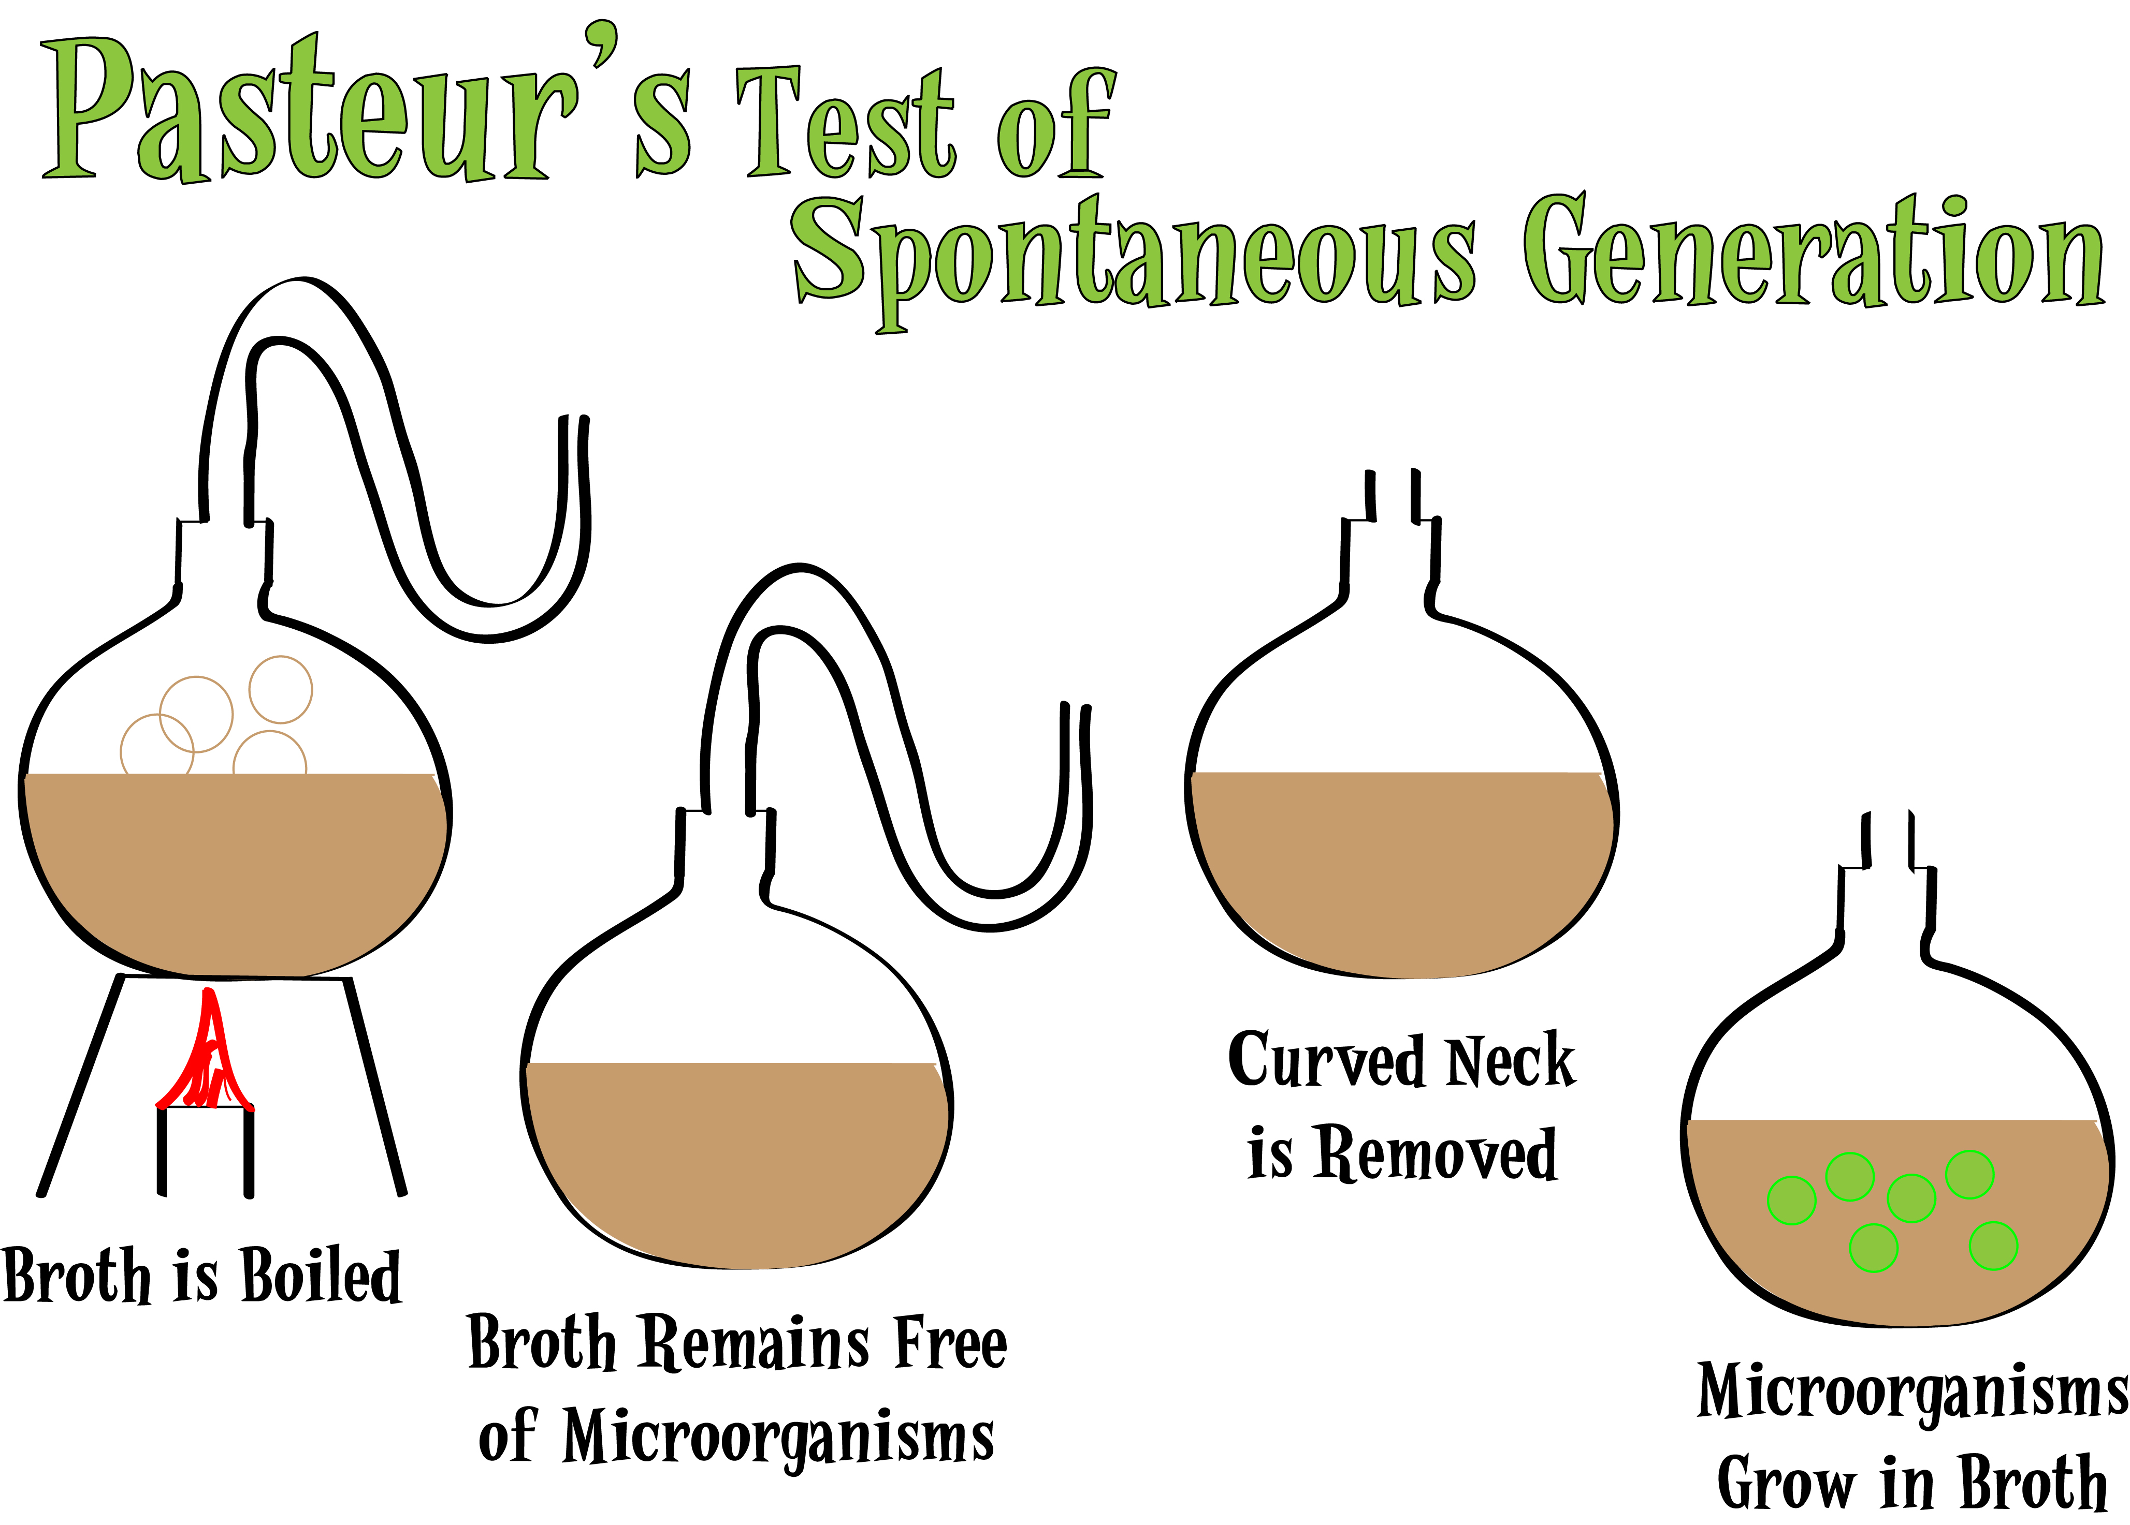
Prior to van Leeuwenhoek’s work spontaneous generation was widely hypothesised
Certain forms of life could arise from inanimate matter e.g. maggots from dead flesh
van Leeuwenhoek’s observations lay the groundwork for dispelling this hypothesis
Louis Pasteur 1859
Used sterilised cultures kept isolated from the environment
Clouding of the broth only happened when the microcosms were not sealed off
Proved that all life originates from living sources
Led to the biogenesis hypothesis and the discovery of germ theory
https://bio.libretexts.org/Bookshelves/Microbiology/Book%3A_Microbiology_(Boundless)/1%3A_Introduction_to_Microbiology/1.1%3A_Introduction_to_Microbiology/1.1C%3A_Pasteur_and_Spontaneous_Generation

Slide 5
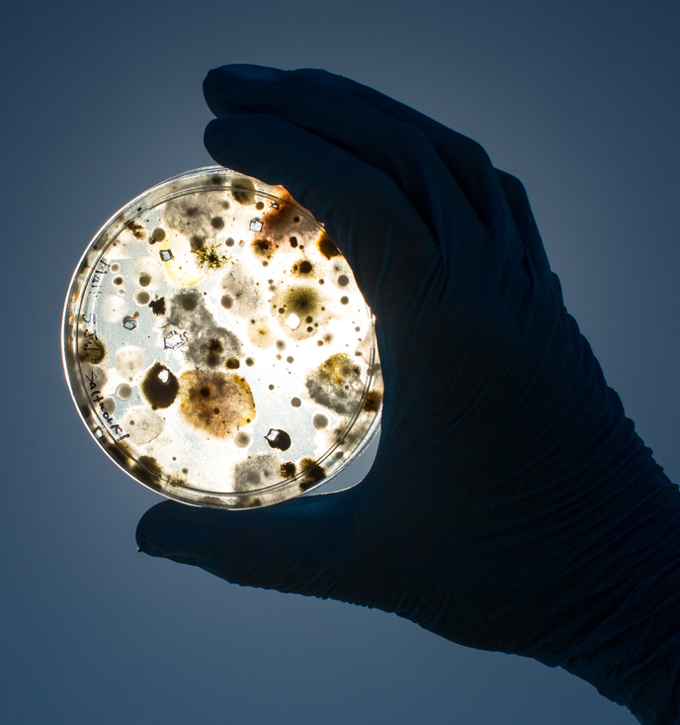
Why study microbes?
Involved in and drive many of life’s processes
Highly adapted to their environment
Highly sensitive to environmental change
Excellent indicators of the condition of the environment
Source of many useful chemical products e.g. medicines
Can be used in industrial cleaning and environmental remediation applications due to diverse nutritional modes

Slide 6
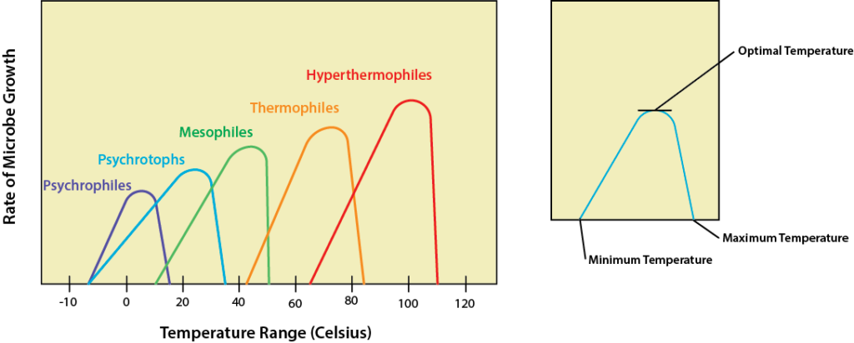

Where do microbes live?
All habitats on Earth
Baas-Becking hypothesis: “Everything is everywhere, but the environment selects” (Lourens Baas-Becking 1934)
i.e. environmental filtering over dispersal constraints
If a metabolic strategy is thermodynamically feasible, there is some microbe somewhere that uses that strategy
There are extremophiles & mesophiles

Slide 7
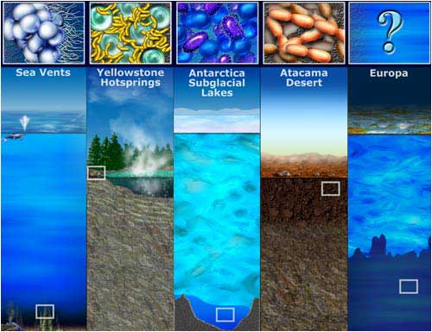
Microbes and environmental factors
Temperature
Light
pH
Oxygen
Water & osmotic pressure
Barometric pressure
Notes:
microbes, particularly the prokaryotes, are the most successful group of organisms on the planet and you get extremophiles that live in even the most extreme of environments. They have literally colonised every inch of our planet
Whether a microbial cell is able to tolerate conditions within a given range of points on all of these scales has allowed us to categorise much of what we’ve been able to categorise of microbial life. So we group these organisms according to their abilities to withstand each of these factors
It’s important to remember that each of these factors is going to affect the functionality of the enzymes needed by microbes for cellular functions so they affect a microbe’s ability to metabolise their food as well as physically affecting the microbe themselves

Slide 8
Temperature
Three cardinal temperatures:
Minimum temperature – lowest temperature that permits a microbe’s growth and metabolism
Maximum temperature – highest temperature that permits a microbe’s growth and metabolism
Optimum temperature – promotes the fastest rate of growth and metabolism
Notes:
Microbes have no way of regulating their internal temperature so they are going to be highly sensitive to changes in it and temperature is also a significant driver of enzyme activity, either being too low to facilitate enzymatic activity or so high that the enzymatic proteins are denatured and unfolded so they lose their functionality
And of course there is going to be a range of temperatures that a microbe, or any organism, can withstand so we will often talk in microbial ecology in terms of the three cardinal temperatures
That is the lowest and highest temperatures a microbe can withstand before metabolism stops and cell death occurs
But also the optimum temperature that promotes the fastest growth rate and metabolism
To test these limits we use growth curves wherein microbes are grown under different conditions and the number of calls counted at regular intervals over a set period, often 24 or 36 hours
Growth curves allow us to plot the number of live microbial cells over time, resulting in a curve with an asymptote which is representative of the optimum temperature
The cardinal temperatures are going to be dictated very much by where in nature the microbes are found – those associated with mammalian guts for example are going to have a hard time growing at anything below around 10 degrees Celsius or above 45 or 50 degrees C and their optimum temperature is going to be around 37 degrees

Slide 9
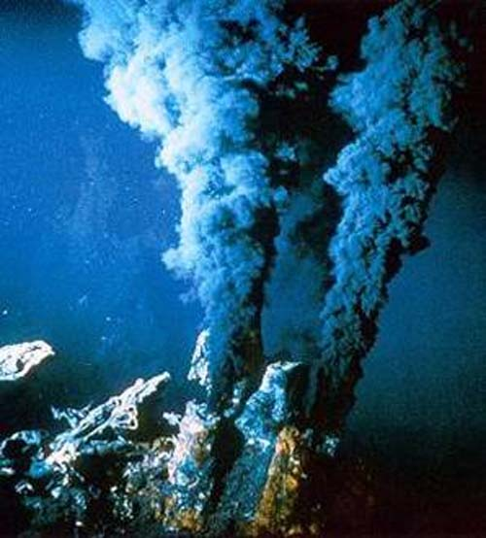
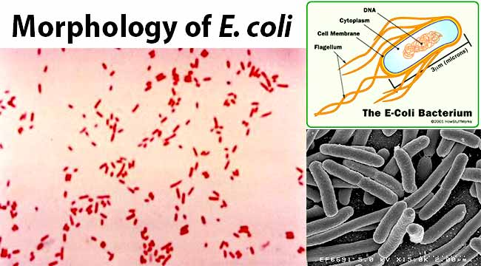
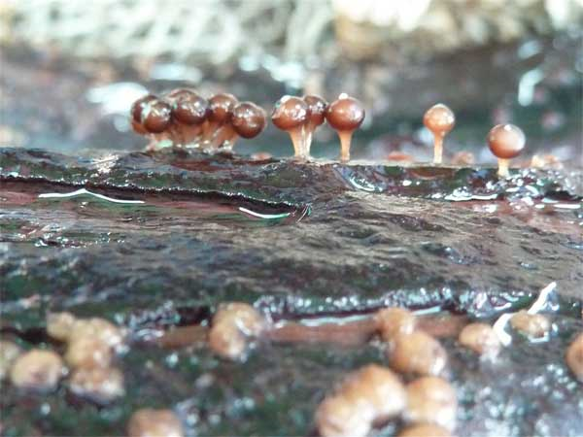
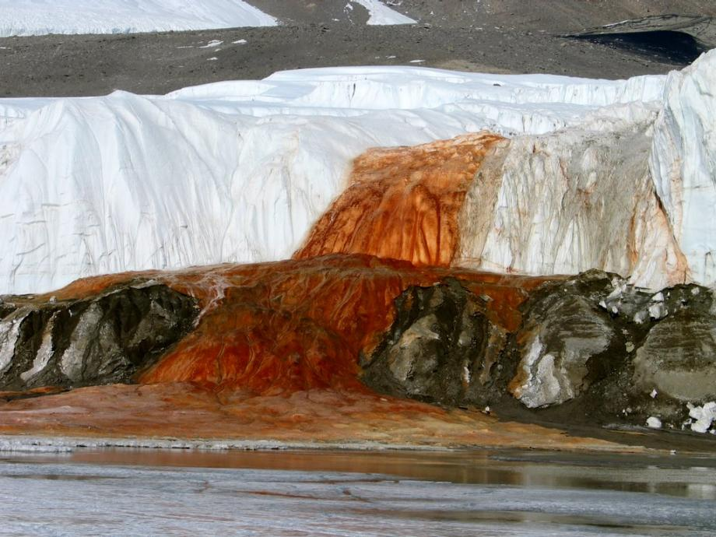
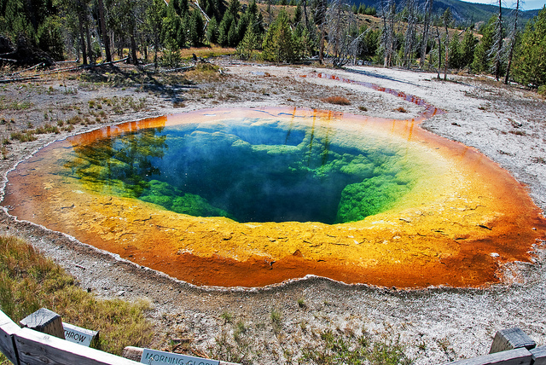

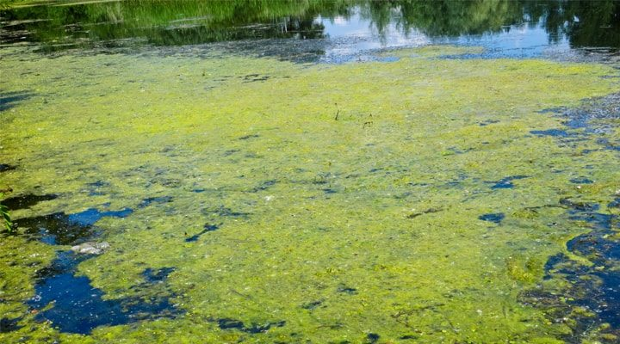
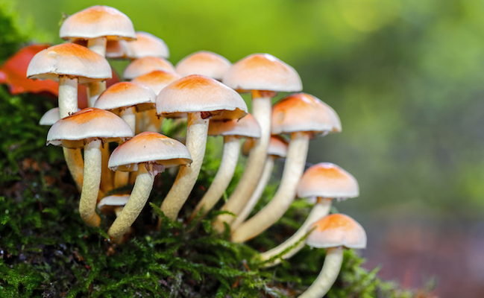
Temperature adaptation groups
Psychrophiles – optimum temperature below 15°C; capable of growth at 0°C
Mesophiles – optiumum temperature 20° - 40°C; most animal and plant pathogens and soil and wood saprobes
Thermophiles – optimum temperature greater than 45°C
Notes:
microbes fall within three main adaptation groups as far as temperature is concerned, psychrophiles mesophiles and thermophiles but there are also other ranges between and to the extremes of those that microbes fall into
Psychrophiles are the cold lovers with an optimum of 15°C or lower and a growth range of around -20 to +20°C. Most of these microbes are found in the oceans where the temperature os often 5°° or cooler. They can also be found living in pockets of liquid in glaciers and this is an image of a community of microbes that had been trapped for millions of years inside a salt and iron rich pocket inside the Taylor Glacier in Antarctica and is now ‘bleeding’ out into the ocean
Ive also put here a picture of one of the marine fungi because there are indeed many marine fungi which are a much understudied group. This one is known as Alisea longicolla found in 2010 growing on a piece of submerged wood
Adaptation to the cold required evolution of specific proteins, particularly enzymes, that can still function in low temperatures as well as modification of the plasma membrane to keep it semifluid and an increased amount of unsaturated and shorter-chain fatty acids.
Psychrophiles produce cryoprotectants, special proteins or sugars that prevent the development of ice crystals that might damage the cell
There are also psychrotrophs which are cold tolerators, rather than cold lovers, and have a range of 0-35 degrees with an optimum of around 16 degrees. These include pathogens that can be very dangerous to humans because they can withstand refrigeration and are much more common than psychrophiles
We are probably best acquainted with the mesophiles, microbes with a growth optima of 37ºC and a range of 20-45ºC.
Almost all of the human microflora fall into this category, as well as almost all human pathogens. The mesophiles occupy the same environments that humans do, in terms of foods that we eat, surfaces that we touch, and water that we drink and swim in
On the warmer end of the spectrum is where we find the thermophiles (“heat lovers”), the microbes that like high temperatures. Thermophiles typically have a range of 45-80ºC, and a growth optimum of 60ºC.
There are also the hyperthermophiles, those microbes that like things extra spicy. These microbes have a growth optima of 88-106ºC, a minimum of 65ºC and a maximum of 120ºC. This group largely belong to the archea and are found in environments like the deep sea vents
Both the thermophiles and the hyperthermophiles require specialized heat-stable enzymes that are resistant to denaturation and unfolding, partly due to the presence of protective proteins known as chaperone proteins. The plasma membrane of these organisms contains more saturated fatty acids, with increased melting points.

Slide 10
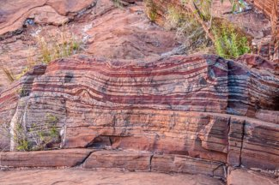
Gas requirements
Oxygen – anaerobes & aerobes
Toxic by-products
  Singlet oxygen ¹O₂
  Superoxide ion O₂⁻
  Hydrogen peroxide H₂O₂
  Hydroxyl radicals OH⁻
Adaptation = neutralising enzymes evolved from obligate anaerobes
Cyanobacteria → Oxygen revolution & ancient rust 3.4 – 2.5 billion years ago
Notes:
Another factor is oxygen availability
Given that we are very much aware of our need of oxygen to survive, the tendency I think is to think of oxygen as always having a positive effect on the organism
But cellular respiration creates several toxic by-products of oxygen such as hydrogen peroxide and hydroxyl radicals
Most cellular life has developed enzymatic adaptations to neutralise these chemicals
But, don’t forget that microbes created the “oxygen revolution” on Earth. No oxygen existed on the planet prior to its creation 4.5 billion years ago
Life emerged around 3.8 billion years ago in an anaerobic environment so the original prokaryotes were obligate anaerobes
Cyanobacteria evolved between around 3.4 and 2.5 billion years ago and they were able to photosynthesise which produced oxygen as a by-product
The evidence for this comes in the form of banded iron formations, ancient rust, in marine sediments which appear as a result of oxygen build-up oxidising iron in the oceans forming iron oxide. Prior to that time period, there was no oxygen build up and therefore no rust in the sediment
Following that period oxygen build up increased until oxygen concentration in the oceans and atmosphere started to select against obligate anaerobes – there were fewer and fewer places left for them to hide and obligate aerobes began to evolve
So if a microbe is not capable of dealing with toxic oxygen it is forced to live in oxygen free habitats

Slide 11
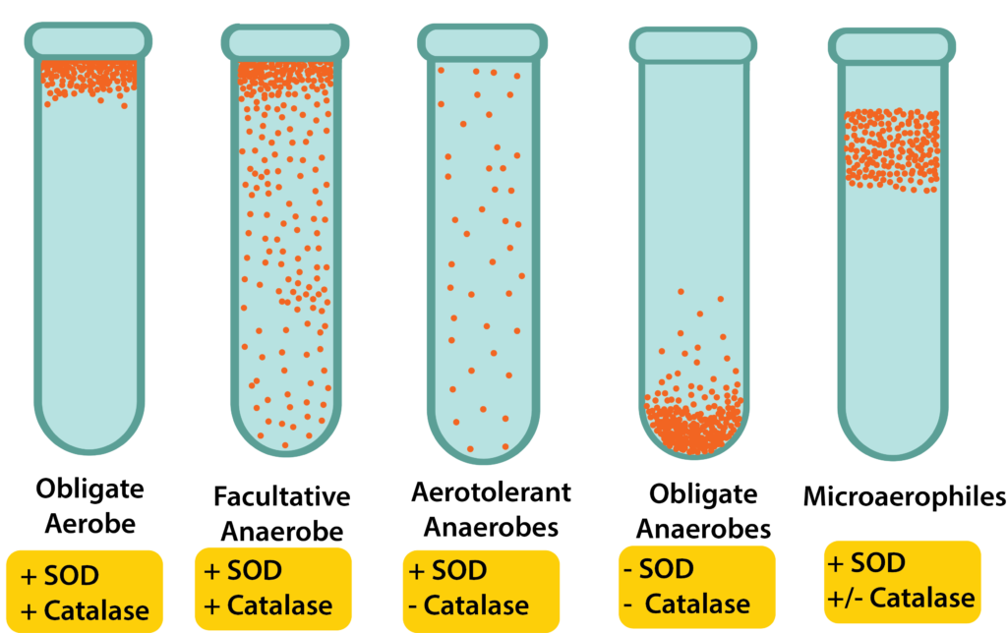
Oxygen requirements
Aerobe – utilises oxygen and can detoxify it
Obligate aerobe – cannot grow without oxygen
Microaerophilic – requires a small amount of oxygen to survive
Anaerobe – don’t utilise oxygen
Obligate anaerobe – lacks the enzymes to detoxify oxygen so cannot survive in an environment where oxygen is present
Aerotolerant anaerobes – do not utilise oxygen but can survive in its presence
Facultative anaerobe – utilises oxygen when available but can also grow in its absence
Notes:
The oxygen requirement of an organism relates to the type of metabolism that it is using.
Energy generation is tied to the movement of electrons through the electron transport chain (ETC), where the final electron acceptor can be oxygen or a non-oxygen molecule.
Organisms that use oxygen as the final electron acceptor are engaging in aerobic respiration for their metabolism.
If they require the presence of atmospheric oxygen (20%) for their metabolism then they are referred to as obligate aerobes.
Microaerophiles require oxygen, but at a lower level than normal atmospheric levels – they only grow at levels of 2-10% and are often found in environments like soil
Organisms that can grow in the absence of oxygen are referred to as anaerobes, with several different categories existing.
The facultative anaerobes are the most versatile, being able to grow in the presence or absence of oxygen by switching their metabolism to match their environment.
Often they would prefer to grow in the presence of oxygen, however, since aerobic respiration generates the largest amount of energy and allows for faster growth.
However if there is no oxygen present facultative aerobes are often able to produce their own oxygen through fermentation of sugars in their environment
Gut-associated microbes like e coli are often facultative anaerobes because oxygen isn’t always present in the gut and e coli also needs to be able to survive outside of the mammalian body in fecal matter and in the soil
Aerotolerant anaerobes can also grow in the presence or absence of oxygen, exhibiting no preference.
Obligate anaerobes can only grow in the absence of oxygen and find an oxygenated environment to be toxic so they are highly restricted to extreme envioronments
The toxic by-products of oxygen and collectively called reactive oxygen species or ROS.
The enzymes that can offer some protection from ROS include superoxide dismutase (SOD), which breaks down superoxide radicals, and catalase, which breaks down hydrogen peroxide.
One way we identify microbes from environmental samples is to grow them in media with a pH indicator in test tubes and either prevent or allow the availability of oxygen by covering the media or not with oil or wax
Microbes, because they acidify their environment, will change the colour of the medium so we can see where in the test tube they have grown
Obligate aerobes will grow near the top of the tube where there is plenty of oxygen availability while obligate anaerobes will grow at the bottom where there is no oxygen
Facultative anaerobes will grow most densely where there is more oxygen but will also grow more sparsely deepr down in the tube, while aerotolerant anaerobes will grow equally densely throughout the tube and microaerophiles will grow in a band somewhere near the top but not at the very top where the oxygen availability is just right for them

Slide 12
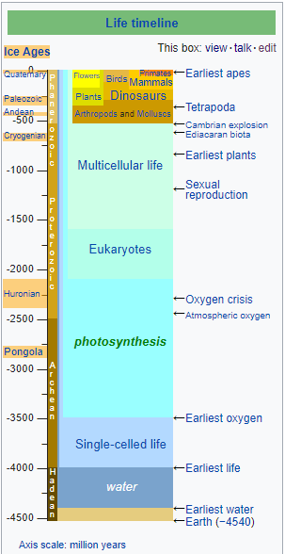
Light availability
An archea, common ancestor of the Cyanobacteria, first organism to harvest light energy
Possibly around 3.4 billion years ago
Used H2O as a source of electrons in photosynthesis
Sunlight (UV light) degrades DNA and so some microbes are sensitive to light
Microbes develop pigments to combat UV damage – useful natural products

Slide 13
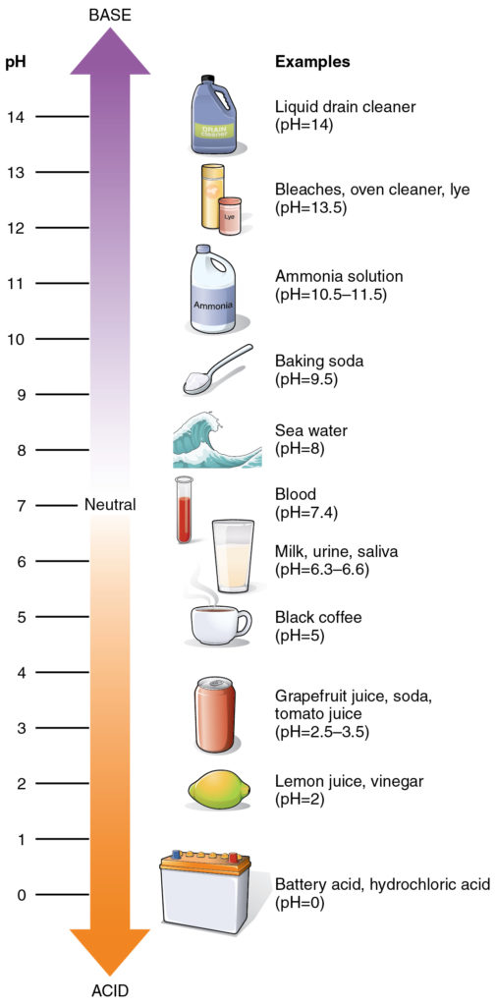
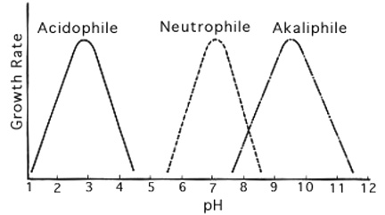
pH
Notes:
pH is defined as the negative logarithm of the hydrogen ion concentration of a solution, expressed in molarity.
The pH scale ranges from 0 to 14, with 0 representing an extremely acidic solution (1.0 M H+) and 14 representing an extremely alkaline solution (1.0 x 10-14 M H+).
Each pH units represents a tenfold change in hydrogen ion concentration, meaning a solution with a pH of 3 is 10x more acidic than a solution with a pH of 4.
Typically cells would prefer a pH that is similar to their internal environment, with cytoplasm having a pH of 7.2.
That means that most microbes are neutrophiles (“neutral lovers”), preferring a pH in the range of 5.5 to 8.0. There are some microbes, however, that have evolved to live in the extreme pH environments.
Acidophiles (“acid lovers”), preferring an environmental pH range of 0 to 5.5, must use a variety of mechanisms to maintain their internal pH in an acceptable range and preserve the stability of their plasma membrane.
So an example is the prokaryote genus Thiobacillus which are obligate chemo-autotrophs. They use elementary sulfur as an energy source from which they oxidise the carbon into carbon dioxide before assimilating it
Theobacillus are found in many environments like brackish mud, soil, freshwater and marine sediments, sewage, digestion tanks and mines
Alkaliphiles (“alkaline lovers”), preferring an environmental pH range of 8.0 to 11.5, usually with an optimal pH of around 10
An example is a genus of heliobacteria called Natronomonas which grows optimally in 3.5M (molar) sodium chloride at a pH of 8.5. In nature they are found in environments highly saturated with salt like the soda lakes of Kenya and Egypt

Slide 14
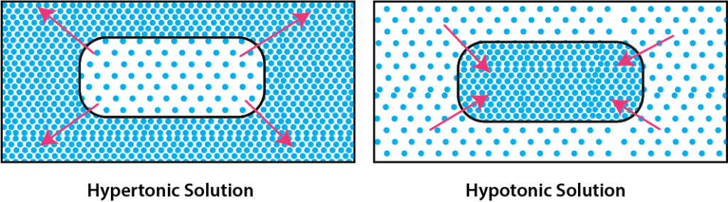
Water and osmolarity
Halophiles – require a high concentration of salt
Osmotolerant – do not require a high concentration of solute but can tolerate it when it occurs
Notes:
All microbes need water to survive. Being very small means being intricately connected with your environment and so microbes are able to colonise environments where water availability is very very low, for example on human skin
However microbes are differently adapted to levels of osmotic pressure which is a function of the availability of salts in the water inside and outside of the cell
Cells are subject to changes in osmotic pressure and differences in osmolarity between the inside and the outside of the cell
This is caused by the concentration of solutes, that is salts, in the fluid inside and outside of cells
Iif a microbe finds itself in an environment where the concentration of solutes outside the cell is greater than inside then fluid is going to pass into the cell causing it to swell. If the situation is not rectified then the cell will burst, a process we call lysis
Conversely if the concentration of solute is lower outside of the cell than fluid will diffuse out of the cell and the cell will dehydrate. Extended periods of dehydration will cause permanent damage to the cell membrane
Most microbes exist under either hypotonic or isotonic conditions, isotonic meaning there is equilibrium
Some microbes have developed mechanisms allowing them to withstand high levels of salt in the environment. An example are the Staphylococcal bacteria that live on human skin and can cause infections of the skin, blood, lungs and heart and also the archea found in highly saline environments like in the Great Salt Lake in the United States

Slide 15
Other environmental factors
Barophiles – can survive under extreme pressure and will rupture if exposed to normal atmospheric pressure
Also called a piezophile
Found deep in the earth in deep sea hydrothermal vents etc
Notes:
some microbes, particularly archea, are able to withstand extreme pressure that would normally be lethal to cellular life
In order to inhabit such extreme environments, these organisms have evolved various mechanisms to counteract the effects of the elevated pressures they endure but relatively little is known about those mechanisms yet
We know that high pressure has a similar effect on the cell membrane as low temperature, which reduces fluidity by acting on fatty acids causing the membrane to become gel-like which inhibits nutrient uptake and cell signaling
In fact most barophiles we know of will be subject to both extremes of pressure and low temperature and they tend to have increased proportions of nonsaturated and polyunsaturated fatty acids in their membranes which can’t be packed as tightly as saturated fatty acids and so the cell membrane maintains it’s fluidity and doesn’t become gel-like

Slide 16
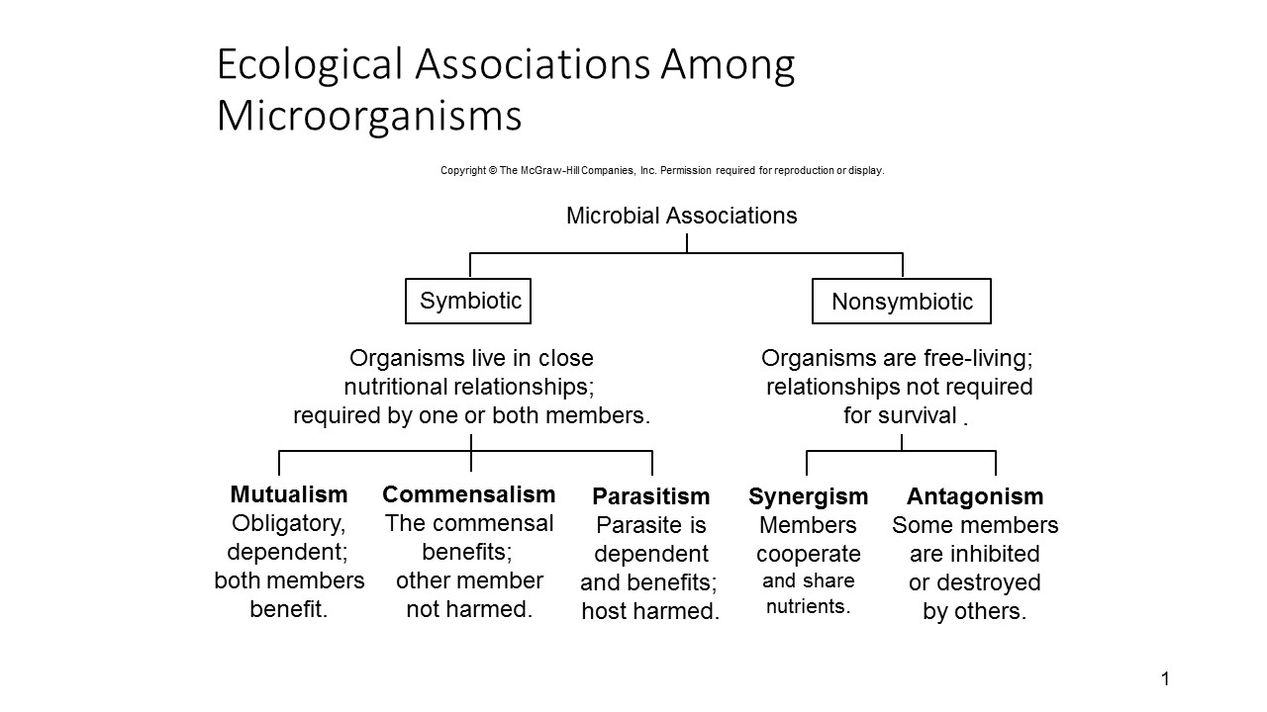
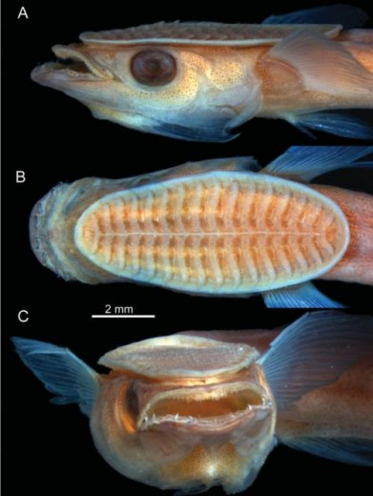
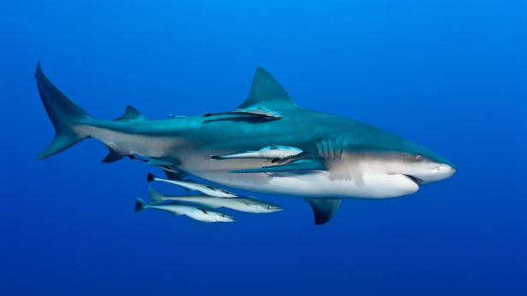
Ecological associations of microbes
Mostly microbe-host interactions
Mostly microbe-microbe interactions
Notes:
Another factor that affects microbial lifestyles is the associations they form with other organisms
Can anyone tell me what symbiotic means?
OK so symbiosis is a close and long-term biological interaction between two different types of organisms but there is a general misconception that the relationship is mutually beneficial. In fact that is the definition of mutualism which is one form of symbiosis
But other symbiotic relationships may harm one of the organisms because the host is parasitized or not affect the other organism at all, so has a beneficial effect for one party but a neutral effect for the other
An example of commensalism is the remora fish which attaches itself to other marine animals
OK so what we’re concerned with here is what types of relationships microbes form with each other and with other types of organisms
These are what we call biotic interactions – the interactions organisms have with other biota
And biotic interactions are hugely important in shaping community structure, that is the identity and relative abundance of members of the community
The vast majority of microbes are free living
Some might develop synergistic relationships with other microbes and this is the case certainly for microbes that form biofilms
In the vast majority of cases though they are going to be competing for resources and so they are going to develop antagonistic, competitive relationships with each other
This is true of most communities of microbes
What keeps the communities in check and maintains diversity in these communities is that, in addition to biotic pressures from each other, community members are also going to be subject to abiotic interactions that is interactions with the physical environment so all the factors we just looked at.
Even though microbes will be found in environments and habitats to which they have adapted, minor fluctuations in temperature, pH, osmotic potential, water and oxygen availability are going to be acting on the community all the time. Which means that a microbe can rarely, or never, put all of its energy into competitive interactions to maintain its hold on the resource pool
The symbiotic relationships microbes form are largely going to be about food preference and where they live. In the main, organisms with which they form mutualist, commensalist or parasitic relationships are going to be hosts AND these microbes are also then going to form nonsymbiotic relationships with the other microbes that share the same niche space
There are some microbes that do form mutualistic relationships with each other and pass resources between one and the other for example and there are certainly some microbes that parasitise other microbes, the Trichoderma fungi for example are mycoparasites that is they are fungi that infect and then eat other fungi
But in the main microbe-microbe interactions are going to be nonsymbiotic while microbe-host interactions are going to be symbiotic
So in the case of wood decay fungi for example, these fungi do the job of decomposing dead woody material.
They have a commensalist relationship with the host tree because in the main they are not pathogenic so cannot attack healthy wood. The tree likely isn’t affected by the fact that fungi might be degrading parts of it that are already dead.
But the fungi inside the wood are living in highly competitive relationships with each other, constantly fighting for more space and therefore more food within the wood

Slide 17
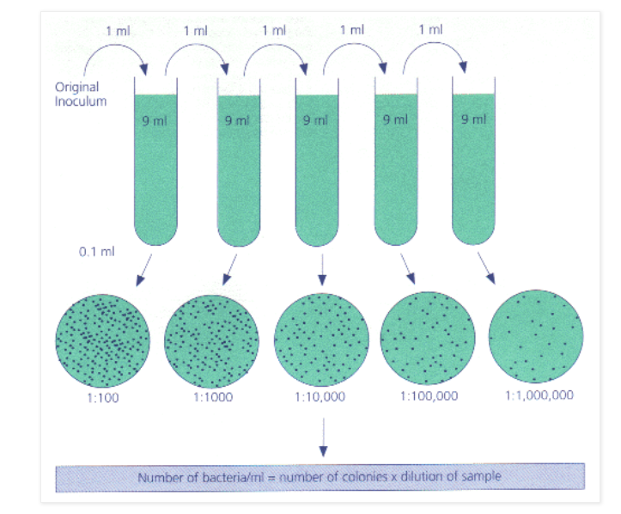

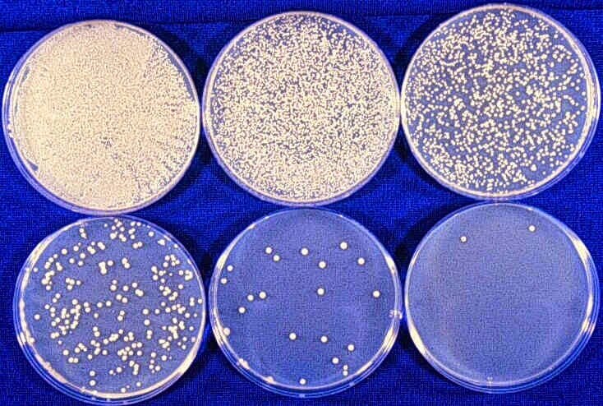
The challenges of studying microbes
Very, very small
Inaccessible habitats
Difficult – impossible to culture
Behaviour is difficult to observe
Too numerous to observe in environmental samples
Dilutions and plate-counts bias results towards culture conditions
Changes happen very quickly

Slide 18
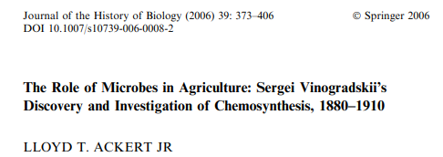
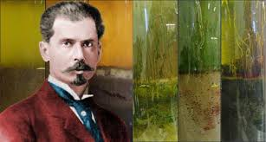
Sergei Winogradsky’s column
Studies microbial interactions
Relationship between microbe identities, microbial activity and environmental conditions
Discovered a novel life process in 1890: chemosynthesis
Some microbes can live solely on inorganic matter (lacking carbon)
E.g. Sulphur (S), Iron (Fe), Nitrogen (N₂)
Solved the mystery of how Nitrogen was converted to useable form for plant nutrition
Also explains how bacteria were able to survive prior to the evolution of photosynthesis and oxygen tolerance

Slide 19
The Winogradsky column - Objectives
How do microbial communities develop in relation to the varying environmental gradients present in natural systems?
Our planet is a closed system, subject to the Law of Conservation of Mass
Microbes help to cycle the limited pool of nutrients, making them constantly available for organisms with different metabolic strategies
Different microbes are adapted to different conditions
Nutrients are cycled through microbes consuming and producing the major nutrients in different forms, leading to zonation and eventually to the original product being restored to the atmosphere
The Winogradsky column is an anaerobic environment and so the major cycle is the sulphur cycle
Adding different nutrients to the column can enhance or diminish the prominence of sulphur-dependent organisms

Slide 20
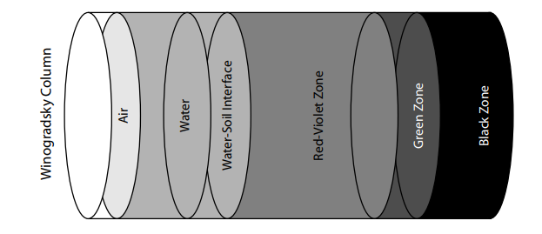
Winogradsky column – chemistry and gradients
Shape of the column creates chemical gradients:
  Oxygen concentration
    Oxic
    Sub-oxic
    Anoxic
  Carbon dioxide concentration
  Hydrogen sulphide concentration
  Nutrients (carbon, sulphur)
  Light
Assignment: research, draw and label the various gradients that apply to each column

Slide 21
Winogradsky column – chemistry and gradients
Oxic zone
The column is open to the air, meaning that the overlying water contains oxygen, carbon dioxide and light. Oxygen in the atmosphere is produced by photosynthesis. Globally around half of the oxygen in the atmosphere is produced by photosynthetic bacteria
Where in the column is oxic?

Slide 22
Winogradsky column – chemistry and gradients
Suboxic zone
The suboxic zone takes its name from the low oxygen levels resulting from respiration of microbes in the overlaying zones.
Since oxygen is a strong electron acceptor, its decrease means that you can find higher levels of reduced compounds in this zone compared to the oxic zone. For example, reduced forms of iron and sulphur have excess electrons that can be transferred in redox reactions and used for energy generation
Where in the column is suboxic?
What does reduced (oxidised) iron look like?

Slide 23
Winogradsky column – chemistry and gradients
Anoxic zone
The anoxic zone is devoid of free oxygen
Instead of using oxygen (like all eukaryotes) in respiration, microbes in anoxic zones use other chemical compounds
Sulphate is an oxidised form of sulphur that is very common in this zone
Where in the column is anoxic?
What chemical is going to be highly concentrated in this zone?

Slide 24
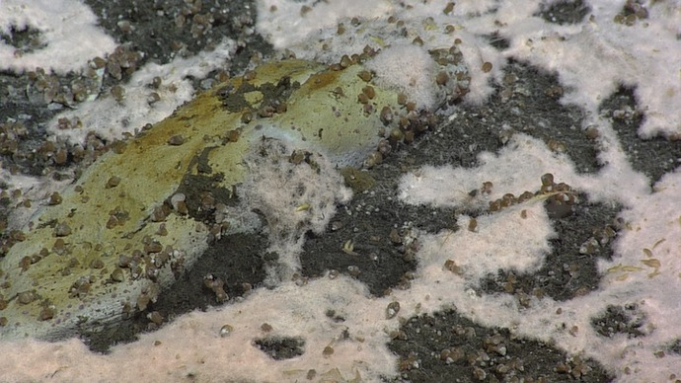
Winogrdasky column – field guide
Sulphide oxidisers
Sulphide oxidizers are a group of bacteria that eat hydrogen sulphide and breathe oxygen. They live near black sediments rich in hydrogen sulphide.
A field mark of sulphide oxidizers is the white scum and fuzz they often produce. They require oxygen and therefore, will not be too deep in the sediment, but may be hidden below the green photosynthetic bacteria and algae.
The ideal location for these microbes is where the layers of oxygen rich sediment and anaerobic, hydrogen-sulphide rich sediment meet, such as marine estuaries
Representative genera: Beggiatoa & Thiobacillus
Morphology: filamentous / rods
Metabolism: chemolithotrophic

Slide 25
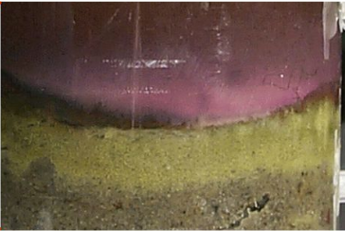
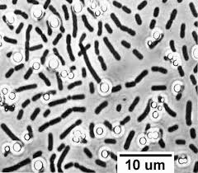
Winogrdasky column – field guide
Green Sulphur bacteria
Green sulphur bacteria can be seen in suboxic to anoxic environments that receive light and have high sulphur and low oxygen levels. They get their energy from light, use hydrogen sulphide as an electron donor and the get their carbon from CO₂.
They can be seen as a thin layer of green beneath the purple bacteria and above a black sediment rich in sulphide.
Representative genera: Chlorobium
Morphology: straight or curved rods
Metabolism: photoheterotrophic

Slide 26
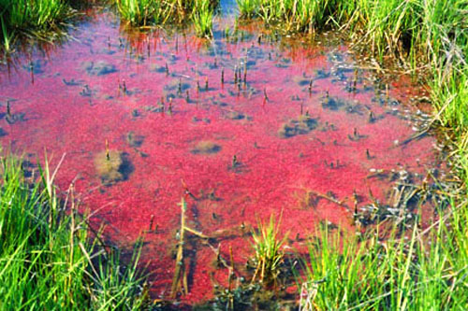
Winogrdasky column – field guide
Purple Sulphur bacteria
Purple sulphur bacteria use hydrogen sulfide, light and carbon dioxide to make sugars. Therefore, they thrive in environments that are within the photic zone and are rich in sulphide compounds.
These bacteria can be found as a purple-pink layer beneath the green cyanobacteria and in contact with sediments that are sulphide-rich, anaerobic, and black in colour.
Representative genera: Chromatium
Morphology: ovals or rods
Metabolism: photoheterotrophic

Slide 27
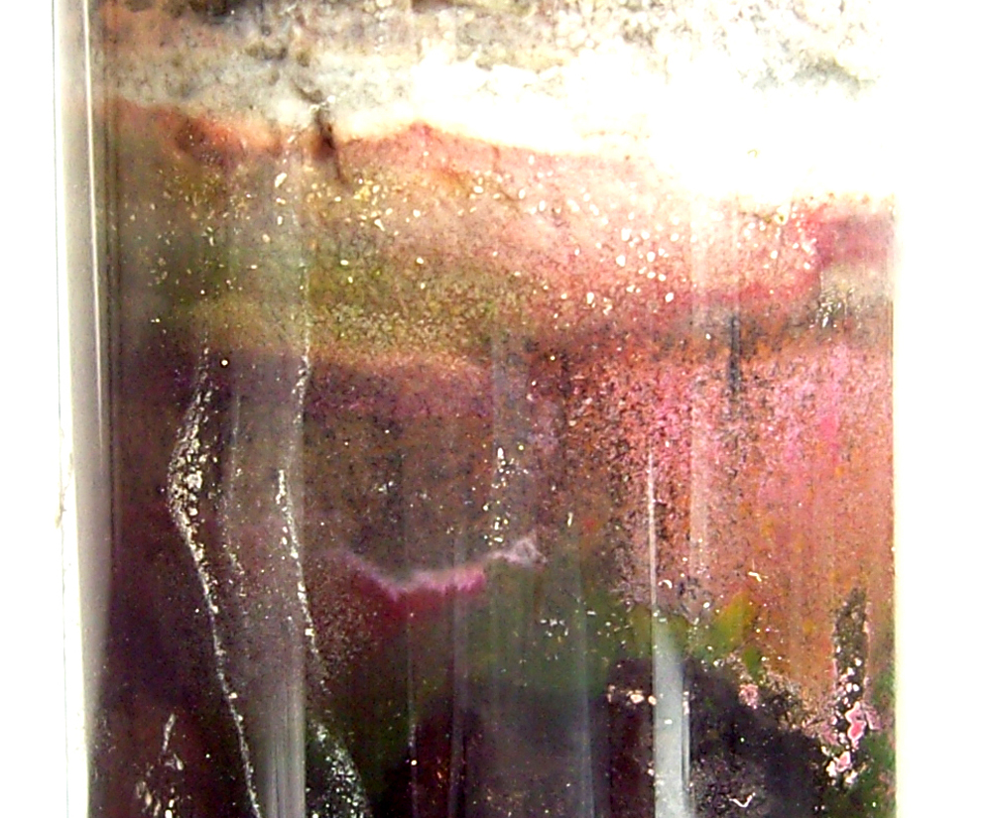
Winogrdasky column – field guide
Purple Non-Sulphur bacteria
The purple non-sulphur bacteria can be found in low-oxygen environments in the photic zone where they can carry out photosynthesis. They gain their carbon from CO₂.
Some representatives of this group are very metabolically flexible. These bacteria can be found in marine, fresh, hypersaline, or thermal waters, and are common in temporary puddles in hardwood forests.
Representative genera: Rhodospirilium & Rhodopseudomonas
Morphology: vibrio-spiral rods
Metabolism: photoheterotrophic

Slide 28
Winogrdasky column – field guide
Sulphur-reducing bacteria
Sulphur reducers eat hydrogen and sugars and breathe sulphate. They produce hydrogen sulphide. They form a black layer of sediment below the photic zone, especially in marine environments as sulphate is plentiful in seawater
Representative genera: Desulfovibirio
Morphology: vibrio (comma shape)
Metabolism: chemoheterotrophic

Slide 29
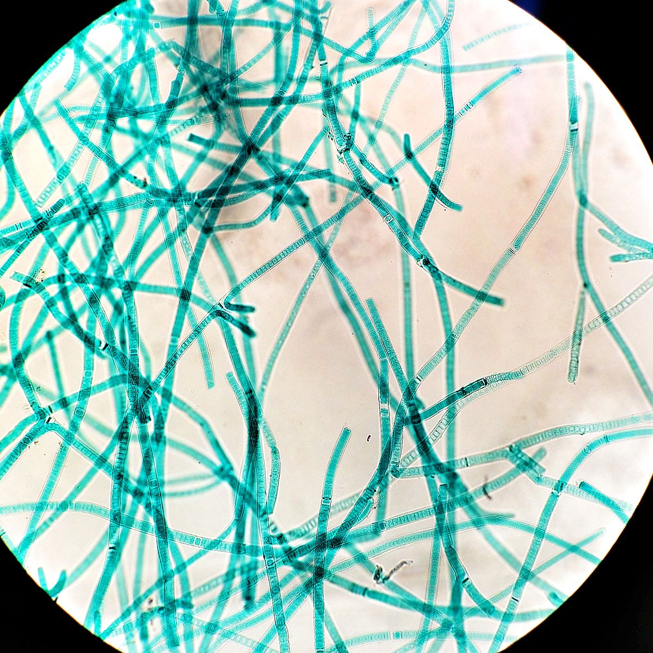
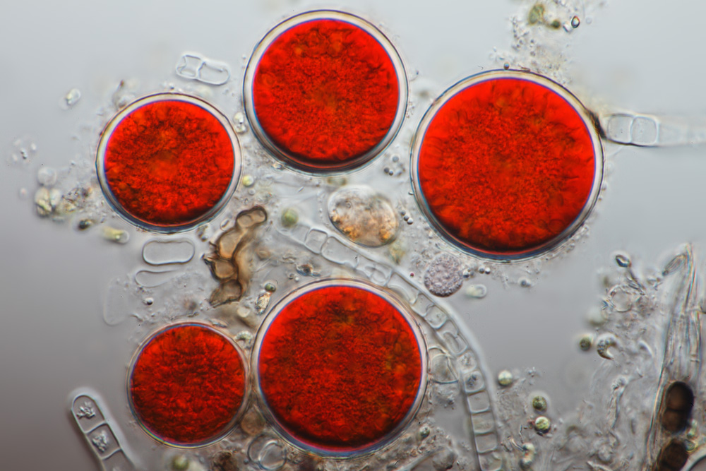
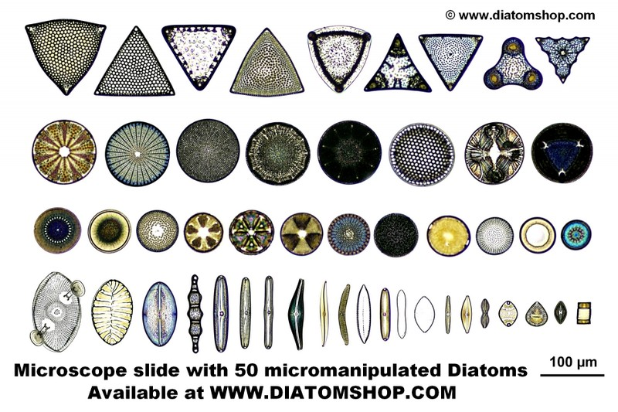
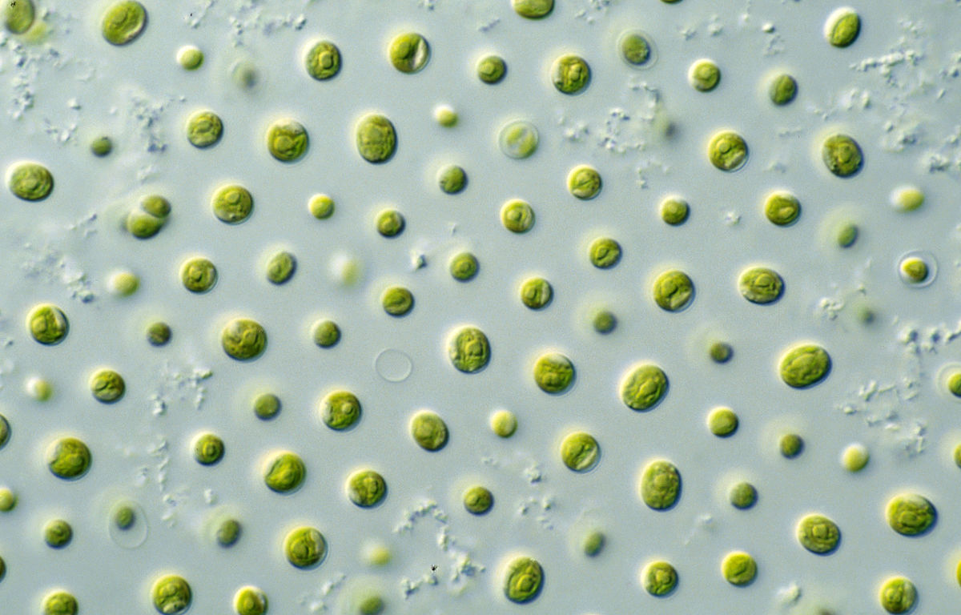
Winogradsky column – field guide
Photosynthesising organisms:
Cyanobacteria – often army green but can also be brown-black patches, gooey reddish-orange floating masses or yellow-brown films free-floating or attached to vegetation
Algae – single celled plants, may be emerald green, blood-red or brown depending on levels of carotene
Diatoms – a type of algae with golden coloured chloroplasts surrounded by silica which makes them appear opalescent. Various shapes and sizes https://diatoms.org/what-are-diatoms
Where will the photosynthesising organisms be found?

Slide 30
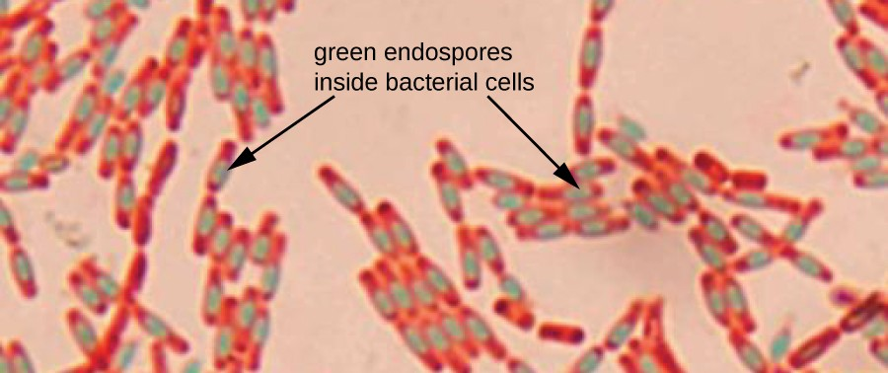
Winogrdasky column – field guide
Fermenting, non-sulphur bacteria
Fermenting bacteria are obligate anaerobes which ferment sugars and produce hydrogen, CO₂ and alcohols as waste products
They are found in the most anaerobic environments including deep in sediments and inside mammalian guts. Their field sign is the presence of bubbles of CO₂ gas
Representative genera: Clostridium
Morphology: rods with endospores
Metabolism: fermentative

Slide 31
Assignment – write up a lab report including well-labelled diagrams
Introduction
  Introduce the experiment: what problem it aims to solve and what question it aims to answer, why it’s an appropriate experimental design to answer the question, some background history of the field and Winogradsky
Methods
  Explain the method in sufficient detail to allow next-years class to replicate your experiment.
  Provide a good-sized and well-labelled diagram of the experimental design
  Explain the major findings you expect (i.e. zonation)
Results and discussion
  Describe the major patterns; the similarities and differences between the three columns
  Provide a good-sized diagram of each column showing the gradients (labelled), major findings (zones) and tabulated interpretation (see field guide)
  Summarise your interpretation of the results and how this relates to biogeochemical processes
Conclusion
  Summarise what you think are the major points from 1, 2 and 3 above

