Slide 1

Croeso i Brifysgol Cymru Y Drindod Dewi Sant
Welcome to the University of Wales
Trinity Saint David

Slide 2

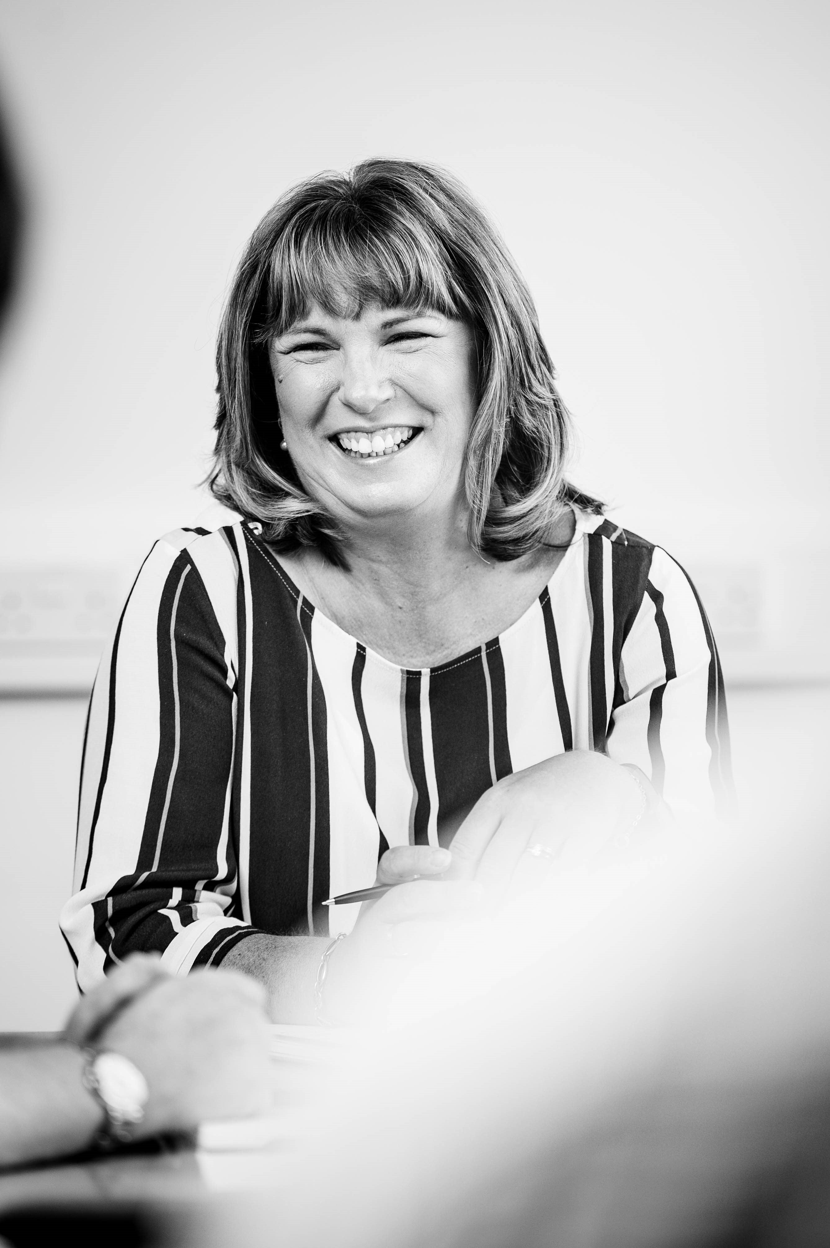

Cyflwyniad i PCYDD
An introduction to UWTSD

Slide 3
Cysylltiadau allweddol ar gyfer eich rhaglen
Key staff contacts for your programme
Sarah Loxdale– Darlithydd a Chyfarwyddwr Rhaglen y Dystysgrif Raddedig / Lecturer and Programme Director for Graduate Certificate S.Loxdale@uwtsd.ac.uk
Mrs Ann Beaumont – Swyddog Gweinyddol – Fframwaith Arfer Proffesiynol / Administrative Officer – Professional Practice Framewok a.beaumont@uwtsd.ac.uk
Dr Annette Fillery-Travis – Pennaeth Academi Cymru ar gyfer Arfer Proffesiynol ac Ymchwil Cymhwysol / Wales Academy for Professional Practice and Applied Research
a.fillery-travis@uwtsd.ac.uk

Slide 4


Reminder for learners
Prior to/after each workshop please access the resources available on Moodle
www.uwtsd.ac.uk/moodle
The Username needs to be in the following format - studentnumber@student.uwtsd.ac.uk
e.g. If your student number is 1234567, you need to enter your Username as:- 1234567@student.uwtsd.ac.uk
If you experience any issues with your student account password please contact the HWB team (hwb@uwtsd.ac.uk)
We also have an IT Service Desk Team who offer 24/7/365 days a year support:-
Phone: 0300-500-5055 or ITServiceDesk@uwtsd.ac.uk
www.uwtsd.ac.uk/moodle
Cyn/ar ôl pob gweithdy, ewch I’r adnoddau sydd ar gael ar Moodle os gwelwch yn dda
www.pcydds.ac.uk/moodle
Rhaid i’r Enw Defnyddiwr fod yn y fformat canlynol -rhifmyfyriwr@myfyriwr.ydds.ac.uk
e.e. Os oes gennych y rhif myfyriwr 1234567, bydd angen i chi roi eich Enw Defnyddiwr i mewn fel a ganlyn: 1234567@myfyriwr.ydds.ac.uk
Os ydych yn cael unrhyw drafferthion gyda’ch cyfrinair ar gyfer eich cyfrif myfyriwr, cysylltwch â’r tîm HWB os gwelwch yn dda (hwb@pcydds.ac.uk)
Mae gennym hefyd Ddesg Wasanaeth TG sy’n cynnig cymorth 24/7/365 diwrnod y flwyddyn:-
Ffoniwch: 0300-500-5055 neu cysylltwch ag ITServiceDesk@ydds.ac.uk
www.pcydds.ac.uk/moodle

Slide 5
Induction to Trinity St David’s
These short videos can be accessed via Moodle.

Slide 6
Porth Agored

Slide 7
Partneriaeth Porth Agored Partnership
Gwynedd
Môn
Conwy
Denbighshire
Wrecsam
Flintshire
Powys
Ceredigion
Carmarthen
Neath Port Talbot
Pembrokeshire
Swansea
University of Wales Trinity Saint David

Slide 8
CPEL
Mae'r Fframwaith CPEL yn disgrifio'r trefniadau sylfaenol ar gyfer addysg a dysg barhaus gweithwyr cymdeithasol ar ôl iddynt gymhwyso i ddechrau er mwyn symud ymlaen ar y llwybr gyrfa:
O 2016 ymlaen mae’r Rhaglen Gadarnhau wedi’i chysylltu â'r tair blynedd gyntaf yn ymarfer ac mae’n ofynnol ar gyfer cyfnod cyntaf ail-gofrestru fel gweithiwr cymdeithasol
The CPEL Framework describes the minimum arrangements for the continuing education and learning of social workers after initial qualification in order to progress on the career pathway:
From 2016 onwards the Consolidation Programme has been linked to the first 3 years in practice and is a requirement for the first period of re-registration as a social worker.

Slide 9
Portffolio / Portfolio
Canllawiau
Cyflwyno’r portffolio
Asesiad
Datganiad cyfrinachedd
Dyslecsia ac amgylchiadau arbennig
Guidance
Presentation of portfolio
Assessment
Confidentiality statement
Dyslexia and other special circumstances

Slide 10
Graduate Certificate in Consolidation of Social Work Practice
Tystysgrif I Raddedigion mewn cadarnhau ymarfer Gwaith Cymdeithasol
Portffolio yn seiliedig ar ofynion Gofal Cymdeithasol Cymru a’r Safonau Galwedigaethol Cenedlaethol
Dadansoddi wrth asesu er mwyn llywio ymyriadau
Cydweithio â phobl sydd angen gofal a chefnogaeth, eu gofalwyr a gweithwyr proffesiynol eraill;
Ymyriad a chymhwyso barn broffesiynol mewn sefyllfaoedd cynyddol gymhleth
Portfolio is based on the Social Care Wales requirements and the National Occupational Standards
Learning outcomes:
Applying analysis in assessment to inform intervention
Working collaboratively with people in need of care and support, their carers and other professionals;
Intervention and application of professional judgement in increasingly complex situations.

Slide 11
Tudalen Cynnwys / Contents Page
Rhestr cynnwys portffolio (Tud.5)
Defnyddiol ar y diwedd i sicrhau fod popeth yn eich portffolio
List of portfolio content (Page 5)
Useful as a tool at the end to ensure your portfolio is complete

Slide 12
Adolygiad Datblygiadol
Developmental Review - Task 1
Ymarfer
Edrych yn ôl ar eich blwyddyn gyntaf o ymarfer, nodwch feysydd yr ydych yn teimlo eich bod wedi'u datblygu'n broffesiynol ers cymhwyso?
Pa feysydd yr ydych yn feddwl fydd yn bwysig i chi eu datblygu dros y flwyddyn nesaf? E.e. bylchau yn eich gwybodaeth neu sgiliau
Activity
Looking back over your first year in practice, identify key areas where you feel you have developed professionally since qualifying?
What areas do you think will be important for you to develop over the next year? E.g. gaps in your knowledge or skills.

Slide 13
Adolygiad Datblygiadol Tasg 1
Developmental Review Task 1
Tasg 1 rhan a (Tud. 6)
750 gair i adfyfyrio ar eich datblygiad proffesiynol ers cymhwyso ac amlinellu'r hyn rydych chi wedi'i nodi a'i gytuno â'ch rheolwr a / neu fentor ar gyfer eich datblygiad dros y 12 mis nesaf. Rhaid i chi ddangos sut rydych chi'n bwriadu cwrdd â 3 phrif amcanion dysgu GCC a defnyddio model adfyfyrio.
Task 1 part a (Page 6)
750 words to critically reflect on your professional development since qualifying and outline what you have identified and agreed with your manager and/or mentor for your development over the coming 12 months. You must demonstrate how you intend to meet the 3 main SCW learning outcomes and use a model of reflection.

Slide 14
Arsylliad / Observation Task 2
Tasg 2 (Tud. 7)
Angen cwblhau 1 arsylliad
Caniatâd y defnyddiwr gwasanaeth
Hyd o leiaf 30 munud neu am gyfnod amser addas i gwrdd a’r deilliannau dysgu os yn rhithiol neu dros y ffon.Canolbwyntio ar sgiliau ac arddull cyfathrebu, Cod Ymarfer Proffesiynol a gwerthoedd
Arsyllwr yn gofyn am adborth gan y defnyddiwr ar ôl yr arsylliad (Tud. 10 Fersiwn hawdd ei ddarllen ar Moodle).
Cofiwch gynnwys gyfeiriad at y Cynnig Gweithredol
Task 2 (Page 7)
Need to complete 1 observation
Seek the individuals permission before hand
At least 30 minutes long or of a suitable duration to meet the learning outcomes if virtually or over the phone
Emphasis is on communication skills and methods, values, ethics and the Code of Professional Practice
Observer gets feedback from individual, following the observation (Page 10 handbook/easy read version on Moodle)
Include reference to the Active offer.

Slide 15
Diogelu Tasg 3/ Safeguarding Task 3
Tasg 3 (Tudalen 11)
Astudiaeth achos myfyriol beirniadol 4000 o eiriau ar ddiogelu plant neu oedolion yn eich prif faes gwaith.
Tasg 4 (Tudalen 13)
Arddangos gwybodaeth a dealltwriaeth o ddiogelu oedolion neu blant mewn maes nad yw'n brif ffocws eich gwaith.
Task 3 (Page 11)
4000 word critically reflective case study based on an assessment concerning the safeguarding of children or adults in your main area of work.
Task 4 (Page 13)
Demonstrate knowledge and understanding of safeguarding adults or children in an area that is not the main focus of your work.

Slide 16
Adolygiad Datblygiadol Tasg 1 rhan b
Developmental Review Task 1 part b
Tasg 1 rhan b (Tudalen 13)
750 gair yn myfyrio'n feirniadol ar eich datblygiad proffesiynol dros gyfnod y rhaglen yn seiliedig ar eich adfyfyriad yn Nhasg 1 rhan a.
Gan gynnwys adfyfyrio ar adborth a gawsoch gan unigolion sydd angen gofal a chefnogaeth.
Task 1 part b (Page 13)
750 words critically reflecting on your professional development over the duration of the programme based on your reflection in Task 1 part a.
Including reflecting on feedback you have received from individuals in need of care and support.

Slide 17
Adroddiad y Mentor a gwiriad y Rheolwr Llinell
Mentor’s Report and Line Managers Verification
Mae cyflwyno adroddiad Mentor ynghyd â gwiriad Rheolwr Llinell yn ofyniad gorfodol ar gyfer y cyflwyniad. Bydd methu â chynnwys adroddiad Mentor wedi’i lofnodi ynghyd â gwiriad Rheolwr Llinell yn arwain at fethu’r rhaglen.
Submission of a Mentor’s report together with Line Manager’s verification is a compulsory requirement of the submission. Failure to include a signed Mentor’s report together with Line Manager’s verification will result in failure of the programme.

Slide 18
Adroddiad y Mentor a gwiriad y Rheolwr Llinell
Mentor’s Report and Line Managers Verification
Bydd adroddiad y Mentor ynghyd â gwiriad y Rheolwr Llinell yn darparu tystiolaeth o Ymarfer Proffesiynol a goruchwyliaeth ac arsylwi arfer proffesiynol sydd wedi’u cyflawni wrth ddilyn llwybr y Dystysgrif Raddedig mewn Cadarnhau Ymarfer Gwaith Cymdeithasol, sydd yn cyfateb i 7,000 o eiriau.
The Mentor’s report together with the Line Manager’s verification will provide evidence of Professional Practice, professional supervision and observation of practice that has been undertaken whilst following the Graduate Certificate in the Consolidation of Social Work practice pathway, which is equivalent to 7,000 words.

Slide 19
Adrannau Terfynol y Portffolio
Final Sections of Portfolio
Rhestr gyfeirio - deunydd wedi'i gyfeirio'n unig
Manylion y gweithdai a fynychwyd (mae'r rhain yn orfodol)
Adroddiad mentoriaid
Manylion, llofnodion, llofnod y Mentor a chadarnhad rheolwyr llinell
Cytundeb Dysgu Dysgwr a Chyflogwr
Reference list - referenced material only
Detail of workshops attended (these are mandatory)
Mentors report
Learners details, signatures, signature of Mentor and line managers verification
Learner and Employer Learning Agreement

Slide 20
Rolau a Chyfrifoldebau
Roles and Responsibilities

Slide 21
Cytundeb dysgwr a chyflogwr
Learner and employer agreement
Tudalen 22
Cytundeb Dysgu Dysgwr a Chyflogwr (cytundeb dysgu)
I'w gwblhau ar y dechrau ac i'w roi yn y portffolio
I’w gwblhau gyda'r mentor
Yn amlinellu'r disgwyliadau gan bawb sy'n ymwneud â'r broses
Page 22
Learner and employer agreement (learning agreement)
To be completed at the beginning and inserted into the portfolio
To be completed with the mentor
Sets out the expectations of everyone involved in the process

Slide 22
Rol yr Uned Hyffoddi
Role of Training Department
Rheoli'r broses gwneud cais
Ymdrin â gweinyddiad a thalu ffioedd
Trefniadau ar gyfer cyflwyno portffolio
Darparu cefnogaeth ychwanegol e.e. mynediad i adnoddau; cyfleoedd hyfforddi, hwyluso trefniadau anwytho a chadarnhau, gweithdai, cyngor, arweiniad a chefnogaeth gyffredinol
  Manage the application process
  Deal with administration and payment of fees
  Arrangements for portfolio submission
  Provide additional support e.g. access to resources; training opportunities; facilitate induction arrangements and consolidation workshops, general advice, guidance and support

Slide 23
Cyfrifoldebau’r Dysgwyr
Learner Responsibility
Ymrwymo'n llawn i ofynion y rhaglen.
Cwblhau'r rhaglen o fewn yr amserlen o 12 mis.
Gwneud cais am unrhyw raglenni hyfforddi cytunedig.
Mynychu’r anwytho a 4 gweithdy mandadol
Hysbysu'r Adran Hyfforddi/PCYDDS ar unwaith o unrhyw newid mewn amgylchiadau allai effeithio ar gwblhau'r rhaglen
Commit fully to the programme requirements.
Complete the programme within the timescale of 12 months
Apply for any agreed training programmes
Attend induction and the 4 mandatory workshop days
Notify the Training Department/UWTSD immediately of any change in circumstances which may affect the completion of the programme

Slide 24
Rol y Mentor / Mentor Role
Cyfarfod efo’r dysgwr i gwblhau y Cytundeb Dysgu cyn gynted a phosibl ar ôl y sesiwn anwytho
Sicrhau mentora rheolaidd trwy gydol y rhaglen i gefnogi’r dysgwr
Arsylwi neu sicrhau bod person addas ar gael i wneud hyn
  Complete the Learning Agreement with Learner after induction
Ensure regular mentoring takes place for the duration of the programme to support the learner
Carry out observation or ensure a suitable person is available to do this

Slide 25
Rol y Mentor / Mentor Role
Cefnogi’r dysgwr i gadw at derfynau amser
Darparu adroddiad mentor ar gynnydd y dysgwr
Darparu manylion a llofnodion cadarnhau.
Support the learner to keep to deadlines
Provide mentor’s report on the learner’s progress
Provide details and verification signatures.

Slide 26
Trefniadau y Rhaglen
Arrangements for Programme
Bydd pedwar gweithdy rhanbarthol yn cael eu cynnal yn ystod y flwyddyn, gweler rhagor o fanylion ar Moodle.
Mae'r cytundeb dysgu
yn caniatáu 3 diwrnod astudio i gwblhau'r gwaith portffolio.
Four regional mandatory workshops will be held during the year, see further details on Moodle.
The learning agreement
allows for 3 study days to
complete the portfolio work.

Slide 27
Learning Strategies
Pa strategaethau fydd angen i chi eu hystyried er mwyn cynorthwyo eich dysgu a'ch datblygiad ar y rhaglen?
What strategies could you consider to aid your learning and development on the programme?

Slide 28
Cyflwyno Portffolio / Portfolio Submission
Dyddiad Cyflwyno:
Gweler Moodle
Submission:
Please see Moodle

Slide 29
Cynllun Gweithredu
  7 diwrnod
  1 mis
  3 mis
  6 mis
Action Plan
  7 days
  1 month
  3 months
  6 months

Slide 30
Gwerthusiad Evaluation
Fel rhaglen Porth Agored rydym yn ein hybu i gymryd rhan yn y broses gwerthuso yma
Os ydych yn hapus i gymryd rhan fedrwch chi gwblhau’r ffurflenni os gwelwch yn dda
The Porth Agored programme we encourage you to partake in the evaluation process
If you are happy to take part please complete the evaluation forms

Slide 31
Evaluation of the session
We will now leave you for a few minutes. Please could one student take responsibility for gathering the others' views and putting the summary into the discussion box here or email it to the trainer afterwards. Thankyou.
+
What did you find most useful?
What was good about the session?
Anything you would like to see improved
/developed?

