Slide 1


Module Title: Professional Career Development within H&SC
Module Number: LCHS 4009 (LON)
Assignment No: ASSIGNMENT 1
Student Name: Wuendy Paz
Student ID: 2024424091
Lecturer’s Name: Dr Christopher Mafuva

Slide 2
Acknowledge use of AI
AI tools were used only for proofreading.
All academic content and analysis were written in my own words.

Slide 3

Introduction
Today I will present communication as an important skill in health and social care.
Objectives of the Presentation:
To explain what communication means.
Communication is essential for effective practice in health and social care.
To Show how communication improves patient care.

Slide 4

Communication
• Communication is the process of sharing information, ideas and feelings between people.
• Listening to patients carefully
• Giving clear information
• Understanding patients’ needs
• Communicating with colleagues
(Arnold and Boggs, 2020)
What does it involve in everyday practice?

Slide 5

Importance of Communication in Professional Practice
Communication helps provide safe and effective care.
It helps professionals understand patients’ needs and concerns.
Good communication improves teamwork between staff.
It helps prevent errors and misunderstandings in healthcare.
(O’Daniel and Rosenstein, 2008)

Slide 6
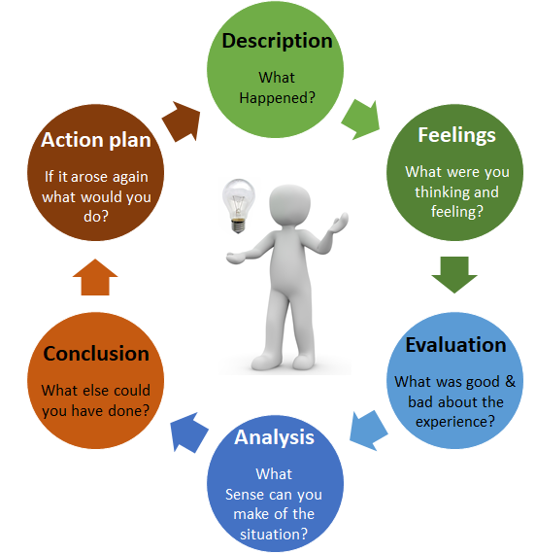
Model or framework linked to your chosen skill
A model used to reflect on professional practice
It includes six stages of reflection
Helps professionals improve communication
Supports learning from experience
(Gibbs, 1988)

Slide 7

Applying Communication in Practice
Role: Care assistant working in a care home
Situation: Helping an elderly resident during daily care
Communication: Listening carefully and explaining care clearly
Result: The patient feels safe, understood and supported
(Arnold and Boggs, 2020)

Slide 8

How does this skill support my future career?
Communication is essential for working in healthcare settings
It allows professionals to create strong relationships with patients and families
Effective communication improves patient safety and quality of care
I would like to continue developing this skill in my future career.

Slide 9

Conclusion
Communication is a fundamental skill in healthcare practice
It contributes to safe and respectful patient care
Developing this skill will support my future career

Slide 10
References List
Arnold, E.C. and Boggs, K.U. (2020). Interpersonal Relationships: Professional Communication Skills for Nurses. 8th ed. St. Louis: Elsevier.
Gibbs, G. (1988). Learning by Doing: A Guide to Teaching and Learning Methods. Oxford: Oxford Polytechnic.
O’Daniel, M. and Rosenstein, A.H. (2008). Professional communication and team collaboration. In: Hughes, R.G. (ed.) Patient Safety and Quality: An Evidence-Based Handbook for Nurses. Rockville: AHRQ.

