Slide 1
Management Functions:
Planning, Organising, Leading, Organising
LCBB4015
Week 2 – Session 2

Slide 2
Objectives
Defining Management
Management functions
  Planning
  Organising
  Leading
  Controlling
Importance of each of the management functions

Slide 3
Management
Henri Fayol suggested that “to manage is to forecast and plan, to organise, to command, to coordinate and to control’ (Fayol, 1916)
This definition remains valid after almost a century and has been adapted by more recent writers (Cole and Kelly, 2020).

Slide 4
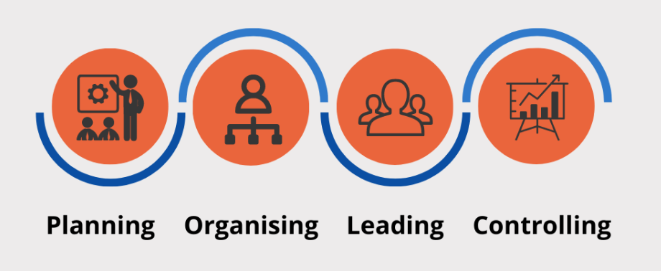
Management Functions
According to the functions approach, managers perform certain activities or functions as they efficiently and effectively coordinate the work of others.

Slide 5
Management functions:
Henry Fayol
Henri Fayol, a French businessman in the early part of the twentieth century, suggested that all managers perform five functions: Planning, organising, commanding, coordinating, and controlling.
Henri Fayol theorized that these functions were universal, and that every manager performed these functions in their daily work.

Slide 6
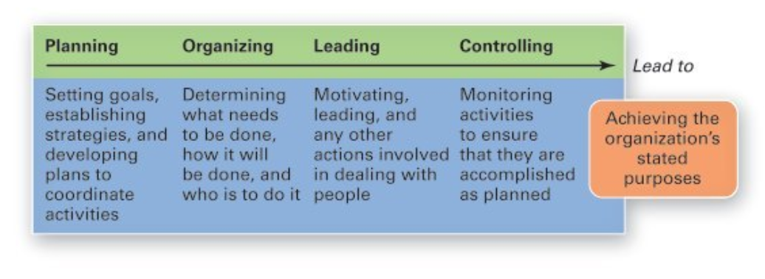
Management Functions

Slide 7

Planning
Planning involves the following actions:
  Setting the organisation’s activities and projects goals and objectives
  Establishing strategies for achieving those goals and objectives.
  Developing plans to integrate and coordinate work activities.

Slide 8
Importance of Planning
Planning establishes a roadmap for the organisation by defining clear directions and objectives. It sets the course for achieving goals and guides decision-making throughout the implementation of strategies.
It helps mitigate the risks associated with uncertainty. By anticipating potential challenges and uncertainties, organisations can develop contingency plans, making them more resilient in the face of unforeseen circumstances.

Slide 9
Importance of Planning
Planning provides a structured basis for decision-making. With defined goals and a clear understanding of the path ahead, decision-makers can evaluate options more effectively and choose courses of action that align with the overall strategy and objectives of the organisation.

Slide 10
Process of Planning
Setting objectives
Developing premises
Identifying alternative courses of action
Evaluating alternative courses
Selecting an alternative
Implementing the plan
Setting up a follow-up action

Slide 11
Organising
Organising is a management function that involves the following elements:
  The process of identifying and grouping of the works to be performed,
  Defining and delegating responsibility, authority and establishing relationships for the purpose of enabling people to work most efficiently.

Slide 12
Importance of Organising
Organising plays a pivotal role in helping companies optimise the utilisation of their resources efficiently.
It serves as a foundation for effective administration, ensuring smooth and organised operations within the organisation.
Through well-structured organising, companies create pathways for expansion and growth, enabling them to capitalise on new opportunities.

Slide 13
Importance of Organizing
Organising facilitates coordination among different departments, promoting seamless collaboration and enhancing overall organisational efficiency.
By providing a structured framework, organising creates a conducive environment for embracing and implementing new changes within the organization.

Slide 14
Process of Organising
Division of work
Departmentation
Linking departments
Assigning duties
Defining hierarchal structure

Slide 15

Leading
Leading involves guiding and directing the people in an organisation. It also involves working with and through people to accomplish organisational goals.

Slide 16
Importance of leading
Leading provides actions to get the desired outcomes in an organisation.
It is crucial for maximising employee potential by recognising their capabilities.
Leadership ensures alignment of all employees with organisational goals and objectives, and effective directing is essential for maintaining workflow efficiency.
Achieving stability and balance is possible through effective directing.

Slide 17
Characteristics of Leading
Leadership -> guiding and influencing the work of subordinates in the right direction.
Motivation -> inspiring and encouraging employees.
Communication -> using appropriate tools and techniques to facilitate the communications.

Slide 18
Controlling
Controlling involves monitoring, comparing, and correcting work performance.
Controlling is the process of checking whether or not proper progress is being made towards the objectives and goals of the organisation and acting if necessary, to correct any deviation.

Slide 19
Importance of controlling
Controlling helps assess actual performance against the established standards and goals. It provides a mechanism to measure achievements and identify areas that may require improvement.
By monitoring and regulating activities, controlling ensures that the organisation is on track to achieve its objectives. It helps in directing efforts toward the fulfillment of organisational goals.

Slide 20
Importance of controlling
Controlling facilitates the identification of deviations. This allows organisations to adapt to changing circumstances, correct course, and make informed decisions to address challenges.
Controlling helps in the efficient use of resources, including financial, human, and material resources. It ensures that resources are allocated and utilized effectively to maximise productivity.
The information generated through the controlling process provides valuable insights for decision-making. It enables managers to make informed choices and take corrective actions when necessary.

Slide 21
Process of controlling
Controlling has the following steps:
  Establishment of standard performance
  Measurement of actual performance
  Comparison of actual performance with the standards and finding out deviation if any
  Corrective action

Slide 22
Activity 1
You have been appointed as the manager of a newly established small restaurant. The restaurant aims to offer a diverse menu with a focus on quick service and a cozy atmosphere. Your goal is to make the restaurant a popular choice in the local community within the next six months.
Instructions:
Planning: Develop a comprehensive plan outlining the steps you will take to make the restaurant a popular choice in the local community.
Organizing: How would you organize the resources and activities required to execute your plan effectively.
Leading: What approach would you do to lead and motivate your team to achieve the restaurant's goals.
Controlling: what steps would you take to implement control measures to ensure that the restaurant is on track to achieve its objectives.

Slide 23
Activity 2
Please attempt activity 2 available in your Moodle.
Be prepared to share and discuss your answers.

Slide 24
References
Cole, G.A and Kelly, P. Phil (2020) Management theory and practice. Ninth edition / Gerald A. Cole, Phil Kelly. Andover: Cengage Learning.
Needle, D. Burns, J. (2019) Business in context: an introduction to business and its environment. Seventh edition. Andover: Cengage Learning.
Robbins, S.P., Coulter, M.K. and Randel, A. (2021) Management. Global edition. Harlow, England: Pearson Education.

