Slide 1
Doctorate in Education (EdD)
ECDE7016
Writing a Critical Literature Review in Education
Welcome to Session 6:
Tuesday 13 Feb 2024
Dr Jingjing Ruan
j.ruan@uwtsd.ac.uk

Slide 2
Previous task
Please start making notes on the following:
Read 5 journal articles in detail: critically review the authors’ (dis)agreement and contribution to the debates; identify gap(s)
Notes:
Within each of the articles on your shortlist, you’ll want to search for a few very specific phrases, namely:
Future research
Further research
Research opportunities
Research directions
All of these terms are commonly found in what we call the “FRIN” section. FRIN stands for “further research is needed”. The FRIN is where the researchers explain what other researchers could do to build on their study, or just on the research area in general. In other words, the FRIN section is where you can find fresh opportunities for novel research.

Slide 3
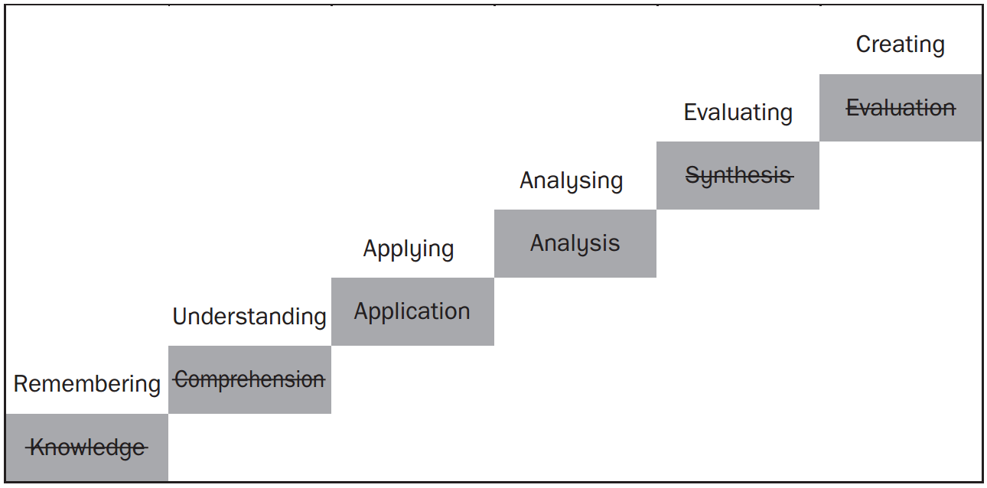
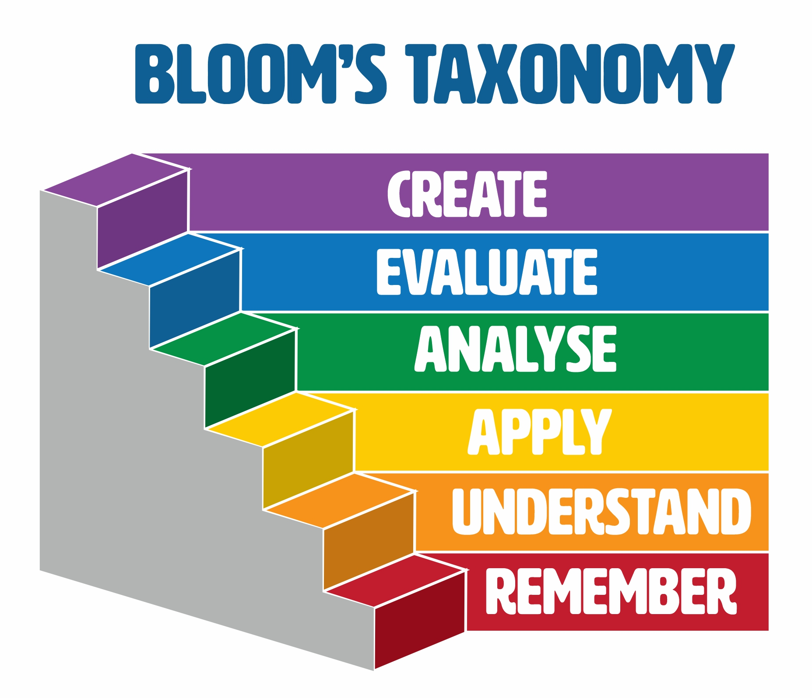
Contribution; gap(s)?
How will your study
address the gap(s)?
Compare & Contrast:
agreement & disagreement
Critical appraisal
Notes:
Remember, a good literature review doesn’t just summarize sources:
it analyzes, synthesizes, and critically evaluates to give a clear picture of the state of knowledge on the subject

Slide 4
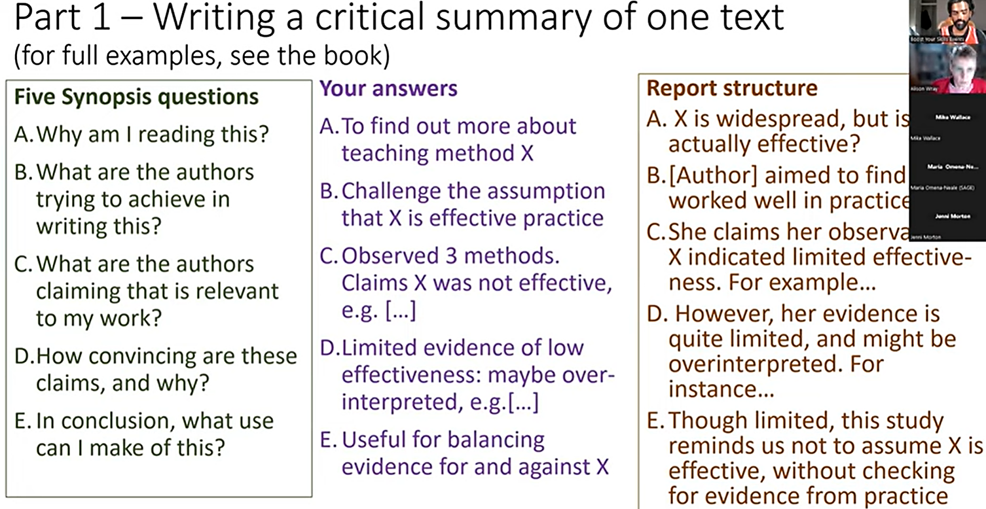

Slide 5
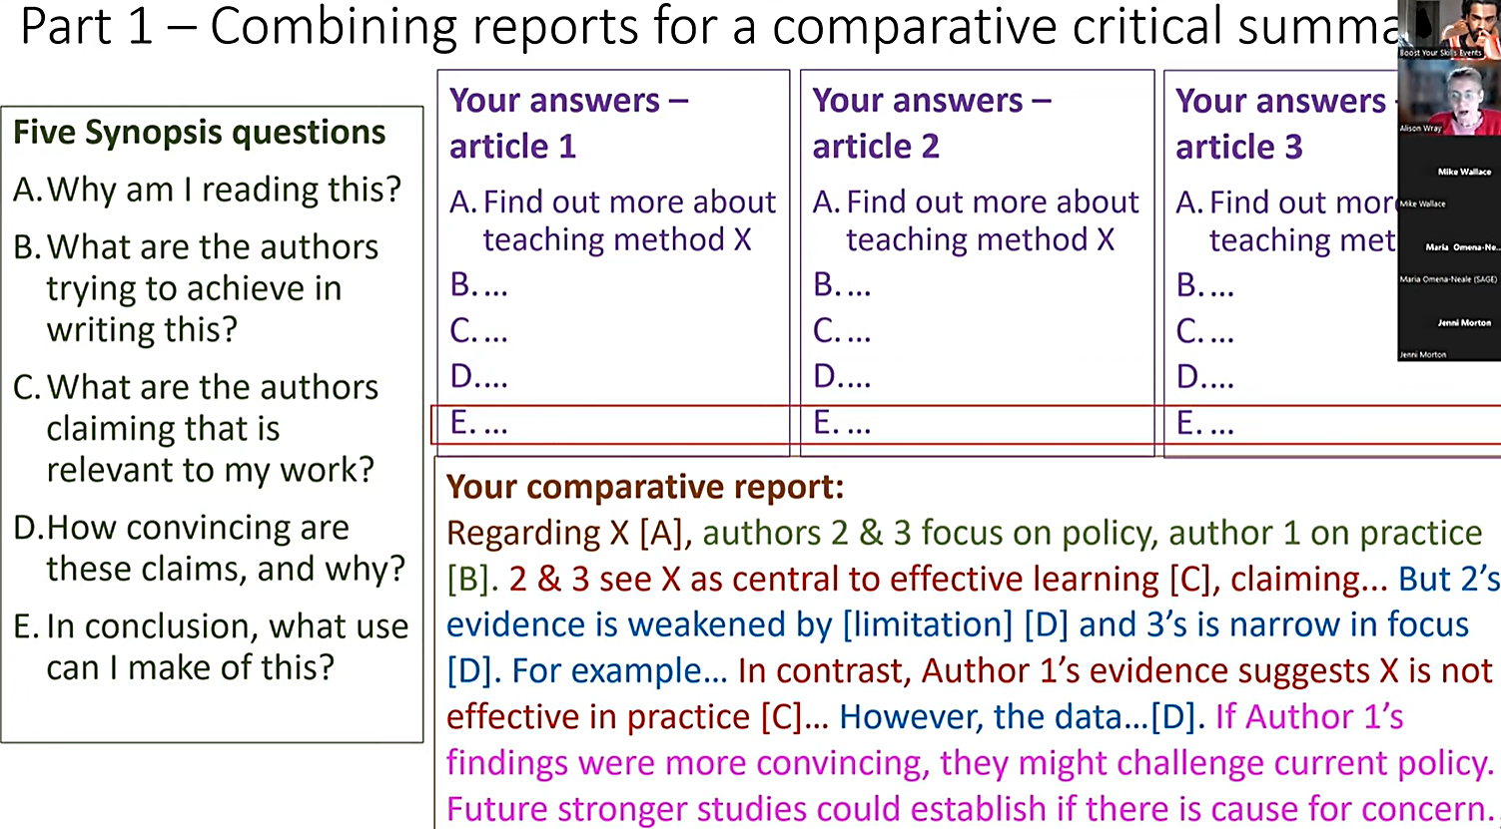

Slide 6
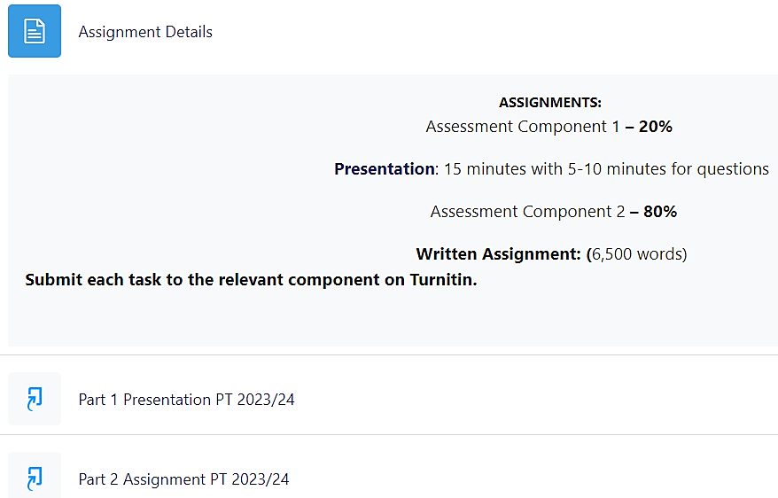
Moodle

Slide 7
Example presentation structure
Opening slide: your title, name, module code, date etc.
Slide 2: whole structure of your LR (highlight 1 section to focus on)
Slide 3: aim of study; how your positionality underpins your critical review
Slide 4: background & context; rationale etc.
Slide 5: process of review; your search terms; databases used
Slide 6: how you understand critical LR; how you will critique the literature
Slide 7: critique current definitions; your own definitions?
Slide 8: summary of key ideas/themes across different papers
Slides 9-10: list what authors agree on; where the debates are
Slide 11-14: 1-2 important pieces of research (strength & weakness?)
Slide 15: conclusion; gaps; refined RQs
Final slide: the reference list (Harvard style 12th)
Notes:
Identify themes across different papers, what authors agree on, where the debates are, critique definitions, identify significance, discuss how valid and reliable the findings are, what it all means for your project etc.
how your positionality underpins your critical review of the literature; what should we take from the literature for your own study
Content summarised in a clear and concise manner, present at an appropriate pace; avoid overreliance on certain sources; use latest reasearch
Cite to back up your arguments and reference to literature throughout your presentation (both references on your slides and a reference list on the final slide)

Slide 8
Presentation tips
Make sure your title gives the context (e.g. in a university in China, in a primary school in Wales)
Outline the whole structure of your Literature Review, but only discuss one section in great detail
Outline aim of study – what you are setting out to do & how this relates to the literature
Present the key concepts, ideas, and debates (weave in your critique)
Ensure consistency between your title, aims, gaps, and RQs

Slide 9
Presentation tips
Discuss briefly how you understand LR and how you will critique the literature
Explain what part of the Critical Literature Review you are going to concentrate on
Mention the nature of key research (e.g. in this small-scale action research, the author claims …)
Highlight the gaps that your research will fill and how they lead to your own project
Refine your specific RQs in light of the gaps at the end

Slide 10
Presentation tips
Enthusiastic, appropriate body language and tone
Avoid busy slides or reading directly from slides/script
Talk to your audience directly and try to make some eye contact
Well-considered response to any questions; handouts?
Keep to time (about 15 mins) and expect questions (about 5 mins)
Upload your PowerPoint to Turnitin by 00:00 27th Feb 2024
Notes:
Consider would your audience benefit from some sort of handout

Slide 11
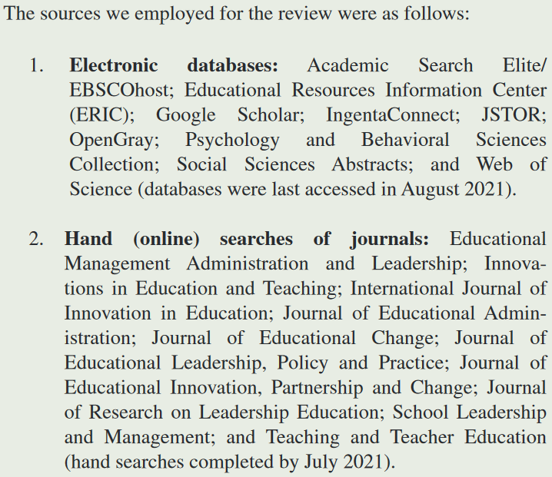
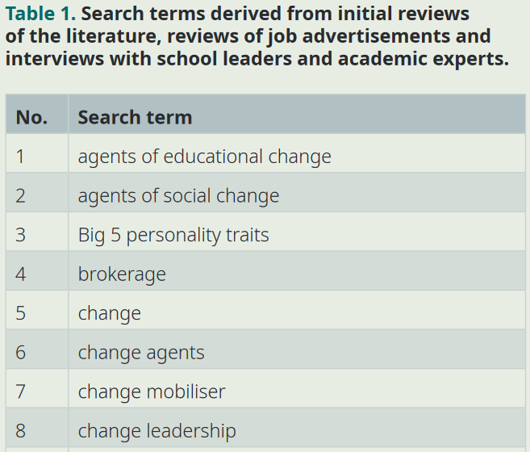
Search strategy (example)

Slide 12
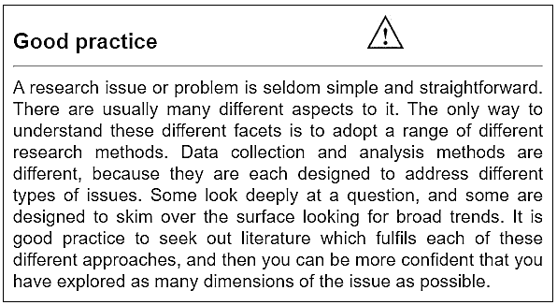
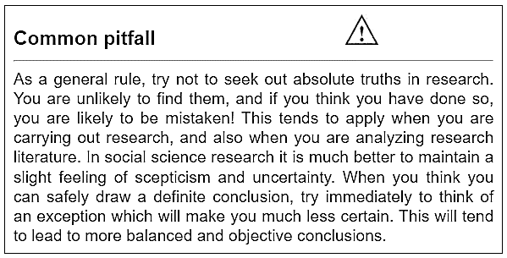
Try not to seek absolute truths
Oliver, P. (2012) Succeeding with your literature review: a handbook for students. Maidenhead: Open University Press.
Notes:
Oliver, Paul. (2012) Succeeding with your literature review : a handbook for students. Maidenhead: Open University Press.

Slide 13
Next
Please make notes on the following:
Continue identifying gaps in the articles by reading:
Future study
Further research
Research opportunities
Research directions
Notes:
“further research is needed”: where the researchers explain what other researchers could do to build on their study, or just on the research area in general.
an unsolved question or problem within your field.
a case where inconclusive or contradictive results exist.
a new concept or idea that hasn’t been studied.
a new/updated research to replace the outdated existing research.
a specific demographic or location that has not been well studied.

Slide 14
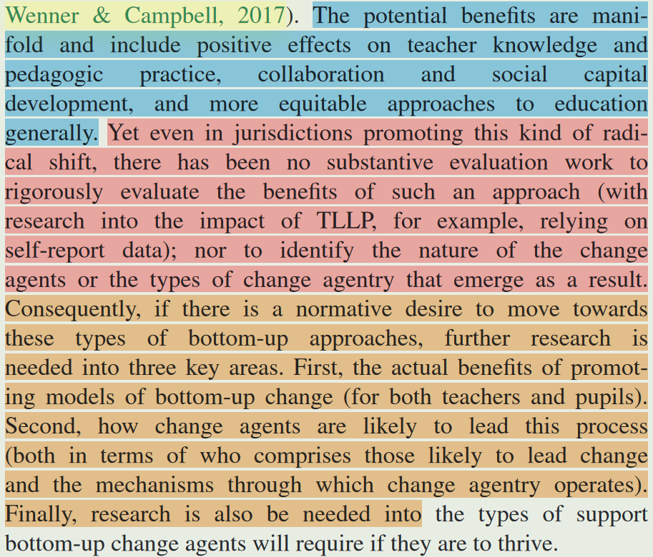

Slide 15
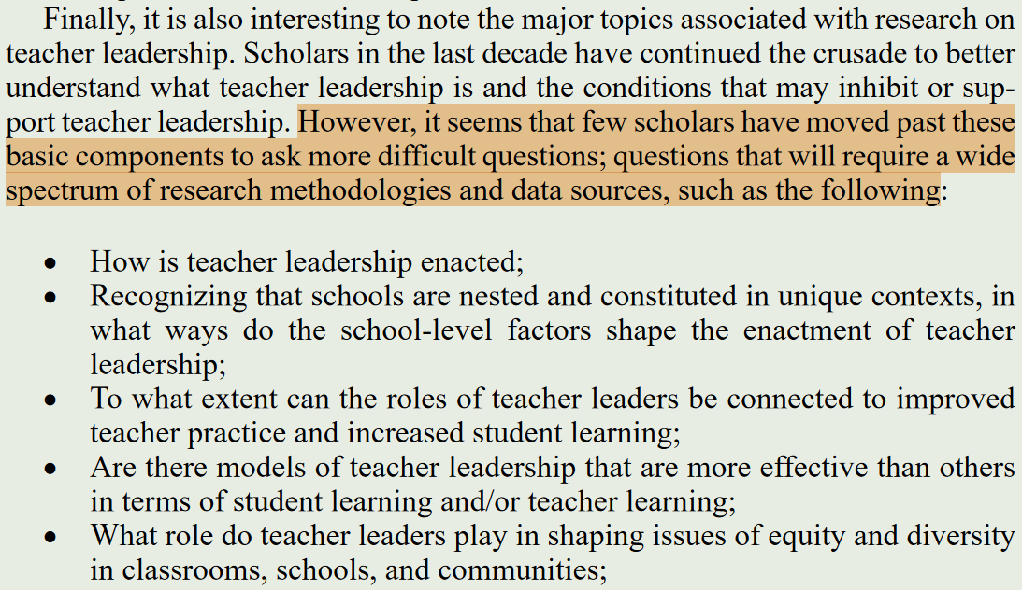

Slide 16

Revisit research gaps
Notes:
A research gap is any space where there’s a lack of solid, agreed-upon research regarding a specific topic/issue/phenomenon.
Unique research topics emerge from research gaps, so it’s essential to first identify high-quality research gaps before you attempt to define a topic.
ensure the rapid generation of subsequent research that is informed by input from previous research studies.
understand areas of uncertainty within the research problem.
establish the research problem and scope of the study.

Slide 17
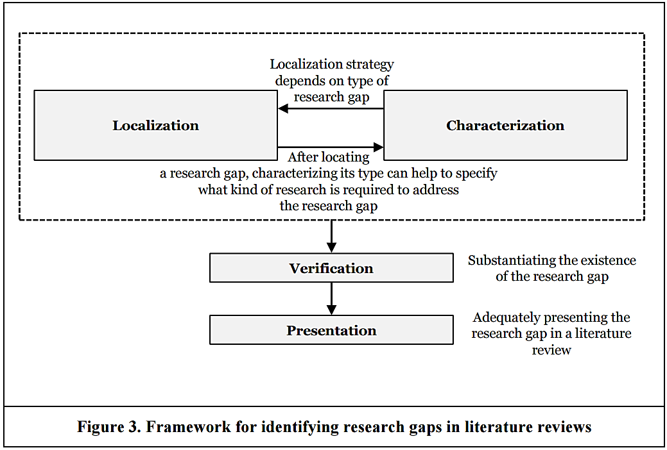
Notes:
A Framework for Rigorously Identifying Research Gaps

Slide 18
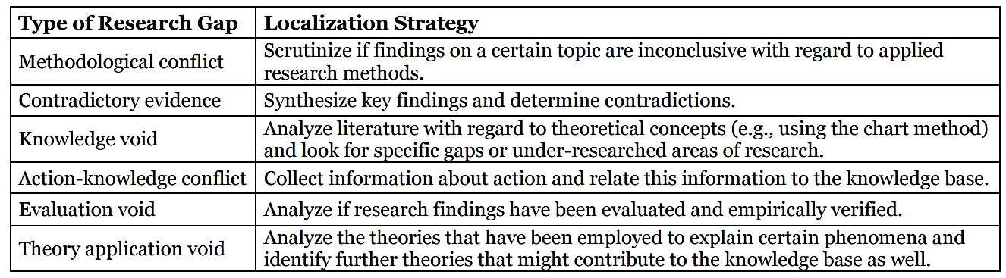

Slide 19
Gaps: unanswered questions; unresolved problems
Task: clearly acknowledge existing research; highlight gaps; convincingly demonstrate how your project will address them; refine your RQs
The classic literature gap
The disagreement gap
The contextual gap
The methodological gap
Knowledge/Practical/Data gaps etc. ……
Notes:
A research gap is an unanswered question or unresolved problem in a field, which reflects a lack of existing research in that space.
A research gap refers to an area where there’s a lack of settled research; a research topic outlines the focus of a specific study.
You are expected to clearly acknowledging the existing research and explain where the current area of lack (i.e., the research gap) exists.

Slide 20
Contextual Gap (the popular option )
Opportunities: when there’s already research on a particular topic, but an absence of evidence in specific contexts (e.g. a specific population: age group/gender/ethnicity; a geographic area: country/city/region; a certain time period: studies took place many years or even decades ago and the landscape has changed)
Challenge: need to clearly articulate why your chosen context is “different” from existing studies and why that might result in different findings
Notes:
The contextual gap is a popular option for dissertations and theses, especially for first-time researchers, as it allows you to develop your research on a solid foundation of existing literature and potentially even use existing methods.

Slide 21
Examples
While empirical research surrounding online learning has grown over the past five years, there remains a lack of comprehensive studies regarding the effectiveness of online learning for students with special educational needs.
Within the existing research regarding factors affect job satisfaction, there may be a wealth of established and agreed-upon empirical work within a US and UK context, but very little research in the context of China.
Notes:
Core point: a research gap reflects a lack of firmly established knowledge regarding a specific matter.
Given this lack, an opportunity exists for researchers (like you) to go on and fill the gap.

Slide 22
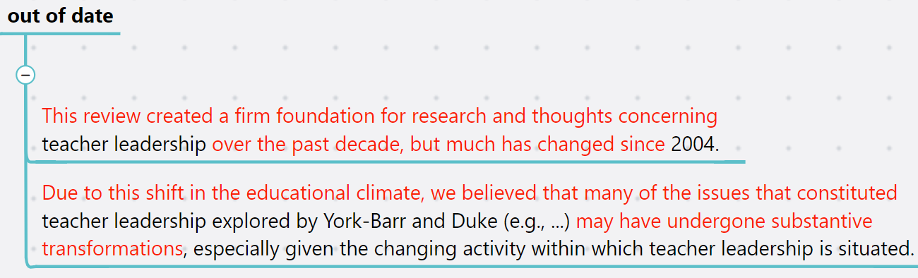
Examples

Slide 23
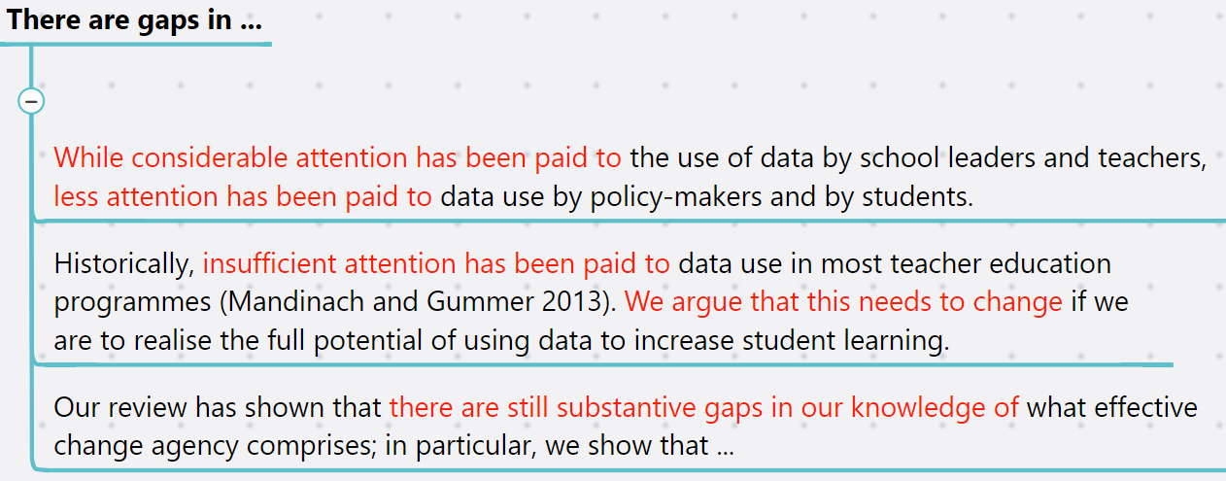
Examples

Slide 24
Disagreement Gap
Opportunities: when there are contrasting or contradictory findings in the existing research regarding a specific research question
Challenge: need to be a relatively balanced set of opposing findings

Slide 25
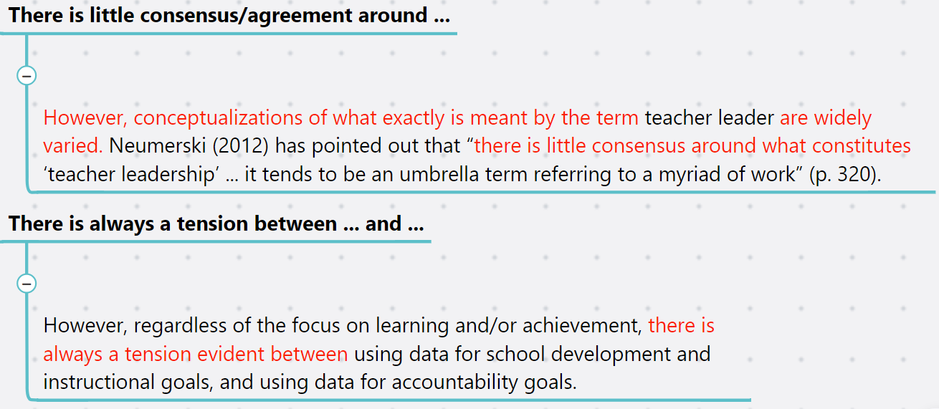
Examples

Slide 26
Methodological Gap
Opportunities: when the methodology of existing studies is lacking in some way, or that they’re missing a certain perspective (e.g. existing research has taken a quantitative approach: lack qualitative insight; current studies only provided a snapshot view of the situation: lack longitudinal approach)
Challenge: need to justify your proposed methodology

Slide 27
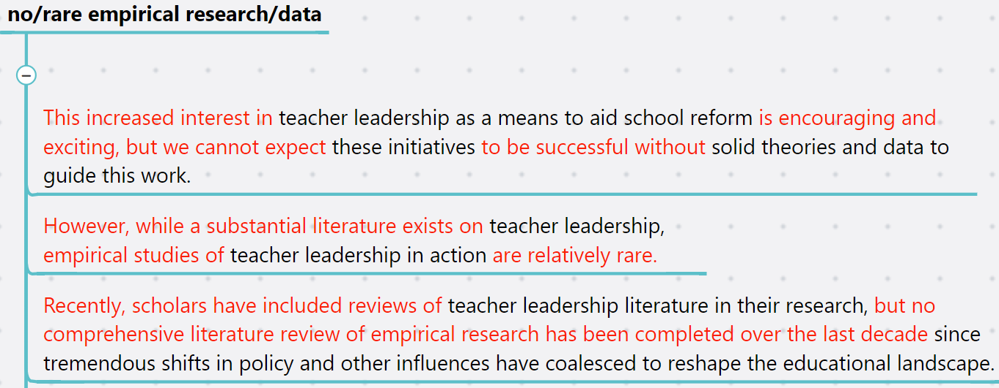
Examples

Slide 28
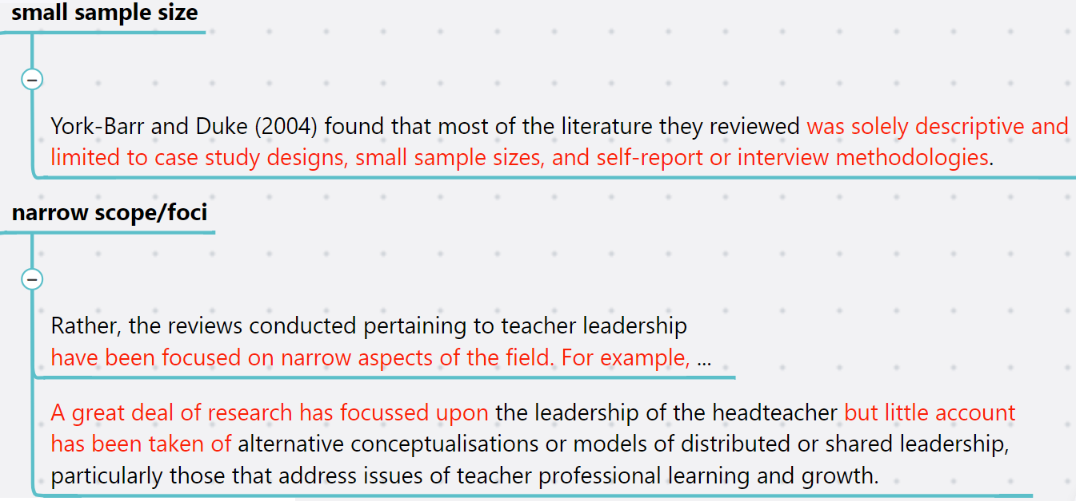
Examples

Slide 29
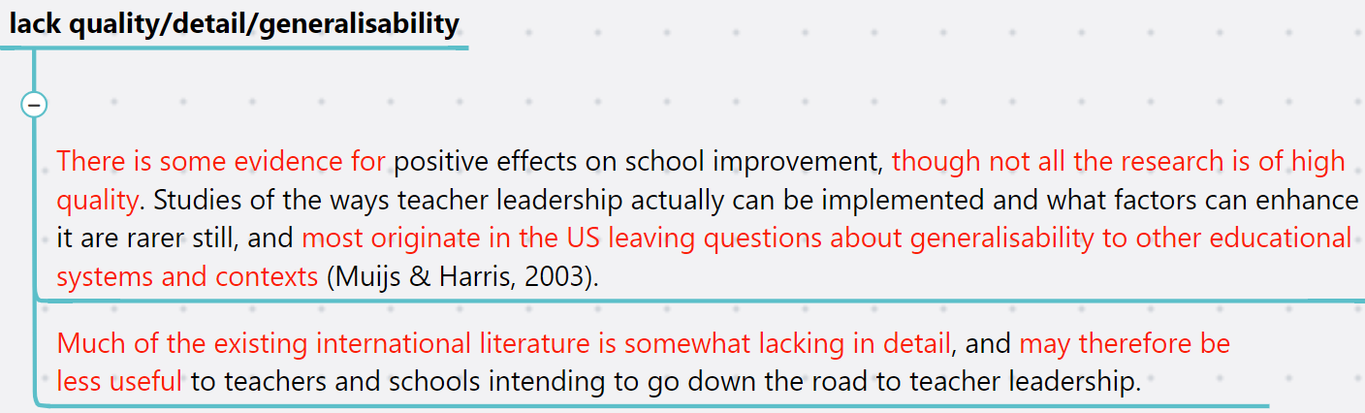
Examples

Slide 30
Classic literature gap
Opportunities: when there’s a new concept or phenomenon that hasn’t been studied much (e.g. a new social media platform is launched; some new AI tool is out etc.)
Challenge: need to explore completely new territory

Slide 31
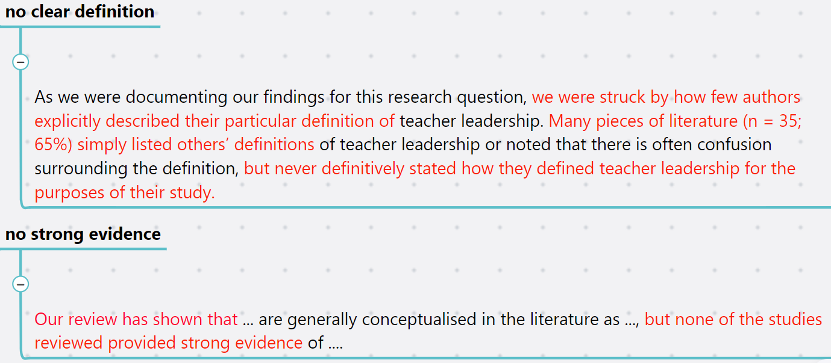
Examples

Slide 32
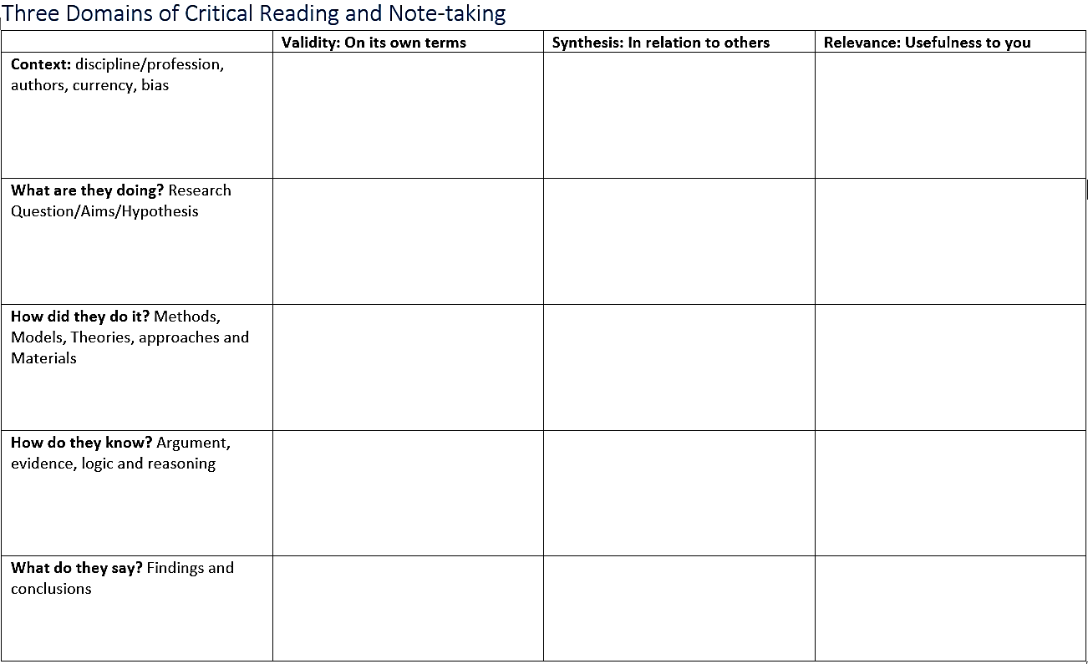

Slide 33
What makes great teaching?
Review of the underpinning research (Coe et al., 2014)
Sample LR: a report from the Sutton Trust which reviewed the evidence around successful teaching practices.
looked at more than 200 pieces of research
analysed different methods of evaluating teaching
found 6 main elements to great teaching
highlighted common practices that can be harmful

Slide 34
Highlight limitations/gaps
The report makes an assumption when defining teaching effectiveness: that students’ achievement, outcomes, or grades, indicate their learning.
This report selected strategies that is easier to find evidence while avoiding others, which may be equally beneficial but somehow the evidence base is not strong enough yet.
……?
Compare with Coe et al. (2020) Great teaching toolkit: evidence review.

Slide 35
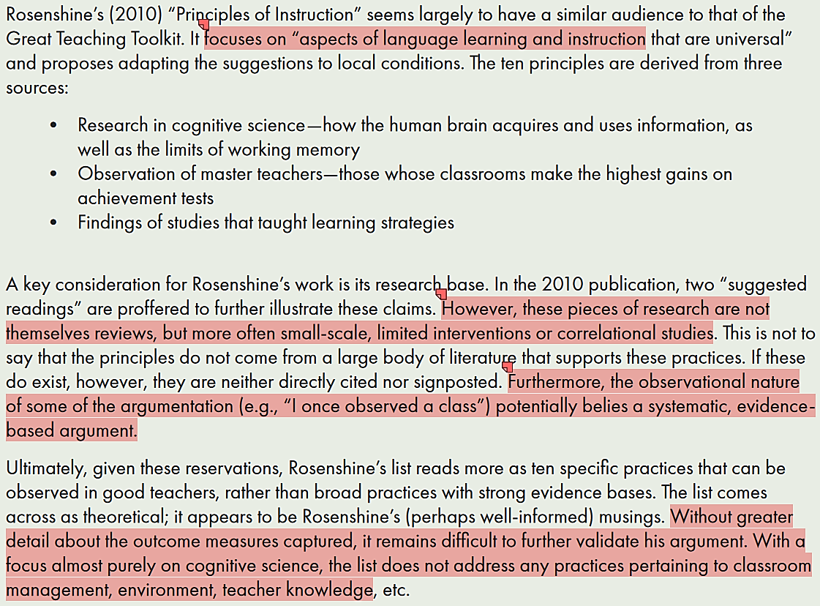
Coe et al. (2020)

Slide 36
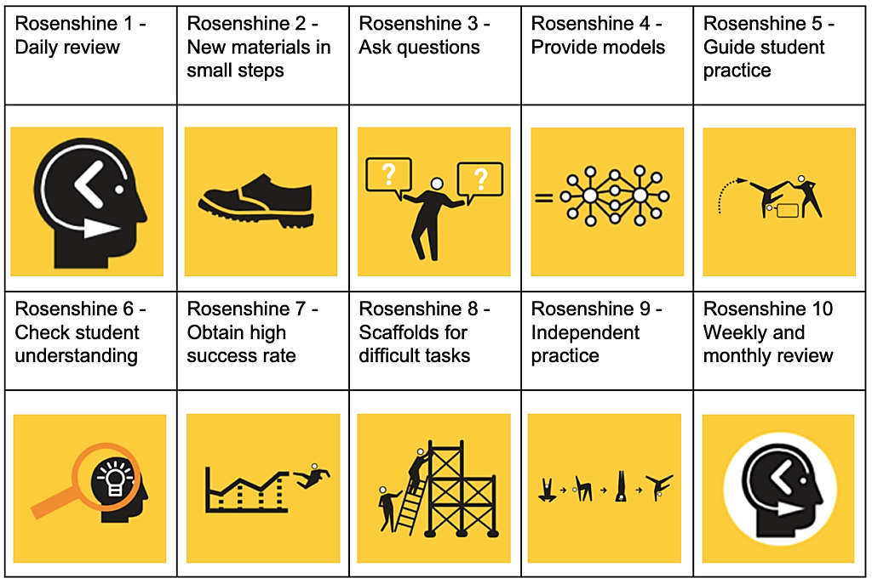
Rosenshine’s
Principles of
Instruction

Slide 37
Use timeline / mind maps / concept maps to organise notes ……

Slide 38
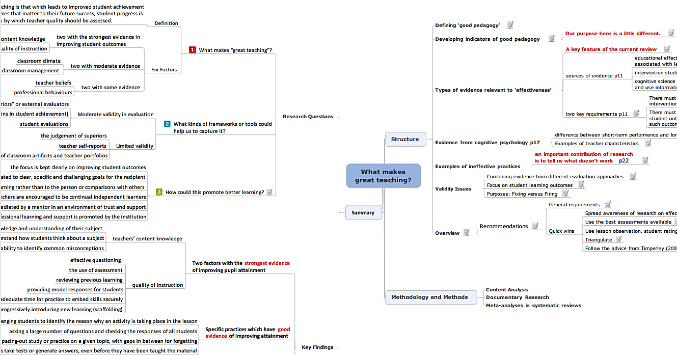

Slide 39
Guest talk: Yanyan on LR tips
Time: 14:00 13th Feb
Location: IQ105

Slide 40
Resources and references
Biggam,J. (2021)
Succeeding with your master's dissertation : a step-by-step handbook
5th edn. Maidenhead : Open University Press, McGraw Hill
Read the chapter on Literature reviews. (e-book, UWTSD library).
Lambert, M. (2021) Top Tips on Writing a Literature Review for Your Education Research Project. Available from: https://www.academia.edu/5195702/Top_Tips_on_Writing_a_Literature_Review_for_Your_Education_Research_Project
Oliver, P. (2012) Succeeding with your literature review: a handbook for students. Maidenhead: Open University Press.
Wallace, M. and Wray, A. (2021) Critical reading and writing for postgraduates. London : Sage Publications Limited.

