Slide 1
Week 4: Session 1 & 2:
Research Methods & Methodologies - 2
Dissertation
LCBB6000

Slide 2
Lesson Aims
By the end of this session, students should be aware of:
Research Methods, Methodology & Research Onion (Recap)
Research Methods
Research Design & Strategies
Finalising research methods, strategies for the dissertation
References

Slide 3
What is Research Method & Methodology?
Research Method: The research method is the techniques and procedures used to obtain data
Research Methodology: The research methodology is the theory of how research should be undertaken

Slide 4
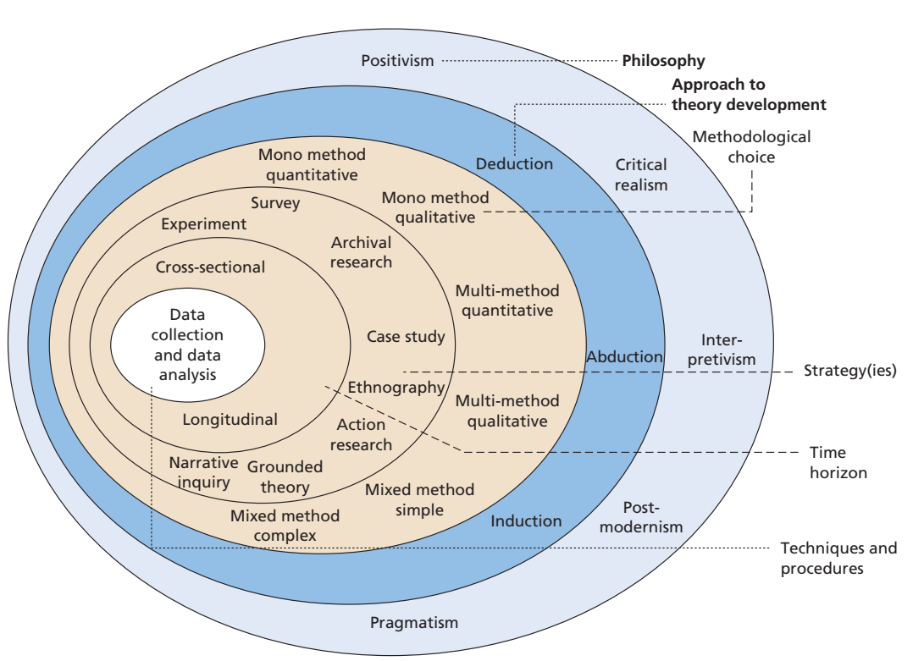
Research Onion

Slide 5
Research Methods – Qualitative
1. Qualitative Research:
Qualitative research is a situated activity that locates the observer in the world
Qualitative research consists of a set of interpretive, material practices that make the world visible, and these practices transform the world
These practices turn the world into a series of representations, including field notes, interviews, conversations, photographs, recordings, and memos to the self
Qualitative research begins with assumptions and the use of interpretive/theoretical frameworks that inform the study of research problems addressing the meaning individuals or groups ascribe to a social or human problem

Slide 6
Research Methods
Qualitative Research:
Qualitative research refers to the method of data collection and analysis
It refers to research strategies that usually emphasize words rather numbers
Has an inductive view of the relationship between theory and research
Has an epistemological position described as interpretivism, where the social reality is examined through the interpretation of that world by its participants

Slide 7
Characteristics of Qualitative Research
Uses words
Concerned with meanings
Induces hypotheses from data
Case study

Slide 8
Process of Qualitative Research
The research process is much less structured than quantitative research
The researcher may begin with no fixed idea of what they want to find out
Appropriate questions will arise through the research process
The researcher will collect initial data, analyse it, and then think of new questions to ask

Slide 9
The Focus of Qualitative Research
The subject matter of the management studies does differ from the subject matter of the natural science (ex.: the social world must be interpreted from the perspective of people being studied)
Qualitative researchers are concerned with explanations and providing descriptive details (ex.: details about the context are very important for qualitative researchers as they can help explaining people’s behaviour)
Qualitative research view social life in terms of processes, means researchers are concerned with explaining how events and patterns take shape and change over time
Qualitative researchers do not have pre-determined views of the social world; this is because they are interested in seeing through the eyes of the people being studied

Slide 10
Research Methos – Quantitative
2. Quantitative Research:
Quantitative research is concerned with explaining phenomena by collecting numerical data that are analysed using mathematically based methods (in particular statistics)
Quantitative research is concerned with how data can be counted or expressed using numbers
In Quantitative research, researchers knows clearly beforehand what they are looking for
Quantitative research method may miss contextual information – the meaning behind situations

Slide 11
Characteristics of Quantitative Research?
The data is usually gathered using more structured research instruments
The results are based on larger sample sizes that are representative of the population
The research study can usually be replicated or repeated, given its high reliability
All aspects of the study are carefully designed before data is collected
Data are in the form of numbers and statistics
Researcher uses tools, such as questionnaires or equipment to collect numerical data

Slide 12
Process of Quantitative Research Method
Defining the problem and establishing research objectives
Exploring theory (i.e.: reading books and scientific articles)
Sample design and characteristics of the population (e.g.: age, education status)
Designing data collection instruments
Collecting data and preparing it for analysis
Data analysis
Interpreting the results and writing the final research report

Slide 13
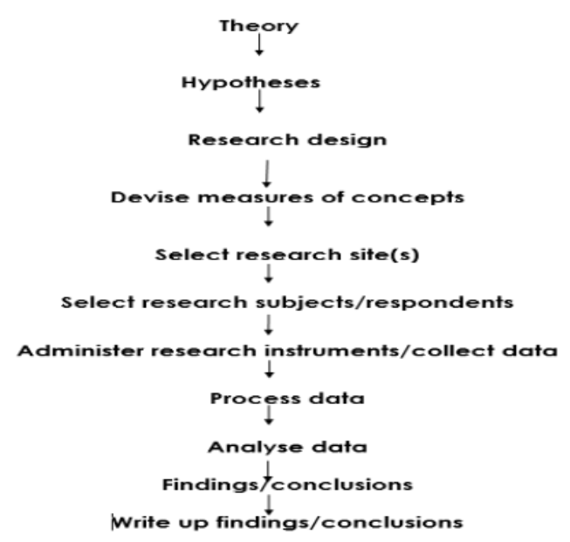
Process of Quantitative Research Method

Slide 14
When to do Quantitative Research?
If your study aims to find out the answer to an inquiry through numerical evidence, then you should make use of the Quantitative research
In general, use qualitative research at the beginning of a design process to uncover innovations, while use quantitative research at the end of a design process to measure improvement
The main activity for which quantitative research is especially suited is the testing of hypotheses
When researchers aim to achieve an in-depth understanding of a situation/topic/issue
When researchers want to classify features, count them, and construct statistical models in an attempt to explain what is observed

Slide 15
Research Methods – Mixed
3. Mixed Method:
Mixed research method involves the use of both quantitative and qualitative methods in a single study
Mixed research method are those who engage in such research argues that the use of both methods provides a more complete understanding of research problems than does the use of either one
Mixed research method clarify and explain relationships found to exist between variables
Mixed method studies can help to confirm or cross-validate relationships discovered between variables, as when quantitative and qualitative methods are compared to see if they converge on a single interpretation of a phenomenon

Slide 16


Drawbacks of Mixed Method and how to Avoid?
You might ask “why all research problems are not addressed using mixed methods designs”?
Extremely time-consuming and expensive to carry out
Many researchers are only experienced in only one type of research
Avoiding the drawbacks:
Multiple researchers with different areas of expertise work as a team
Better off doing a purely quantitative or qualitative study and doing it well

Slide 17
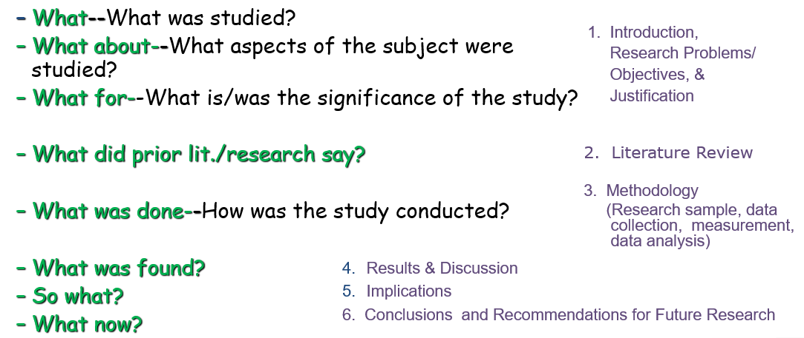
Research Design & Strategies:
Process of Designing & Conducting a Research

Slide 18
Steps Leading to the Formulation of a Research Design
Define the Research Topic and Question
Develop an Approach to the Research
Formulate the Research Design
18

Slide 19
Tasks Involved In a Research Design
Define the Information Needed
Design the Exploratory, Descriptive, and Explanation of the Research
Specify the Measurement and Scaling Procedures
Construct a Data Collection Method(s)
Specify the Sampling Process and the Sample Size
Develop a Plan of Data Analysis

Slide 20
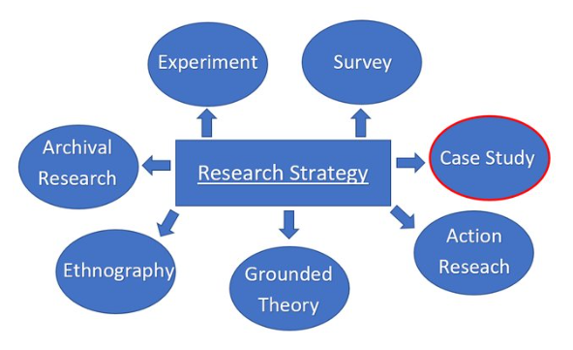
Research Strategies

Slide 21
Research Strategies
Narrative:
  The term narrative comes from the verb “to narrate” and “to tell a story in detail”
  Researchers describe the lives of individuals and write narratives of individual experiences
  Narrative research is done to get specific insights
  Narrative research help reduce a commonly held perception by practitioners
  Narrative research make the participants feel that sharing their stories is important and its heard
  Types: 1) Exploratory (new dimension), 2) Explanatory (causal relationship)

Slide 22
Exploratory Studies
Exploratory research is a valuable means to find out “what is happening to seek new insights”
To ask questions and to assess research phenomena in a new light
Help to clarify researcher’s understanding of a problem, especially if you are unsure of precise nature of the problem
Exploration does help to find out if the research is not worth to pursue although some time is spent
Satisfy the researcher’s curiosity and desire for better understanding.
Test the feasibility of undertaking a more extensive study.
Develop the methods to be employed in any subsequent study.

Slide 23
Exploratory Studies – How to Conduct?
A search of the literature
Interviewing ‘experts’ in the subject
Conducting interviews
Exploratory Studies – Advantages?
The biggest advantage is that it is flexible and adaptable to change
You must be willing to change your direction as a result of new data that appear and new insights that unfold
Remember to be Pragmatic!!!

Slide 24
Explanatory Studies
Studies that establish causal relationships between variables fall into this category
The emphasis is on studying a situation or a problem in order to explain the relationship between variables
The main aim of explanatory research study is to identify any casual links between the factors or variables that pertain to research problem
Explanatory research design focuses on explaining the structure in detailed manner
Sometimes it is referred to as Analytical study

Slide 25
Research Strategies
2. Descriptive Studies
The aim of descriptive research is to “portray an accurate profile of persons, events or situations” or to “describe various aspects of the phenomenon”
This may be an extension of or a forerunner to a piece of exploratory research or a piece of explanatory research
It is necessary to have a clear picture of the phenomena on which you wish to collect data prior to collection of data

Slide 26
Research Strategies
3. Experiment Studies
An experiment study involves:
  Definition of a theoretical hypothesis
  Selection of samples from know populations
  Random allocation of samples
  Introduction of planned intervention
  Measurement on a small number of dependent variables
  Control of all other variables

Slide 27
Research Strategies
4. Survey Studies
Key features of Survey studies are:
  Popular in business research
  Perceived as authoritative
  Allows collection of quantitative data
  Data can be analysed quantitatively
  Samples need to be representative
  Gives the researcher independence
  Structured observation and interviews can be used

Slide 28
Research Strategies
5. Case Study
Provides a rich understanding of a real-life context
Uses and triangulates multiple sources of data
A case study can be categories in four ways and based on two dimensions:
- single case v. multiple case
- holistic case v. embedded case

Slide 29
Research Strategies
6. Action Research
Research IN action – not ON action
Involves practitioners in the research
The researcher becomes part of the organisation
Promotes change within the organisation
Can have two distinct foci – 1) the aim of the research and 2) the needs of the sponsor
7. Grounded Theory
Theory is built through induction and deduction
Helps to predict and explain behaviour
Develops theory from data generated by observations
Is an interpretative process, not a logico-deductive one

Slide 30
Research Strategies
8. Ethnography
Aims to describe and explain the social world inhabited by the researcher
Takes place over an extended time period
Is naturalistic
Involves extended participant observation
9. Archival Research
Uses administrative records and documents as the principal sources of data
Allows research questions focused on the past
Is constrained by the nature of the records and documents

Slide 31
Choosing Your Research Approach
The right choice of approach helps you to
  Make a more informed decision about the research design
  Think about which strategies will work for your research topic
  Adapt your design to cater for any constraints

Slide 32

Any Questions?
Thank You ☺

Slide 33
Group Activity
Discuss and finalise your proposed research methods and strategies for your dissertation.

Slide 34
References
Adams, J. (2014) Research Methods for Business and Social Science Students. New Delhi: SAGE Publications.
King, N. and Brooks, J. (2016), Template Analysis for Business and Management Students, London: Sage
O’Gorman, K. (2015) Research methods for business & management: a guide to writing your dissertation. 2nd ed. Oxford, England: Goodfellow Publishers Ltd.
Saunders, M.N.K. (2019) Research methods for business students. 8th ed. Harlow: Pearson.
Zikmund, W. G. (2010) Business research methods. 8Th ed. Mason, OH: South-Western Cengage Learning.
Creswell, J. W. (2003) Qualitative Inquiry & Research Design: Choosing Among Five Approaches, London, Sage Publications

