Slide 1
Title: The role and importance of quality service, hospitality and guest service within hotel industry
Student Name/ID: Kadiza Alom/ 2127731
Module Name: Hospitality and Guest Services
Module Code: BMIH4003
Lecturers Name: Lisa- Marie Basler
Date: 3 February 2023

Slide 2
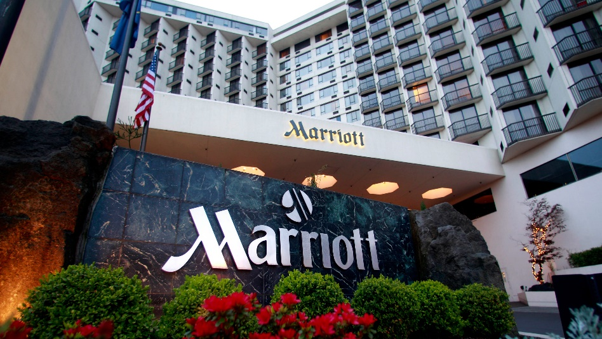
Introduction
Marriott International is an American multinational company founded in 1927, that services, operates, licenses and franchises lodging including residents, assets management, hotels and timeshare properties.
Marriott International has many subsidiaries and brands
It was founded in 1957 as a subsidiary brand of Marriott International. Marriott Hotel and reports operate around the world and have more than 665 locations across the world. It has more than 120,000 skilled and experienced employees to service customer services.
Marriott Hotel has 582 hotels and resorts, where more than 205,000 rooms are available for guests (Araujo et al., 2022). The hotel management is planning to establish around 160 hotels with 47745 rooms for expanding the business area and scope.

Slide 3
Identify the hotel brand's main consumers
Marriott Hotels and Resorts adopt a status segmentation strategy to classify the main consumers.
There have more than 143 hotels under luxury hotel brands under Marriott Hotels and restaurants where the company offer the highest facilities charging the highest value (Beldona & Cobanoglu, 2007).
Marriott Hotels operates in more than 72 countries around the world. The luxury hotels are located in developed countries and cities such as the USA, UK, Germany and another European countries.
Those people are located in Egypt, Canada, Mexico, Germany and The United Kingdom (Araujo et al., 2022).

Slide 4
Consumers are classified according to demographic factors
Marriott Hotels classified consumers based on demographic identities including consumer income, marital status, choice, and occupation. Guest services and other facilities are varied based on consumer status.
For this reason, Marriott Hotels' services differ from one category to another according to consumer status (Tran, 2015). The main Consumer categories are high-income persons and professionals, high-class businessmen, married couples, seasonal travellers, friends and family travellers, and professionals who are working in foreign countries.

Slide 5
Outline the nature, scope and role of the guest service and facilities that are provided to these guests by the hotel brand (Marriott Hotels and Resorts)
Nature and scope of guest management
Accommodation
It refers to a combined package that includes any premises where any of the housekeeping, reception, food and beverages, maintenance and clearing services need to be provided by the hotel on a large scale than in a domestic dwelling (Chigozie-Nwokorie, 2021). Accommodation management includes the following facilities-
  The hotel provides accommodations to suit the consumers’ needs
  Care, safety and security of the stay
  Businesses promote accommodation facilities via a marketing channel
  Company concern uses safety, well-being, comfort, satisfaction and health safety during accommodation
  Accommodation products are provided by Marriott Hotels and Resorts

Slide 6
Gift Certification- Marriott Hotels sell gift certificates while there has less consumer demand, this gift certificate is not valid during the busy session.
Accommodation clubs- Consumer gets special discounts on tariffs while buying large sum. For example, a car hire firm offers such a discount.
Frequent Guest Programs- the Hotel record each guest visit, upon satisfying a certain number, the hotel offers certain benefits such as a free visit.
Accommodation Passes- purchase a certain quantity of accommodation such as nights staying in advance. The legitimacy of the accommodation passes valid for a certain period, usually for 3 months or 6 months or 12 months (Moronta & Fredey, 2020).

Slide 7
Guest services and Service expectations offered by the Marriott Hotels and Resorts
The importance of hospitality and how hotel can meet guest expectations
The three most common and important expectations of guests in taking hotel services include::
comfort,
Cleanliness
communication.
Marriott Hotel is concern about customer satisfaction. Good communication between guests and hotel management ensures better customer satisfaction (Chigozie-Nwokorie, 2021).

Slide 8
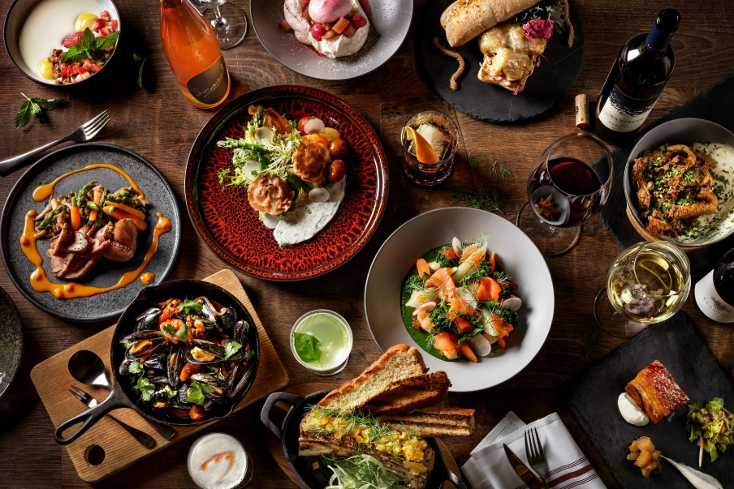
Marriott Hotels and Resorts are offering many guest services including accommodation, food and beverages, a swimming pool, fitness, conference rooms, open spaces and entertainment.
Food and beverage hotel facilities: Consumer frequently changes their tests. Marriot Hotels have more than 3000 executive chefs and expert culinarians to formulate new tastes for guests.
Experts and chefs combine new ingredients and the freshest concept to attract customers. Marriott Hotels offer both traditional and non-traditional food options (Cvelbar et al., 2019).
Non-traditional break options like juice stands, nuts, candy bars, etc

Slide 9
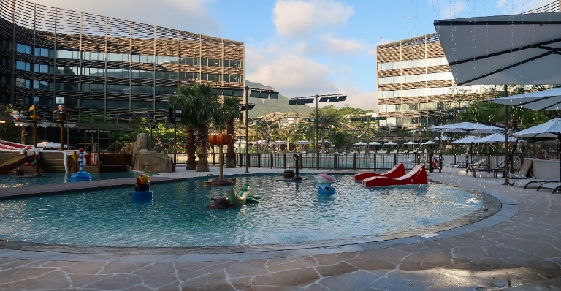
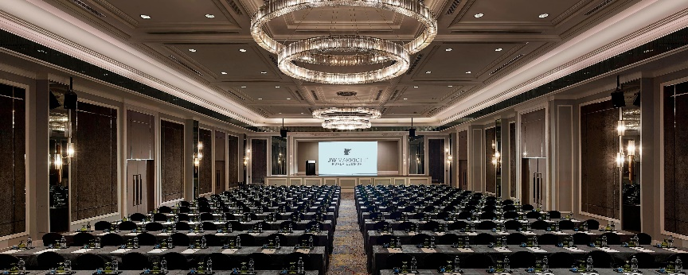
Swimming pool: Marriot Hotels and Resorts become more popular for its swimming pool facilities.. Marriot Hotels and Resort offers luxuries, upper-scale and midscale hotel swimming pool facilities (Mohammed Shobri & Putit, 2015). In addition, a Shallow pool is offered for children's entertainment.
Conferences/ meeting rooms: Marriot Hotels and Resort offer conference or meeting room facilities for its business-oriented guests. Hotel management is concerned about the good atmosphere, and calm environment for dealing with a bilateral agreement

Slide 10
Fitness facilities: guest demand fitness facilities with essential exercise machines. Marriot Hotels offers a skilled gym trainer, a guide for a long walk, and suitably qualified staff to satisfy guests' specific health needs (Ivkov et al., 2016).
Open spaces/ Cowering areas: Many start-up hotel businesses bring this idea to the front. This generates additional booking, adds more business value and raises revue.

Slide 11
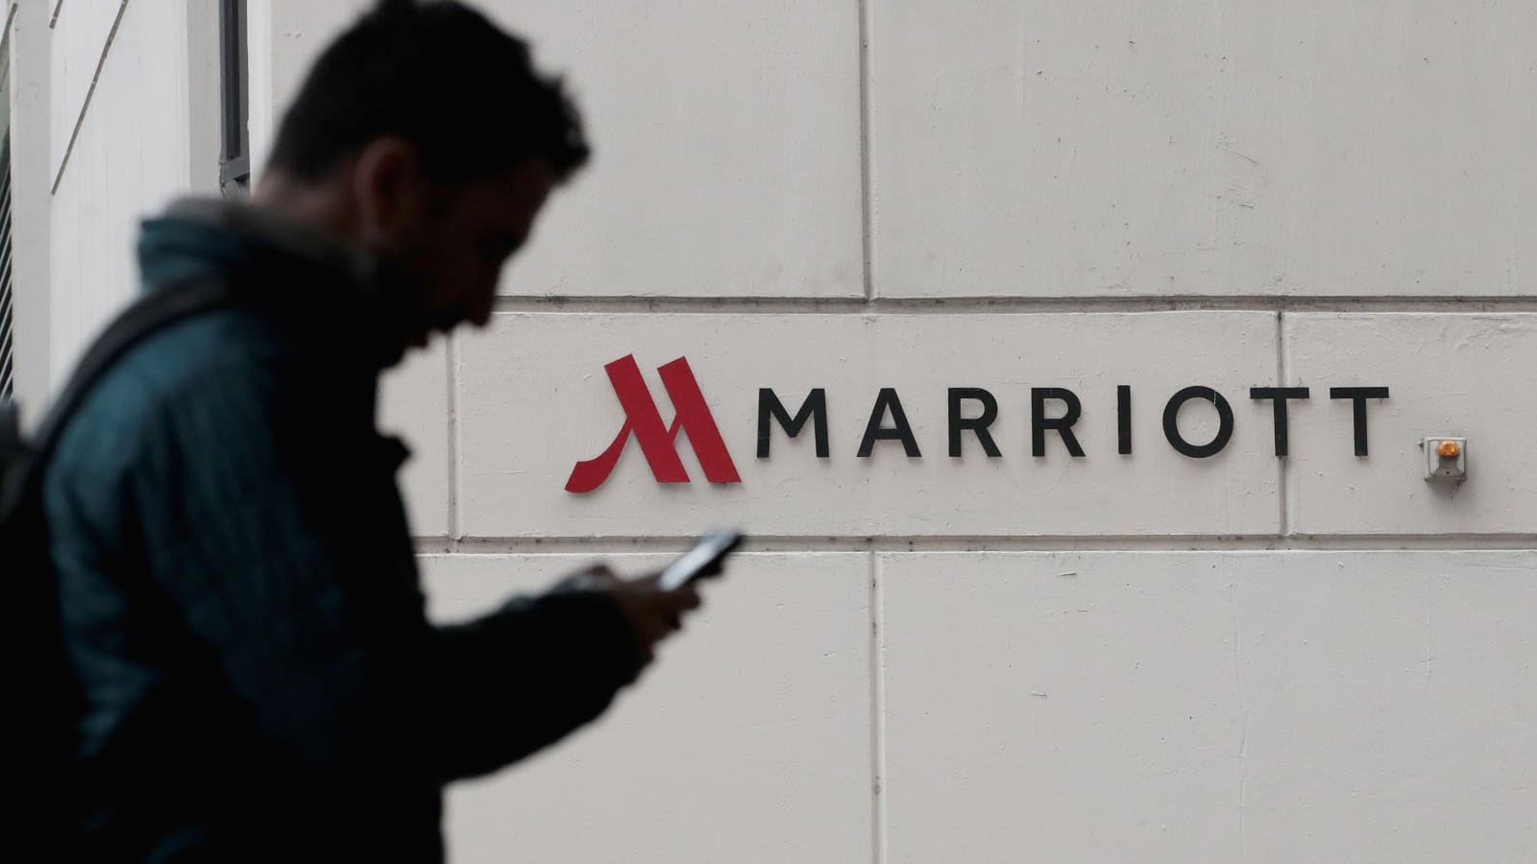
Expiation of the role and function of guest service in general
Guest reservations
Front office management performs this function. They reserve a room for various occasions and programmes.
online reservation system via a software application that allows both regular and potential customers to book directly with their chosen date and place. Here, guests need no direct intermediary in booking their desired travels (Mathur et al., 2006).
The reservation software made booking connections with the hotel's official website passing the required information. Research data identified that more than 700 million guests will book their desired travel via the online website by 2023 (Moronta & Fredey, 2020).

Slide 12
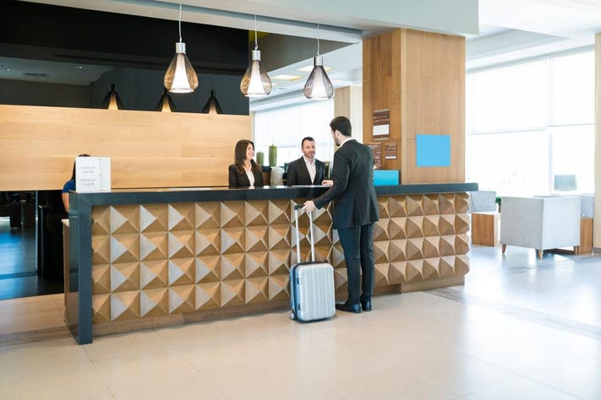
Front office functions
Guest registration: The front office manager performs register-related roles including guest check-in, room assistance, room choice, etc.
Guest history and records- Front office manager create a guest profile, and important feedback relating to hotel services.
Updated room status: Marriott Hotel record daily update on its room like CO, CI and DND records (Ivkov et al., 2016).
Telephone: The guest can contact both internally and externally via hotel telephone
Inquiry: Under this supervision, the front office manager alerts guest of all unknown movement outside or inside the hotel.

Slide 13
Conclusion & References
Conclusion
Marriot Hotels and resorts offer competitive and feasible guest room facilities. In the global hotel industry, there have many powerful giants such as Hilton Hotels, Holiday Inn, Jurys Inn, McMillan Hotels, Best Western GB, etc. To compete with these strong competitors in this ever-changing hotel industry, Marriott Hotel offers better guest services.
References
Araujo, P.S., Campos, D.F. and Campos, D.C. (2022) “Dimensions of hotel service quality and its impacts on guest satisfaction and Loyalty,” International Journal of Services and Operations Management, 1(1), p. 1. Available at: https://doi.org/10.1504/ijsom.2022.10046615.
Beldona, S. and Cobanoglu, C. (2007) “Importance-performance analysis of guest technologies in the lodging industry,” Cornell Hotel and Restaurant Administration Quarterly, 48(3), pp. 299–312. Available at: https://doi.org/10.1177/0010880407304023.
Chigozie-Nwokorie, E. (2021) “Service management and guest satisfaction for the hotel industry in Abeokuta, Nigeria,” Zbornik radova Departmana za geografiju, turizam i hotelijerstvo, (50-1), pp. 52–69. Available at: https://doi.org/10.5937/zbdght2101052c.
Cvelbar, L.K., Grün, B. and Dolnicar, S. (2019) “Which hotel guest segments reuse towels? selling Sustainable Tourism Services through target marketing,” Marketing for Sustainable Tourism, pp. 53–66. Available at: https://doi.org/10.4324/9780203711668-4.
Ivkov, M. et al. (2016) “Service orientation as a basis for quality services and competitiveness in hotel industry,” Proceedings of the Singidunum International Tourism Conference - Sitcon 2016 [Preprint]. Available at: https://doi.org/10.15308/sitcon-2016-199-202.
Mathur, S., Khanna, K. and Saxena, S.K. (2006) “Sustainability practices in hotel industry: A study on guest awareness and satisfaction,” GIS Business, 1(6), pp. 9–10. Available at: https://doi.org/10.26643/gis.v1i6.5142.
Mohammed Shobri, N.D. and Putit, L. (2015) “Building guest loyalty: The role of guest based Brand Equity and guest experience in Resort Hotel Industry,” Advanced Science Letters, 21(5), pp. 1605–1609. Available at: https://doi.org/10.1166/asl.2015.6116.
Moronta, R. and Fredey, C. (2020) “The Fundamentals of Pricing Hotel Guest Rooms,” Hospitality Revenue Management, pp. 31–60. Available at: https://doi.org/10.1201/9781003019923-2.
Tran, B. (2015) “The next generation of leaders,” Educational Strategies for the Next Generation Leaders in Hotel Management, pp. 16–42. Available at: https://doi.org/10.4018/978-1-4666-8565-9.ch002.

