Slide 1
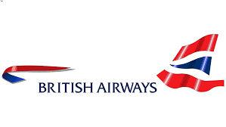

An Appraisal of a Guest Service Experience
Title: An Appraisal of a Guest Service Experience for British Airways
Nathalie Quayle 1815194
Benonia Ngwala 1813797
Lecturer Name: Olubukola Adegbite (Ade)

Slide 2



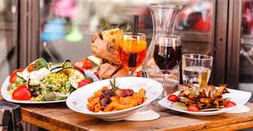
TRANSPORTATION Sector Industry
The transportation sector industry refer to a way of carrying passengers and freight. (EconomyWatch 2010).
Transportation Sector Industry includes:
Railways
Airways
Shipping and Logistics

Slide 3
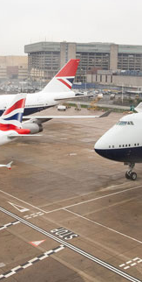
British Airways
British Airways is the flag carrier airline of the United Kingdom, with its headquarters in London.
2nd largest airline globally, with fleet size of 278 and 183 destinations covered globally (British Airways Annual Report, 2018).
Strong name as a premium airline, with quality, choice, and convenience

Slide 4
Products, Services, and USP of British Airways
Products/Services
Inter-continental offerings
First Delux Service
Club World (Busines class)
Intra-European offerings
Club Europe (Business class)
World Traveller Plus (Premier Economy)
World Traveler (Economy)
Euro-traveler (Economy class)
UK Domestic
Economy flights connecting London and major UK cities
7 distinct services: 4 Intercontinental offerings,2 intra-European, in domestic travel in UK
Unique Selling Point (USP): Reputation as a full-service airline.
Offers full range of service including, in-flight entertainment, meals, beverages, blankets, pillows, checked baggage, all within the ticket price.
Figure: Products/Services by BA (British Airways Annual Report, 2018)

Slide 5
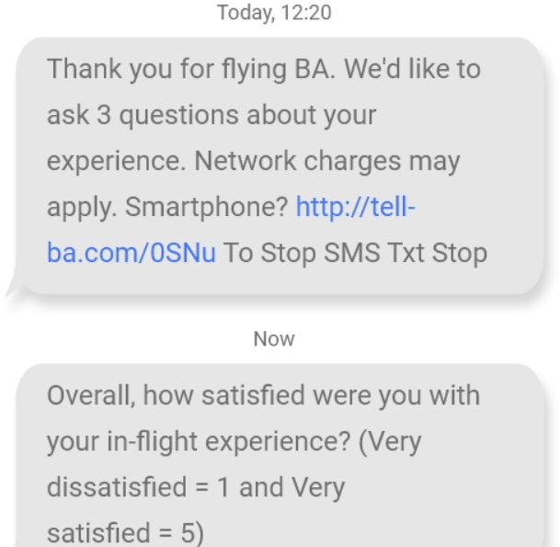
Strategies for appraising guest service experience
British airways uses survey to capture their customer service experience and recommended it to others
Email surveys
NPS surveys
Post surveys
Two way SMS surveys
800 K messages a month
40 countries worldwide receive two-way SMS (dotdigital.com, 2020).
NPS Surveys by BA: Source: (customerstrategy.net, 2019)
Two-Way SMS surveys by BA: Source: (dotdigital.com, 2020)

Slide 6

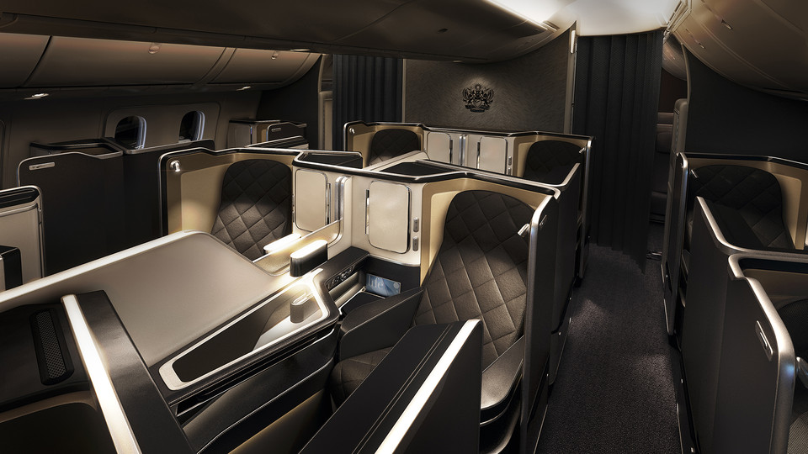
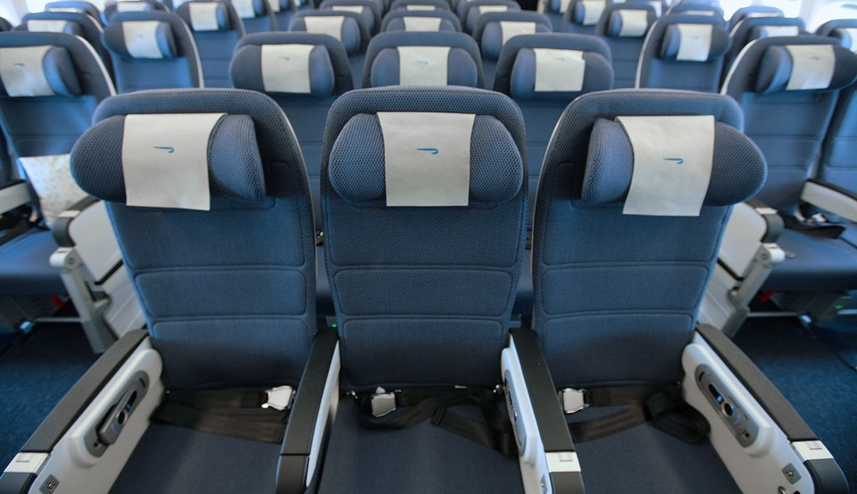
Service Quality, Service Setting, & Service Delivery
Service Quality
British Airways is Certified with the 4-Star Airline Rating for the quality of its Onboard product and staff service, and the British Airways home base Airport service
Nathalie had a good experience from her flight to Germany, she needed a baby bed and one the flight attendant provided her one ,staff was very helpful, and she enjoyed the rest of her flight.
Service Setting
Most aircraft have comfortable seats with adjusted footrest
Food and beverages on short haul services
USB power
Audio and Video on Demand . Based on Benonia experience, she needed to charge her phone while on the plane, unfortunately, USB power are only available on long haul flight, and that was a bad experience she had. Nathalie experience was good as she could see her destination on screen on her flight to Germany, that was a good experience.
Service Delivery
There is few service delivery such as transportation between hotel and airport, good punctuality service. Based on Benonia experience, her flight was due to leave at 5 am, British Airways provided a shuffle bus from the hotel to the airport and she was pleased with the service.
Source: (airlinequality.com,2020)

Slide 7
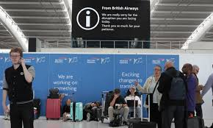
Guest Service Experience
According to Coffey (2019), British Airways has been named the second worst airline in a new ranking due to poor seat comfort, bad quality of food and value for money.
Travel’s annual airline survey from the UK based on the experiences of 6,500 holidaymakers.
customer satisfaction score was just 55 per cent.
Benonia and Nathalie both had bad and good experience while on board on the flight to the destination of our choices, about service quality, staff was helpful. Based on service settings, no USB power was available for short haul flight and service delivery was brilliant as a shuffle bus was provided.

Slide 8
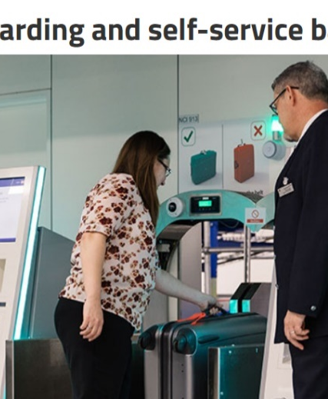
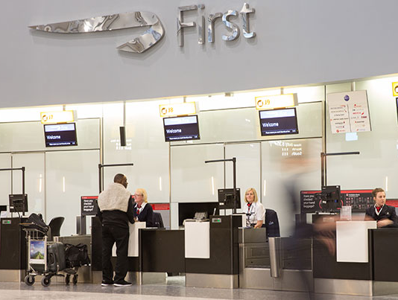
Appraisal of Service Quality
High Quality: Biometric boarding now operational in most airports
Simply scan the boarding pass and move ahead
Self-service baggage drop where boarding pass can be scanned and baggage can be dropped
High Quality: Dedicated desks
Two-lane security channel
First Lounge and Concorde Room
Source: (futuretravelexperience.com, 2017)

Slide 9
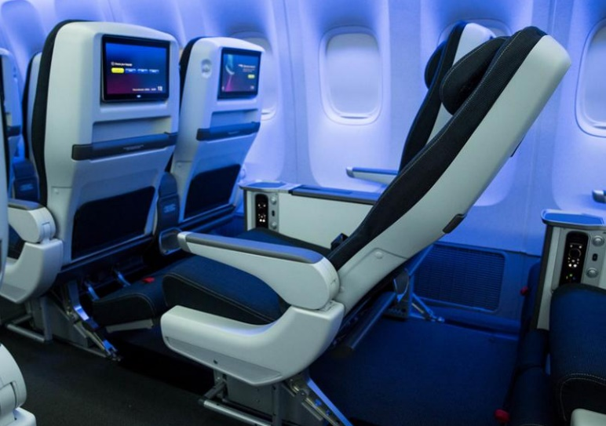
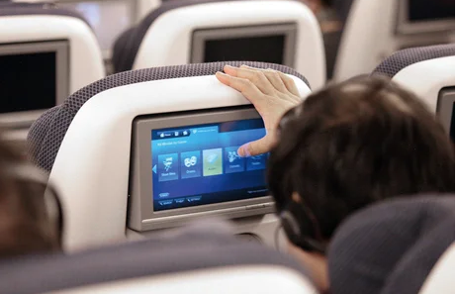
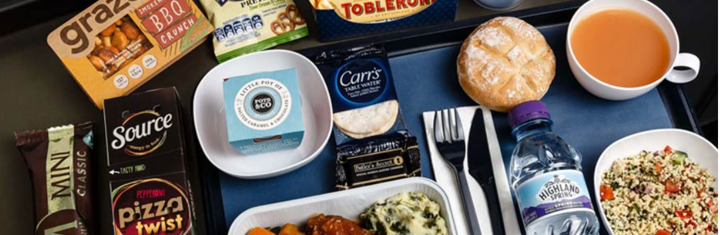
Appraisal of Service Setting
Cosy design quilt along with a plush pillow
Noise-cancelling headphones given
High Quality: Complementary drinks, snacks, four course meal, and lighter snacks just before landing.
High Quality: Wi-Fi connectivity service
Digital newspapers and magazines
TV Shows, Movies, programs across a wide range of languages
Large selection of programs for kids
Source: (futuretravelexperience.com, 2017)

Slide 10
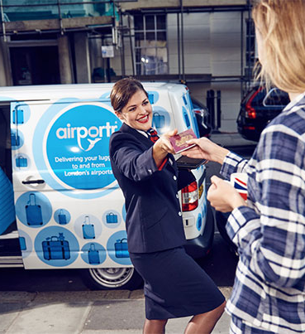
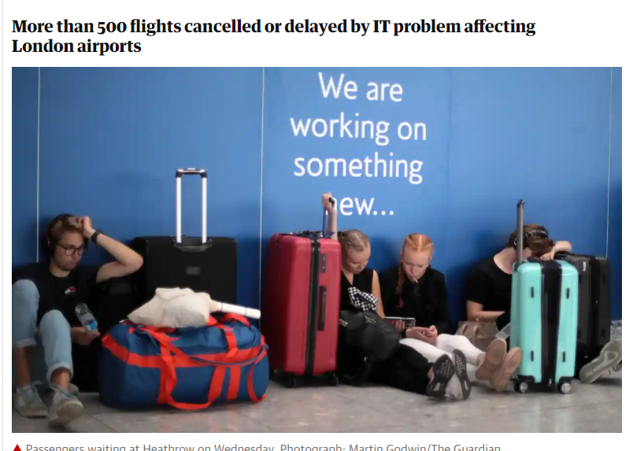
Appraisal of Service Delivery
Easy assistance through dedicated IT portal for a wide range of customer concerns
Dedicated customer care and support contact number and email ID.
Negative incidents: IT failure in Aug 2019, 140 Flights cancelled, 370 delayed.
Source: (BritishAirways.com, 2020)
Source: (theguardian.com, 2019)

Slide 11
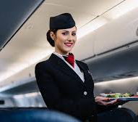

Findings
Good structure strategy for guest appraisal
Popular full-service airline
High quality service
Negative findings
Safety dimension of quality is poorly handled
Service Delivery dimension witnessing disruptions
Positive findings
High Quality Check-in, Booking, baggage management etc.
High Quality service settings, seats, entertainment, food and beverages

Slide 12
Conclusion
To summarise, actions are needed for British Airways to boost its reputation and competitiveness.
British Airways needs to implement support system, resolve customer issues, handle sudden disruptions.
British Airways needs to improve all parts of the service experience and areas like booking, seating, entertainment and safety of passengers.

Slide 13
References
Bitish Airways Annual Report, (2018). British Airways Annual Report,
available at https://www.iairgroup.com/~/media/Files/I/IAG/annual-reports/ba/en/british-airways-plc-annual-report-and-accounts-2018.pdf, accessed [06/06/ 2020].
BritishAirways.com, (2020). British Airways: Customer service and contingency plans, available at https://www.britishairways.com/en-it/information/customer-service-and-contingency-planning#:~:text=Customer%20service%20plan,a%20safe%20and%20enjoyable%20journey.&text=In%20the%20US%2C%20please%20contact,at%20866%2D393%2D0961, accessed [ 05 June 2020].
Coffey, H., (2019), Independent, British Airways Named As Second Worst Airline In New Ranking, available at https://www.independent.co.uk/travel/news-and-advice/worst-airlines-ryanair-british-airways-which-survey-a9251656.html, accessed [08/06/2020]
Customerstrategy.net, (2019). Customer Strategy : NPS., available at https://customerstrategy.net/how-not-to-do-research/ , accessed [05/06/2020]
Dotdigital.com, (2020). British Airways:
Two-way SMS helps gather post-flight feedback on customer satisfaction, available at https://dotdigital.com/customers/travel/british-airways/ , accessed [05/06/2020]
EconomyWatch, (2010),Transportation Industry, Transportation Sector, aavailable at https://www.economywatch.com/world-industries/transportation-industry.html, accessed [08/06/2020]
Futuretravelexperience.com, (2017). Analyzing BA’s major customer experience investment, available at https://www.futuretravelexperience.com/2017/04/british-airways-major-customer-experience-investment/,accessed [05 May 2020].
Skytrax, (2020), British Airways Customer Reviews, available at https://www.airlinequality.com/airline-reviews/british-airways/ ,accessed [06/06/2020]
Theguardian.com, (2019). Passenger anger as tens of thousands hit by BA systems failure, available at https://www.theguardian.com/business/2019/aug/07/british-airways-it-glitch-causes-disruption-for-passengers-delays ,accessed [05 June 2020].

