Slide 1
WHERE'S MY LOCAL?
Company Presentation

Slide 2


Our Logo

Slide 3
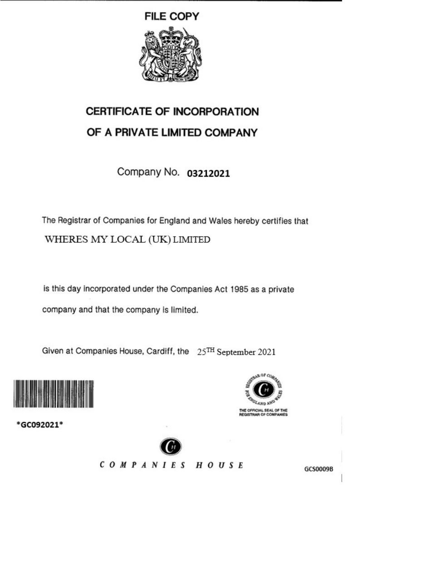
Company Registration(1)
Where’s my Local? Has been
Registered with Companies House under Reg No. 03212021
The company full name is Where’s my Local (UK) Limited T/A Where’s my Local.

Slide 4
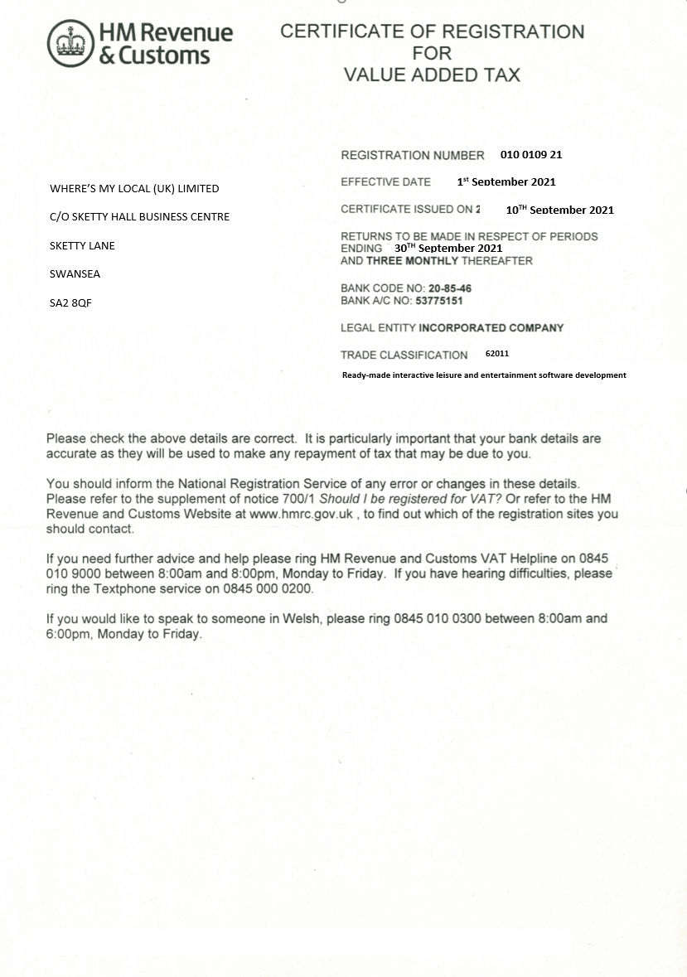
VAT (Value Added Tax) Registration(2)
Where’s my Local (UK) Ltd has been
Registered with the HMRC under Vat Reg No. GB 010 0109 21.
A form has been completed to register for VAT.
Future Companies would be allocated their own VAT Numbers for Accounting Purposes.

Slide 5
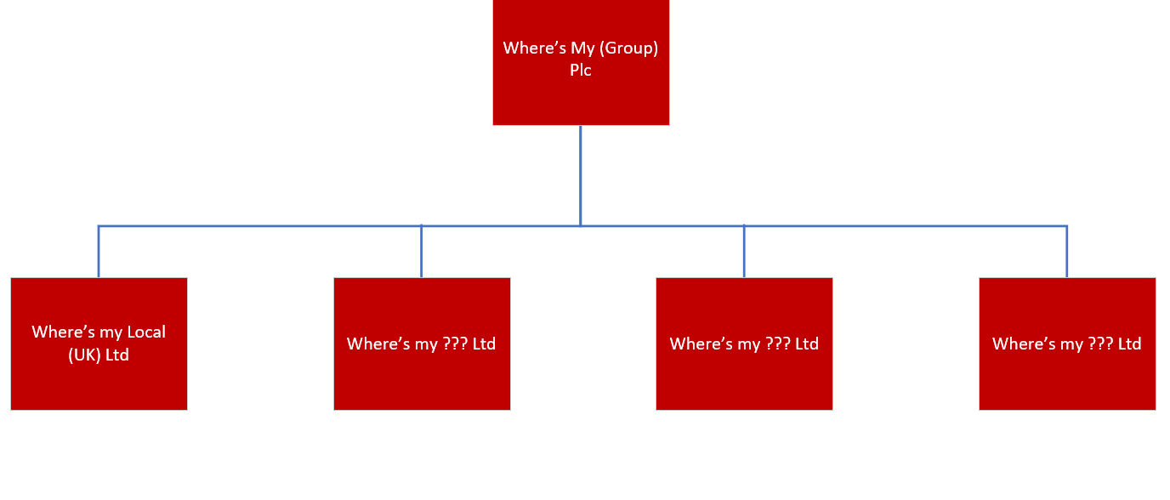
Future
In the event of expansion, a group entity can be created.
The Where’s my (Group) PLC would become the Parent Company.
Where’s my Local (UK) Ltd and other companies would be become part of this group underneath the Parent Company.

Slide 6
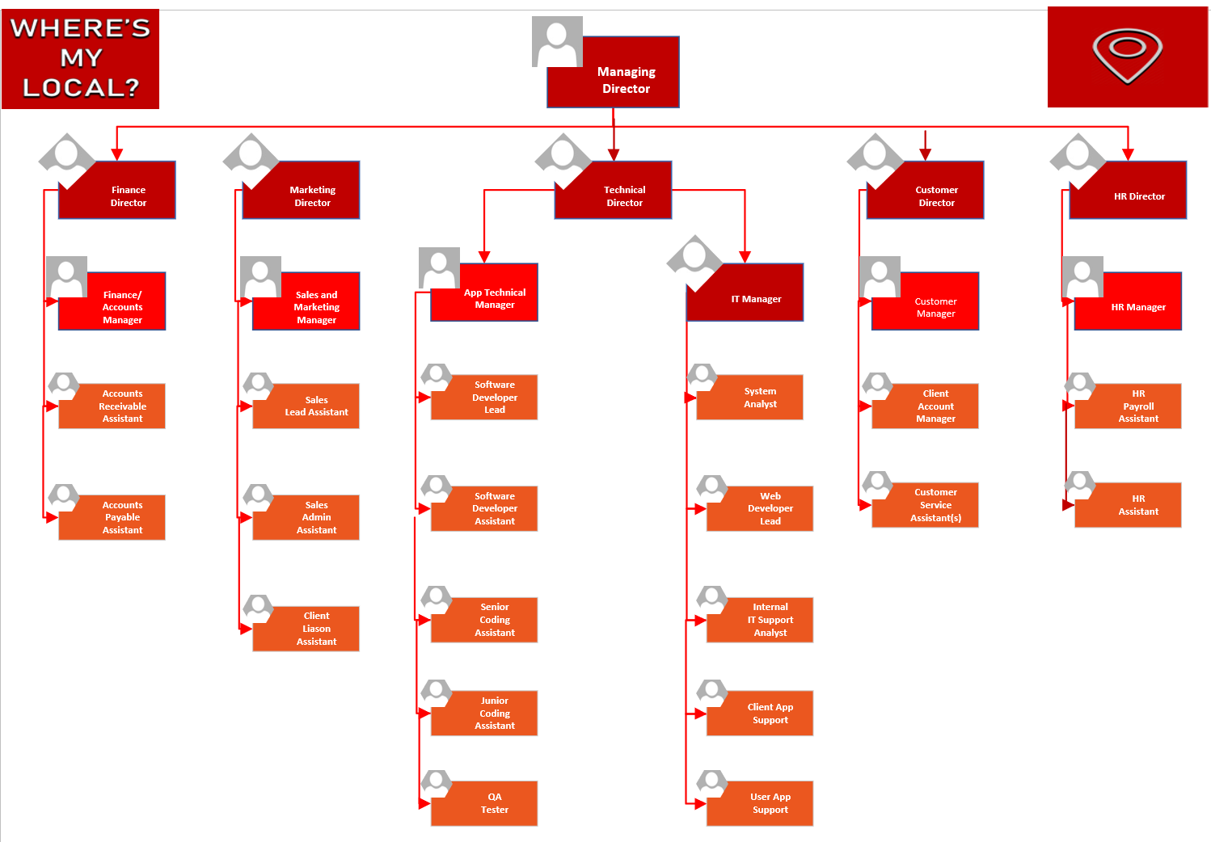
Organisation Structure
The company will organize as above.
There are five directors each managing each aspect of the business.
Each department will have its own Manager to deal with the day to day running of each department answerable to the department Director.

Slide 7
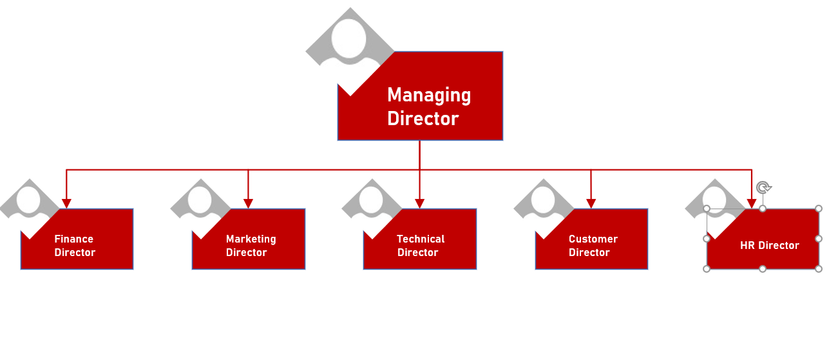
Leadership Structure
The Directors will organize as shown.
Each of the Directors will report to the Managing Director.
The Managing Director will represent the company and provide leadership and be responsible for encouraging growth of the company.

Slide 8
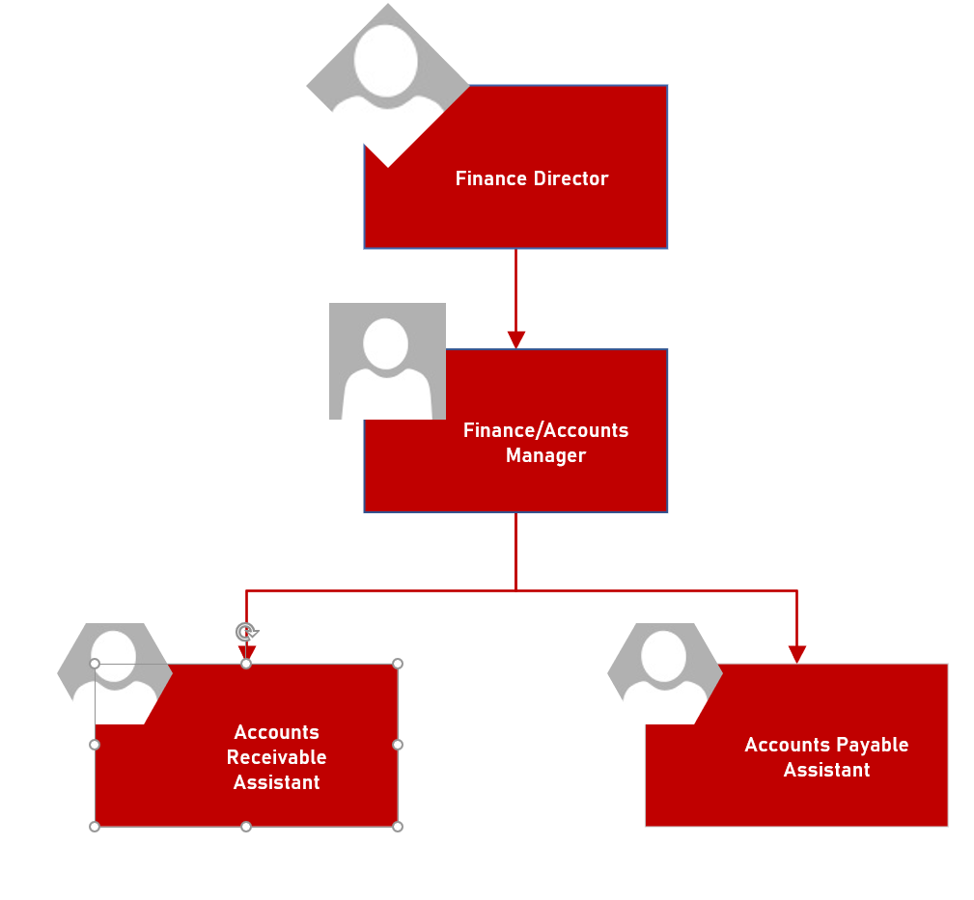
Finance Department Structure
The Finance Account Manager will run the Finance department and report to the Finance Director.
The Accounts Receivable Assistant will process and incoming payments and take appropriate action if late.
The Accounts Payable Assistant will make the payments to suppliers and ensure this is done on time.

Slide 9
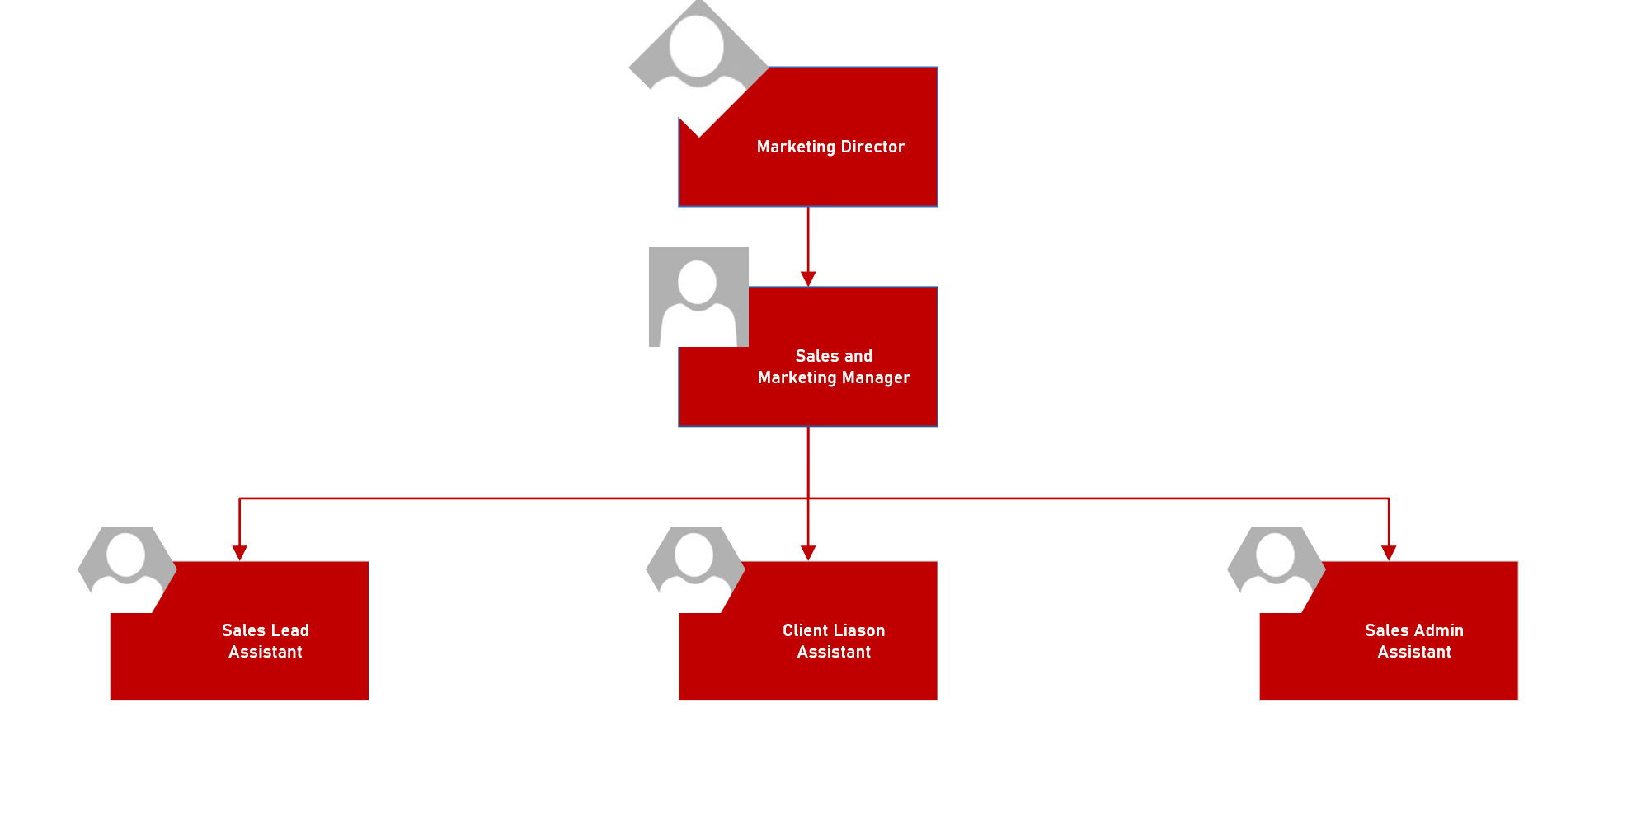
Marketing Department Structure
The Marketing Manager will run the Marketing department and report to the Marketing Director.
The Sales Lead Assistant will work with the Sales Admin Assistant to bring in and process new clients such as large Breweries.
The Client Liaison Assistant will maintain these new relationships and help identify new opportunities for the Sales Lead Assistant.

Slide 10
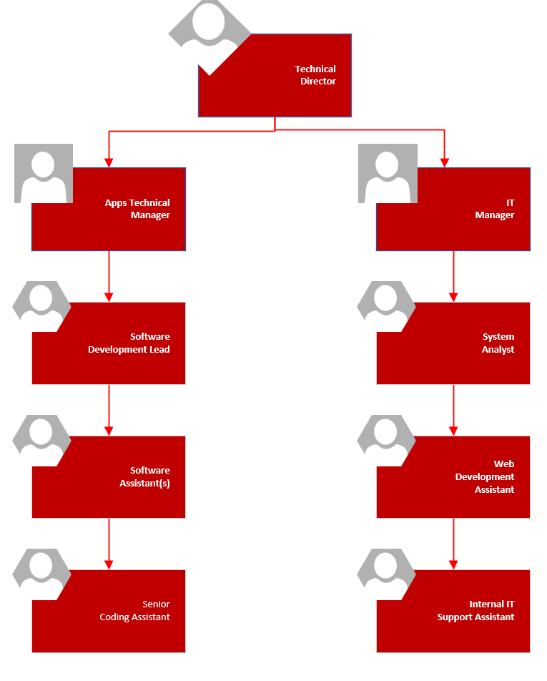
Technical Department Structure
There are two Managers who will report to the Technical Director
App Technical Manager and their team will develop the App(s).
The IT Manager and their Team will manage the Companies IT Systems and provide support to the Users and employees.

Slide 11
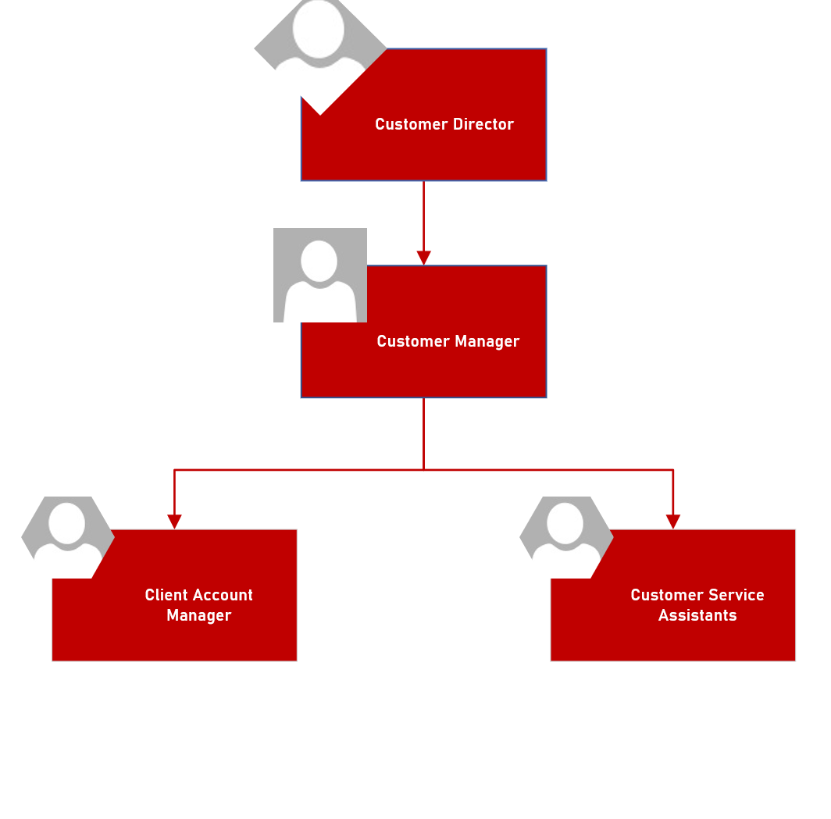
Customer Department Structure
The Customer Manager will report to the Customer Director.
The Client Account Manager will look after Client Accounts and deal with any queries.
The Customer Service Assistants will deal with Users and address any issues or complaints that they have.

Slide 12
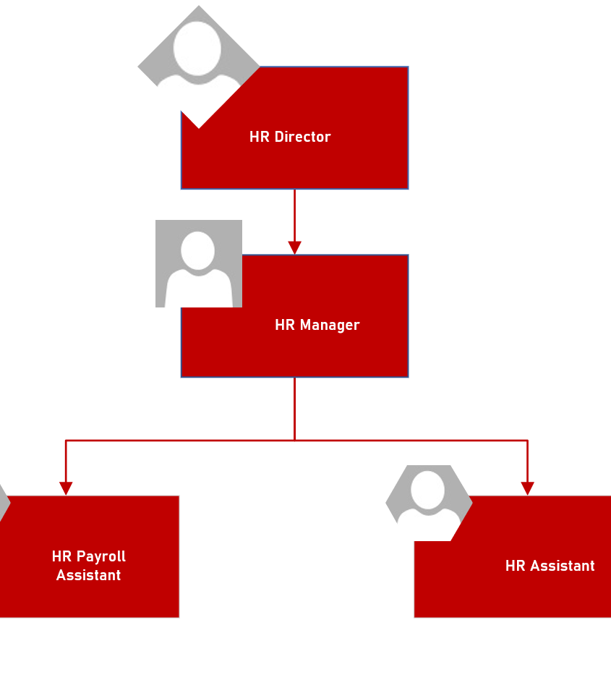
HR Department Structure
The HR Manager will report to the HR Director.
HR Payroll Assistants will deal with payroll and ensure correct taxations details are used.
HR Assistants will deal with employee queries, document disciplinary issues and conduct interviews for staff.

Slide 13
Mission Statement
“Dedicated to helping people plan and enjoy their Evening Out”.

Slide 14
Vision Statement
“Where’s My Local? aims to be your constant company during your search for good food and drink whether your young and on the town or a family looking for a quiet meal”.

Slide 15
Objective
“Our objective is simple. To become the essential, reliable and friendly App for those who are going out on the town or for those who want a quiet meal without sacrificing quality and accuracy”.

Slide 16
Code of Conduct(3)
In this section a summary of the code of conduct will be outlined.

Slide 17
Use of Technology
Mobile phones or other electronic items must be off during working hours.
However, use of the above is allowed during break times only.
Social media will be monitored and any detrimental posts to the company or brand will be investigated, and appropriate action taken.
Any social media posts must be clearly stated to be opinion and not that of the company.
Personal internet usage during working hours is prohibited unless on a break.

Slide 18
Software and IP/Copyright Properties
Staff will be expected to work on and develop software.
Any code/software or properties developed during the contract of employment remains the sole property of the company.
Under the contract of employment the company is entitled to any or all royalties earned from the publication of the software and this remains in place for a period of no less than one year after the termination of employment.
Any staff found to be in breach of the above will be met with legal action and the company reserves the right to exercise this at it’s discretion.

Slide 19
Dress Code
Casual wear such as Jeans, skirts and dresses is acceptable however outfits must be appropriate for a working environment.
Clothing with inappropriate use of language or images will not be allowed.
If a client or potential visit is due to take place employees will be notified and requested to wear appropriate business attire.

Slide 20
Employee Breaks.
A 60-minute lunch break is allocated to employees, and they are required to log out for lunch, and they log in on time.
Failure to do so will result in 30 minutes wages to be deducted.
Consistent offences will lead to disciplinary action and possible dismissal.
Lunch breaks will be allocated to you by your manager and break swapping is to be at your managers discretion.

Slide 21
Absenteeism
Please follow the standard practice if you do not believe you will be in work.
Please inform your line manager at least one hour before you are due to start your shift.
Consistent absences will be investigated, and action could be taken.
You must start and end your shift at the designated time or disciplinary action will be taken.

Slide 22
Confidentiality
Employees are reminded that:
Any information acquired during the course of employment
Relating to the business or other persons, IP or bodies with whom the company has dealings
Or has not been made public without our express consent
Is confidential and employees shall not disclose such information or IP at any time before or after the termination of employment and cannot be disclosed to any third party without our express written consent.

Slide 23
Disciplinary Action.
First stage is a verbal warning.
Second stage is a written warning.
Third stage will result in a verbal and written warning.
Fourth stage if a further violation takes place, then summary dismissal will occur.
If the initial offence is severe enough then the employee may be sacked for Gross Misconduct.

Slide 24
Any Questions?
End of Company Details presentation.

Slide 25
Bibliography
(1) https://www.gov.uk/limited-company-formation/register-your-company
(2) https://www.gov.uk/vat-registration/how-to-register
(3) https://uk.indeed.com/career-advice/career-development/code-of-conduct-examples

