Slide 1

How Constructivism and Social Constructivism Underpin Classroom Practice.

Slide 2
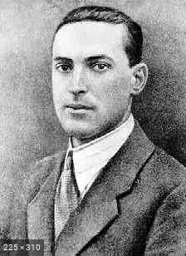
Theoretical approach to Social Constructavism
Lev Vygotsky (1896-1934)a Russian psychologist whose theory of social constructivism believed that the role of other people was essential for children’s learning. (Bosanquet, Radford and Webster 2016 pg.26-28). Vygotsky's theories stress the fundamental role of social interaction in the development of cognition (Vygotsky, 1978), as he believed strongly that community plays a central role in the process of "making meaning." (McLeod, 2018). This is a general theory of cognitive development. Most of the original work was done in the context of language learning in children (Vygotsky, 1962), although later applications of the framework have been broader (Wertsch, 1985).
https://my-ecoach.com/project.php?id=12152&project_step=80474

Slide 3
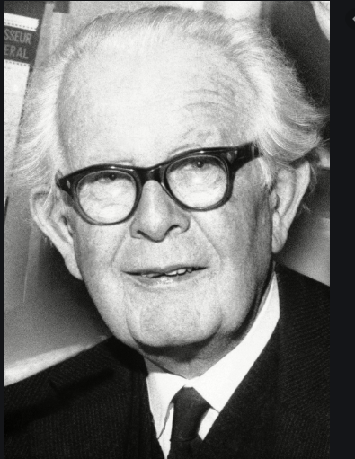
Theoretical approach to Constructivism
Jean Piaget (1892-1980) A swiss biologist whose theory of constructivist tells us “that we interact with the world around us from birth, making links between known and new ideas, words with concepts, assimilating and understanding these ideas and links and then accommodating them and finding an equilibrium that continues on as a cycle as we grow. learning new ideas from experiences that we have” (Bosanquet, Radford and Webster 2016 pg. 25). Piaget's (1936) theory of cognitive development explains how a child constructs a mental model of the world. He disagreed with the idea that intelligence was a fixed trait, and regarded cognitive development as a process which occurs due to biological maturation and interaction with the environment. McLeod, S. A. (2018, June 06)
https://www.britannica.com/biography/Jean-Piaget

Slide 4
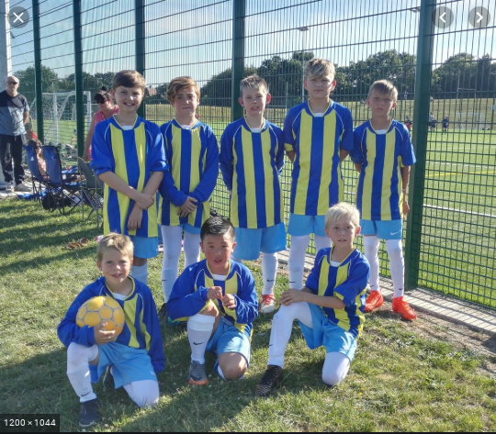

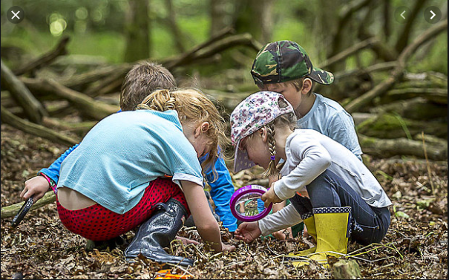
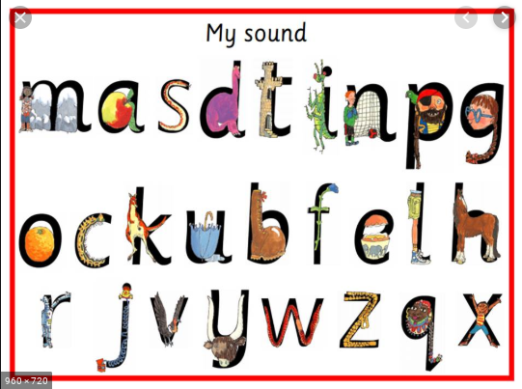
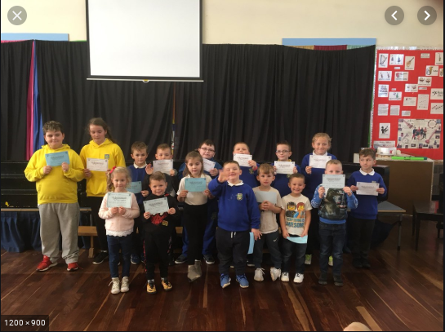
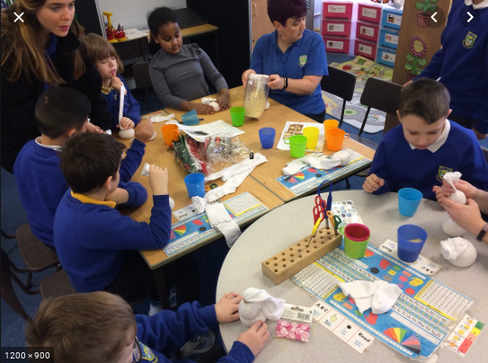
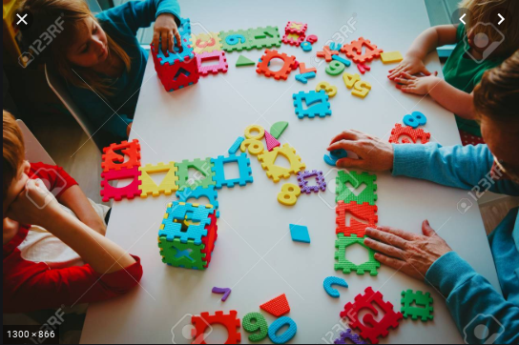

Some of the approaches used in school A that underpin Constructivism and Social Constructivism:
Social Constructivism
Constructivism
STF Football
Sensory Play
Forest Schools
Read, Write inc
(telegraph.co.uk)
(School A Website)
(schoolhealth.com)
(clapgate.leeds.sch.uk)
Special Mention – Fun Time Friday
Pop up Shop
Feelings Board
Number Ordering
(School A Website)
(School A Website)
(123rf.com)
(npted.org)

Slide 5
Conclusion
When looking at both Piaget's and Vygotsky's theories it is evident that there are both similarities and differences between both Constructivism and Social Constructivism. One of the similarities is their Emphasis on both nature and nurture - Both recognise the role of heredity and maturation of the brain and body=nature. Piaget recognises how children meet the demands of their environment. On the other hand there are more differences between both theories that include the fact that Piaget said that cognitive development is driven by a child's inbuilt tendency to adapt to new experiences whereas Vygotsky said that cognitive development is driven by social interaction and Piaget said that cognitive development is driven by a child's inbuilt tendency to adapt to new experiences whereas Vygotsky said that cognitive development is driven by social interaction. The key difference between Piaget and Vygotsky is that Piaget believed that self-discovery is crucial, whereas Vygotsky stated that learning is done through being taught by a More Knowledgeable Other. (caitlin.hole 01-11-17)

Slide 6
References
https://my-ecoach.com/project.php?id=12152&project_step=80474
McLeod, S. A. (2018, Aug 05). Lev Vygotsky. Simply Psychology.
Wertsch, J.V. (1985). Cultural, Communication, and Cognition: Vygotskian Perspectives. Cambridge University Press.
https://www.britannica.com/biography/Jean-Piaget
McLeod, S. A. (2018, June 06). Jean Piaget's theory of cognitive development. Simply Psychology.
Bosanquet, P, Radford J and Webster R, (2016) pg. 25 (Piaget) pg. 26-28 (Vygotsky) : The teaching assistants guide to effective interaction published by :Routledge Taylor and Frances group Abingdon.
Caitlin.hole 01-11-17 https://getrevising.co.uk/grids/comparison-between-piaget-and-vygotsky
https://www.npted.org/schools/elrs/Examples/Forms/DispForm.aspx?ID=12
https://www.123rf.com/photo_107497261_teacher-and-kids-playing-with-number-puzzle.html
https://www.clapgate.leeds.sch.uk/read-write-inc/
https://www.schoolhealth.com/premium-sensory-room
https://www.telegraph.co.uk/education/primaryeducation/12038625/Reading-writing-and-mud-the-growth-of-Forest-Schools.html

