Slide 1
Data Handling and
Business Intelligence
Lecture 3:
Data Warehousing

Slide 2
Learning Objectives
Understand the basic definitions and concepts of data warehouses
Learn different types of data warehousing architectures; their comparative advantages and disadvantages
Describe the processes used in developing and managing data warehouses
Explain data warehousing operations
(Continued…)

Slide 3
Learning Objectives
Explain the role of data warehouses in decision support
Explain data integration and the extraction, transformation, and load (ETL) processes
Describe real-time (a.k.a. right-time and/or active) data warehousing
Understand data warehouse administration and security issues

Slide 4
Opening Vignette…
Isle of Capri Casinos Is Winning with Enterprise Data Warehouse
Company background
Problem description
Proposed solution
Results
Answer & discuss the case questions.

Slide 5
Questions for the Opening Vignette
Why is it important for Isle to have an EDW?
What were the business challenges or opportunities that Isle was facing?
What was the process Isle followed to realize EDW? Comment on the potential challenges Isle might have had going through the process of EDW development.
What were the benefits of implementing an EDW at Isle? Can you think of other potential benefits that were not listed in the case?
Why do you think large enterprises like Isle in the gaming industry can succeed without having a capable data warehouse/business intelligence infrastructure?

Slide 6
Main Data Warehousing Topics
DW definition
Characteristics of DW
Data Marts
ODS, EDW, Metadata
DW Framework
DW Architecture & ETL Process
DW Development
DW Issues

Slide 7
What is a Data Warehouse?
A pool of data produced to support decision making
It is also a store of current and historical data of potential interest to managers throughout the organisation.
Data will be structured to be in a form ready for analytical processing i.e. data mining, querying.

Slide 8
What is a Data Warehouse?
A physical repository where relational data are specially organized to provide enterprise-wide, cleansed data in a standardised format
“The data warehouse is a collection of integrated, subject-oriented databases designed to support DSS functions, where each unit of data is non-volatile and relevant to some moment in time”

Slide 9
Characteristics of DWs
Subject oriented
Integrated
Time-variant (time series)
Nonvolatile

Slide 10
Subject orientated
Data organised by detailed subject e.g. sales, customers etc containing only information for Decision Support.

Slide 11
Integrated
Data warehouses must place data from different sources into a consistent format.
As they may be coming from different software with different formatting and naming conventions.

Slide 12
Time variant
Data warehouse will have a look of (mainly) historical data.
Crucial for analysis that all data can scan be measured in terms of date/time.

Slide 13
Non Volatile
Once the data goes into a data warehouse it cannot be changed or updated by a user.

Slide 14
Video:
https://www.youtube.com/watch?v=KGHbY_Sales

Slide 15
Data Mart
A departmental small-scale “DW” that stores only limited/relevant data
  Dependent data mart
  A subset that is created directly from a data warehouse
  Independent data mart
  A small data warehouse designed for a strategic business unit or a department

Slide 16
Data Mart
Whereas a data warehouse combines data across an entire enterprise, a data mart is usually smaller and focusses on a particular subject or department e.g. marketing
Data Marts can be dependent -come from a data warehouse (expensive)
Or independent not from data warehouse (cheaper)

Slide 17
Other DW Components
Metadata
Data about data. In a data warehouse, metadata describe the contents of a data warehouse and the manner of its acquisition and use. https://www.youtube.com/watch?v=i2a8pDbCabg

Slide 18
Application Case 2.1
A Better Data Plan: Well-Established TELCOs Leverage Data Warehousing and Analytics to Stay on Top in a Competitive Industry
Questions for Discussion
What are the main challenges for TELCOs?
How can data warehousing and data analytics help TELCOs in overcoming their challenges?
Why do you think TELCOs are well suited to take full advantage of data analytics?

Slide 19
Major componets of a data warehouse
Data sources. Data are sourced from operational systems and possibly from external data sources.
Data extraction and transformation. Data are extracted and properly transformed using custom-written or commercial software called ETL.
Data loading. Data are loaded into a staging area, where they are transformed and cleansed. The data are then ready to load into the data warehouse.
Comprehensive database. This is the EDW that supports decision analysis by providing relevant summarized and detailed information.
Metadata. Metadata are maintained for access by IT personnel and users. Metadata include rules for organizing data summaries that are easy to index and search.
Middleware tools. Middleware tools enable access to the data warehouse from a variety of front-end applications.

Slide 20
A Generic DW Framework

Slide 21
Data Integration and the Extraction, Transformation, and Load (ETL) Process
ETL = Extract Transform Load
Data integration
Integration that comprises three major processes: data access, data federation, and change capture.
Enterprise application integration (EAI)
A technology that provides a vehicle for pushing data from source systems into a data warehouse
Enterprise information integration (EII)
An evolving tool space that promises real-time data integration from a variety of sources, such as relational or multidimensional databases, Web services, etc.

Slide 22
Data Integration and the Extraction, Transformation, and Load (ETL) Process

Slide 23
Analysis of Data in DW
OLTP vs. OLAP…
OLTP (online transaction processing)
  Capturing and storing data from ERP, CRM, POS, …
  The main focus is on efficiency of routine tasks
OLAP (Online analytical processing)
  Converting data into information for decision support
  Data cubes, drill-down / rollup, slice & dice, …
  Requesting ad hoc reports
  Conducting statistical and other analyses
  Developing multimedia-based applications
  …more in the book

Slide 24
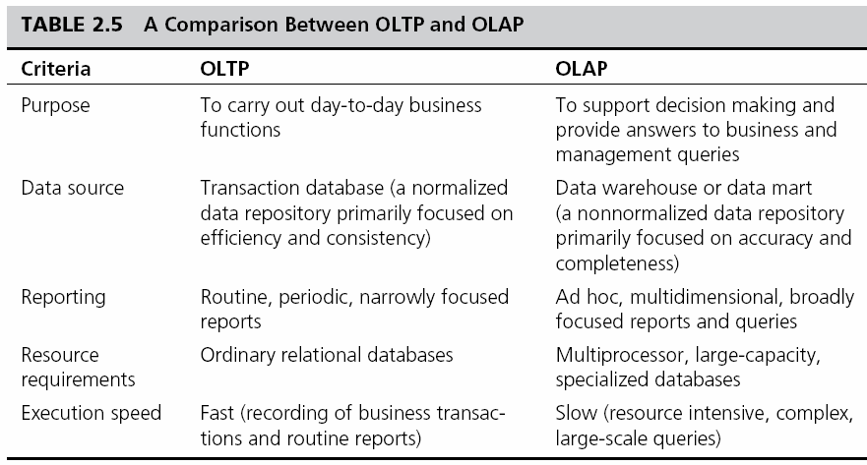
OLAP vs. OLTP

Slide 25
OLAP Operations
Slice - a subset of a multidimensional array
Dice - a slice on more than two dimensions
Drill Down/Up - navigating among levels of data ranging from the most summarized (up) to the most detailed (down)
Roll Up - computing all of the data relationships for one or more dimensions
Pivot - used to change the dimensional orientation of a report or an ad hoc query-page display

Slide 26
Multidimensionality
The ability to organize, present, and analyze data by several dimensions, such as sales by region, by product, by salesperson, and by time (four dimensions)
Multidimensional presentation
  Dimensions: products, salespeople, market segments, business units, geographical locations, distribution channels, country, or industry
  Measures: money, sales volume, head count, inventory profit, actual versus forecast
  Time: daily, weekly, monthly, quarterly, or yearly

Slide 27
OLAP
Slicing Operations on a Simple Three-Dimensional
Data Cube

Slide 28
Real-Time/Active DW/BI
Enabling real-time data updates for real-time analysis and real-time decision making is growing rapidly
  Push vs. Pull (of data)
Concerns about real-time BI
  Not all data should be updated continuously
  Mismatch of reports generated minutes apart
  May be cost prohibitive
  May also be infeasible

Slide 29
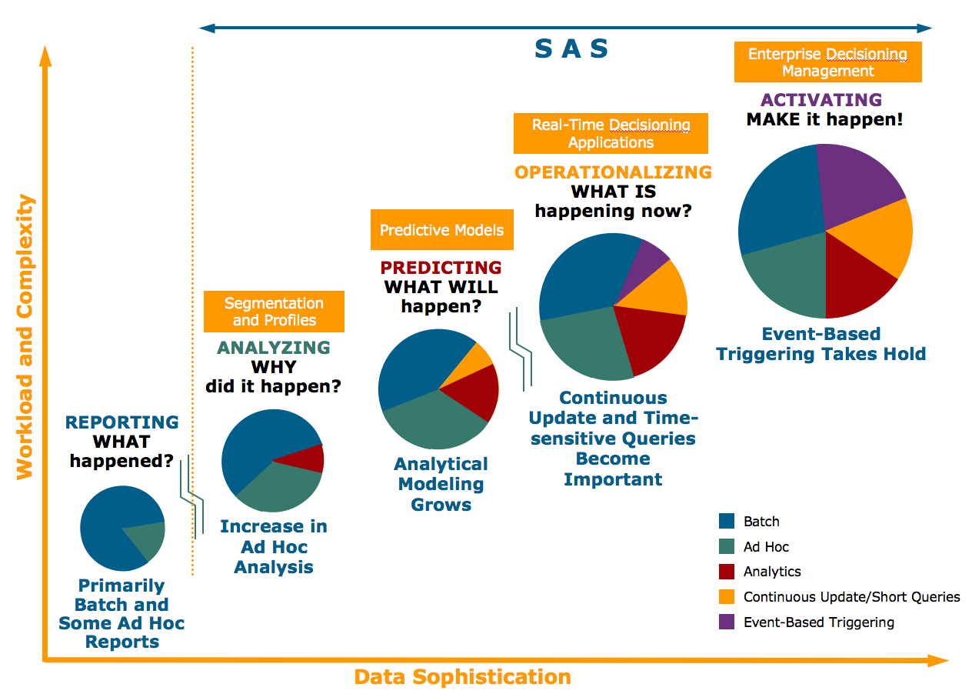
Enterprise Decision Evolution and Data Warehousing

Slide 30
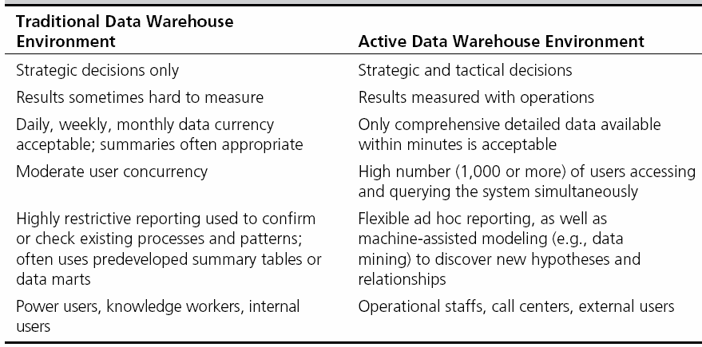
Traditional versus Active DW

Slide 31
DW Administration and Security
Data warehouse administrator (DWA)
  DWA should…
    have the knowledge of high-performance software, hardware and networking technologies
    possess solid business knowledge and insight
    be familiar with the decision-making processes so as to suitably design/maintain the data warehouse structure
    possess excellent communications skills
Security and privacy is a pressing issue in DW
  Safeguarding the most valuable assets
  Government regulations (HIPAA, etc.)
  Must be explicitly planned and executed

Slide 32
The Future of DW
Sourcing…
  Web, social media, and Big Data
  Open source software
  SaaS (software as a service)
  Cloud computing
Infrastructure…
  Columnar
  Real-time DW
  Data warehouse appliances
  Data management practices/technologies
  In-database & In-memory processing New DBMS
  Advanced analytics
  …

