Slide 1
BUSINESS PLAN
Title: Arthur’s Bridal
Student: Florina Roxana Gavril 2108397
Lecturer Name: Vasilios Tavlaridis

Slide 2
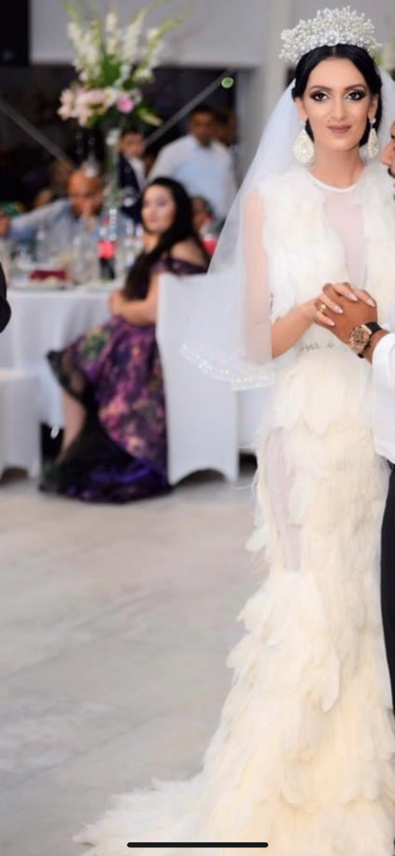
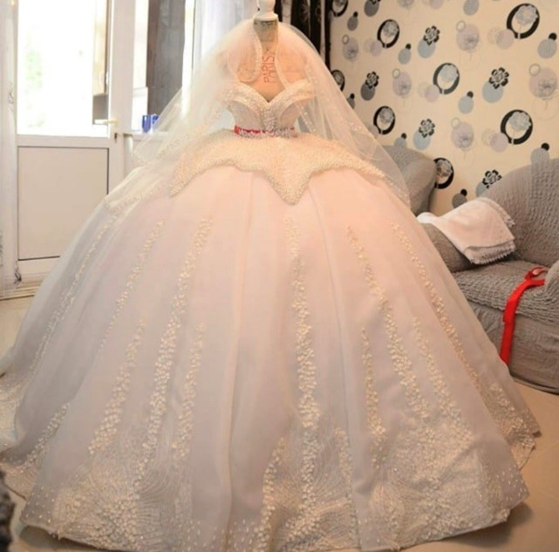
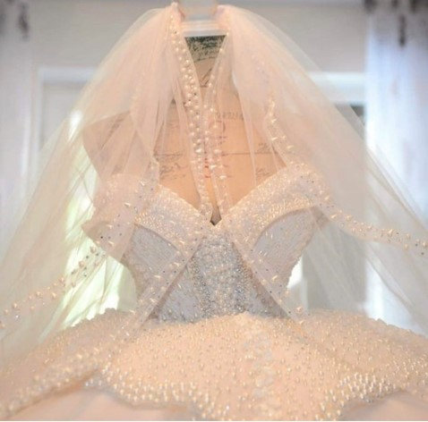
Introduction
  My name is Florina Roxana Gavril and I have a passion for the wedding dresses since I was a little girl.
  At my wedding all the creation and the concept was thought and created entirely by me. I have a passion in this and everything which requires attention to details and special care.
  I really enjoy to provide consultancy for the future brides and to make them look stunning at the big day.

Slide 3
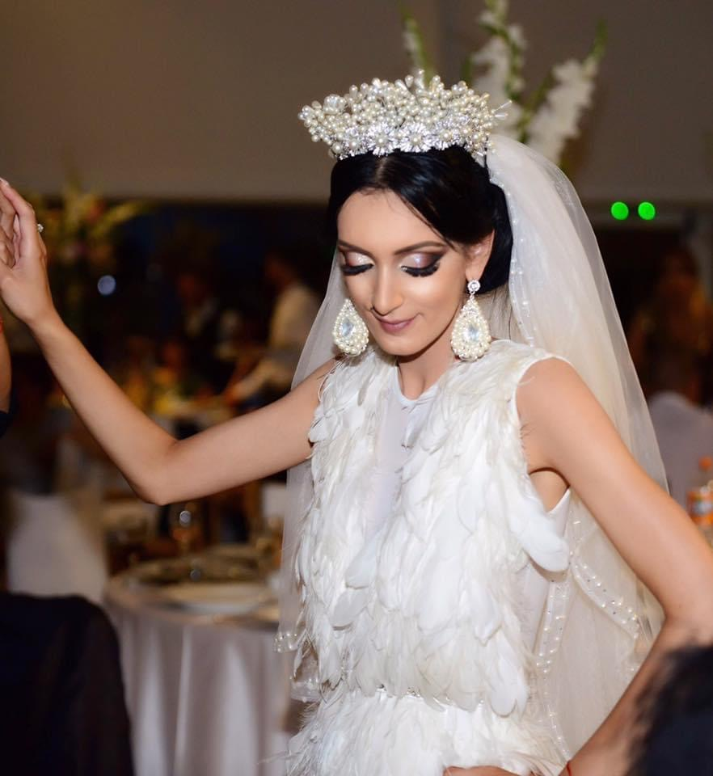
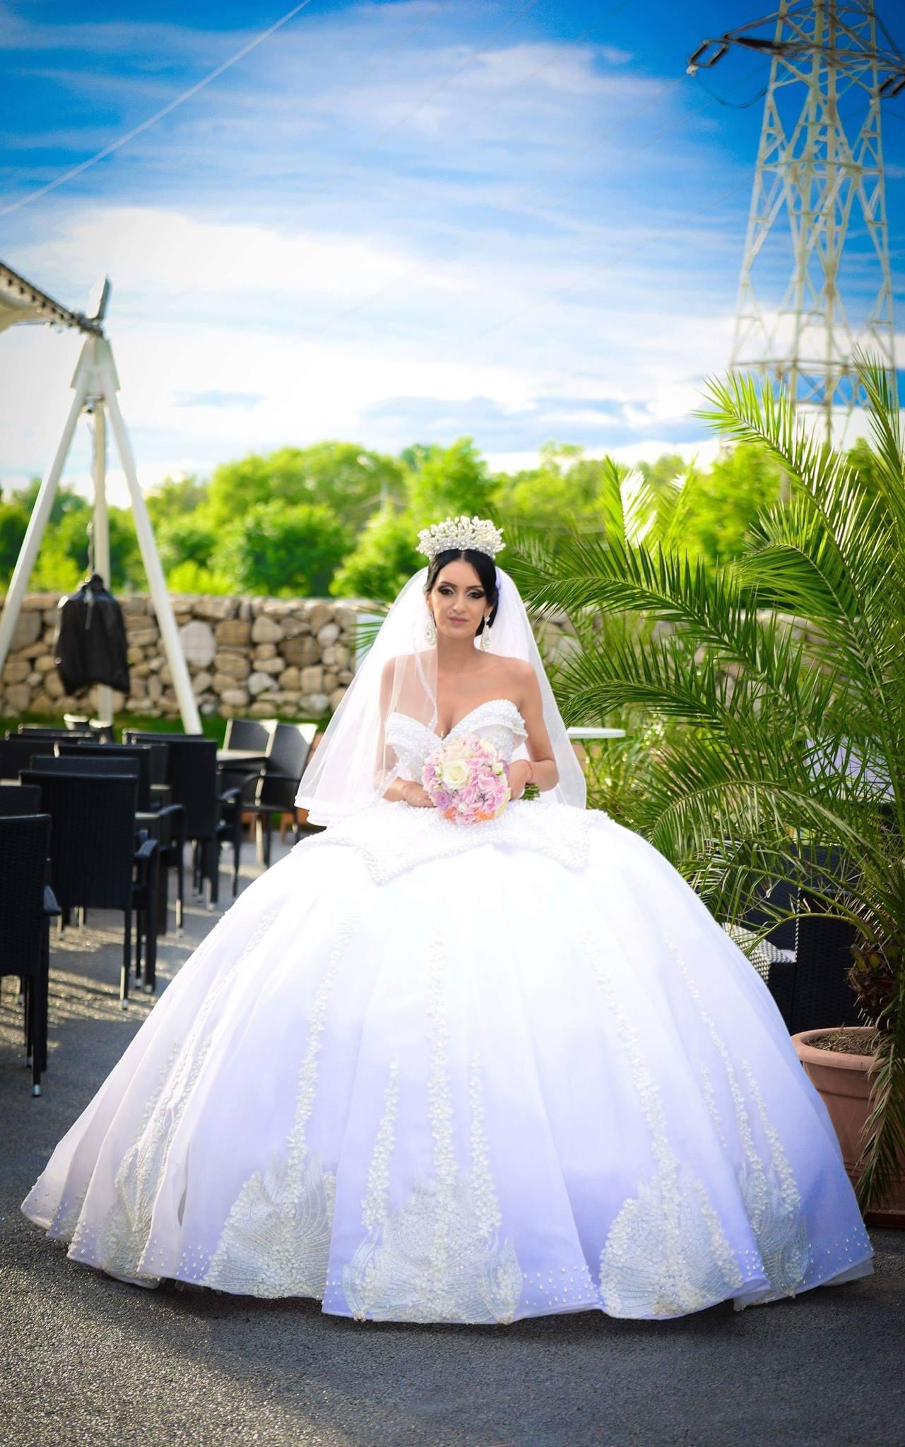
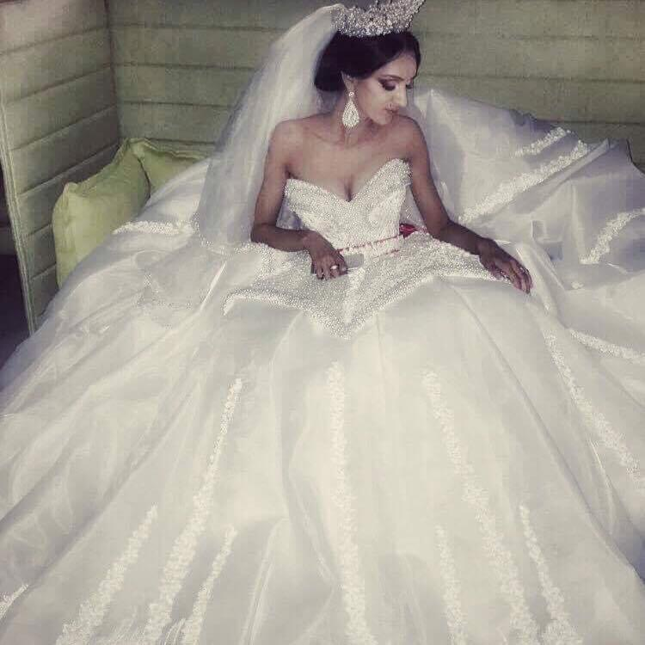
Overview of the business idea, product and/or service
  The Arthur’s Bridal is a bride and special occasion dresses for the powerful women who wants to express themselves with their look.
  The shop wants to cover all the types and tastes of various women and to be the best shop created for them. So, covers all the shapes and body types even if you want a princess or a mermaid dress the shop is able to provide this with special adjustments, crystals or special material, precious or simple whenever you need for your iconic day.
  As per numerous studies the brides and the concept was changed during the last 30 years and the women wants something different and unique for their big day. The Arthur’s Bridal is able to create and to push this concept in a different way creating something that before was called “inappropriate” in something suitable, fashion and to fulfil the clients wishes.

Slide 4
Legal format & Management
Ownership and Legal format
The company will be a SOLE Trader company because of its purpose which requires a total implication of the owner, as because is the owner idea for many years, requires an attention and a good schedule of all the steps for a good outcome.
After the registration to the HMRC, the place will be the second priority and the most important factor, as depends of the position and customers involved in this kind of business how can survive, keep roots and grow.
Management
As per legal format, the company will be running by myself with a smooth help of my family, as they are the only ones that I can trust in the beginning and the only ones who can listen my advices and my implication in the company.
The most important supplier for the business will be a Turkish retailer and my husband and I can travel once per month to check the models, material and the quality of the products. This will be an important factor for the business, because if the company provides quality products that will be one of the strengths.

Slide 5
SWOT ANALYSIS
SWOT is the crucial instrument which helps the company to highlight the potential strengths and use them to cover the threats, and also to have an overview for the weaknesses in order to diminish them (Ayub et al., 2013, p.92).
On the other hand, SWOT is very useful for the business as the overview regarding the weaknesses and strengths helps the company to build a strategy (Business Dictionary, 2019)

Slide 6
STRENGHTS | WEAKNESSES | OPPORTUNITIES | THREADS
I have a passion for fashion especially for wedding dresses since I was a little girl, and I can prove this with my wedding dresses which were created by myself With the degree that I’m currently follow at UWTSD I’ll be well educated and prepared with all the skills and abilities to drive a company I have experience in sales as I had some shops before. | Is a new company a requires time to be seen and recognized by the possible customers The fashion industry is changing season by season and I need to be prepared for it | Because is a new company developed by young people can attract as well young people with different perceptions for the wedding day as the fashion is different now and what was “strange” before now can be cool and in “trends” With the Turkish supplier the prices will be lower and that can be a plus for the company to attract more customers The company want to provides installments payments and flexible plans to be easier for the customers to afford all the pieces they want for the shop, as the desire is to have cheap and luxury stock | Political factors has the power to make the import harder as since the BREXIT happened the taxes increased and sometimes can be expensive to buy for abroad, especially when you need to buy a large stock for a shop etc.

Slide 7
4Ps of marketing
Marketing mix represent the most influential thing regarding the development of both sides of a business, theory and practise and helps the company to have a well understanding about all the tools that are important and crucial for the organisation (Moller, 2006).
  PRODUCT
  We sell a large spectrum of bridal dresses
  We try to cover as much as we can regarding different body types
  One year warranty
  Special packaging with special hungers (bride’s name), special boxes with brand name and possibility to rent a mannequin to keep the dress safe and ironed in your big day
  We offer the possibility to come in your big day to help you to put on the wedding dress
  PRICE
  We have different discounts depending of events and holidays (Valetine’s Day, Spring and Autumn discounts)
  Possibility to pay in installments (weekly, monthly)
  We offer you catalogues with different models and prices
  We offer you the possibility to make some adjustments or modify your dress
  PLACE
  Distribution mix of Arthur’s Bridal is used to be in shop and online retailing and domination of players such as AMAZON.
  PROMOTION
  Advertising is shop, online, Facebook and Instagram page, online events, presentations etc.

Slide 8
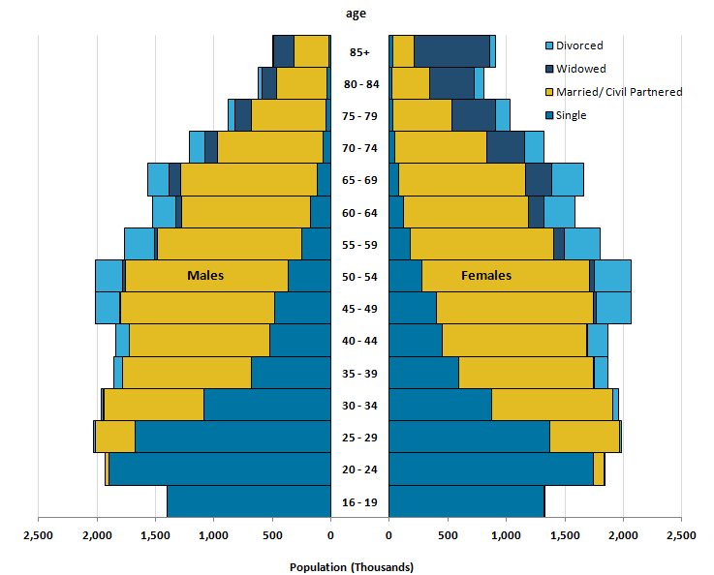
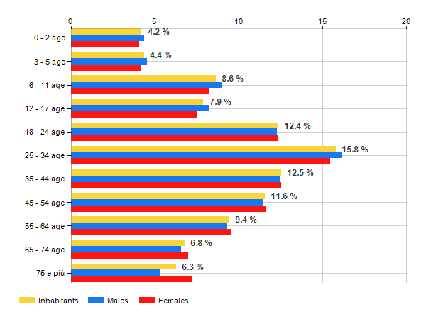
Target Market and Marketing strategies
Possible brides aged between 25-35 years
The younger women are most possible to get married and to want a bridal look
As per statista.com the UK wedding In 2021 was 470,000 and 350,000 in 2022, with 200,000 more weddings than in pre-pandemic years, and for the shop is a good and satisfactory news which increase the confidence and the ambition to open it as soon as possible.
Population of Birmingham by age – source Age Classes: Fonte ONS

Slide 9
THANK YOU ! AND IF YOU ARE READY TO MARRY, I’M HERE TO HELP!

Slide 10
References
Age Classes: Fonte ONS – Population of Birmingham by age
Ayub, A., Razzaq, A., Aslam, M.S. and Iftekhar, H. (2013), “A conceptual framework on evaluating SWOT analysis as the mediator in strategic marketing planning through marketing intelligence”, European Journal of Business and Social Sciences, Vol. 2, No. 1, pp. 91–98
Business Dictionary (2019), “What is a SWOT analysis? definition and meaning - BusinessDictionary.com”, available at: http://www.businessdictionary.com/definition/SWOT- analysis.html (accessed on 12th March 2023)
Moller, K. (2006). The Marketing Mix Revisited: Towards the 21st Century Marketing by E. Constantinides. Journal of Marketing Management, 22(3), 439-450.
Office for National Statistics (accesed on 28th February 2023)

