Slide 1
Menu Engineering
-Practical Tasks
Name: Claudia Zaharia
I.D Student Number: 2246452
Module Title: Food & Beverage
Operations
BMIH4002
Tutor: Ka Po Chong
Number of words: 400

Slide 2
TRINITY HOTEL RESTAURANT CONCEPT
Trinity Restaurant is a four-star restaurant part of Trinity Hotel-Chain. recently opened in Ashford Town Center. This new concept restaurant will go underneath the 200-room hotel and feature an “open kitchen where Chefs can double-up as service staff”. (Chef Zhou Ziling, 03 Jan 2023). The 650-meter new space has room for 60 tables and 250 people. “A construction is made once and used for a lifetime. The more regularly and completely it is made, the more effortless and convenient it serves”. (Chef Ahmet Ozdemir, 22 Sept 2022). The architects create a modern space for the most sophisticated tastes with a colored artesian fountain, SST with Ambiental music, an Atrium naturally illuminated and decorated with local artist pictures and black marble floor. Having a smoking area in a tropical garden with rattan furniture, a kid's playroom, it will be great for families, for people who come for business meetings or for special occasions or go to the airport or holidays. Been a hotel restaurant, the menu chosen is A la Carte.” With an A La Carte menu, customers can choose exactly what they want to eat and how much they want to spend. They can customize their meal to their liking and choose dishes that fit their dietary restrictions or preferences”. (Menubly blog,3rd, Apr 2023). A La Carte menu uses fresh ingredients for each dish, paid individually, and the restaurant is motivated to use the best organic ingredients from local producers and international dishes to ensure customer satisfaction. Thanks to IoT integration, smart ovens, cooking equipment and stock tracking system were streamlined. Digital menus can be accessed via QR codes or viewed on interactive tablets of hotel rooms. Trinity Restaurant also has renewable energy solar panels and energy efficient devices and, to minimize food waste, was implemented new techniques and systems. Modern plates were chosen following contemporary trends colors according to restaurant concept-different color for different food. “The most important principle in the Food and Beverage Industry is the goal of serving the best quality food and drinks to the restaurant guests as soon as possible, taking into account the special standards requested” by Rules and Regulations (Expert in Business). “The food business is not just about the food!” (Try Otter). “Food brings people together and it is going to be fun and tasty" (Chef Pichaya Pam, 2023), “it is a journey to create an elevated, memorable dining experience” promised in the Restaurant MENU! (Shaw C.,2010)

Slide 3
References:
1. Ahmet Ozdemir Chef, Published Sep 22, 2022, LinkedIn “Gastronomy Consultation International”, linkedin.com, https://gastronomyconsultation.com
2. Eazy.Plus/Menu, www.ezplus
3.” Expert in Business”
4. Francesca E.,12 oct.2021,” Most beautiful and unique design”, Posted
In ”60+Restaurant Menu Design”, https://www.creativefabrica.com
5.Gastronomy Consultation, www.gastronomyconsultation.com
6.MenuBly, https://www.menubly.com
7. Pichaya Pam Chef, 2023, Ecriture’s, “MICHELIN Guide” https://guidemichelin.com>people
8.Sabroso Restaurant, https://www.sabroso.ro
9.Shaw Colin, Qaalfa Dibeehi and Steven Waden, 2010,” Customer experience: Future Trends and Insights”, https://books.google.co.uk
10.Smartboy10/Getty Images/Trinity Sigla
11.Stone&Grill Restaurant, www.stoneandgrill.co.uk
12.Tryotter.uk/blog, https://www.tryotter.com
13. Zhou Ziling Chef, 03 JANUARIE 2023, “Five Restaurant Trends for 2023, According to MICHELIN Chefs”, https://guide.michelin.com>futures

Slide 4
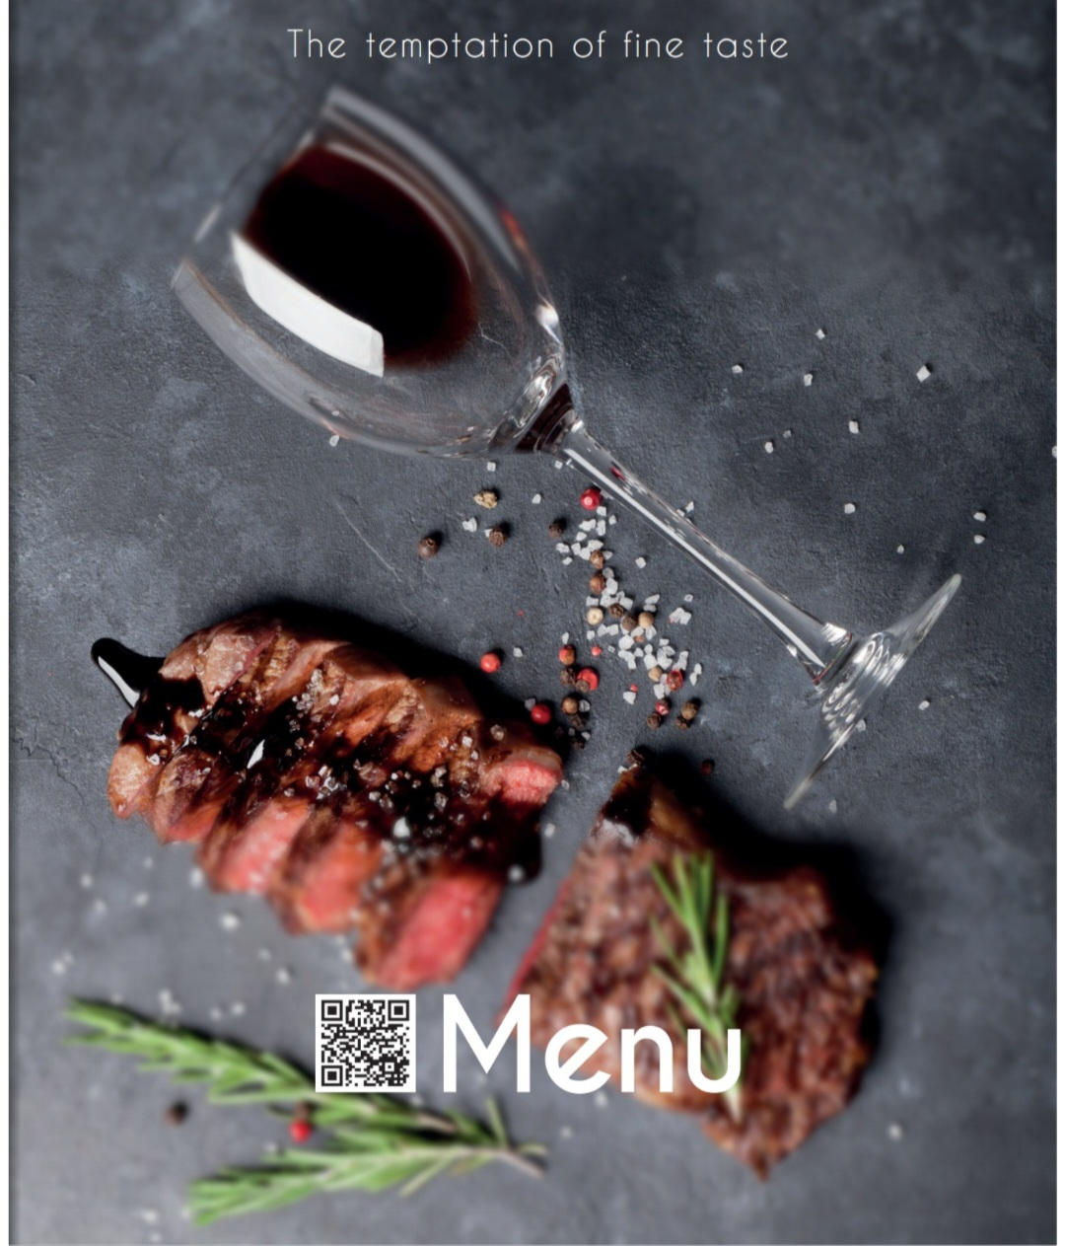

TRINITY RESTAURANT
We are glad that you are here

Slide 5
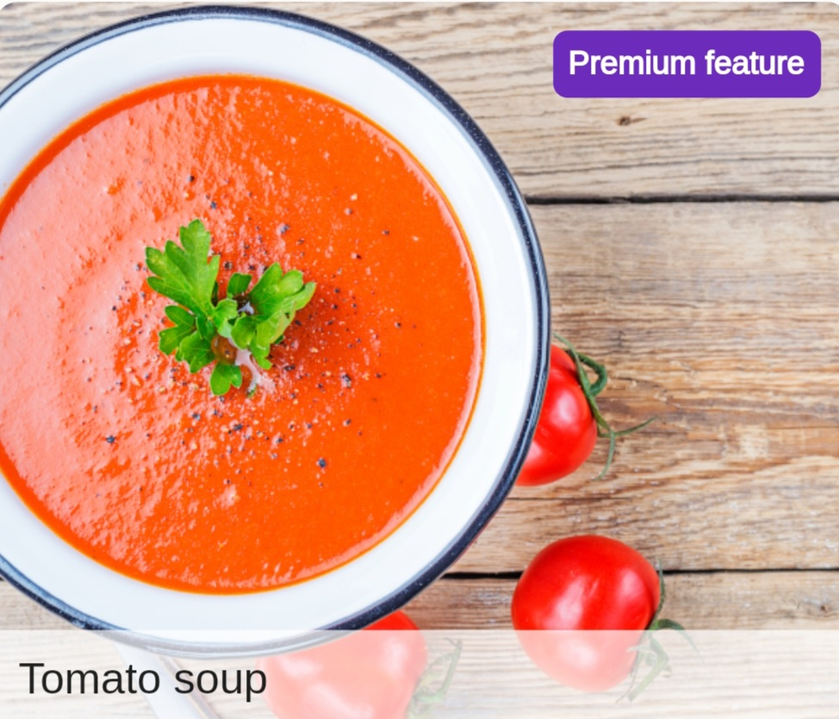

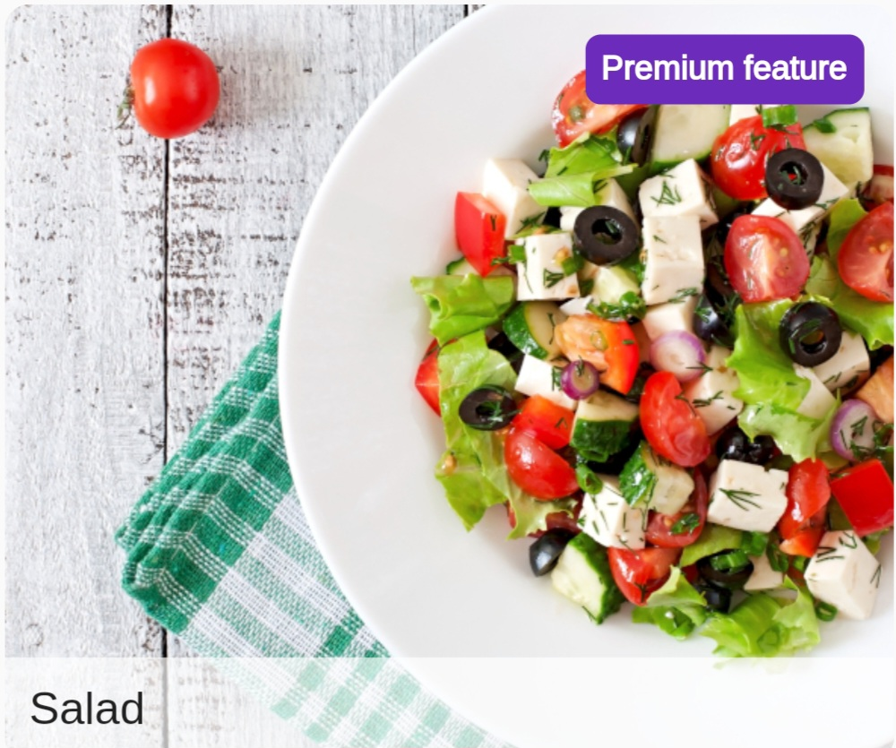
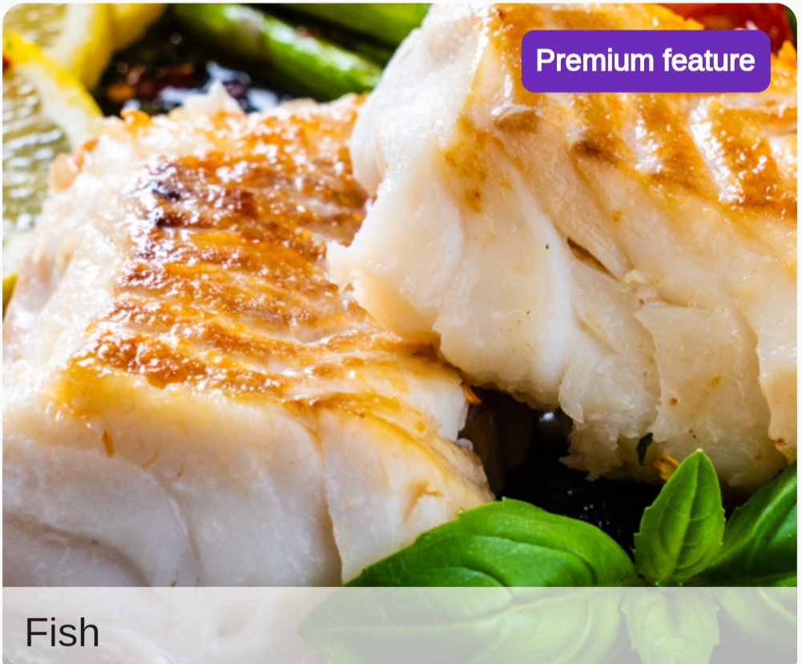
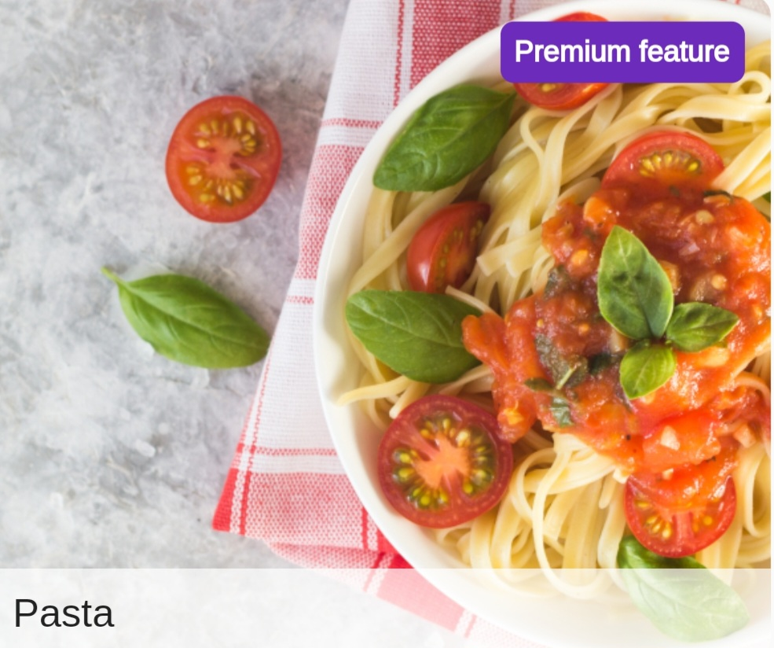


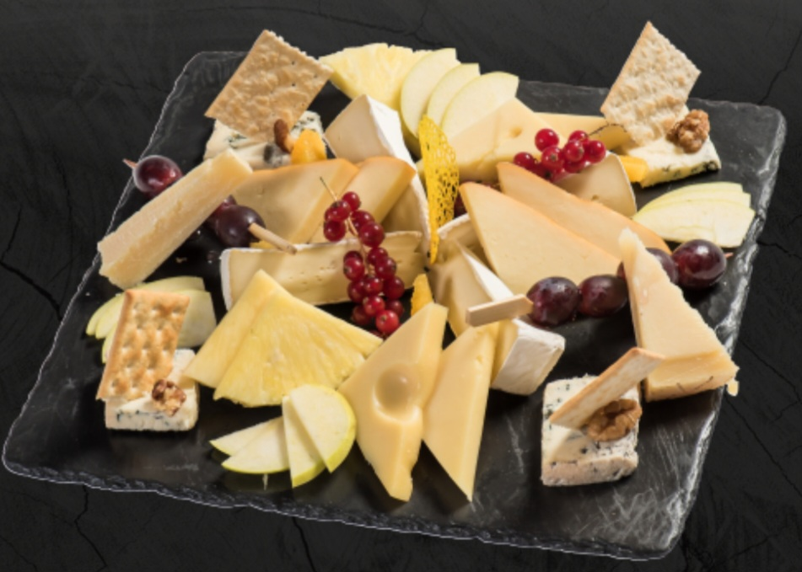
STARTERS
Tomato Soup V VG £14.95
Our freshly made tomato
soup is prepared with tomatoes
and herbs from the local market
and packed with vegetable flavour.
Falafel V VG GF DF £18.95
A blend of chickpeas, broad
beans, coriander, onions, garlic,
bell pepper, carrots, dill, parsley,
chickpeas flour and sesame seeds.
Served with hummus.
Hairy Prawns £16.95
Prawns wrapped in vermicelli,
deep-fried and
served with sweet chilli sauce.
Calamari £17.95
Deep-fried squid rings in batter,
served with tartare sauce.
Cheesy Aubergine V GF £ 16
Oven-baked aubergine slices
layered with cheese and
tomato ragu.
Mixed Olives V VG GF £15.50
A selection of green and
black olives.
Garlic Bread and olive £ 9.95
oil dip V
Our handmade bread with
the finest Greek olive oil dip.
Bruschetta V VG DF £ 8.50
Toasted slices of bread brushed
with garlic olive oil and topped
with fresh tossed tomatoes,
garlic, shallots, basil and parsley.
Garlic MushroomS V £16.95
Pan-fried mushrooms with
garlic, onion and parsley.
Served with bread.
Caprese Salad V GF £17.50
Buffalo Cheese, basil and
tomatoes
British Cheese Platter £ 25
Yorkshire Blue, Sharpham Brie,
Westcombe Cheddar, served
with apple, caralelised onion
chutney and sourdough biscuits.
MAINS
Rib-eye Steak GF £ 39.95
28-day aged prime-cut
10 oz steak ,charcoal-
grilled and served with
chips and salad.
Confit Duck Leg £ 38.50
Celeriac and potatos
dauphinoise,duck fat
confit carrots, curly
kale and ginger jus.
Beetroot Cured Salmon GF £ 37
Rocket, charred lemon,
creme friache and rye
bread.
Parnish Wellingthon VG £28.50
Sweet pottatoes fonda,
braised leek and crispy
kale.
Chicken and bacon pasta £ 25
From farm to table for
you, chicken and bacon
with ribbons of tagliatelle
in a deliciously creamy sauce.
DESSERT & WINES
New York Baked
Cheesecake £16.95
Old fashioned vanilla style
New York recipe baked
cheesecake on a crunchy biscuit
base Flourless Chocolate and
Olive Oil.
Tiramisu £16.50
Tasty irtalian Tiramisu with
savoiardi biscuits and real
mascarpone.
Flourless Chocolate
& Olive Oil Cake V VG £17.95
A flourless cake with a hint
of olive oil and a rich flavour
from the cocoa and almonds,
served with a scoop of vegan
coconut and chocolate ice cream.
WE RECOMMEND: £20/200 ML
Shizan from Australia
Pinot Noir from California's Valley
Sauvignon Blanc from New Zeeland
£15.95
FOOD ALLERGY NOTICE:
Please be advised that food is prepared in an area where allergens are present.
If you have food allergies, intolerances or special dietary requirements and wish to know more about ingredients used, please ask a member of the team.
.
V Vegetarian
VG Vegan
GF Gluten Free
DF Dairy Free

