Slide 1

NHS Staff Shortage – Economic Crysis and Political Analysis
Prepared by Beatris Gelkova

Slide 2
Contents Page
Problem Statement
NHS Staff Shortages
Tools are used to analyse the problem
PESTEL ANALYSIS
Development Plan for the NHS
Conclusion
Reference Page

Slide 3
Problem Statement
NHS is the biggest government healthcare institution in the United Kingdom.
NHS face problem because of the staff shortage that has a negative impact on the company’s services.
The nurses, doctors, and other allied health professionals are resigning from their jobs.
Pandemic is one of the major reasons of lacking healthcare professionals in the NHS.

Slide 4
NHS Staff Shortages
NHS suffers from different challenges such as a shortage of staff
The trust has the threat to deliver the quality health care services to the people.
According to a recent report almost 40 000 nursing posts are unfilled which creates problems for the company to provide its services.
The huge spending on agency staff, is crucially worsening the financial situation of the NHS.

Slide 5
Tools are used to analyse the problem
The PESTLE Analysis is one of the most important tools to analyze that how external factors affect the problem.
The PESTLE analysis of the business could help with understanding external factors affecting any organization, and the receptive behavior towards.
This analysis includes the most significant areas like political, economic and Technical.
The Ishikawa (Fishbone Analysis), is another tool that is used to focuses on the root cause of a problem, it recognizes all inner inputs and provides a full representation of an issue.

Slide 6
PESTLE ANALYSIS
Political Factors | Economic Factors | Social Factors | Technological Factors | Legal Factors | Environmental Factors
Brexit (leaving the NHS with a huge gap) | The financial of 2008 (Moving the NHS under stress from shorter and longer shifts) | UK is experiencing demographic Issues (Indicating that the NHS constantly provides for the elderly People’s needs) | NHS lack funding to recruit all available candidates. | Patient Cases (Owing to Unjust treatment, many dissatisfied sufferers are attempting to assert their legal rights) | Contaminated Garbage (The NHS must have an open and practical waste management program, just like any other Chemical enterprise.)

Slide 7
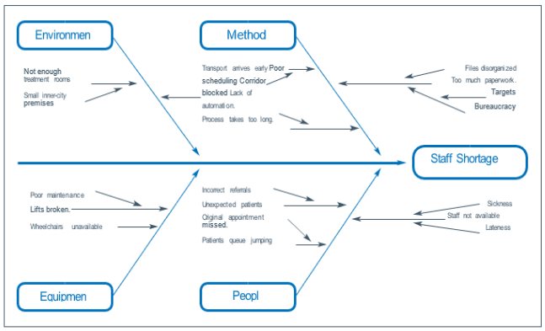
Fishbone Diagram (Ishikawa Method)

Slide 8
Development Plan For NHS
NHS needs to focus on the following actions which will beneficial for the company.
Redesign the present healthcare industry’s business strategy as developing infrastructural problems and developments in medical knowledge.
There is need to adjust medical school prospectuses to reflect the growth of healthcare values.
To be certain of that in the 21st century, it is preposterous to believe that attractive a doctor requires seven years of education.
This is what these performances must be applied if the incoming British government and the Commons Health as well as Social Care Select Committee.
The hiring of medical workers from overseas is really a impermanent fix.
A systemic problem cannot be fundamentally fixed with money alone.

Slide 9
Recommendations for Management areas
Managers in charge of a specific group within a healthcare association are referred to as department managers in the industry.
Research managers create research plans, measure data, and investigate developing tendencies in the medical industry.
In order to grow fresh rules and practices that will be beneficial for their trades and the medical system, they next use their study.

Slide 10
CONCLUSION
As a result of pandemic, many NHS employees left, and vacancies were filled by people with less qualifications.
The NHS can no elongated operate at its historical level, while having arose ten years ago, the effects of the monetary crisis are clearly still being felt.
It is concluded that the NHS should focus on the business strategy and redesign it according to needs of the employees.

Slide 11
Reference
Umar, F. (2022), “PESTLE Analysis of the NHS”, Available at:
https://www.marketingtutor.net/pestle-analysis-of-the-nhs/
Anita, C. (12 January 2021), “Staff shortages left the NHS vulnerable to the COVID-19 storm”, Available at:
https://www.health.org.uk/news-and-comment/blogs/
(Unknown Author) Morningbusinesschat.com (2019), “The Benefits of Hiring The Most Qualified People for the Job”, Available at:
The Benefits of Hiring The Most Qualified People for the Job (morningbusinesschat.com)

