Slide 1
Report discussing improving the efficiency in the Slab Yard at a Hot Rolling Mill
Matthew Preece
1809102

Slide 2
Contents
Process
Lit review
What I learned from the lit review
Conclusion

Slide 3
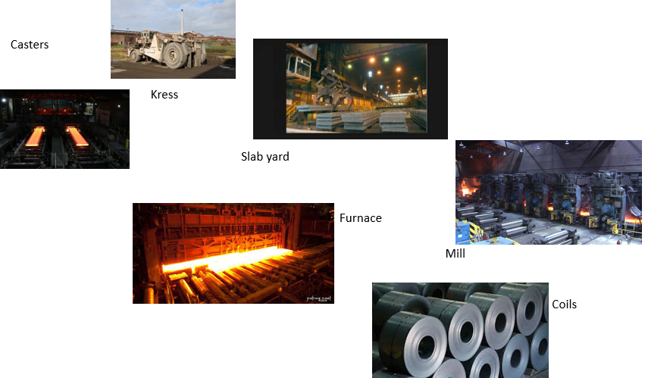
Process
Hot mill process
Slab yard

Slide 4
Lit review
Evraz Highveld Steel and Vandum [1] were experiencing difficulties in their slab yard including excessive obsolete stock and poor inventory control
Li and Tian [3] also recognised that slab yard efficiency was crucial to ensure productivity in the hot rolling process and they set out to develop a computer programme to use to maximise scheduling in the slab yard.
The literature review also identified the need to use cranes in the best way to improve scheduling [5]

Slide 5
What I have learned from the lit review
The slab yard only has a certain amount of slabs it can hold at any one time
Cranes are used to move slabs around the slab yard and if one breaks down it will cause a delay
The quality of slab coming into the slab yard from the casters is poor

Slide 6
Conclusion
Slab yard is key for productivity
Lit review identifies a range of problems that are being tackled to improve slab yard efficiency
shows other steel companies are having the same problems
Lit Review helps identify solutions such as inventory control and systems to improve stacking, shuffling and moving slabs

