Slide 1
ECEY5004C
Iaith a Llythrennedd yn yr Oes Ddigidol
Llafaredd
ECEY5004
Language and Literacy in the Digital Age
Oracy

Slide 2
Cynnwys
Contents
Llythrennedd gynnar;
Cymwyseddau digidol;
Agweddau at lythrennedd;
Llafaredd;
Early literacy;
Digital competencies;
Attitudes towards literacy;
Oracy;

Slide 3
Cynnwys
Contents
‘Amgylcheddau siarad’;
Goblygiadau;
Adrodd stori a llafaredd.
‘Talking environments’;
Implications;
Storytelling and oracy.

Slide 4
Cymwyseddau trosglwyddadwy lefel uwch
High-level transferable competencies
Trefnu a Chynllunio;
Ymchwilio a Chymryd nodiadau;
Trafod;
Cysylltu damcaniaeth ag arfer.
Organisation and Planning;
Researching and Note taking;
Discussing;
Linking theory to practice.

Slide 5
Adnoddau
Resources
PP ar gyfer y ddarlith;
Ymchwil;
Clipiau fideo a gwefannau;
Delweddau a blogiau.
PP for the lecture;
Research;
Video clips and websites;
Images and blogs.

Slide 6
Termau
Cymhwysedd digidol – y sgiliau, yr wybodaeth a'r agweddau sy'n galluogi unigolion i ddefnyddio technolegau digidol yn effeithiol;
Fframwaith – dull strwythuredig neu set o ganllawiau a ddefnyddir i gefnogi datblygiad rhywbeth;
Llefaredd – y gallu i fynegi eich hun yn rhugl, yn ogystal â deall iaith lafar;
Llythrennedd digidol – y gallu i ddefnyddio ystod o dechnolegau digidol i archwilio, asesu a chynhyrchu gwybodaeth;
Rhyngweithio – cyfnewid gwybodaeth sy'n digwydd mewn gwahanol ffurfiau (cyfathrebu geiriol, ystumiau corfforol, cyfnewidfeydd digidol);

Slide 7
Glossary
Digital competence – the skills, knowledge and attitudes that enables individuals to use digital technologies effectively;
Digital literacy – the ability to use a range of digital technologies to explore, assess and produce information;
Framework – a structured approach or set of guidelines used to support the development of something;
Interaction – an exchange of information that occurs in various forms (verbal communication, physical gestures, digital exchanges);
Oracy – the ability to express oneself fluently, as well as to understand spoken language.

Slide 8
Llythrennedd gynnar
Early literacy
Siarad/Lleferydd – defnydd o eiriau, brawddegau a mydryddiaeth i gyfathrebu;
Ysgrifennu – cynrychiolaeth symbolaidd o’r hyn a ddywedwyd;
Darllen – y broses o ddeall a chreu ystyr o’r cynrychiolaeth.
Talking/Speech – use of words, sentences and prosody to communicate;
Writing – symbolic representation of what is spoken;
Reading – process of understanding and creating meaning from this representation.
(Dickinson and Morse, 2019)

Slide 9
Llythrennedd digidol
Digital literacy
“…digital literacy, or digital competence, is as important in the twenty-first century as literacy and numeracy.”
(Donaldson, 2015: 24).
“…digital competence is increasingly fundamental to learning of life and that it should have similar status within the curriculum to that of literacy and numeracy.”
(Donaldson, 2015: 40).
“…literacy, numeracy and digital competence should be Cross-curriculum Responsibilities for all teachers and people who work with children and young people.”
(Donaldson, 2015: 40).

Slide 10
Cymhwysedd digidol
Digital competency
“There is an urgent need for every citizen to develop the knowledge, skills and attitudes required to participate in a complex and increasingly digitised society for personal and societal prosperity”
(Blum-Ross et al., 2020)

Slide 11
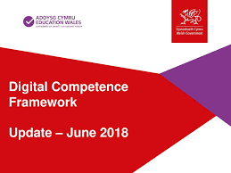
Fframwaith Cymhwysedd Digidol
Digital Competence Framework
Curriculum reform: The Digital Competence Framework

Slide 12
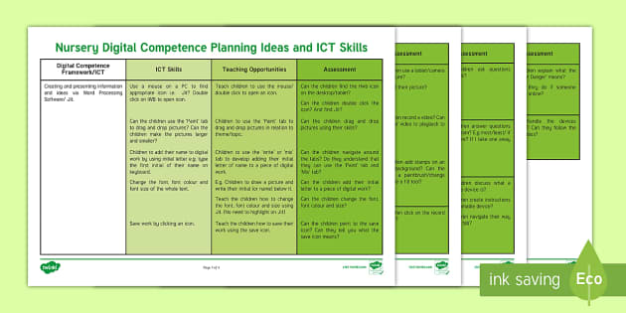
Lleferydd – FfCD 2020
Oracy – DCF 2020
Fframwaith Cymwyseddau Digidol/Digital Competence Framework

Slide 13
Strategaeth ddigidol i Gymru
Digital Strategy for Wales
Gwaith grŵp;
Dewch o hyd i'r ddogfen (ar-lein), trafodwch, a rhestrwch 3 maes allweddol y gallai'r strategaeth hon gael effaith ar eich rôl.
Group work;
Find the document (online), discuss, and list 3 key areas on which this strategy may have an impact on your role.

Slide 14
Llafaredd
Oracy
  Siarad;
  Gwrando;
  Cydweithio a thrafod.
  Speaking;
  Listening;
  Collaboration and discussion.

Slide 15
Llafaredd
Oracy
"Llafaredd yw'r gallu i siarad yn huawdl, i gyfleu syniadau a meddyliau, i ddylanwadu drwy siarad, i gydweithio â chyfoedion ac i fynegi barn yn hyderus ac yn briodol. Mae llefaredd yn cyfeirio at ddatblygiad sgiliau siarad a gwrando, a defnydd effeithiol iaith lafar ym maes addysgu a dysgu."
(Oracy All-Party Parliamentary Group, 2021:9).

Slide 16
Llafaredd
Oracy
“Oracy is the ability to speak eloquently, to articulate ideas and thoughts, to influence through talking, to collaborate with peers and to express views confidently and appropriately. Oracy refers both to the development of speaking and listening skills, and the effective use of spoken language in teaching and learning.”
(Oracy All-Party Parliamentary Group, 2021:9).

Slide 17
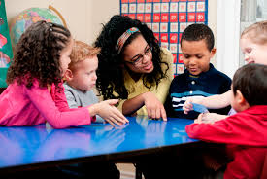
Pam fod llafaredd yn bwysig?
Why is oracy important?
“Communication is a key life skill”
(Lodge, 2020, p.3)
Os nad yw plant yn cael cyfle i siarad, maent fwy tebygol o gael geirfa wan;
If oracy is stifled, young children are more likely to have poor vocabulary.

Slide 18
Rhieni – rôl bwysig iawn
Parents – very important role
Siarad;
Canu;
Darllen;
Chwarae.
Talking;
Singing;
Reading;
Playing.

Slide 19
Ymchwil – Hart a Risley (1995)
Research – Hart and Risley (1995)
Lefelau uchel o iaith/rhyngweithio;
= Datblygiad iaith DA.
Lefelau isel o iaith/rhyngweithio;
= Datblygiad iaith GWAN.
Bwlch ieithyddol o 30 miliwn gair erbyn 3 oed.
High levels of language/interaction;
= GOOD language development.
Low levels of language/interaction;
= POOR language development.
Language gap of 30 million words by 3 years.

Slide 20
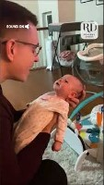
Rhyngweithrediadau o ansawdd uchel
High quality interactions
Bondio;
Ymlyniad;
Ystumiau;
Cilyddiaeth.
Bonding;
Attachment;
Gestures;
Reciprocity.

Slide 21
Rhyngweithrediadau o ansawdd isel
Poor quality interactions
Statws economaidd-gymdeithasol;
Oedran dechrau ysgol;
ADY;
Cyfryngau.
Socio-economic status;
Age when starting school;
ALN;
Media.

Slide 22


Slide 23
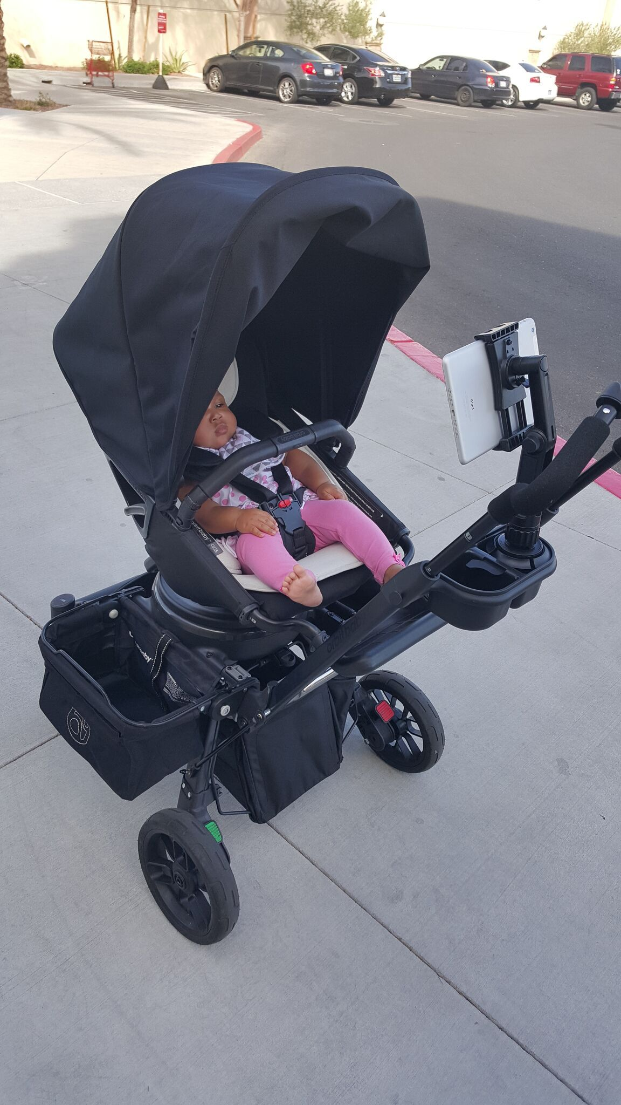

Slide 24
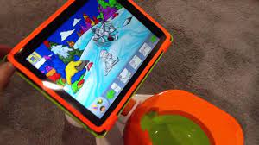

Slide 25
Geirfa wan yn 5 oed
Poor vocabulary at 5 years
6 gwaith yn llai tebygol o gyrraedd safon ddisgwyliedig Saesneg/ Cymraeg yn 11 oed;
10 gwaith yn llai tebygol o gyflawni'r lefel ddisgwyliedig mewn Mathemateg;
Mwy na dwywaith fwy tebygol o fod yn ddi-waith yn 34 oed;
Ddwywaith fwy tebygol o gael anawsterau iechyd meddwl.
6 times less likely to reach expected standard of English/Welsh at age 11;
10 less likely to achieve expected level in Maths;
More than twice as likely to be unemployed at 34 years;
Twice as likely to have mental health difficulties.

Slide 26
Agweddau tuag at lafaredd
Attitudes towards oracy
Athrawon, rhieni ac arolygwyr yn aml yn ystyried mai gwaith ysgrifenedig yw'r unig waith “go iawn”, tra bod siarad yn cael ei ystyried yn gefnogol i'r sgiliau hyn.
Teachers, parents and inspectors often consider written work as the only “real” work, while talk is primarily viewed as supportive for these skills.
“oracy has a low status, while acquiring the written code is far more visible as an outcome of schooling”
(Kaldahl et al., 2019, p. 2)

Slide 27
‘Silence is not golden’ (Lodge, 2020)
Distawrwydd yn dod yn norm;
Plant yn methu mynegi:
- Meddyliau;
- Teimladau;
- Barn;
Silence is becoming the norm;
Children unable to express:
Thoughts;
Feelings;
Opinions;

Slide 28
‘Silence is not golden’ (Lodge, 2020)
Gormod o blant dan glo mewn ‘lled-dawelwch’;
Yn aml esgeulusir llafaredd.
Too many children locked in ‘semi-silence’;
Oracy is often neglected.

Slide 29
Cyfleoedd i hyrwyddo llafaredd
Opportunities to promote oracy
Cymryd tro;
Cwestiynu ac ateb;
Croesawu ac ymateb;
Taking turns;
Questioning and answering;
Greeting and responding;

Slide 30
Cyfleoedd i hyrwyddo llafaredd
Opportunities to promote oracy
Ciwiau heb eiriau;
Sut i wrando;
Sut i siarad.
Non-verbal cues;
How to listen;
How to speak.

Slide 31
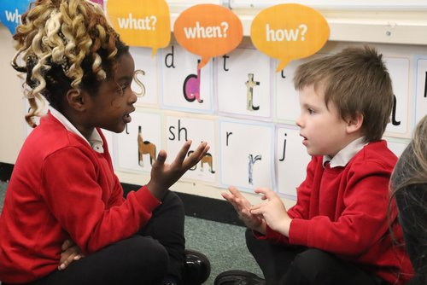
Ymarfer wrth sgwrsio
Practising when conversing
Beth sy’n digwydd yma?
What is happening here?

Slide 32
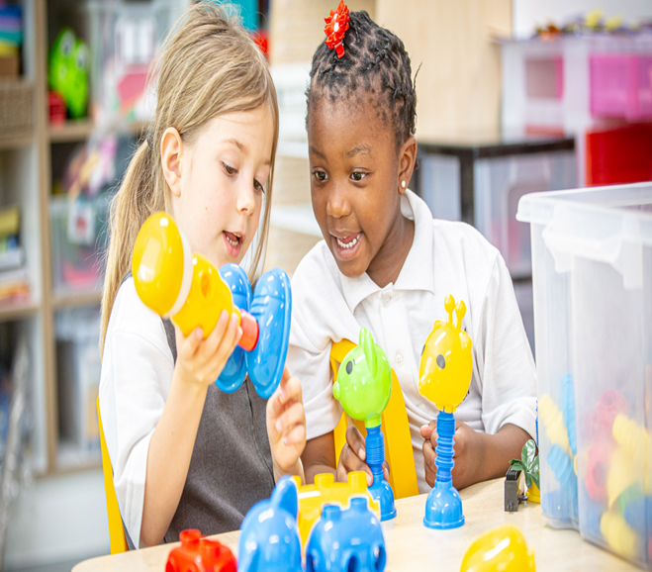
Gweithio ar y cyd
Collaborative work
Ac yma?
And here?

Slide 33
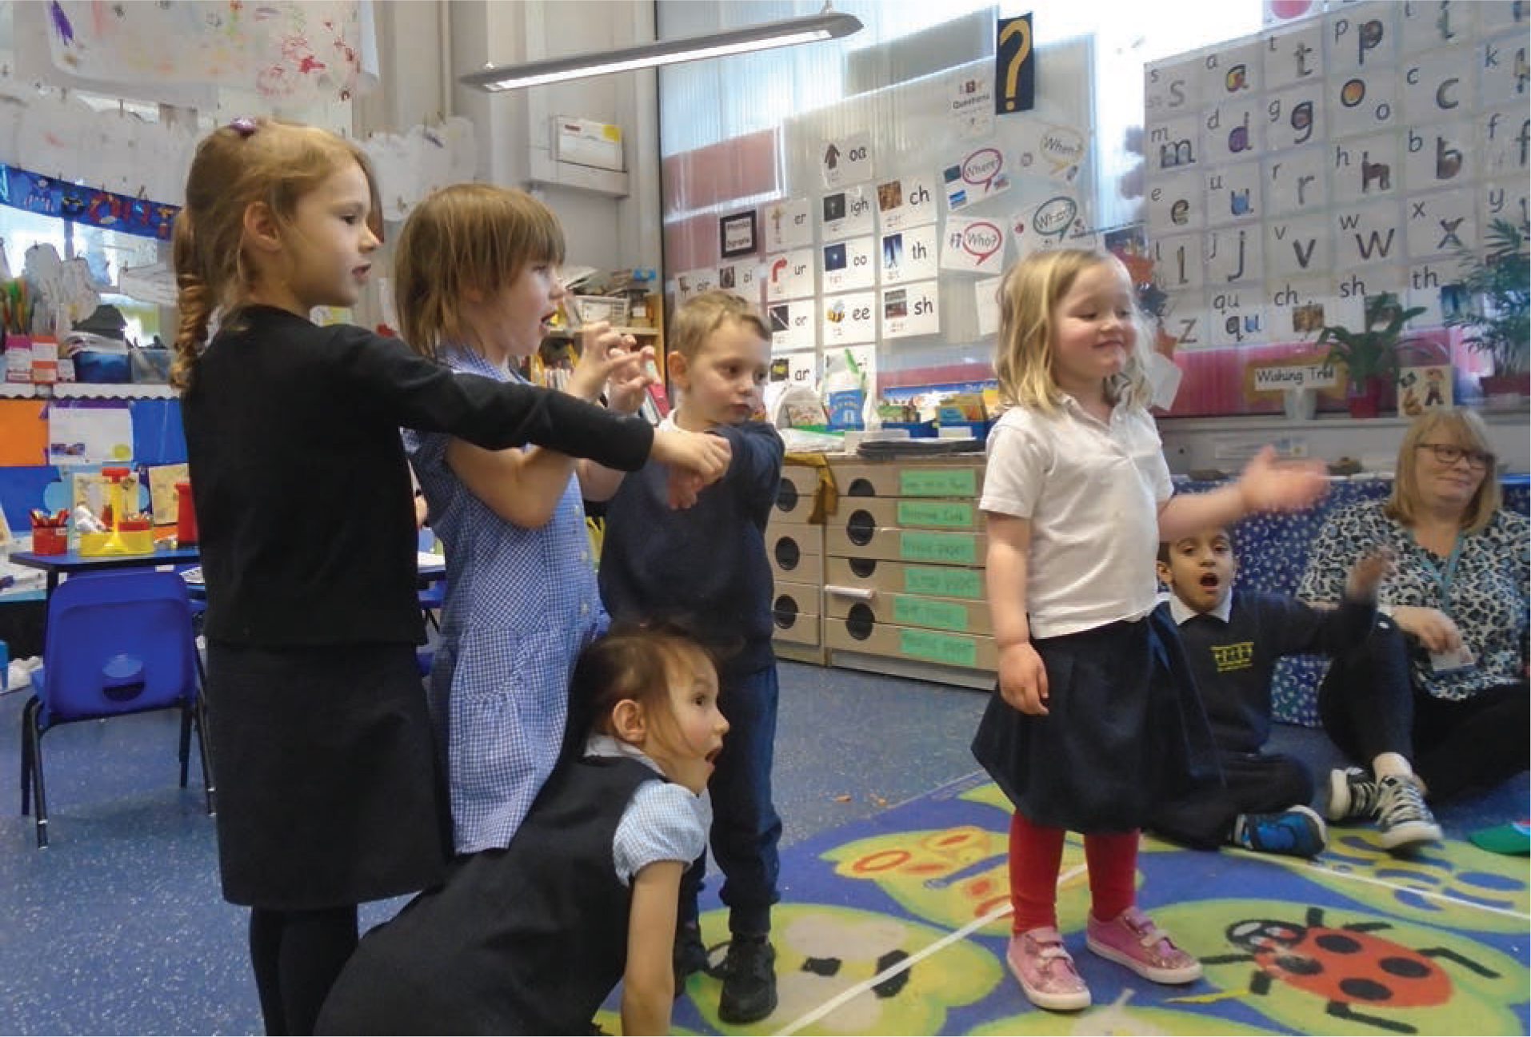
Datblygu naratif
Mae sgiliau naratif yn rhan gymhleth a phwysig o gyfathrebu:
- ail-ddweud digwyddiadau;
dweud wrth eraill am ein hunain;
rhoi cyfarwyddiadau;
adrodd – perswadio – disgrifio;
- deall beth sydd wedi cael ei ddarllen;
- difyrru.

Slide 34

Developing narrative
Narrative skills are a complex and important part of communication:
re-tell events;
tell others about ourselves;
give instructions;
report - persuade - describe;
understand what we read;
entertain.

Slide 35
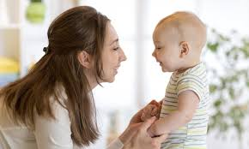

Brwdfrydedd ac ysgogiad
Enthusiasm and motivation

Slide 36
‘Amgylcheddau siarad’
‘Talking environments’
Sgwrs plant yn cael ei meithrin;
Diwylliant lle mae siarad a sgyrsiau plant yn cael eu gwerthfawrogi'n fawr;
Oedolion yn modelu ‘siarad o safon’.
Children’s talk is nurtured;
A culture where children talking and having conversations is highly valued;
Adults model ‘quality talk’.
(Atwal, 2019)

Slide 37
Trafodaeth grwpiau bach
Small group discussion
Eich profiadau chi?
Your experiences?

Slide 38
Llafaredd ag adrodd stori
Oracy and storytelling
Rhannu profiadau;
Rhannu teimladau;
Traddodiad llafar;
Sharing experiences;
Sharing feelings;
Oral tradition;

Slide 39
Llafaredd ag adrodd stori
Oracy and storytelling
Storïau’n datblygu ac ymestyn;
Clywed iaith lafar;
Rheolau gramadeg.
Stories develop and expand;
Hearing oral language;
Rules of grammar.

Slide 40
Fframweithiau Llythrennedd a Rhifedd
Literacy and Numeracy Framework
Cefnogi ysgolion i
ymgorffori
llythrennedd a rhifedd
yn y cwricwlwm;
Codi safonau llythrennedd;
Helpu plant i gyflawni
eu potensial.
Support schools to embed literacy and numeracy in the curriculum;
Raise literacy standards;
Helping children to
achieve their
potential.

Slide 41
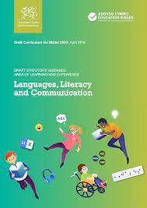
Ieithoedd, Llythrennedd a Chyfathrebu/Languages, Literacy and Communication

Slide 42
Y dyfodol
The future
Mae cyflogwyr eisiau pobl sy’n medru:
Cyflwyno’n glir;
Bod yn aelod tim da;
Meddu ar sgiliau cydweithredu da;
Bod yn wrandawyr astud.
Employers want people who can:
Present clearly;
Be a good team-member;
Have good collaborative skills;
Be attentive listeners.
“…employers do not see the level of communication skills…workers need to succeed in the working world…employers put the ability to communicate effectively at the top of their wish list when looking to hire”
(Phelan, 2015).

Slide 43
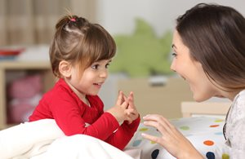
Y dyfodol
The future
“Oracy pedagogy has the potential to provide all learners with ample opportunities to communicate creatively, purposefully and productively in a variety of contexts that are exciting, engaging and meaningful”
(McCormack and Klopper, 2016, p. 417).

Slide 44
Aseiniad
Assignment
Ystyriwch eich sgiliau adrodd stori…
Sut gallech chi hyrwyddo llafaredd plant?
Unrhyw gysylltiadau â theori?
Consider your storytelling skills…
How might you promote children’s oracy?
Any links with theory?

Slide 45
Cyfeiriadau
References
Atwal, K. (2019) Pupil talk: 6 questions to see if you are getting it right. https://www.tes.com/news/pupil-talk-6-questions-see-if-you-are-getting-it-right [Accessed: November 7 2020].
Blum-Ross, A. et al. (2020) Enhancing digital literacy and creativity: Makerspaces in the early years. London: Routledge.
Dickinson, D. K. and Morse, A. B. (2019) Connecting through talk: nurturing children’s development with language. Baltimore: Paul H. Brookes Publishing Co.
Hart, B. and Risley, T. R. (1995) Meaningful Differences in the Everyday Experience of Young American Children. Baltimore: Brookes Publishing.
Lodge, L. (2020) Silence is not golden: the importance of improving oracy, https://www.oneeducation.co.uk/news-blog/silence-is-not-golden-the-importance-of-improving-oracy [Accessed: November 7 2020].

Slide 46
Cyfeiriadau
References
McCormack, B.A. and Klopper, C. (2016) ‘The potential of music in promoting oracy in students with English as an additional language’, International journal of music education, 34(4), pp.416-432.
Phelan, T. (2015) Lack of communication skills poses problems for employers. Available at: https://hrreview.co.uk/hr-news/recruitment/lack-communication-skills-poses-problem-employers/55750 [Accessed: August 20 2024].
Welsh Government (2018) Digital Competence Framework guidance: Update. Available at: A curriculum for Wales – a curriculum for life (gov.wales) [Accessed: August 9 2022].
Welsh Government (2021) Digital strategy for Wales. Available at: Digital strategy for Wales | GOV.WALES [Accessed: August 9 2022].

