Slide 1
Instructor Materials lecture 2: The Cybersecurity Sorcery Cube
Advanced Cyber Security
Lecture 5
Compromising Mobile Platforms
Dr. Carlene Campbell

Slide 2
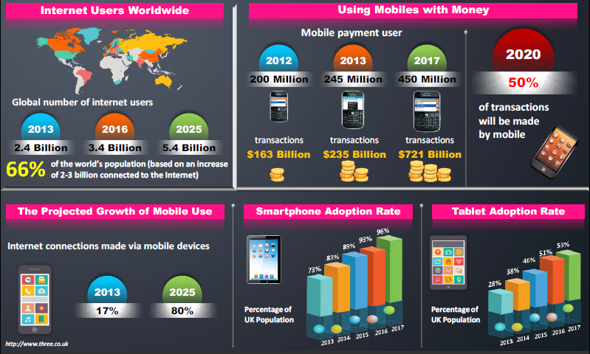
The Future of Mobile

Slide 3
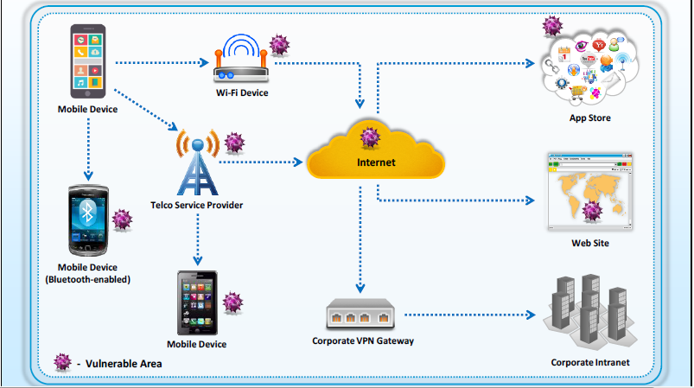
Vulnerable Areas in Mobile Business Environment

Slide 4
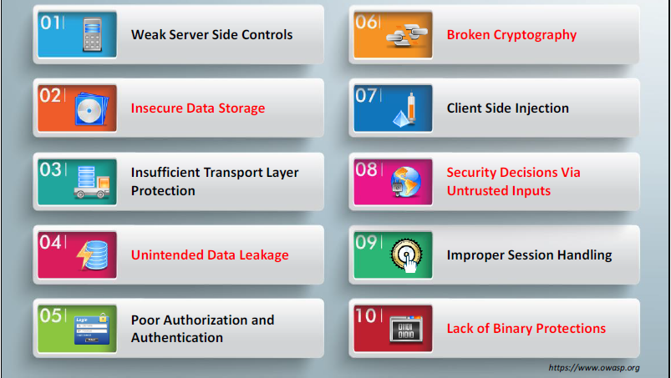
OWASP Mobile Top 10 Risks

Slide 5
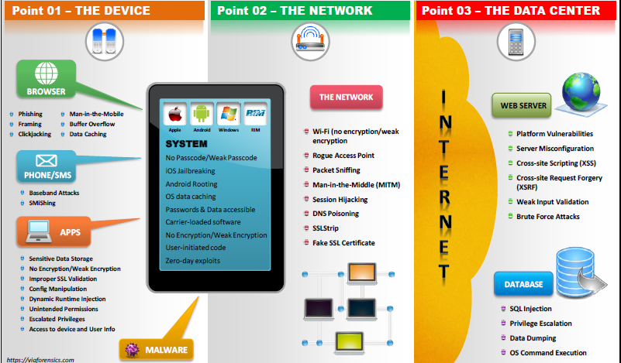
Anatomy of a Mobile Attack

Slide 6
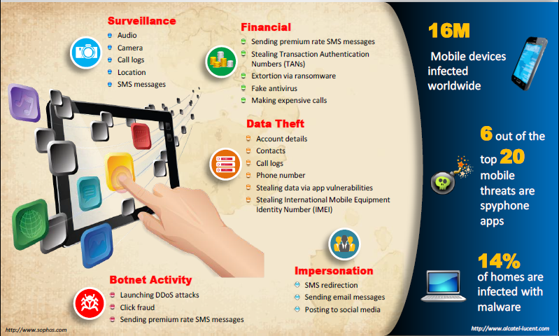

Slide 7
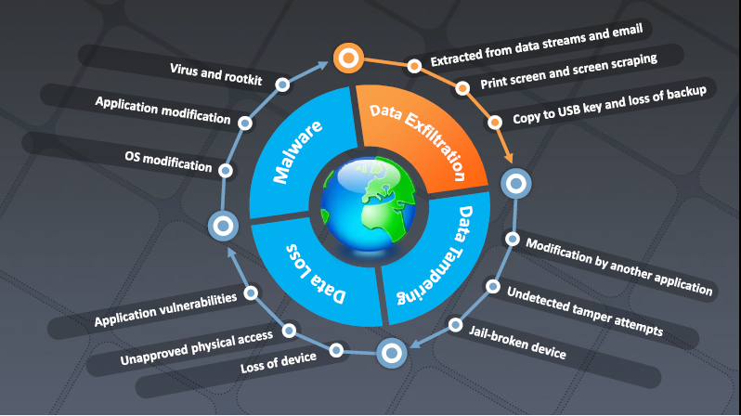

Slide 8
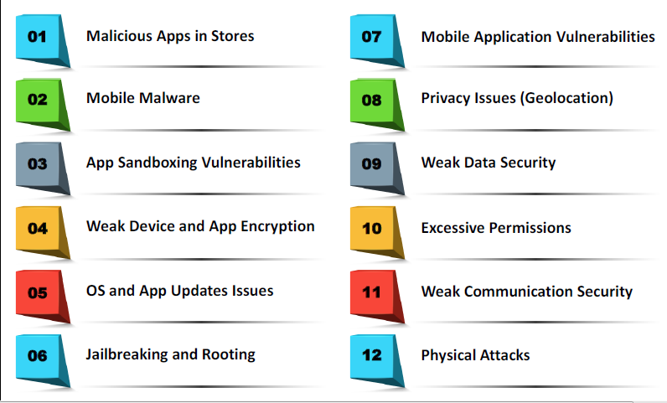

Slide 9
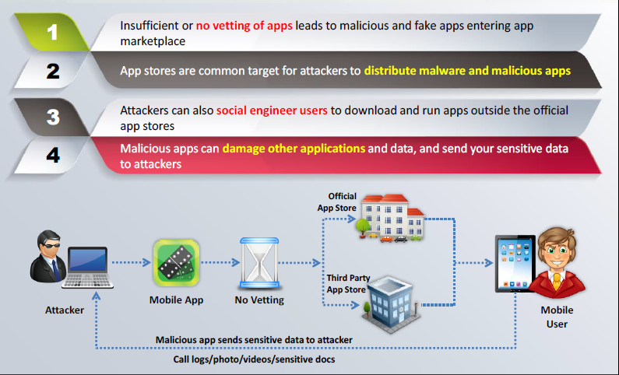
Security Issues Arising from App Stores

Slide 10
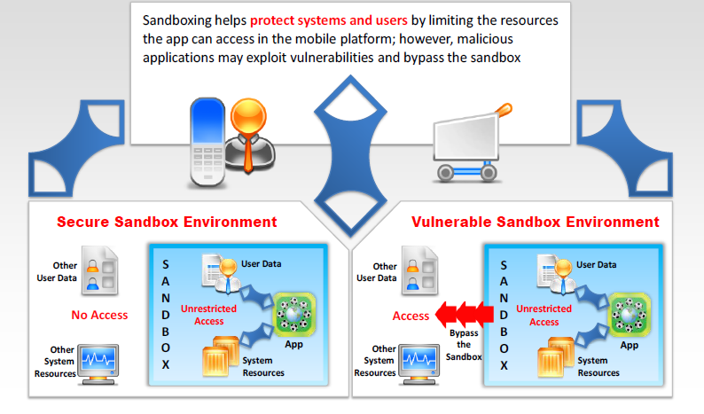
App Sandboxing Issues

Slide 11
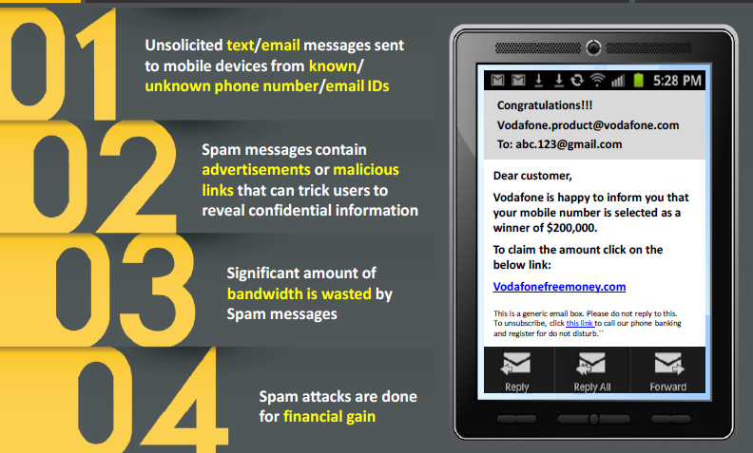
Mobile Spam

Slide 12
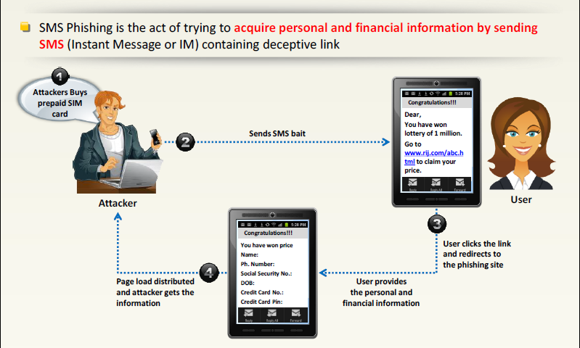
SMS Phishing Attack (SMiShing)
(Targeted Attack Scan)

Slide 13
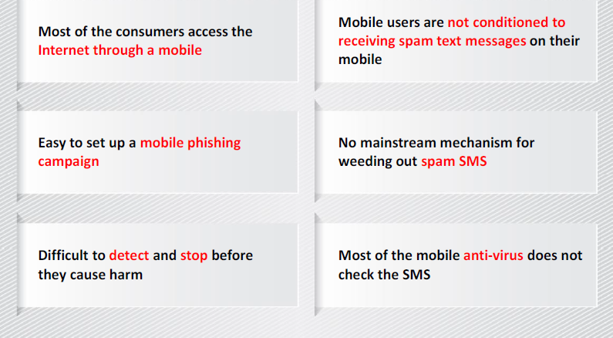
Why SMS Phishing is Effective?

Slide 14
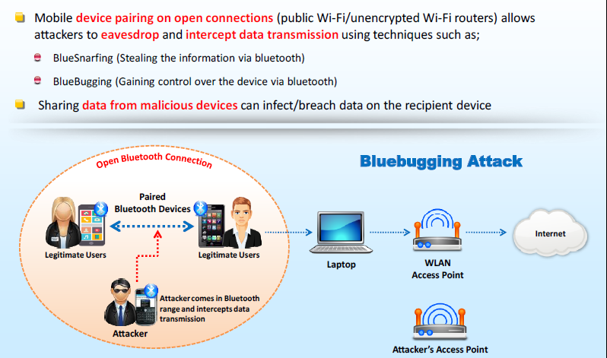
Pairing Mobile Devices on Open Bluetooth and Wi-Fi Connections

Slide 15
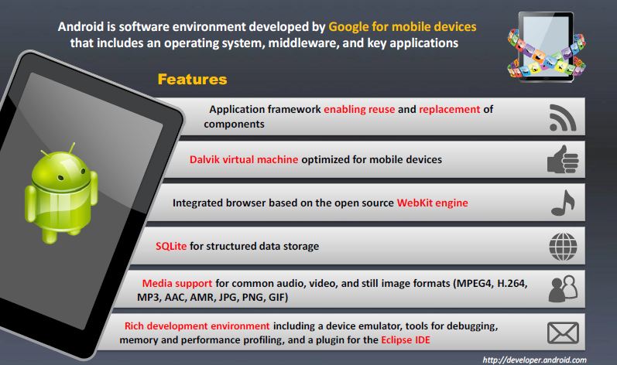
Android OS

Slide 16
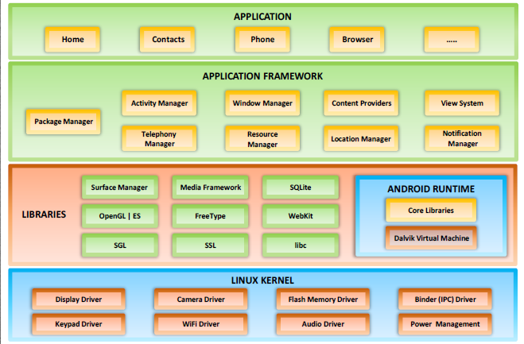

Slide 17
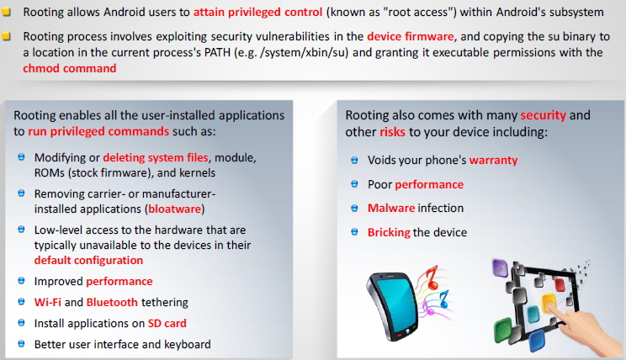

Slide 18
Android Mobile Devices
SuperOneClick tool – Used for Rooting Android Phones
Network Spoofer – Used for Hacking computers from Android phone
DroidSheep – Android tool for web session hijacking
FaceNIff – Android app for sniff and intercept wed session profiles WI-Fi that your mobile is connected to.
Android Trojan:
  ZitMo (SeuS-in-the-Mobile)
  FakeToken and TRAMP.A
  AndroRAT and Dendroid
Notes:
ZitMo – intercpt SMS confirmation codes to access bank accounts
FakeToken – steals both banking authentication factors directly from the mobile devices
TRAMP.A – Design to log the keystrokes of target android mobile to steal passwords and other sensitive information
AndroRAT – allows a remote attacker to gain control over the device and steal information. Also to retrieve call long and contact information, place call, etc.
Dendroid – HTTP RAT that is marketed as being transparent to user and firmware interface, having a sophisticated PHP panel, am

Slide 19
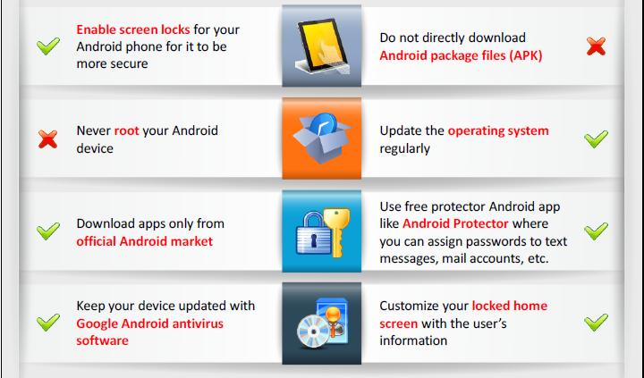
Securing Android Devices

Slide 20
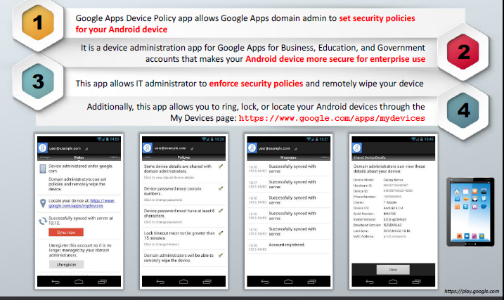
Google Apps Device Policy
Notes:
Google Apps Device Policy app – Remote Wipe, that can use the Google Admin console to remotely wipe the device.

Slide 21
Android Security Tools
360 Security
AVL
Avira Antivirus Security
X-Ray – Vulnerability Scanner

Slide 22
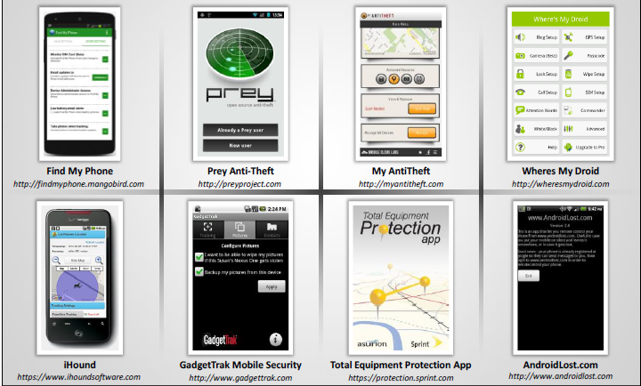
Android Device Tracking Tools

Slide 23
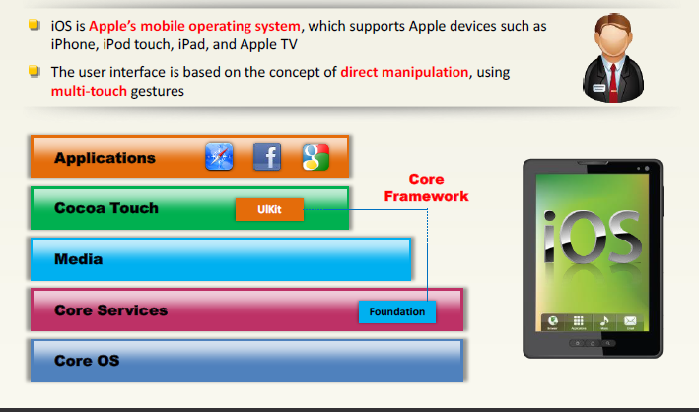

Slide 24
iOS
Jailbreaking – process of installing a modified set of kernel patches that allows users to run third party application not signed by the OS vendor
Jailbreaking Techniques:
  Untethered Jailbreaking
  Semi-tethered Jailbreaking
  Tethered Jailbreaking
App Platform for Jailbroken Devices
  Cydia – a software for iOS that enables user to find and install software packages on a jailbroken iPhone, iPod touch, or iPad
Notes:
Jailbreaking void your phone’s warranty, poor performance, malware infection, bricking the device.
Types of Jailbreaking: Userland Exploit, iBoot Exploit, Bootrom Exploit

Slide 25
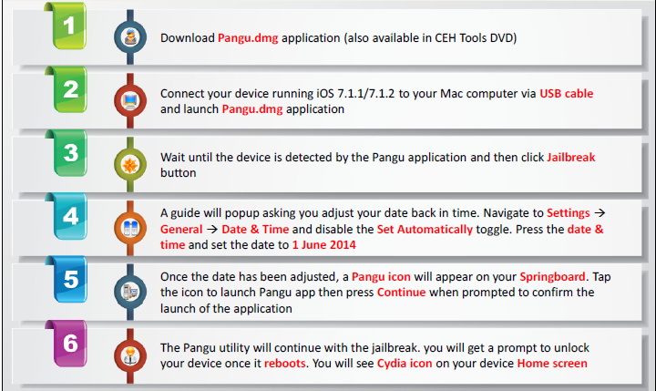

Slide 26
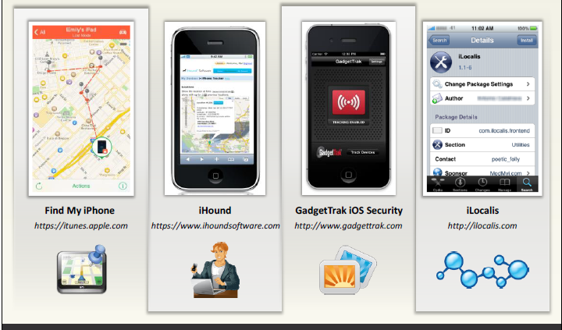
iOS Device Tracking Tools

Slide 27
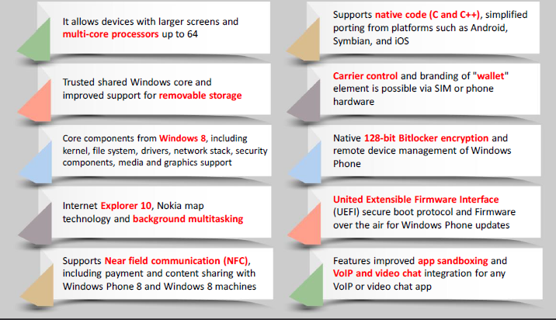

Slide 28
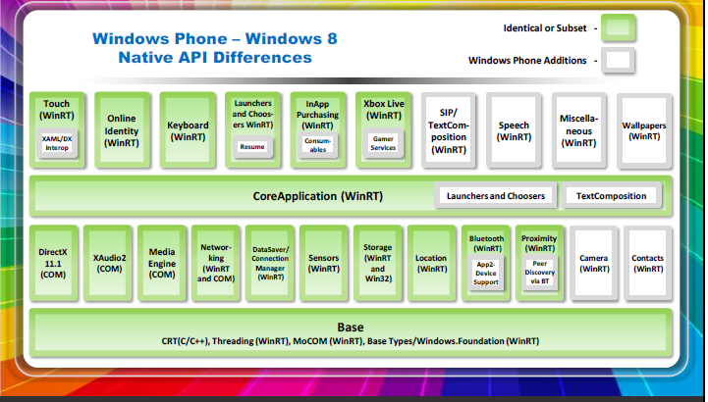

Slide 29
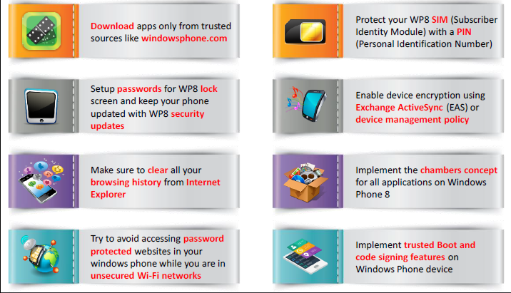

Slide 30
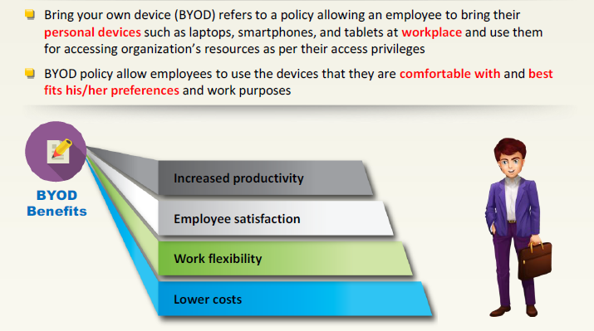

Slide 31
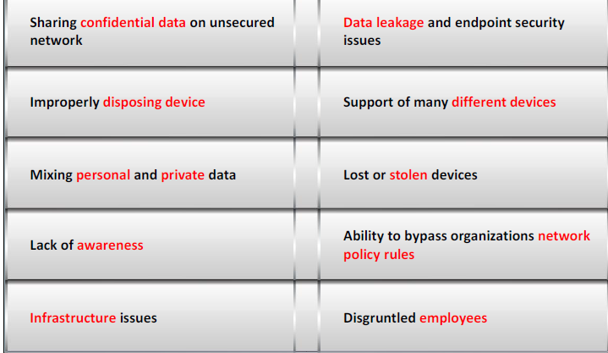

Slide 32
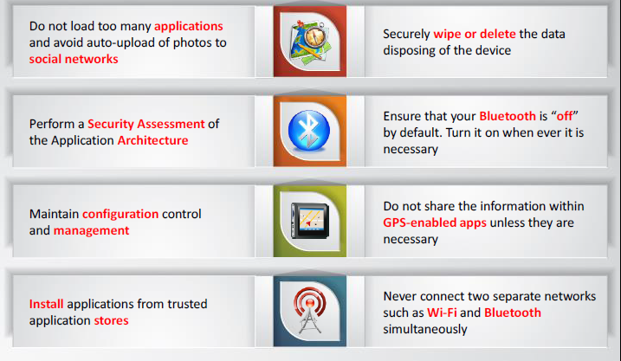

Slide 33
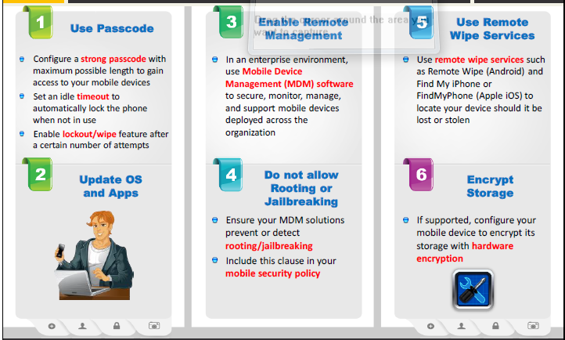

Slide 34
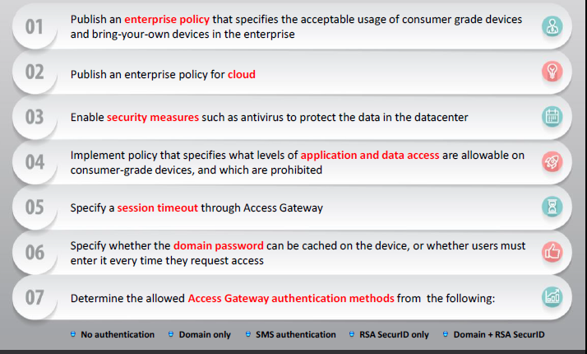

Slide 35
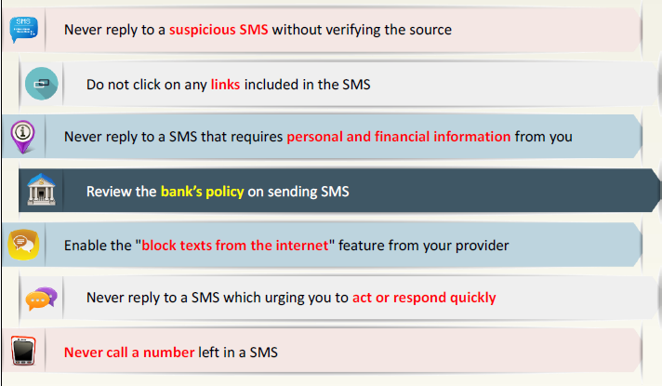

Slide 36
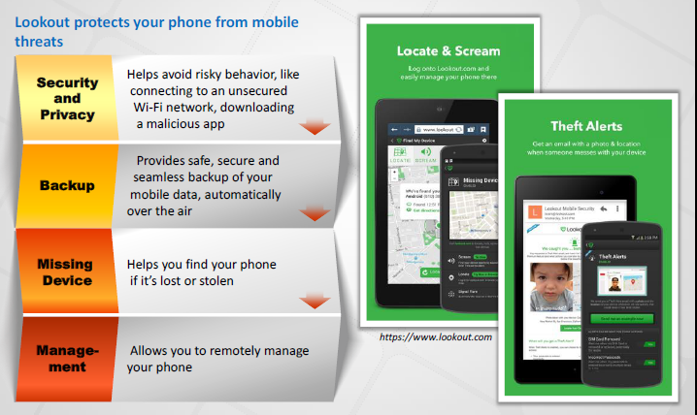

Slide 37
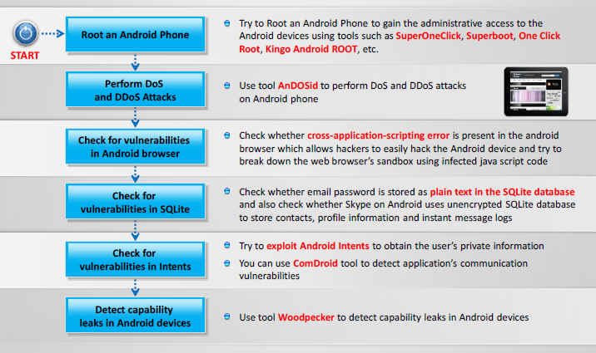
Android Phone Pen Testing

Slide 38
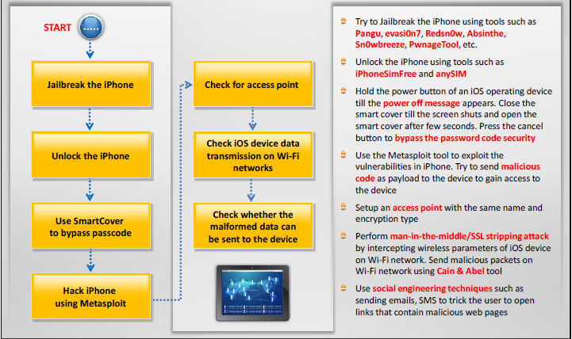
iPhone Pen Testing

Slide 39
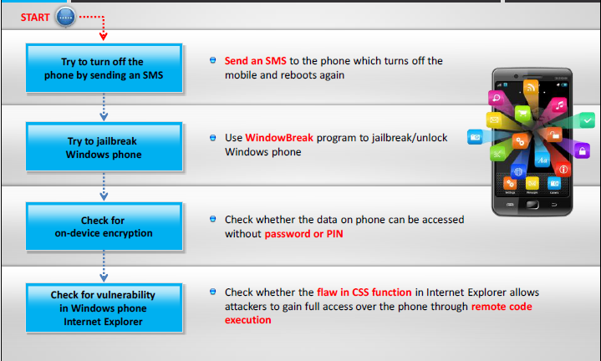
Windows Phone Pen Testing

Slide 40
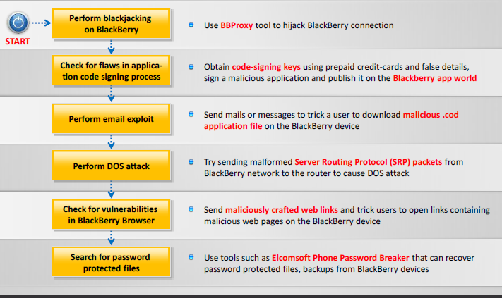
BlackBerry Pen Testing

Slide 41
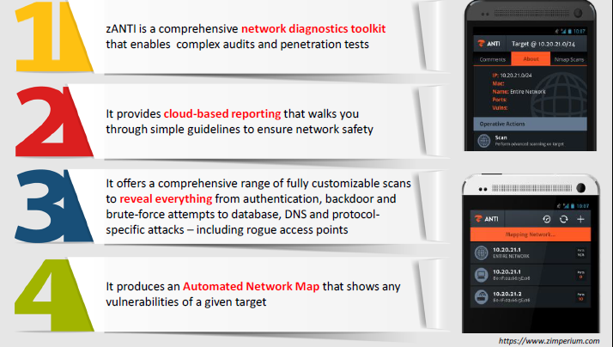
Mobile Pen Testing Toolkit: zANTI

Slide 42
Questions?

Slide 43
Sources References
Fundamentals of Information Security Systems, David Kim, Michael G Solomon, 2nd ed.
CCNA security v2
CCNA Cybersecurity Operations v1.0
Certified Ethical Hacker (CEH) v9, EC-Council certified
Technology, Entertainment and Design (TEDx) Talks, www.ted.com
Copyright 2017 CloudNexus and First Resource Insurance Group
Source: Hackmageddon, http://www.hackmageddon.com/category/security/cyber-attack-statistics
Source: http://www.idtheftcenter.org/2016databreaches.html

