Slide 1
walmart
Business Plan

Slide 2
Company history
Sam Walton founded Walmart.
There were more than 30 Walmart stores in the late 1960s, and there are now more than 20,000 locations across the world . Walmart is one of the world's largest retail stores.
According to the National Retail Federation,Walmart is the undisputed leader in yearly offers,Walmart is a store that sells goods,as well as the discount business Walmart sells almost everything, including food and beverages.
Target, Amazon, Alibaba, Home Depot, and others are some of Walmart's competitors.
The important ingredient in the Walmart is retail benefits.
Walmart's internet-based retail is also included in the retail advantages.
Walmart provides an all-encompassing resource that appeals to the majority of customers.

Slide 3
Worldwide target
The geographical difference from the United States is so great that Walmart has been put to the test by the linguistic barriers and requirements of foreign buyers.
Walmart's major focus worldwide is on acquiring significant competitors as well as more vulnerable ones in order to penetrate the market under the Walmart brand.
Walmart employs people from the United States, China, Germany, the United Kingdom, and Asian countries all over the world
Since the eighteenth century, Walmart has had a worldwide procedure in place.
With its unique strategy, Walmart employs a process of sending progress groups that focuses on replicating present business sectors.

Slide 4

2021 Gross profit $138.836B, a 7.33% increase from 2020.
Lofrev.net. (2022). [online] Available at: http://lofrev.net/wp-content/photos/2016/06/walmart-logo.jpg [Accessed 28 Mar. 2022].
(Lofrev.net, 2022)

Slide 5
4ps marketing mix
Product
Price
Place
The firm has been able to attract a significant number of clients due to the low cost of its products.The company's catchphrase, 'Save money. Live better,' demonstrates the priority it places on product price. As a result, 'Every Day Low Price' (EDLP) is the pillar of Walmart's price strategy.
Discount Stores at Walmart: Smaller than a Supercenter, discount stores employ roughly 200 workers and provide electronics, fashion
.Walmart Supercenters combine a grocery store, bakery, deli, and dairy items with electronics, fashion, toys, and home furnishings to provide a one-stop shopping experience.
Walmart Neighborhood Markets were created in 1998 as a smaller-footprint option for towns in need of a pharmacy, low-cost food, and other items.
Walmart Express was a series of smaller cheap stores that offered a variety of services such as groceries, check cashing, and gasoline.
Walmart is divided into departments, each of which sells a distinct product.Appliances and electronicsProducts for the Home and FurnitureClothesInfant and ToddlerVideo Games and ToysAutomobiles and tyres, for example
Promotion
Walmart spends millions of dollars each year advertising its products and ensuring that they are at the forefront of consumers' minds.For brand recognition and product promotion, the corporation employs a strategic combination of ATL, BTL, and digital media.

Slide 6
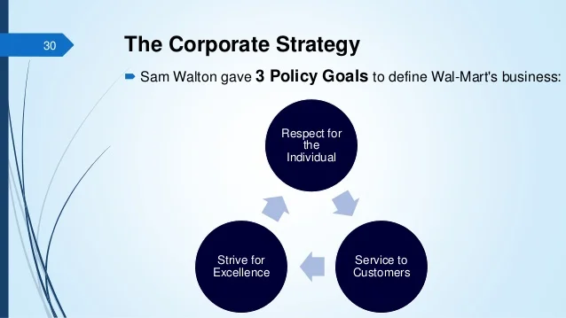
(Slidesharecdn.com, 2022)

Slide 7
THANK YOU
Anamaria Gabriela Duman

