Slide 1


HNC / HND / BA (Hons)
Computer Games Design
Undergraduate Programmes

Slide 2



TODAY’S PRESENTATION
Welcome to Games
Get Involved!
Example: Game Design Study
Contact Us
HNC / HND / BA Computer Games Design

Slide 3
HNC / HND / BA Computer Games Design
Welcome to Games

Slide 4
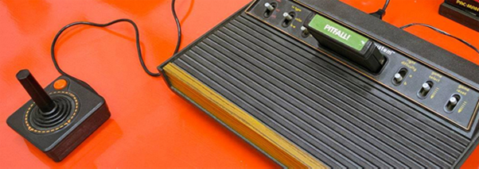

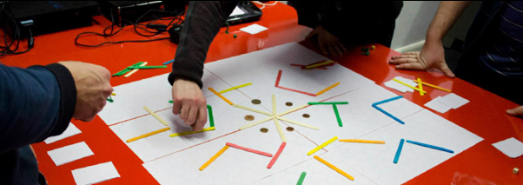
OVERVIEW
Today will be light – it is a short ‘taster’ session rather than an in-depth lecture or complex tutorial.
However, what we do hope to present to you is the energy and feel of a typical session on our course.
HNC / HND / BA Computer Games Design

Slide 5
HNC / HND / BA Computer Games Design
Get Involved

Slide 6
TIME TO GET INVOLVED
Who plays computer games?
HNC / HND / BA Computer Games Design

Slide 7
TIME TO GET INVOLVED
Who plays computer games?
What do they play?
HNC / HND / BA Computer Games Design

Slide 8
TIME TO GET INVOLVED
Who plays computer games?
What do they play?
When do they play them?
HNC / HND / BA Computer Games Design

Slide 9
TIME TO GET INVOLVED
Who plays computer games?
What do they play?
When do they play them?
Where do they play them?
HNC / HND / BA Computer Games Design

Slide 10
TIME TO GET INVOLVED
Who plays computer games?
What do they play?
When do they play them?
Where do they play them?
Why do they play them?
HNC / HND / BA Computer Games Design

Slide 11
HNC / HND / BA Computer Games Design
Example: Game Design Study

Slide 12







“If you want to write novels, you’ve got to read lots of novels. If you want to make movies, you’ve got to watch lots of movies.
And if you want to design games, you’ve got to play lots of games. Every game designer must try out an exotic array of games.”
(Crawford, 2003)
HNC / HND / BA Computer Games Design
Notes:
Yes, this means any game, any platform – old, new, good, bad – even Barbie’s Horse Adventures.
You will learn a lot by looking at examples of both GOOD and BAD games – you can learn so much from a frustrating experience!

Slide 13
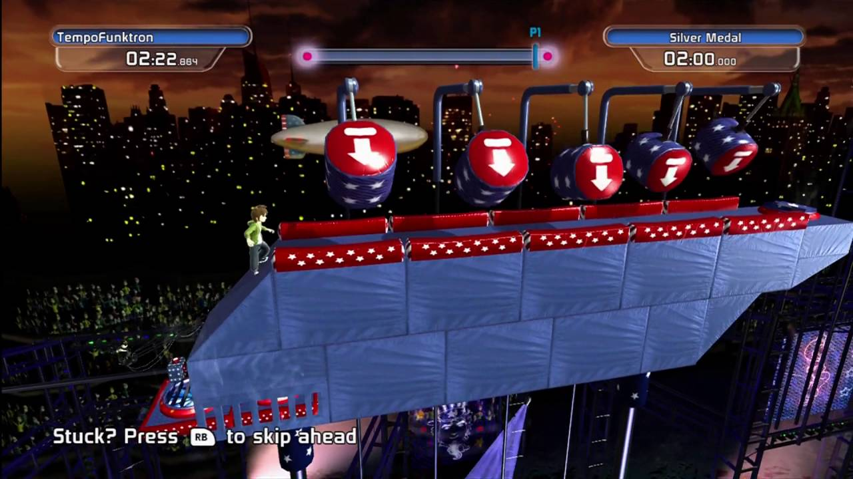
EXAMPLE: Doritos Crash Course (2010), Behaviour Interactive
HNC / HND / BA Computer Games Design
Notes:
Yes, this means any game, any platform – old, new, good, bad – even Barbie’s Horse Adventures.
You will learn a lot by looking at examples of both GOOD and BAD games – you can learn so much from a frustrating experience!

Slide 14
EXAMPLE: Doritos Crash Course
We want two groups (of up to four volunteers) to play Doritos Crash Course.
Race each other to the finish – the quickest time wins!
Target level: USA 1-1: Safety First!
Feel free to pass the controller to another volunteer once you’ve completed the course. Consider your favourite and least favourite parts of the experience and write them down after playing if you feel the need to.
HNC / HND / BA Computer Games Design
Notes:
Yes, this means any game, any platform – old, new, good, bad – even Barbie’s Horse Adventures.
You will learn a lot by looking at examples of both GOOD and BAD games – you can learn so much from a frustrating experience!

Slide 15
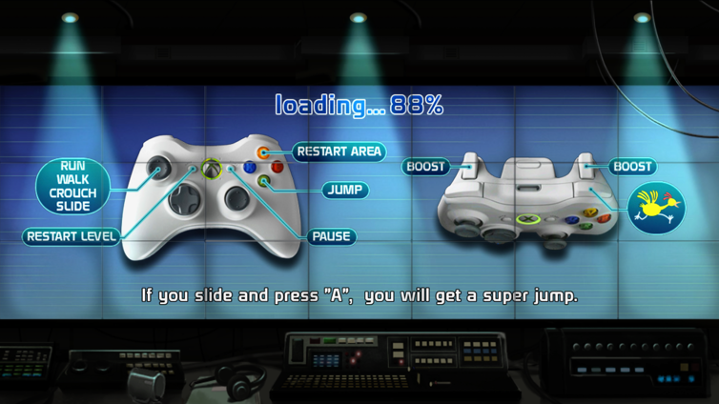

Slide 16
HNC / HND / BA Computer Games Design
Conclusions

Slide 17
EXAMPLE: Doritos Crash Course
CONCLUSIONS
Any thoughts on the game / points anyone would like to raise?
HNC / HND / BA Computer Games Design
Notes:
Yes, this means any game, any platform – old, new, good, bad – even Barbie’s Horse Adventures.
You will learn a lot by looking at examples of both GOOD and BAD games – you can learn so much from a frustrating experience!

Slide 18
EXAMPLE: Doritos Crash Course
CONCLUSIONS
Engaging with today’s game is considered primary research.
Research is essential in University as it is the foundation in which you build all of your ideas and proposals upon.
HNC / HND / BA Computer Games Design
Notes:
Yes, this means any game, any platform – old, new, good, bad – even Barbie’s Horse Adventures.
You will learn a lot by looking at examples of both GOOD and BAD games – you can learn so much from a frustrating experience!

Slide 19
EXAMPLE: Doritos Crash Course
CONCLUSIONS
Engaging with today’s game is considered primary research.
Research is essential in University as it is the foundation in which you build all of your ideas and proposals upon.
It is important to do as much research as possible.
HNC / HND / BA Computer Games Design
Notes:
Yes, this means any game, any platform – old, new, good, bad – even Barbie’s Horse Adventures.
You will learn a lot by looking at examples of both GOOD and BAD games – you can learn so much from a frustrating experience!

Slide 20
EXAMPLE: Doritos Crash Course
CONCLUSIONS
On this course that can often mean playing games, and writing down your thoughts after you play. Sometimes this is discussed verbally, presented to your cohort, or written up in a report.
This research and experience can then be used to steer or influence your own design work for levels, characters, ideas, etc.
HNC / HND / BA Computer Games Design
Notes:
Yes, this means any game, any platform – old, new, good, bad – even Barbie’s Horse Adventures.
You will learn a lot by looking at examples of both GOOD and BAD games – you can learn so much from a frustrating experience!

Slide 21
HNC / HND / BA Computer Games Design
Contact Us

Slide 22

CONTACT
Programme Manager for HNC / HND / BA Computer Games Design
Rich Morgan
richard.morgan1@uwtsd.ac.uk
Course Website
BA Computer Games Design
www.uwtsd.ac.uk/ba-computer-games-design
HNC / HND / BA Computer Games Design

Slide 23
HNC / HND / BA (Hons)
Computer Games Design
Undergraduate Programmes

