Slide 1

Job Satisfaction
Based on Chapter 7, Management and Organisation Behaviour 9ed by Laurie J. Mullins.

Slide 2
What is Job Satisfaction?
Reflect and write down your answer?

Slide 3
Job Satisfaction
Job Satisfaction or Life Satisfaction always comes down to the individual, to you.
It is up to each of us to find out:
  Who we are?
  What do we love?
  What do we value?
  What do we want to do with our lives?
  And then ‘to do it’.
The only person that can make you happy and fulfilled is You by doing what you love.
Each of us is different and what makes one person happy haha maybe the bane for another.
And so it is up to each of us to discover within who we are and what we want to do and then to follow our inspiration and do it.

Slide 4
Job Satisfaction
Today we will look at several factors that can effect Job Satisfaction each of these could be an area of study for your assignment:
Motivation
Motivation and Job Alignment
Recognition Reward and Respect
Organisational Behaviour & Culture
Flexible Working
Work Environment
Job Enrichment
Empowerment
Appreciative Inquiry
Well-being at Work
Fun at Work
Generation Y

Slide 5
Job Satisfaction
Mullins 2010 states that Job satisfaction “is usually linked with motivation… Satisfaction is not the same as motivation. Job satisfaction is more of an attitude, an internal state.”

Slide 6
Job Satisfaction defined
Job satisfaction can be defined as a pleasurable emotional state resulting from one’s job;
An affective reaction to one’s job;
A positive attitude towards one’s job.
Weiss (2002) has argued that job satisfaction is an attitude ... and that we form attitudes towards our jobs by taking into account our feelings, our beliefs, and our behaviours.
Based on: http://en.wikipedia.org/wiki/Job_satisfaction

Slide 7
Job Satisfaction defined
Job satisfaction describes how content an individual is with his or her job.
The happier people are within their job, the more satisfied they are said to be.
Happier people are more productive in the workplace. Research shows stress reduces performance and productivity.
‘Job design’ aims to enhance job satisfaction and performance, methods can include job rotation, job enlargement & job enrichment, people enjoy variety and greater responsibility when they are comfortable with existing tasks.
Other influences on satisfaction include the management style and culture, employee involvement, empowerment and autonomous work position.
Job satisfaction is a very important attribute which is frequently measured by organizations.

Slide 8
Job Satisfaction & Open Communication
HRM, Line-managers and Team leaders:
Meet and mentor team-members/employees to openly discuss how they feel about their job.
A Questionnaire can be completed beforehand and brought to the meeting.
Questionnaires can be used to gauge the current level of Job Satisfaction with individual personnel, with teams, departments, branches and/or the entire organisations, distributed by line-managers, team-leaders or by the central HRM department.
It is important that Job Satisfaction is discussed openly at annual appraisals so that Managers work with personnel on their Job Design, so they can ensure the right people are doing the right jobs i.e. Employee’s tasks/roles are aligned with their intrinsic motivation (=WIN/WIN).
Questions can relate to happiness and well-being, work load, working patterns and responsibilities, communication, culture, promotional opportunities, co-workers, and rate of pay.
Regular appraisals and feedback are very important to review the above.

Slide 9
Recognition Reward & Respect
Appreciation : as we have seen with Maslow’s hierarchy recognition and reward such as a simple Thank you, Well done, Great job goes a long way to creating a Positive environment, culture and motivated team.
Appreciative Inquiry : a method whereby Personnel ‘focus’ on the Strengths of the Organisations and of People.
It is part of a Managers roles to work with people to help them identify their innate strengths whether it is technical, social, design, creative and to place them in appropriate roles where they can thrive (=WIN/WIN).

Slide 10
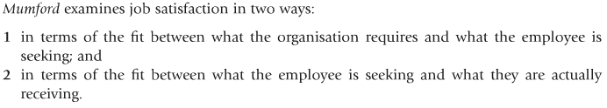
Mumford’s ‘Fit’ or Alignment
Mumford’s contractual areas correspond with peoples needs and other motivation theories. Creating an enterprise or working in an organisation is a way for people to meet their ‘Physical, Mental, Emotional, Social and personal development ‘needs’.

Slide 11
Flexible working arrangement
An increasingly significant aspect of motivation and job satisfaction is flexible working. According to CIPD, ‘This relates to an organisation’s working arrangements in terms of working time, working location and the pattern of working.’⁶⁴
Moves towards greater flexibility may afford opportunities for employees to have more freedom and control over their working arrangements and have noticeable effects on their job satisfaction and performance.

Slide 12
Flexible working
Job Satisfaction & Empowerment
Broader approaches to job satisfaction aim to give the person improved empowerment and job enrichment through greater autonomy and authority over the planning execution and control of their work. It focuses attention on intrinsic satisfaction.
Job enrichment … should provide the person with a more meaningful and challenging job and offer greater opportunities for psychological growth.
The main methods of achieving job enrichment include the following:
permitting workers greater freedom and control over the scheduling and pacing of their work as opposed to machine pacing;
supporting workers to establish an appropriate work/life balance.

Slide 13
Job Enrichment
Job enrichment is an attempt to motivate employees by giving them the opportunity to use the range of their abilities.
It is an idea that was developed by the American psychologist Frederick Hertzberg in the 1950s.
It can be contrasted to job enlargement which simply increases the number of tasks without changing the challenge.
As such job enrichment has been described as 'vertical loading' of a job, while job enlargement is 'horizontal loading'.
An enriched job should ideally contain:
A range of tasks and challenges of varying difficulties (Physical or Mental)
Feedback, encouragement and communication.

Slide 14
Personal development & satisfaction @ Work
Consider the positive effect the industrial revolution has had on job satisfaction as many monotonous tasks are now automated freeing human labour to focus on more satisfying jobs which meet their holistic mental, emotional , social and creative needs allowing them to focus more on personal learning and development.
Such evolution in the workplace enhances a person’s internal state (Job Satisfaction) and enriches their lives.
As a result it is interesting to consider how important work can play in enriching ones life.
JW

Slide 15


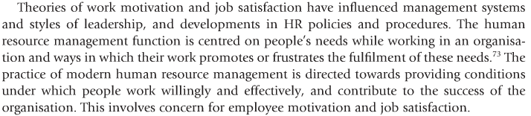
Job Design: modern HRM support Job Satisfaction

Slide 16
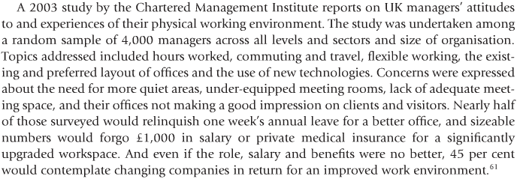

CMI work environment study

Slide 17


The work environment

Slide 18
Life @ Google
Google is not a conventional company, and we don’t intend to become one. True, we share attributes with the world’s most successful organizations – a focus on innovation and smart business practices comes to mind – but even as we continue to grow, we’re committed to retaining a small-company feel. At Google, we know that every employee has something important to say,
Google has offices around the globe, from Bangalore to Zurich, but regardless of where we are, we nurture an invigorating, positive environment by hiring talented, local people who share our commitment to creating search perfection and want to have a great time doing it. Googlers thrive in small, focused teams and high-energy environments, believe in the ability of technology to change the world, and are as passionate about their lives as they are about their work.
http://www.google.com/intl/en/jobs/lifeatgoogle/

Slide 19
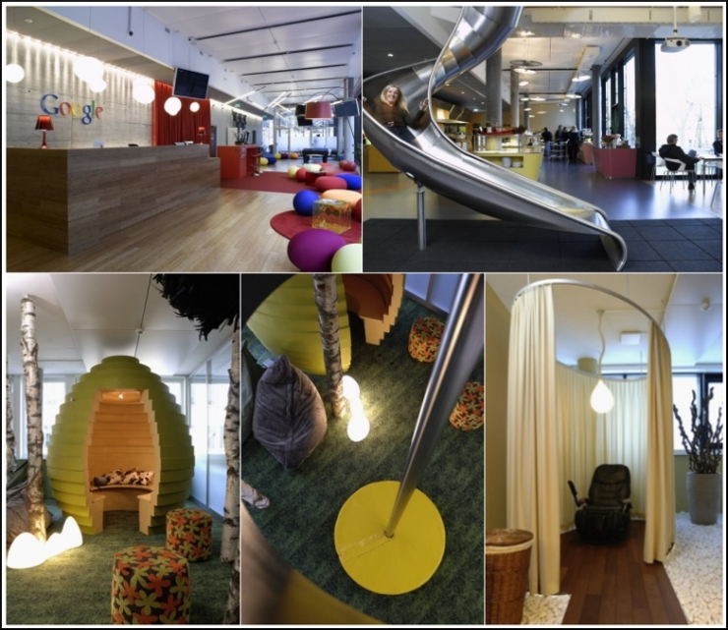
Google : Creative Work Environment
Click here for photos:
http://anasedris.blogspot.com/2009/04/googles-work-environment.html

Slide 20
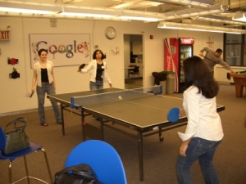

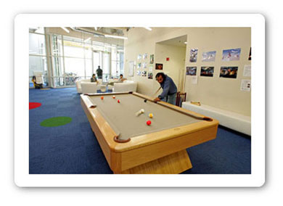
Google : Creative work Environments
Video: http://news.bbc.co.uk/1/hi/7290322.stm

Slide 21
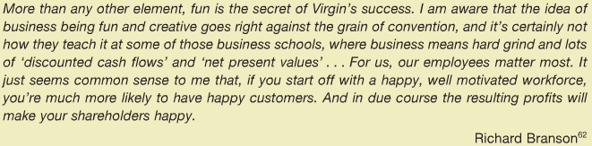
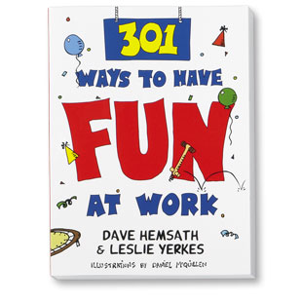
Fun @ work

Slide 22
Fun : Unlocking Creativity & Healing
For example:
Fun Managers e.g. NTL/Virgin
Giggle doctors

Slide 23
Well-being @ Work
According to De Vita, well-being at work pays because employees who are happy and healthy take fewer days off sick, are more productive and more likely to stay with their organisation. The starting point to supporting and promoting well-being in the workplace has to be good people management and effective work organisation.

Slide 24
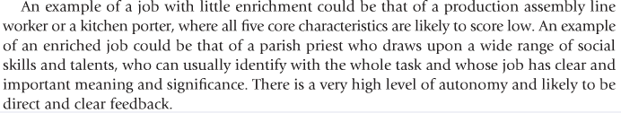
Job Enrichment

Slide 25

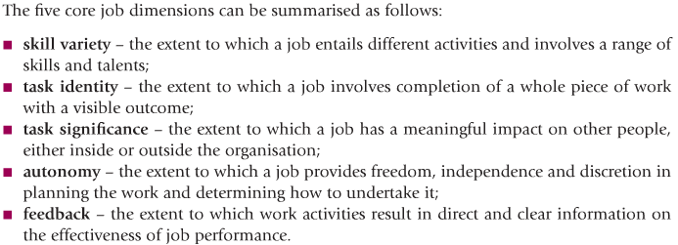

Comprehensive model of Job enrichment
These job characteristics create three psychological states:

Slide 27
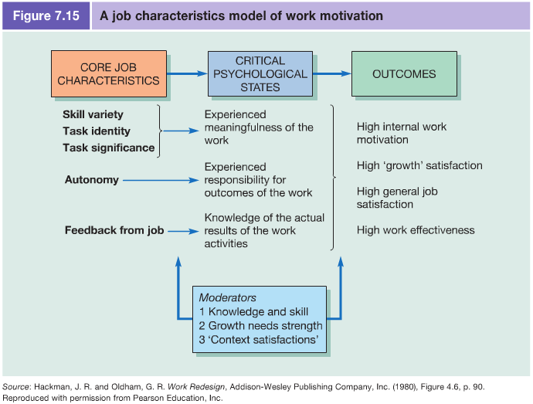

Slide 28
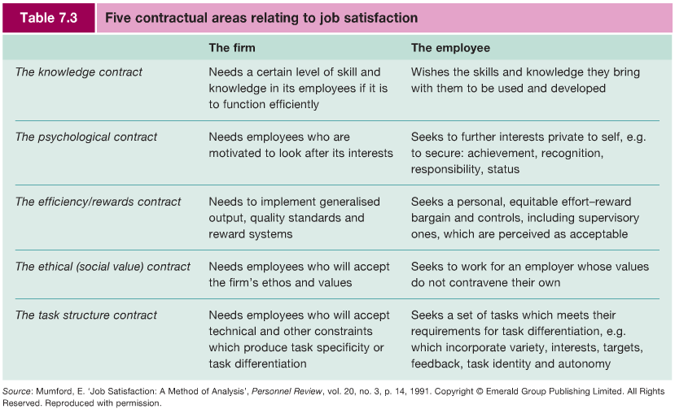
Aligning Organisational and employee needs

Slide 29
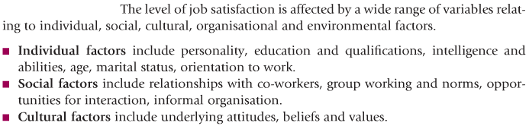

Dimensions of Job Satisfaction
The level of Job Satisfaction is affected by a wide range of variables relating to individual, social, cultural, organisational and environmental factors:

Slide 30


Slide 31
Activity: Job enrichment
Refer to the ‘job characteristics model’, apart from the examples below reflect and write down:
    2/3 jobs that are likely to have little job enrichment
    2/3 jobs that are likely to have a lot of job enrichment.

