Slide 1
EXAM
SOUND, LIGHT and HEAT
THURSDAY 8th January 2026
You will need:
Pen
Pencil
Rubber
Calculator
2 hours to complete
Task split into 3 parts

Slide 2
General form of the 35 multiple choice questions
Definitions
True or False statements
Minor calculative
The units of calculation
The terms of an equation
Applying knowledge to supply the solution to a practical situation

Slide 3
PART 1: 35 multiple choice questions on SOUND AND LIGHT
General format
Qu.1. The luminous flux emitted by one steradian by a point source of light of one candela is called:
A. a joule
B. a calorie
C. an apostilb
D. a watt
E. a π radian
Qu.2. Which ONE of the following statements is TRUE?
A. Lighting levels increase rapidly as distance from the source increases
B. Lighting levels increase as the surface being lit is tilted
C. The illuminance produced by a point source of light decreases in inverse proportion to the square of
the distance from the source.
D. The illuminance produced by a point source of light increases in inverse proportion to the square of
the distance from the source.
E. The illuminance produced by a point source of light increases in inverse proportion to the square of
the power from the source.
Qu.3. Which one of the following lamps has the lowest value of luminous efficacy?
A. An incandescent lamp with 20W and 450 lumens specification
B. A compact fluorescent light with 8W and 750 lumens specification
C. A LED light with 8W and 400 lumens specifications
D. A fluorescent tube with 9W and 470 lumens
E. A LED down light with 12W and 930 lumens specifications
Qu.4. Which ONE of the following statements is FALSE ?
  A. The higher the colour temperature, the colour appearance becomes “hotter”.
  B. In office environment, the light with lower temperature colour is preferred as it is less likely to induce sleepiness.
C. Colour temperatures are measured in Kelvin's.
D. The Kelvin's temperature is equivalent to Centigrade + 273.
E. For warehouses, the light with lower temperature colour is preferred as it consumes less energy.
Write on the question paper…cross out…or use it for your calculations as you want.

Slide 4
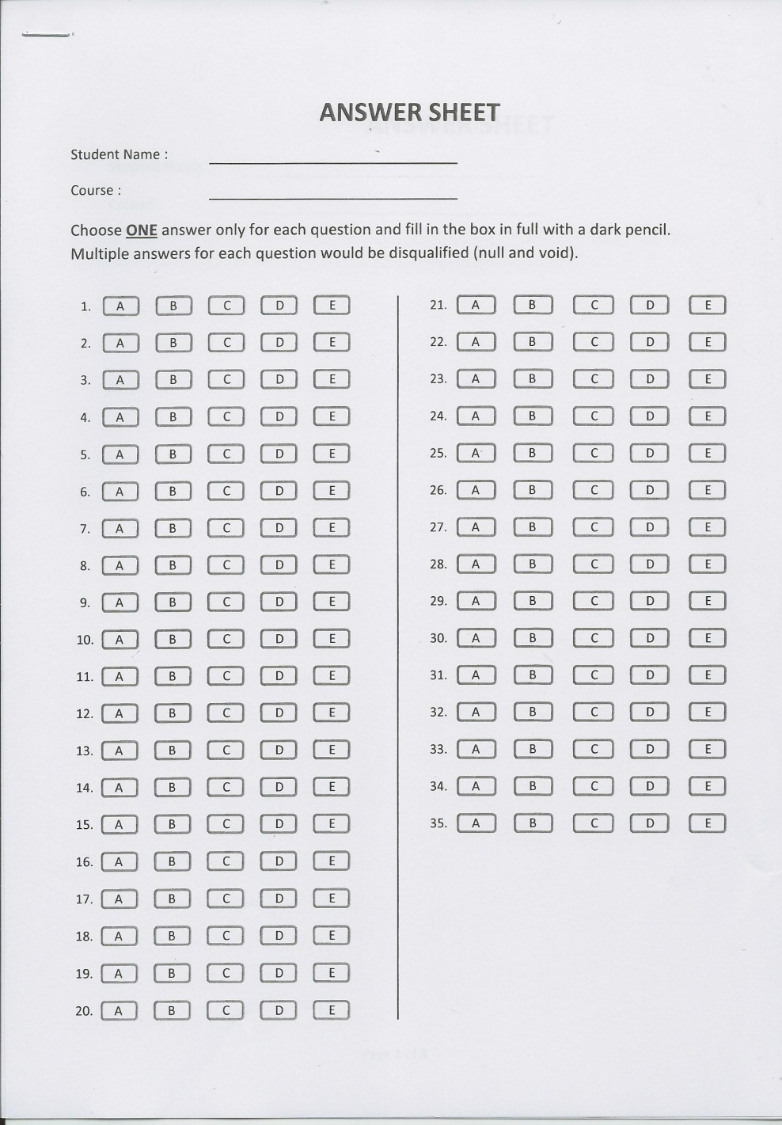
Multiple Choice Answer input sheet
35 questions on
SOUND and LIGHT
2 marks each answer
Choose 1 answer from the five options (A to E)…..and fill in the box corresponding to that option.
This answer sheet to be completed in PENCIL...mistakes can be rubbed out, and the questions re-attempted
One letter shaded only......
Two letters shaded out will void that question.

Slide 5
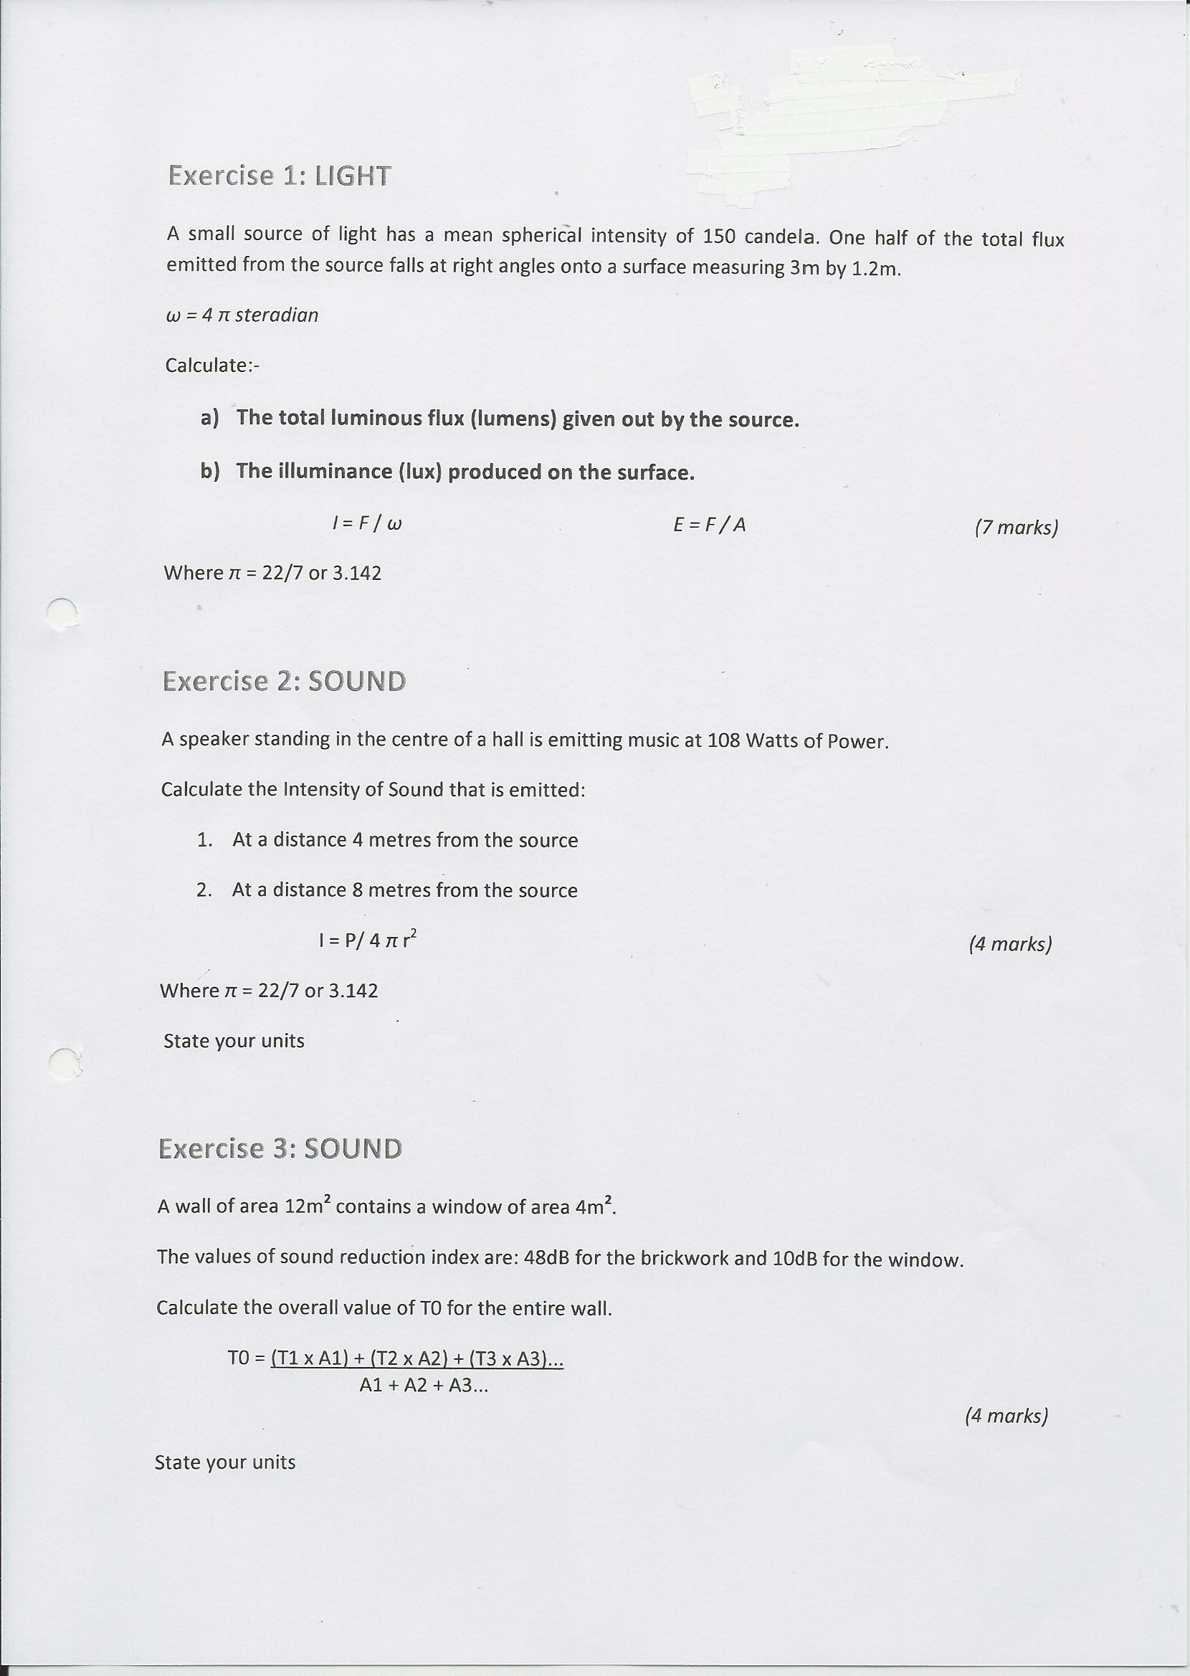
General Format :
PART 2:
Three calculative exercises on HEAT
30 marks up for grabs !
Equations we have studied will be supplied with the questions....but you will need to know how to use them and what the ‘ terms’ used in the equations mean and represent.

Slide 6
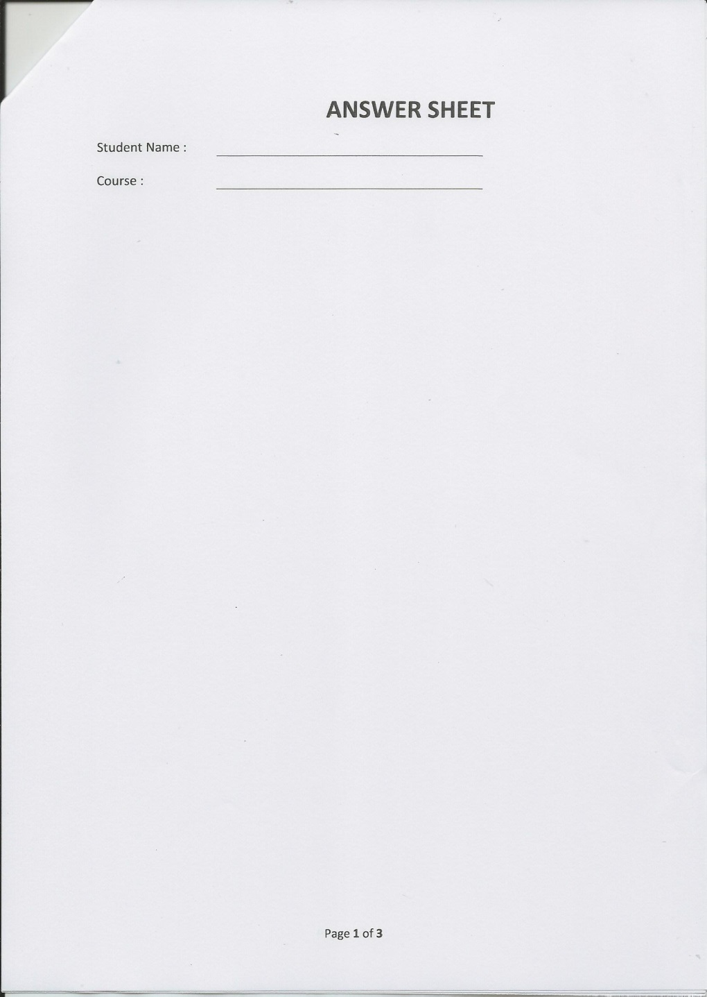
Maths Exercise Answer Sheet x 3
Complete your 4 calculative exercises on HEAT using these three sheets.
Show your workings in PEN on this page. Marks given for formulation of an answer as well as the answer itself.
The marks awarded against each question will be shown on the question sheet

Slide 7
Test will allow 2 hours for completion
Exam Conditions – This means no bags/phones with you, and silence during the exam time.
You can leave at any time if you are satisfied with your answers by handing in your submission....but re-entry to the room will not be allowed.
(Leaving the room is not permitted during the first or last 15 minutes)
All documents are to be handed back in at the end of the test tucked inside the test booklet.
MAKE SURE your name is on all sheets handed in.
That is :
Question booklet
Multiple choice answer sheet
Exercises answer sheets

