Slide 1
ECEY5004
Language and Literacy in the Digital Age
Nursery Rhymes

Slide 2
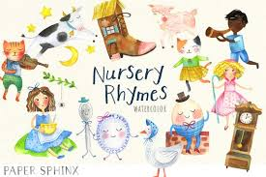
Contents
History of nursery rhymes;
Cultural links;
Discussions;
Research;
Theory;
Features of nursery rhymes;
Questions;
Group task.

Slide 3
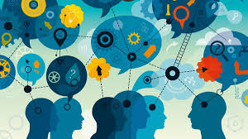
Employability/Transferable Skills
Organisation and Planning;
Researching and Note taking;
Communication and Interaction;
Presenting and Teamwork.

Slide 4

Resources
PP for the lecture;
Nursery rhymes;
Research;
Websites.

Slide 5
Early Years Practitioner programme
The NOS criteria met in this lecture:
Core – K7, K8, K12, K13, K14, K17, K24, K26, K27
0401 – K56, K57, K58, K59, K60; P3, P4, P5, P7, P8
0403 – K60, K61, K62, K63, K64
0408 – K57, K59, K63, K66, K67
0409 – K60, K61, K62, K63, K64, K65, K66, K67, K68, K69, K70, K71, K72; P1, P19, P20, P22

Slide 6
Nursery rhymes - From where?
Parents;
Other family members;
Cultural/social experiences;
Anywhere else?
(Mullen, 2017)
Discuss; can you remember where you sang/recited nursery rhymes? With who?

Slide 7
A little history…
Have been recited to, and by, children for hundreds of years;
Origins of most nursery rhymes reflect historical events;
Important for our history and culture.
Notes:
I always ask if they remember Disney’s version of Robin Hood that has a cockerel as a minstrel…
Do they understand the significance of a minstrel?
Time before radio, television, social media…how did people learn about events on a local/national/international scale?
People would often compose poems/songs to help them remember events

Slide 8
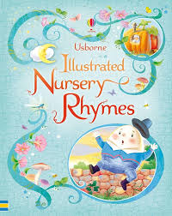
Do you remember these?
Ring-a-ring-o-roses;
Humpty Dumpty;
Baa baa black sheep;
Mary, Mary quite contrary.

Slide 9
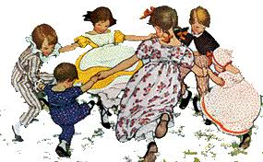
Ring-a-ring-o-rosies,
A pocketful of posies
Atishoo, atishoo,
We all fall down.
Did you know - This has historical links to the plague?

Slide 10
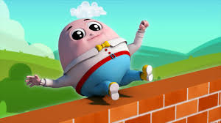
Humpty Dumpty sat on a wall,
Humpty Dumpty had a great fall.
All the king’s horses and all the king’s men,
Couldn’t put Humpty together again.
Did you know – Humpty Dumpty was a cannon?

Slide 11
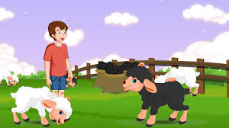
Baa baa black sheep,
Have you any wool?
Yes Sir, Yes Sir,
Three bags full –
One for the master,
And one for the dame.
And one for the little boy,
Who lives down the lane.
Is this still sung with its original lyrics?
Many settings now go through the rainbow… some think that the original is racist

Slide 12
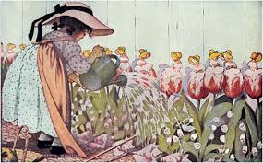
Mary, Mary quite contrary,
How does your garden grow?
With silver bells and cockle shells,
And pretty maids all in a row.
Did you know – This is the story of Mary, Queen of Scots?

Slide 13
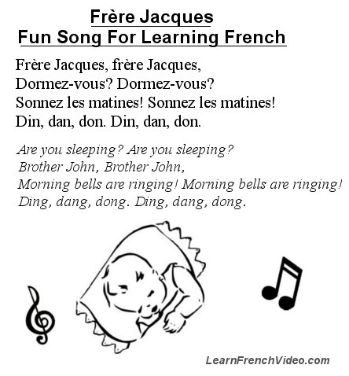
France
Notes:
Rhymes from different countries/cultures

Slide 14
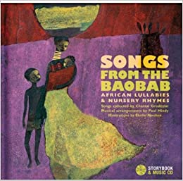
Africa
Songs from the Baobab
Notes:
Baobab = a short tree with a very thick trunk and large edible fruit
Students can listen in their own time..

Slide 15

Chinese Mandarin
Shi Shang Zhi You Mama Hao

Slide 16
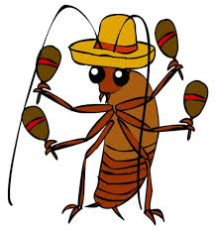
Latin America
La Cucaracha

Slide 17
Today’s thinking...
Outdated;
Obsolete;
Concerns;
- Dark stories;
Bizarre;
No educational value;
Not politically correct;
No time. (The Mail, 2018; Lee, 2017; Burton-Hill, 2015
What are your thoughts?
Do you agree/disagree?
Why?

Slide 18
However…
Physical bond;
Rhythmic movements;
Socialization by singing;
Gestures and facial expressions;
Effective way of learning language/second language;
Promotes auditory perception;
Understand simple story;
Fun – learn about wordplay.
(Lee, 2017; Pourkalhor and Tavakoli, 2017)
Notes:
However, there are several advantages to singing/reciting rhymes with children
Could be linked to some of the theorists from the task....

Slide 19
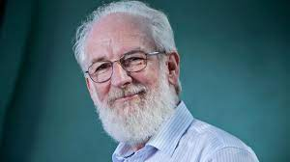
David Crystal
Linguist, academic and author;
Wordplay/language play.

Slide 20
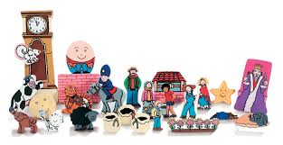
David Crystal
Nursery rhymes are:
Effective;
Visual;
Tactile;
“vocal-visual choreography”.
(Crystal, 1998: 164)

Slide 21
David Crystal (2017: 69)
“Emphatic rhythm permeates the interactions between carers and children during the period from around 6 to 18 months. Think of the games that are played – tickling games, clapping games, knee-bobbing games, repetition songs and a lot of activity nursery rhymes. They all have one thing in common: a strong rhythm, usually reinforced by touch and body movement.”

Slide 22
David Crystal (2017)
Pronunciation;
Accents;
Intonation;
Pace.
“It’s not what you say...It’s the way that you say it….”

Slide 23
Have a go…
Imagine that you are living in an era before social media;
You are asked to share what has happened to Humpty Dumpty;
Notes:
A fun Activity to prehaps do at home!

Slide 24
Have a go…
In small groups, relay the news as if you were:
a newsreader;
a 5-year-old;
a sloth;
Father Christmas;
a football commentator;
David Attenborough;
Can you think of others?
Notes:
A fun Activity to prehaps do at home!

Slide 25
Friedrich Froebel
Act of singing is a way to convey motherly love and care;
Singing can be a pedagogical tool;
Singing rhymes can be an emotional conduit.
(Dyke, 2017)
Usually associated with kindergartens which is also known for maternalistic focus

Slide 26
Linguistic skills
N.B. Some of these could be used in your assignments. E.G. how you change your voices, change in stress/pitch/intonation.
Phonological awareness;
Syllables;
Phonemes;
Rhyme;
Repetition;
Alliteration;
Onomatopoeia;
Rhythm.

Slide 27
Phonological awareness
The ability to understand that letters of the alphabet represent phonemes in speech;
An important precursor in learning to read;
Linked to early reading and success with spelling.
(Saiegh-Haddad, 2019)

Slide 28
Activities to promote phonological awareness
Highlight phonological awareness in rhymes, songs and stories;
Match pictures to words;
Match words to words.
Can you think of what you do in your settings?

Slide 29
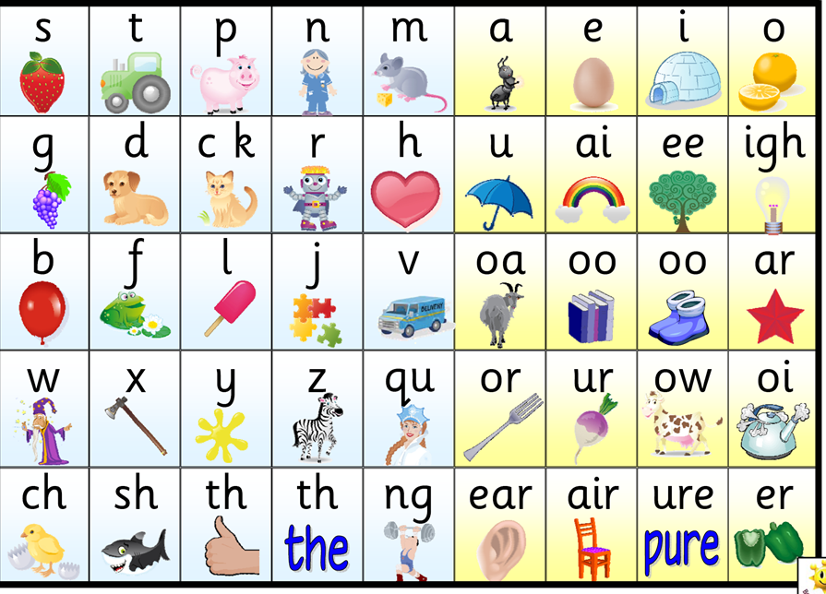
Phonemes
What is a phoneme?

Slide 30
Syllables & Rhythm
Syllables in nursery rhymes help make up their rhythm;
Engages listeners and invites immediate reactions:
Hand clapping;
Jumping up and down.
(Sayakhan et al., 2019)
Musical activity enhances acquisition of reading skills.
(Linnavalli et al., 2018)

Slide 31
Rhyme
Improves memory (word retention);
Children more likely to remember exact words;
Strengthens children’s vocabulary;
Enables children to predict words before they are said/read;
Gives children ‘an edge’ in language comprehension and language learning.
(Read et al., 2014)
Notes:
Could be useful if their choice of stories rhyme

Slide 32
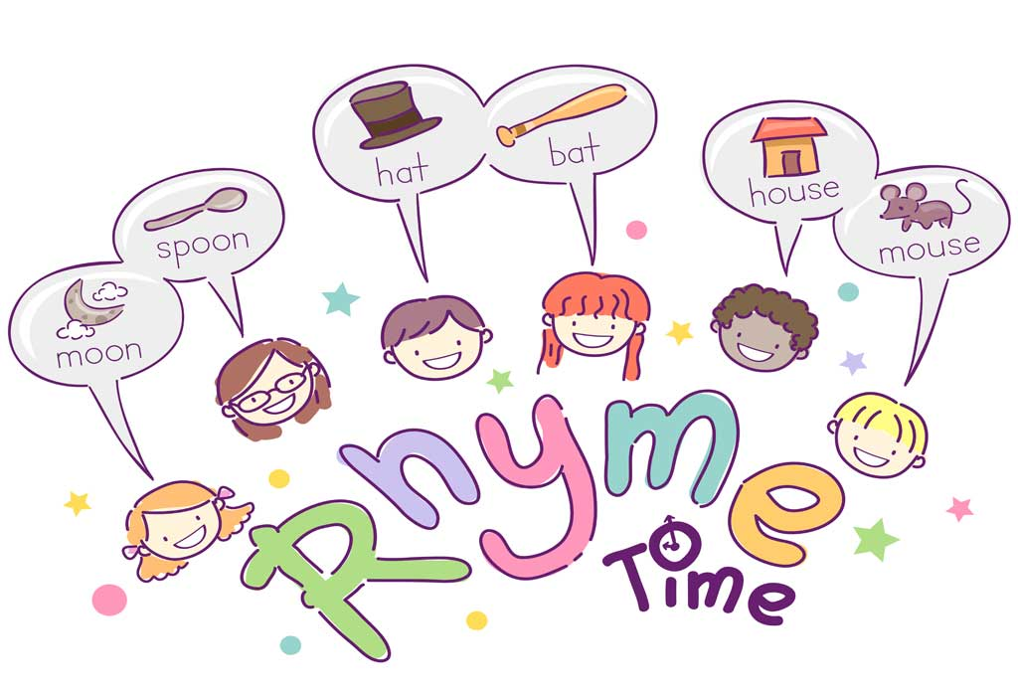
Rhyme - Activity
You have 3 minutes.
Make a list of words which rhyme with ‘RHYME’

Slide 33
Repetition
“…due to the repetitive language and the repetitive nature of their use, nursery rhymes lend themselves well to functioning as linguistic drills, without the accompanying feeling of potential boredom or frustration and they help in developing automaticity of language use, alongside catering for different learning styles and multiple intelligences. In addition, they provide ample opportunities for recycling the language by offering a wide range of options for developing classroom activities to accompany them”
(Prosic-Santovac, 2015, p. 27).
Notes:
Could be useful if there is repetition in their stories

Slide 34
Repetition – Discuss…
Why do you think authors use repetition in children's books?
Have you noticed examples of repetition in books you have read?
What important information was the author drawing your attention to?

Slide 35
Alliteration
Words that begin with the same initial sound, e.g. tongue twisters;
Can have an impact on phonological awareness skills;
Develops sensitivity towards repetition of initial sounds;
Enhances listening skills.
(Symmonds, 2020)

Slide 36
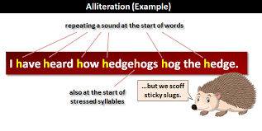
Alliteration – Have a go!
Using the initial of your first name, write your own example of alliteration.

Slide 37
Onomatopoeia
“linguistic forms that imitate sounds from the environment”
(Laing, 2019, p.4)
Helps infants associate speech sounds with referents;
Early vocabulary consists of high number of onomatopoeic words;
Part of child-directed speech;
British babies fixate for longer on onomatopoeic words than nouns.
Notes:
Referents – the thing in the world that a word or phrase denotes or stands for

Slide 38
Onomatopoeia activity
Match the noisy word on the left with a sentence on the right:
beep | I’m asking you politely to be quiet.
chuckle | It’s not that boring, is it?
clatter | A cat having a nap with its owner.
ding dong | The sound of money being made.
drip | The march of time sounds like this.
ker-ching | Is that thunder in the distance?
munch | A guitar being played, but badly.
purr | An angry motorist or a wake-up call.
rumble | Can you answer the door please?
shush | Dropping a dozen plates on the floor.
snore | Do up your coat-it’s cold outside.
tick tock | When something is quite funny.
twang | The sound of a healthy diet.
yawn | Sleeping like a baby.
zip | Turn off the tap properly to avoid this.

Slide 39
To end…
“Reciting and singing nursery rhymes provides practice in different language areas and can help young learners to take the first steps to develop phonological awareness…Educators agree that a great deal of general evidence indicates that both early awareness of rhyme and nursery rhyme knowledge facilitate literacy acquisition”.
(Fleta, 2017: 37)
https://www.youtube.com/watch?v=0ySasQdLkso

Slide 40
References
Burton-Hill, C. (2015) The dark side of nursery rhymes. https://www.bbc.com/culture/article/20150610-the-dark-side-of-nursery-rhymes [Accessed: November 4 2020].
Crystal, D. (1998) Language Play. London: Penguin Books Ltd.
Crystal, D. (2017) Sounds Appealing: The passionate story of English Pronunciation. London: Profile Books Ltd.
Donaldson, G. (2015) Successful Futures. Cardiff: Welsh Government.
Dyke, J. (2017) A Froebelian approach: songs, rhymes and finger plays. Available at:https://www.froebel.org.uk/uploads/documents/FT-Songs-Rhymes-and-Finger-Plays-Pamphlet.pdf [Accessed: August 21 2024].
Fleta, T. (2017) ‘The sounds of picturebooks for English language learning’,Children’s Literature in English Language Education Journal, 5(1), pp.21-43.
Laing, C. E. (2017) ‘A perceptual advantage for onomatopoeia in early word learning:
Evidence from eye-tracking’, Journal of Experimental Child Psychology, 161, pp. 32-45.
Laing, C. (2019) ‘A role for onomatopoeia in early language: evidence from phonological development’, Language and Cognition, 11(2), pp.173-187.

Slide 41
References
Lee, V. (2017) Children are no longer learning traditional nursery rhymes, and that’s sad news. https://inews.co.uk/inews-lifestyle/people/children-no-longer-learning-traditional-nursery-rhymes-thats-sad-news-101889 [Accessed: November 4 2020].
Linnavalli, T. et al. (2018) ‘Music playschool enhances children’s linguistic skills’, Scientific reports, 8(1), p.8767. [online]. Available at: https://www.nature.com/articles/s41598-018-27126-5.pdf [Accessed: August 21 2024].
Mullen, G. (2017) ‘More than words: Using nursery rhymes and songs to support domains of child development’, Journal of childhood studies, pp.42-53. [online]. Available at: https://journals.uvic.ca/index.php/jcs/article/view/17841 [Accessed: August 21 2024].
Phonic Books (2013) What is a phoneme? https://www.youtube.com/watch?v=dwFvD5Cv9n8 [Accessed: November 4 2020].
Pourkalhor, O. and Tavakoli, M. (2017) ‘Nursery Rhymes and Language Learning: Issues and Pedagogical Implications,’ International Journal of English Language & Translation Studies, 5, 1, pp.111-116.
Prosic-Santovac, D. (2015) ‘Making the match: Traditional nursery rhymes and teaching English to modern children’, CLELE journal, pp.25-48.
Read, K. et al. (2014) ‘The Seuss boost: Rhyme helps children retain words from shared storybook reading’, First Language, 34(4), pp.354-371.

Slide 42
References
Saiegh-Haddad, E. (2019) ‘What is phonological awareness in L2?’, Journal of Neurolinguistics, 50, pp.17-27. [online]. Available at: https://www.sciencedirect.com/science/article/pii/S0911604417300520?casa_token=jWByiIBl2_YAAAAA:IteJAcyFCpLrxZXu3awQhBqD5mFttB4W-xo9-jtPBW6wycxlrWpdgbGUqwnpsHRi-d5-wK2ivyM [Accessed: August 21 2024].
Sayakhan, N. I. (2019) ‘Nursery Rhymes as a Vehicle for Teaching English as a Foreign Language’, Journal of University of Raparin, 6(1), pp.44-55.
Symmonds, J.M. (2020) ‘Impact of Quality Shared Reading Experiences on the Phonological Awareness Skills of Preschoolers’. (Doctoral dissertation, The William Paterson University of New Jersey).
The Mail (2018) 'Political correctness gone mad': Readers gobsmacked at overhaul of traditional nursery rhymes. https://www.nwemail.co.uk/news/16426581.political-correctness-gone-mad-readers-gobsmacked-overhaul-traditional-nursery-rhymes/ [Accessed: November 4 2020].
Victoria State Government (2019) Examples to promote phonological awareness. https://www.education.vic.gov.au/school/teachers/teachingresources/discipline/english/literacy/readingviewing/Pages/litfocusphonologicalexample.aspx [Accessed: November 4 2020].
Welsh Government (2017) ‘ Foundation Phase Profile’. Cardiff: Welsh Government.

