Slide 1

Contract law - Recap
2025

Slide 2
1. Introduction to contract
(1) The law of contract is concerned with legally enforceable agreements. It is of significance in everyday life since it applies to a great number and variety of transactions.
(2) A contract is an agreement that is enforceable by law. Its essentials are:
(a) an agreement, traditionally consisting of an offer and an acceptance;
(b) consideration; and
(c) an intention to create legal relations (ITCLR).
The absence of one of the essentials means that there is no enforceable contract in existence.
(3) The doctrine of privity of contract establishes that, generally, only a person who is a party to the contract can sue, or be sued, under it. Exceptions to this rule have been introduced via statute and case law, but the most crucial exceptions are those set out in the Contracts (Rights of Third Parties) Act 1999.
(4) There are several instances where a contract may be unenforceable, even though the key components of offer, acceptance, consideration and an intention to create legal relations are present. These topics fall under the heading of “vitiating” factors and include areas such as capacity, illegality, misrepresentation, duress and mistake.

Slide 3
2. Agreement - Offer
(1) The existence of an agreement is usually established by proof of offer and acceptance. The courts use an objective approach to establish this.
(2) An offer:
(a) must be certain;
(b) can be unilateral or bilateral;
(c) can be made orally, in writing or by conduct;
(d) must be communicated to the offeree, who must have knowledge of it;
(e) can be made to one person, to a group or to the world in general;
(f) must be distinguished from an invitation to treat, examples of which generally include:
(i) — advertisements; — auctions;
(ii) — requests for tenders; — goods on display in shops; and — mere statements of price.
(3) An offer cannot be accepted after it has ended. Offers end by:
(a) revocation;
(b) rejection, or counter-offer;
(c) lapse of time; and
(d) acceptance.

Slide 4
2. Agreement - Acceptance
(4) Once the offer has been accepted, the parties are in a contractual relationship, provided that the other requirements for the formation of a valid contract are in place. Acceptance:
(a) may be made orally, in writing or by conduct;
(b) must correspond exactly with the terms of the offer;
(c) must be communicated in the right way and by the right person.
(5) With reference to communication of acceptance:
(a) silence does not usually amount to acceptance;
(b) the method used must not be less favourable than any method specified in the offer;
(c) actual communication is not required where the acceptance is by conduct or is of a unilateral offer;
(d) where acceptance by post is acceptable, the acceptance is valid as soon as it is posted; and
(e) with reference to modern methods of communication, there is some legal uncertainty here and no over-arching rule, but the accepted approach seems to be that acceptance (at least in a commercial setting) will occur either on receipt (if this is during normal office hours) or at the point when the sender could expect the message to have been read (if receipt occurred outside normal office hours).
(f) The enforceability of growth of smart contracts is a developing area in contract law

Slide 5
3. Consideration
(1) Consideration means that both parties must give something and get something from the agreement. It is essential to every contract unless made by deed.
(2) Consideration:
(a) may be executed or executory;
(b) must move from the promisee, but not necessarily move to the promisor;
(c) must not be past;
(d) need not be adequate; and
(e) must be sufficient.
Implied assumpsit: If work is requested, the expectation is that if that work is carried out, then the recipient will pay the person for that work/service even if no price has been mentioned. Examples include, window cleaning, hair dressers, taxis etc.
Insufficient consideration includes acting under:
(a) an existing public duty;
(b) an existing contractual duty (unless Williams v Roffey Bros [1990] is applicable, i.e. practical benefit or the avoidance of a disbenefit); or
(c) an existing duty to repay a debt.
(d) Where there is insufficient consideration promissory estoppel may be considered

Slide 6
4. Intent to create legal relations
(3) There can be no contract unless the parties intended to create legal relations. There is a rebuttable presumption that agreements in a social context are not intended to be contractual and that those in a business context are intended to be contractual.
(4) The presumption that a social agreement is not intended to be binding might be rebutted if:
(a) it was made between spouses who have separated;
(b) the agreement has been made in writing;
(c) one party placed themselves at a disadvantage; or
(d) some payment was made.
(5) The presumption that a business agreement is intended to be binding can be rebutted if:
(a) the statement was a mere puff;
(b) the agreement contains an honour or honourable pledge clause; or
(c) (possibly) the agreement is contained within a letter of comfort.
(6) There are specific rules within contract law that govern the ability of persons within certain categories to enter into contracts, these categories are:
(a) Those lacking mental capacity – The Mental Capacity Act 2005, s2(1) defines incapacity unless the contract is for necessaries
(b) Minors, and
(c) Companies
Those lacking mental capacity can still be required to pay a reasonable price for necessaries.
Anyone under 18 is said to lack legal capacity unless the contract is for necessaries.
s3(2) Sale of Goods Act 1979 defines necessaries.
Special rules apply for companies.

Slide 7
5. The contents of a contract
(1) The law distinguishes between mere puffs, which have traditionally had no legal effect, representations (called misrepresentations if they are untrue) and terms of the contract. The distinction is very important because only a breach of term entitles the injured party to sue for breach of contract.
(2) The distinction between a representation and a term is established by considering:
(a) the importance that the parties attach to the statement;
(b) whether the statement has been reduced into writing;
(c) the timing of the statement;
(d) and whether either of the parties involved in the negotiations had specialist knowledge or skills.
(3) Terms may be express (spelt out by the parties) or implied (read into the contract).
(4) Express terms need to be shown to have been incorporated into the contract.
5) Implied terms can be incorporated into a contract via:
(a) statute and the key examples here are CRA 2015, SGA 1979 and SGSA 1982;
(b) custom; or the courts.

Slide 8
5. The contents of a contract
(6) Some terms are more important than others. The law distinguishes between:
(a) conditions, breach of which entitles the injured party to treat the contract as ended and/or claim damages;
(b) and warranties, breach of which entitles the injured party to damages only.
(7) Sometimes, it is not possible to know the status of a term (whether a term is a condition or a warranty) until after it has been broken. Such terms are called innominate or intermediate and the court will decide whether a breach of such terms goes “to the root of the contract”. The remedy depends on the effect of the breach.
(8) The court will take an objective approach to the interpretation of contractual terms
(9) The court will attempt to balance the “strict interpretation” approach and the broader “contextual” approach, using the rules of interpretation set out in Investors Compensation Scheme LTD v West Bromwich Building Society [1998] and later refined in Marley v Rawlings [2015] and Arnold v Britton [2015]
(10) Under the parol evidence rule, in cases where the contract is wholly contained in writing, evidence other than that which is embodied in the written document cannot be relied upon to change the written contractual terms

Slide 9
6. Exemption clauses and unfair terms
(1) Exclusion clauses are controlled by common law rules and by statute, with a different statute applicable to purely commercial (UCTA 1977) than for business to consumer contracts (CRA 2015).
(2) To be effective, an exclusion clause must generally be incorporated into the contract. This may be done by:
(a) a signature on a document containing the clause by the party against whom it is to be used;
(b) the giving of reasonable notice:
(i) on a notice or in a document which might reasonably be expected to include or refer to contractual terms; and
(ii) before, or at the time of, the making of the contract;
(c) a previous course of dealing (provided it was consistent).
(3) Where reasonable notice is relied on, the more onerous the clause, the more will be expected in the way of drawing attention to it.
(4) Exclusion clauses have traditionally been interpreted strictly against the person seeking to rely on them (the contra proferentem rule), although the modern approach in respect of commercial contracts is more relaxed, especially if there is equality in bargaining powers. Negligence will generally be taken to be excluded only if either:
(a) it is specifically referred to; or
(b) there is no other basis for liability to which the clause could be taken to apply.
(5) A clause may also fail to be effective because of:
(a) misrepresentation of its effect; or
(b) the overriding importance of the term for which the exclusion purports to limit liability for breach.

Slide 10
6.Exemption clauses and unfair terms
(6) Statutory controls of exclusion clauses are contained in UCTA 1977 and CRA 2015 and the applicable statute depends on the nature of the contract. UCTA 1977 applies to commercial transactions and CRA 2015 applies to consumer transactions.
(7) UCTA 1977 will render some clauses void, or subject to the test of reasonableness. It generally deals with attempts to exclude “business liability”.
(8) UCTA 1977 renders some clauses which exclude or limit liability ineffective, these are:
(a) for negligence giving rise to death or personal injury;
(b) in certain circumstances of manufacturers of defective goods, when this is contained in a “guarantee”;
(c) for breach of s12 SGA 1979 (“right to sell”), or the equivalent in other statutes.
(9) UCTA 1977 imposes a “requirement of reasonableness” on the following:
(a) clauses excluding liability for loss or damage, other than personal injury or death, caused by negligence;
(b) clauses excluding contractual liability contained in written standard terms;
(c) clauses excluding liability for breach of the implied terms as to description and quality, where the buyer is not “dealing as a consumer”.
(10) Guidance on the “requirement of reasonableness” is contained in s11 UCTA 1977 and Sch 2.
(11) CRA 2015 applies only to consumer contracts made by individual consumers.
(12) CRA 2015 renders invalid terms which are “unfair” – that is, those which are “contrary to the requirement of good faith … a significant imbalance in the parties’ rights and obligations”. CRA 2015 will render some clauses void, or subject to the test of fairness and the grey list (Sch 2) provides a list of terms that may be regarded as unfair.
(13) CRA 2015 also requires terms to be written in “plain, intelligible language”.

Slide 11
7. Vitiating factors
These are factors that may make a contract invalid, despite the presence of the essential elements of offer and acceptance, consideration and intention to create legal relations. This factor is called an invalidating or vitiating factor.
Part A: Misrepresentation
Part B: Mistake
Part C: Duress and Undue Influence, and
Part D: Illegal and Unenforceable Contracts
Effect of invalidation
An invalidating factor might affect the validity of the contract. There are two alternative ways in which an invalidating factor can affect a contract: the contract can be void or voidable. It is important to be clear on the distinction between these terms.
(1) A void contract has never existed. This means that no rights or duties can be passed on under a void contract. On discovery, steps may be taken to undo the contract back to the beginning, not just the point of discovery.
(2) A voidable contract does exist and will continue to exist. It will only cease to be valid if and when one of the parties decides to bring it to an end. This differs from a void contract which will be void from the beginning. When a party brings a voidable contract to an end, we say that the contract has been rescinded.

Slide 12
7. Vitiating factors- Misrepresentation
Summary of misrepresentation
(1) Invalidating or vitiating factors may affect the validity of a contract. Misrepresentation is one type of vitiating factor and will make a contract voidable.
(2) A misrepresentation is a false statement of fact or law, made by one party, intended to induce and inducing the other party to make a contract. It makes the contract voidable.
(3) Misrepresentations may be:
(a) fraudulent – a false statement made knowing it to be false or not believing it to be true (Derry v Peek [1889]);
(b) negligent – a false statement made by someone with no reasonable grounds for believing it to be true (s2(1) MA 1967);
(c) innocent – a false statement that is neither fraudulent nor negligent.
Can be common law or under MA 1967.
(4) There are two remedies for misrepresentation:
(a) damages (monetary compensation); and/or
(b) rescission (setting aside the contract).
For fraudulent and negligent misrepresentation, both are available, with damages awarded on a tortious basis, but for innocent misrepresentation, rescission is the main remedy and damages can be awarded on a contractual basis and only as an alternative, at the discretion of the court.
(5) The right to rescind is lost when:
(a) the contract is affirmed;
(b) a “reasonable time” has elapsed;
(c) the parties cannot be restored to their original positions; or
(d) an innocent third party has acquired a right to the subject matter of the contract.

Slide 13
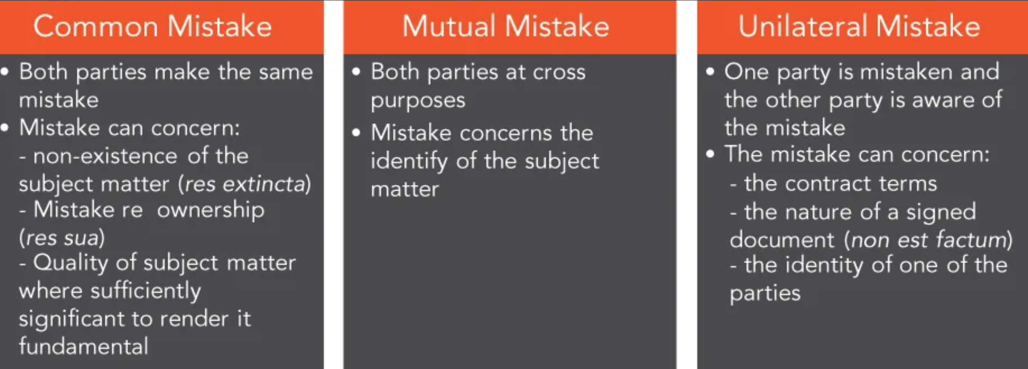
7. Vitiating factors: Mistake

Slide 14
8. Discharge of contract
A contract is discharged when it is at an end and both parties are freed from their obligations. A contract may be discharged in one of four ways.
(1) Performance. In an entire contract, both parties should fulfil their obligations completely (entire performance rule), although there are certain exceptions, including where:
(a) one party has accepted partial performance;
(b) the contract has been substantially performed;
(c) one party prevents the other from performing;
(d) one party has tendered performance, or
(e) the obligations of the contract are severable.
A promise as to the time of a performance may be a vital term, breach of which entitles the other party to treat the contract as repudiated. If this is not the case, it will be viewed as an innominate term, and it will be for the court to assess the impact of the breach on the contract. A promise as to time is, for example, treated as vital if:
(a) the parties indicate that it is a vital term; or
(b) the circumstances indicate that it is a vital term.
(2) Breach of contract. The innocent party may end the contract and/or claim damages if the term breached is a condition, although only damages can be claimed if the term breached is a warranty.

Slide 15
8. Discharge of contract
(3) Agreement. A contract may be ended by agreement if neither party has performed their obligations. If one party has performed but the other has not, the one who has not performed may be released by the other from their promise only for some additional consideration and this is known as accord and satisfaction.
(4) Frustration. A contract ends when unforeseen circumstances, which are the fault of neither party, make performance impossible or illegal, or where the commercial purpose of the contract has been undermined. The principal examples are:
(a) death or illness of one of the parties;
(b) destruction of essential subject matter;
(c) an event fundamental to the contract that radically changes the commercial purpose of the contract does not take place;
(d) government interference; and
(e) illegality.
A contract is not usually ended by frustration if the parties have anticipated and provided for the event, if performance simply turns out to be more expensive than expected or if the frustrating event was the fault of one of the parties.
The effects of frustration are described in LR(FC)A 1943, which, to an extent, replaces the previous common law rules. Payments can be recovered and money originally payable ceases to be so, although in both cases the payee may be able to retain or claim, some or all of their expenses from the money paid or payable. Where a valuable benefit has been conferred before frustration, the court may award a “just sum” in compensation

Slide 16
9. Remedies
The award of a remedy is, in general terms, the way in which the court responds to a breach of contract. The remedies for breach of contract are as follows.
(1) Damages – a monetary award usually intended to put the injured party in the position they would have been in had the contract been performed. Damages can be awarded for pecuniary or non-pecuniary losses. They are only awarded when:
(a) the breach of contract caused the loss;
(b) the loss is not too remote. If the loss suffered is too far removed from the breach, it cannot be recovered, the losses must generally have been within ‘reasonable contemplation of the parties at the time of the contract. Hadley v Baxendale ; and
c) the loss could not reasonably have been avoided, known as mitigation.
(2) Specific performance – a court order telling the party in breach to fulfil their obligations. It is a discretionary remedy and will not be given if, for example, damages would be adequate.
(3) Injunction – a court order telling a party to a contract not to do something. The most common example is a promise not to work for anyone else during or within a specified time after leaving employment. An injunction is another discretionary remedy and will generally not be granted if its effect will be to force someone to perform a contract for personal services.
(4) A range of remedies have also been set out within CRA 2015 in relation to terms implied into contracts for goods, services or digital content. These are available instead of or as well as the more traditional remedies.
(5) The remedies available for business-to-business contracts are contained in the Sale of Goods Act 1979.

Slide 17

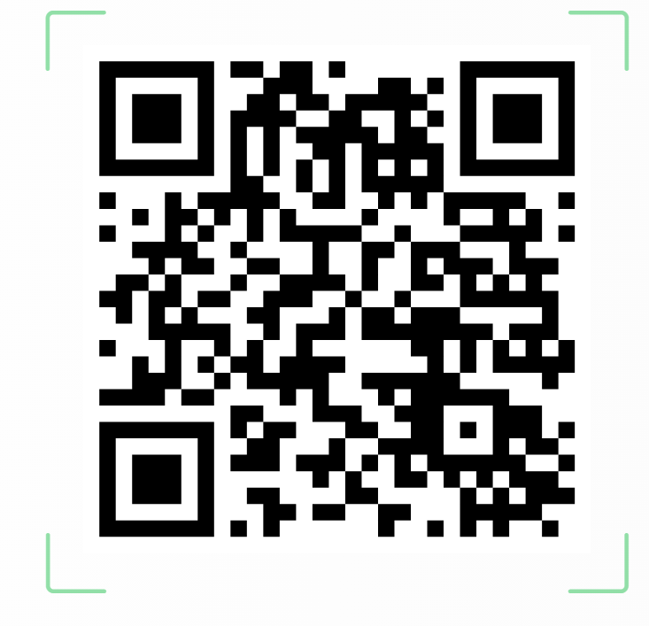
THINGS TO NOTE:
Next week I will release another mock exam with suggested answers for you to do once you have completed some revision.
There will also be a list of key cases to focus on as part of your revision.
Exam date – Please check your Mytsd account
If you could complete the module feedback questionnaire by scanning this QR code please ☺

