Slide 1
Individual Slides for Hackathon
Nathan Pascoe
256620

Slide 2
Project Inception
What it does do
Customer service
Spiral
Notes:
What Will It Do – A library chatbot that can book computers for students, answer queries regarding where resources may be and find books, articles and journals for students based on their info filters.
Chatbots are the emerging trend this project will utilize, why chatbots are an emerging trend in the computing world will be discussed as will the SDLC model we will use – spiral.
Methods of evaluation will also be discussed.

Slide 3
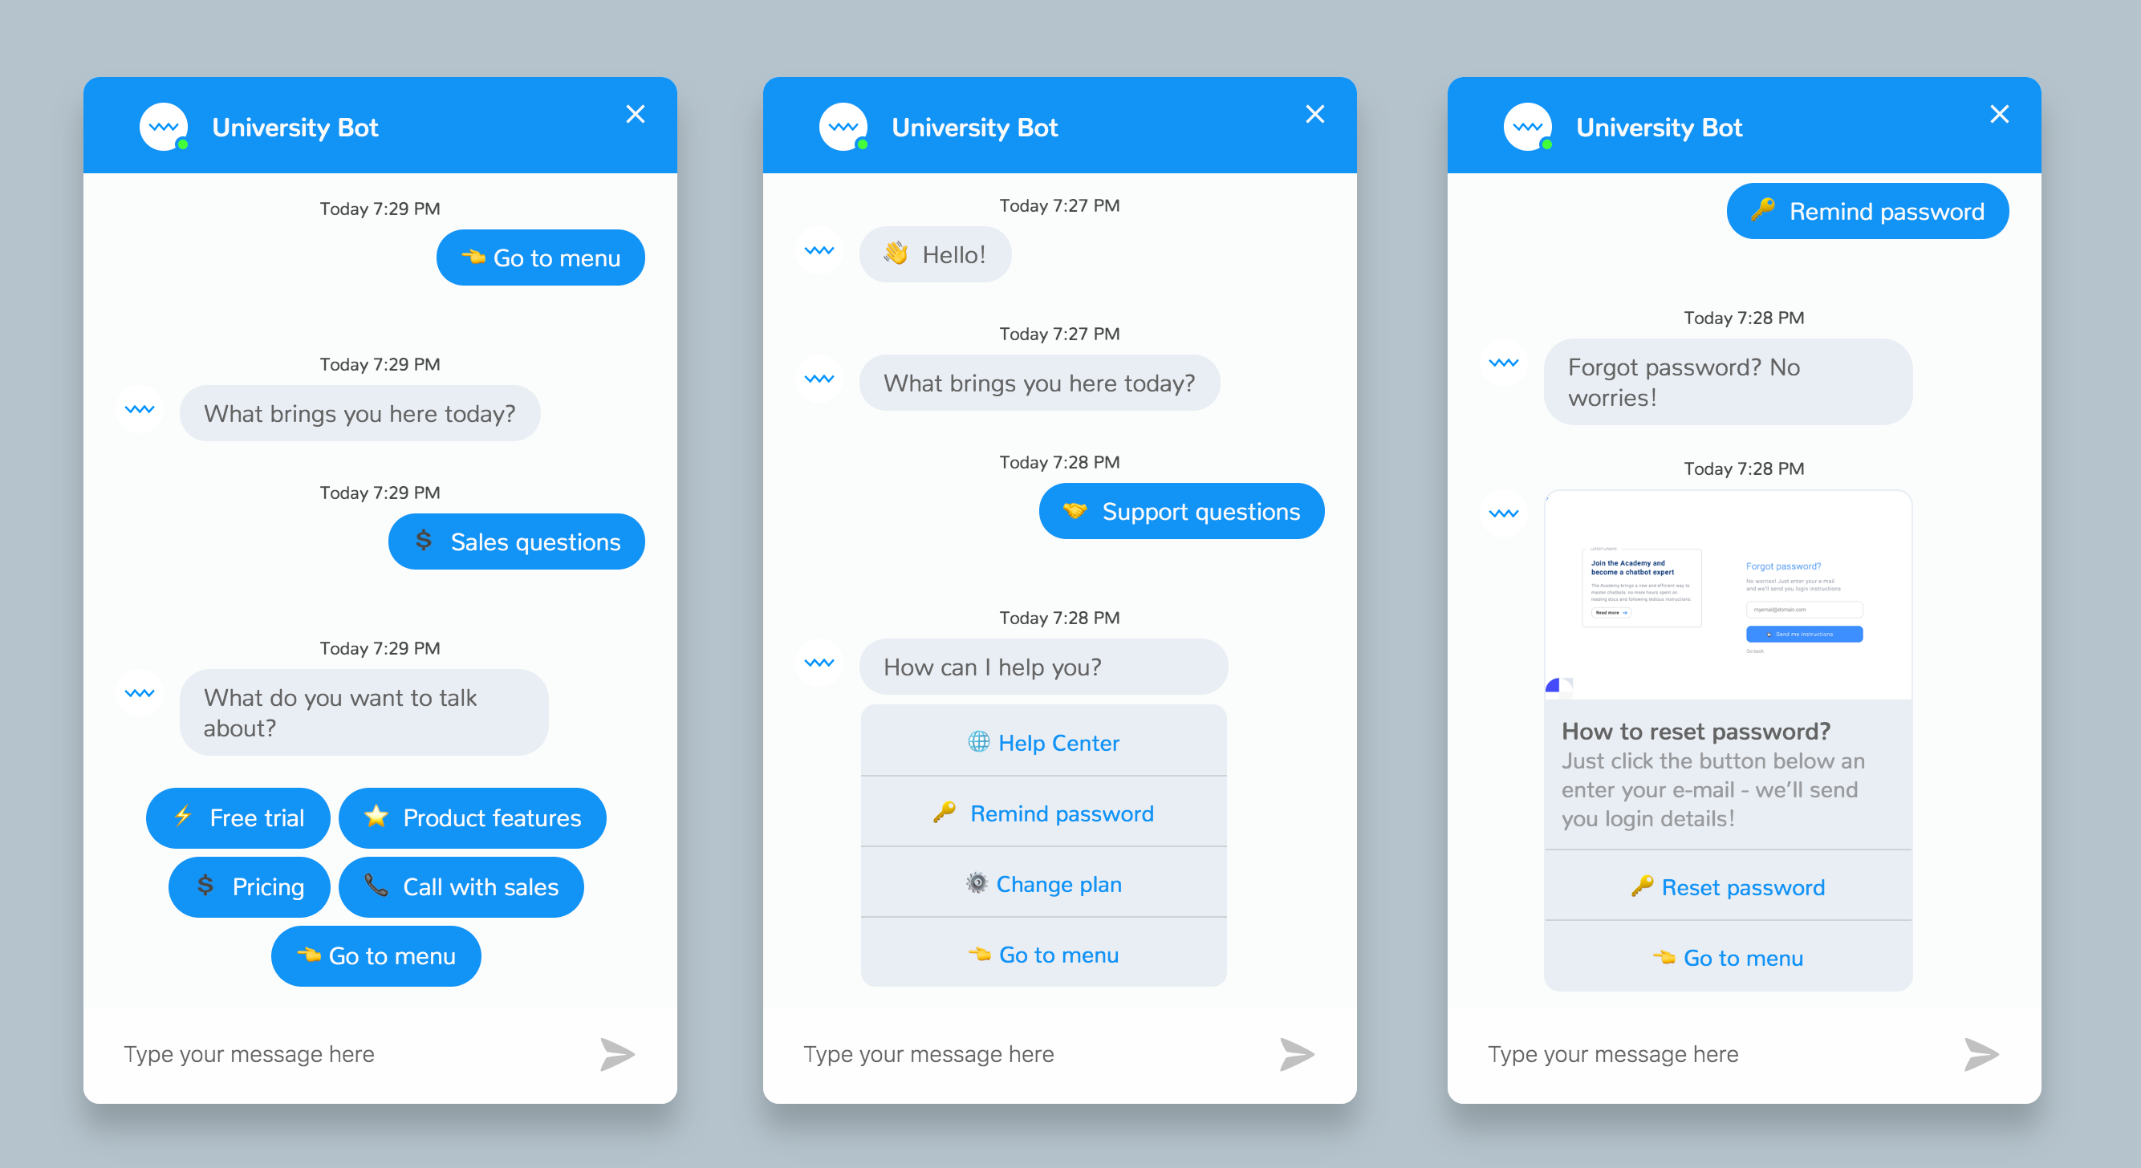
What is a chatbot?
Notes:
simulates human conversation through voice, text or both
Set Guidelines Chatbot – uses existing information and resources to answer questions or help individuals such as FAQs – existing information consists, existing conservation data or inputted data for the bot to use directly – covers support and commercially used chatbots typically - easy to implement
Conversational Chatbot – uses ai and a language matrix (words used in the language) with examples of sentences and machine learning to create conversations or provide the services of the previous – cortana, siri and cleverbot are examples – harder to implement a lot more code needed
[1]

Slide 4
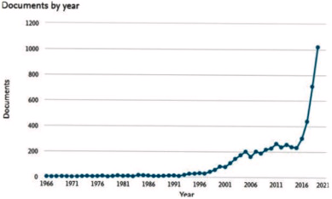
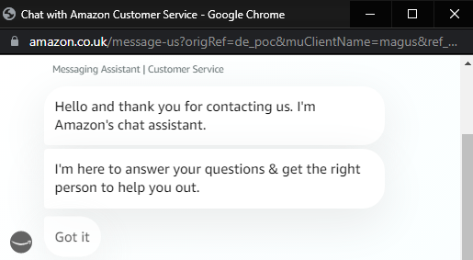
Chatbots – why are they an emerging trend?
Notes:
"From 2016, there is a rapid growth on Chatbot development which results to the creation of various types of Chatbot systems for industrial uses"
67% of consumers worldwide used a chatbot 85% of all customer interactions will be handled without a human agent by 2020.
Chatbots are being considered as a useful technology to facilitate learning within the educational context
Chatbots are transforming the ways businesses connect with current and prospective customers.
Image 1 covers documents that cover chatbots while image 2 covers a typical bot that is used commonly
Chatbots are on the rise and are being used by most companies with any set of foot in the computing world. This is because:
- They save money on hiring real people
- Developments in machine learning have made them more effective in providing their intended services and self-learning, to allow for future improvements.
- Chatbots which use a human voice and can be communicated with via voice are also being used increasingly more, examples include Apple's Siri, Microsoft's Cortana and Amazon's Alexa.
- Their constant use in advertisements for unrelated tech products has made it seem more natural for them to be used by people in casual contexts.
- Chatbots can complete features that would previously have to manually be done by users.
[8][9][10][11][12][13]

Slide 5
Objectives
Aim 1
Look at fields or data from 2017 and onwards – allows for current trends as well as interest
Outline inception of our selection with ideas and initial choices made such as SDLC model
Conduct secondary research into areas relating to the field and about the field
Aim 2
Use the research collected to conduct the creation of the product
When completed carry out feedback collection via questionnaires
Aim3
Using feedback create analysis of the feedback to draw conclusions
Evaluate overall conduction and feedback for future improvements

Slide 6
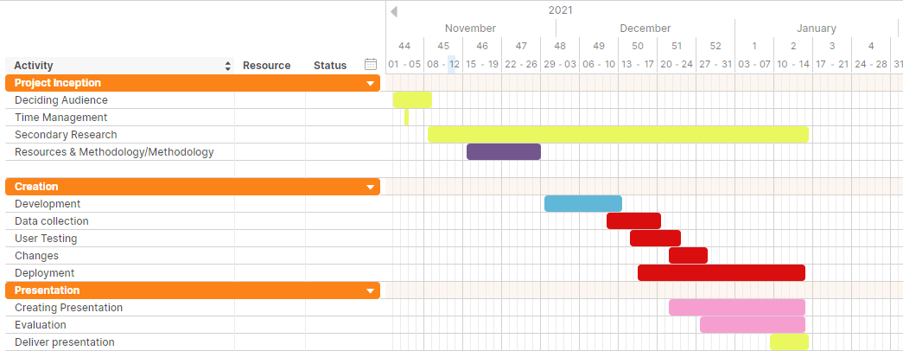
Time Management
Notes:
- Gantt Chart
- Displaying how time allocation was conducted and agreed upon
- Secondary research throughout, as it assisted with all areas
- Deployment occurred for the entire backend, changes made during this time based on user tests

Slide 7
Evaluation methods
PARADISE
Concept of Usability/KGA Prototype
Kuligowska
Notes:
PARADISE - ease of usage, clarity, naturalness, friendliness, robustness regarding misunderstandings, and willingness to use the system again
they link the source material of PARADISE which does not suggest wide usage – it proposes the system - but others do use follows kappa coefficient by Cohen[4]
humanlike conservations
Kappa result be interpreted as follows: values ≤ 0 as indicating no agreement and 0.01–0.20 as none to slight, 0.21–0.40 as fair, 0.41– 0.60 as moderate, 0.61–0.80 as substantial, and 0.81–1.00 as almost perfect agreement.
Concept of Usability – efficiency metric, Effectiveness metric, Users' satisfaction
Based upon a previous chatbot metrics
how conservations are carried out- the one we're using
Originates from ISO 9241 - Ergonomics of Human System Interaction - intended to be used by those managing design processes, and is concerned with ways in which both hardware and software components of interactive systems can enhance human–system interaction. (Satisfaction, usability, user experience, user interface, validation and verification)
Effectiveness, Efficiency, Satisfaction, Learnability and Security – Effectiveness, Efficiency, Satisfaction and learnability can be setup for research in primary research while security is a part of the reflection or secondary research primarily or can be found during creation (Page 17)
Kuligowska method – visual look, implementation method, audio speech ability, knowledge base, ability to give knowledge, conservational abilities, consistency and personality, depth of personality options
Based upon a paper about chatbot evaluation
humanlike conservations and how conservations are carried out
[1][2][5][6][7][8]

Slide 8
User Testing
Testing AI's quality
Gather requirements
Feedback survey
Data collection
Changes
Repeat
Notes:
"Users were given several different tasks to perform using the chatbot. They conversed with the system for an average of 30 minutes and then completed a feedback questionnaire which focused on their feelings, and reactions to the experience"
"…The users were asked to fill in a questionnaire at the end of the test to give their impressions on the performance of the chatbot and volunteer any other thoughts. We also prompted them to provide feedback on the quality and quantity of the information provided by the chatbot, the degree of emotion in the responses, whether an avatar would help, whether the tone was adequate and whether the chatbot was able to carry out a conversation in general. "
Use of surveys/questionnaires would be used and include qualitative and quantitative answers in line with the KGA prototype which uses a mix to measure effectiveness of the ai and user satisfaction. The people who would be asked for this should not be excluded based on characteristics and the aim is to have a varied user test group. This would allow us to potentially gain technical answers from people with similar technological backgrounds and non-technical answers which would give us the expected user of the website's answers.
Then also for users the same test should be given out such as the time it takes to complete with a stop at 30 minutes so that they can have adequate time to use, test and think about the product
Evaluation of results leads to the further development of the emerging trend and the product but time restraints may impact the ability to implement changes which can open up discussion of what users need from the findings in regards to bots or for ourselves when thinking about what to include in the design.
[12]

Slide 9
Stakeholders
Librarians
Students
Teachers
Analytical Team (Business)
Technicians
Researchers using University Library Resources
Notes:
Librarians would be stakeholders as they are the ones that control the books and would have the say in access to them and also for getting ahold of new or other books
Librarians may need to order more books based on popularity
Students and Teachers are a stakeholder as they are the ones directly using the system and have a need for the books
Analytical Team would be a stakeholder as they are part of the college they would most likely like to know the quantity of certain books, genres, artists or other features that can be analyzed to provide an insight into trends or other viable fields.
Can be used by librarians to serve the purpose of popularity viewing

Slide 10
Expected Deliverables
Chatbot Service
Research and Findings both secondary and primary
Progress reporting – meetings, Gantt Chart
Notes:
- The most obvious expected deliverable of this project is the University Library Chatbot service itself, in a working state.
- A decent amount of research will has been done. Secondary research has yielded information regarding the creation of Chatbots, what tools to use, what works and doesn't work and what software would need to be used in our creation.
- Primary research was mostly for obtaining feedback for the chatbot's quality, this was necessary for finding out if the chatbot was functional – troubleshooting – and for if it was easy to use.
- Progress was kept track of by use of a Gantt Chart, which provided an outline for each aspect of this project that needed to be completed, and by when, as well as which part comes after what. Minutes of meeting were kept by me, detailing who was present and absent in each session, and what was being worked on, to ensure progress was always moving.

Slide 11
Methodologies
SDLC Method - Spiral
Coding Languages – Low Code Programming (Visual Building)
Platform – Google Dialogflow
Notes:
Spiral still looked at or compared to in modern day (all 2017 or later sources)
Spiral – allows for continuous creation with issues being fixed in the future
Spiral – Commonly used in the group, experience with it
The evaluation method part outlines a iterative spiral-like form of designed/development which fits in with our desired SDLC
Visual Build – good for web development and builds that repeat processes
Uses keywords to determine response for example a "date" or "time" phrase such as 12pm or tomorrow with the ability for the output to give back the times using the keyword variable
"Give customers 24/7 access to immediate conversational self-service. They can perform tasks such as scheduling appointments, answering common questions, or assisting a customer with simple requests."
[14]

Slide 12
Reference List
Cahn J. CHATBOT: Architecture, Design, & Development [Internet]. scholar.googleusercontent.com. [cited 20 January 2022]. Available from: https://scholar.googleusercontent.com/scholar?q=cache:FYlbiiKd_ooJ:scholar.google.com/+chatbot&hl=en&as_sdt=0,5
Atwell E, Shawar B. Different measurements metrics to evaluate a chatbot system [Internet]. https://aclanthology.org. 2022 [cited 20 January 2022]. Available from: https://aclanthology.org/W07-0313.pdf
Carvalho A. ) MEDIA(TED) DISCOURSE AND SOCIETY, Journalism Studies [Internet]. Repositorium.sdum.uminho.pt. 2008 [cited 11 November 2021]. Available from: https://repositorium.sdum.uminho.pt/bitstream/1822/41143/1/AC_2008_jornalism_studies.pdf
Moller S. Quality of Telephone-Based Spoken Dialogue Systems [Internet]. Google Books. 2005 [cited 20 January 2022]. Available from: https://books.google.co.uk/books?id=ZVMHOvS8LlcC&pg=PA312&lpg=PA312&dq=PARADISE+framework+widely+used&source=bl&ots=RCcGSzHf0y&sig=ACfU3U0uFZfXPfCCxNQOwfiRehX6fIc0Dg&hl=en&sa=X&ved=2ahUKEwjx5qXRr5D0AhUE_6QKHeLzBX8Q6AF6BAgVEAM#v=onepage&q=PARADISE%20framework%20widely%20used&f=false
Radziwill N, Benton M. Evaluating Quality of Chatbots and Intelligent Conversational Agents [Internet]. Arxiv.org. [cited 20 January 2022]. Available from: https://arxiv.org/ftp/arxiv/papers/1704/1704.04579.pdf
Suryn W. Consolidating the ISO Usability Models [Internet]. researchgate.net. 2004 [cited 20 January 2022]. Available from: https://www.researchgate.net/profile/Witold-Suryn/publication/2850057_Consolidating_the_ISO_Usability_Models/links/57d1b2de08ae0c0081e0534b/Consolidating-the-ISO-Usability-Models.pdf
Walker M. PARADISE: A Framework for Evaluating Spoken Dialogue Agents [Internet]. https://dl.acm.org. [cited 20 January 2022]. Available from: https://dl.acm.org/doi/pdf/10.3115/976909.979652
Kuligowska K. Commercial Chatbot: Performance Evaluation, Usability Metrics and Quality Standards of Embodied Conversational Agents [Internet]. papers.ssrn. 2015 [cited 20 January 2022]. Available from: https://papers.ssrn.com/sol3/papers.cfm?abstract_id=2569637

Slide 13
Reference List 2
9. Abu Shawar B. Chatbots: Are they Really Useful [Internet]. D1wqtxts1xzle7.cloudfront.net. 2007 [cited 25 November 2021]. Available from: https://www.researchgate.net/publication/220046725_Chatbots_Are_they_Really_Useful
10. Brandtzaeg P, Følstad A. Why people use chatbots [Internet]. Sintef.brage.unit.no. 2017 [cited 25 November 2021]. Available from: https://sintef.brage.unit.no/sintef-xmlui/bitstream/handle/11250/2468333/Brandtzaeg_Folstad_why+people+use+chatbots_authors+version.pdf?sequence=2
11. Heung-Yeung S, Xiaodong He D. From Eliza to XiaoIce: Challenges and Opportunities with Social Chatbots [Internet]. Arxiv.org. 2021 [cited 25 November 2021]. Available from: https://arxiv.org/ftp/arxiv/papers/1801/1801.01957.pdf
12. Brandtzæg P, Følstad A. Chatbots: changing user needs and motivations [Internet]. Sintef.brage.unit.no. 2021 [cited 25 November 2021]. Available from: https://sintef.brage.unit.no/sintef-xmlui/bitstream/handle/11250/2560163/interactions_changing%2Buser%2Bneeds__preprint.pdf?sequence=4
13. Okonkwo C, Ade-Ibijola A. Chatbots applications in education: A systematic review [Internet]. Computers and Education: Artificial Intelligence. 2021 [cited 25 November 2021]. Available from: https://www.sciencedirect.com/science/article/pii/S2666920X21000278?via%3Dihub
14. Agarwal P, Singhal A, Garg A. SDLC Model Selection Tool and Risk Incorporation. International Journal of Computer Applications. 2017;172(10):6-10.

