Slide 1
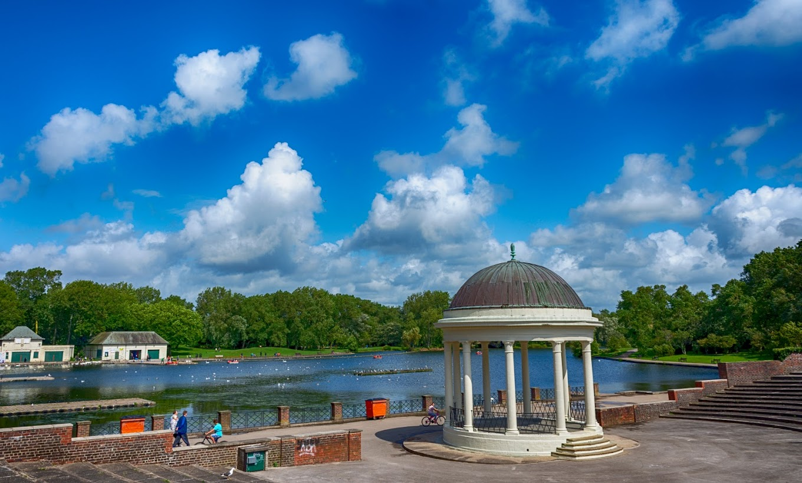
Blackpool Christmas Extravaganza
Roles
Heather & Jules = Presenters and Stage Managers
Eben & Nat = Designers and Construction team
Abbie = Communication Manager and Overseer of stalls
We felt that due to our personal experiences and skill sets we all fit into the roles we assigned each other.
Opportunities
Having different experiences from our respective fields of work and how we can collaborate our ideas from our different point of views to make the best experience for the people attending. We also have some connection with people that are useful for our event.
Weaknesses
We did well in terms of forming our team and we all felt we could openly talk about our ideas without judgment from the others, however, we do struggle to stay focused and collaborate our ideas efficiently.
Strengths
We did well in forming our team and we were quickly able to discuss our ideas openly without judgment from the others. As a result of our teamwork once we got the ideas rolling, we were very quick in formulating ideas with and creating a practical plan on what we needed to do for our event. We used a mind map to communicate our ideas onto paper in a format everyone understood where we collaborated our ideas and discussed possible routes we could have taken with our event.
Threats
One of our threats is our lack and struggle with communication, both digitally and physically. Due to our different courses we struggled to find time to meet each other to do the task. Also, people talking over each other trying to get the others attention and external reasons like jobs and illness made it difficult to keep everyone up to date.
Eben’s Review
The task pushed me out of my comfort zone, providing an opportunity to grow in confidence, team working, and trying to get our focus on the task at hand, though I could have done that a lot better.
Unfortunately due to Abbie missing out on the planning lesson, she couldn’t contribute much to the poster, and wasn’t engaged in the task.
Jules often got distracted and would start talking about irrelevant stuff, which was hard for the rest of us to realign ourselves back to the task as he was the loudest person in the group. Though he was helpful when focused.

