Slide 1

Term 2
Optional modules
MSc. Public Health and Social Care in Practice (PHSCiP)
The optional modules will allow you to explore areas such as:
Quality Assurance and Service Improvement
Population Health and Digital Health Promotion
Service Integration and Partnership Working

Slide 2
Programme Overview
Term | Modules
Term 1 (June 2025)​ | Social Epidemiology and Public Health Development​ LCHS7000
 | Health Care System Organisation and Leadership​ LCHS7002
 | Community Care and Management of Long term conditions​ LCHS7003
Term 2 (Oct 2025)​ | Service Integration and Partnership Working​ LCHS7005
 | Quality Assurance and Service Improvements LCHS7006​
 | Population Health and Digital Health Promotion​ LCHS7007
 | Practice-based Research​ LCHS7008
Term 3 (Feb 2026)​ | Public Health and Social Care in Practice Dissertation​ LCHS7004
Notes:
2

Slide 3

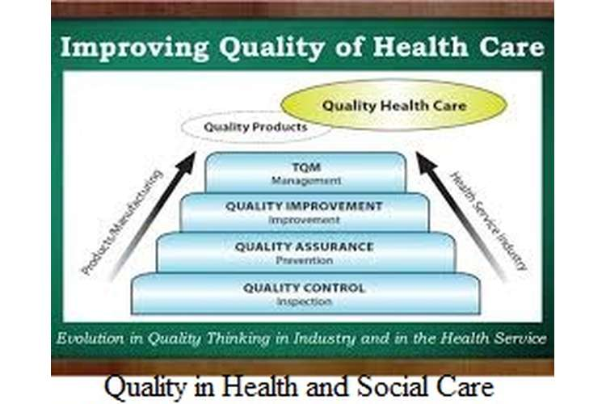

Quality Assurance and Service Improvements

Slide 4
Aims
To explore quality assurance theory and factors that influence the delivery of quality service user care and affect implementation of quality control measures.
To develop the necessary service improvement knowledge and skills while being able to apply a critical perspective related to policy and change within their area of service delivery.

Slide 5

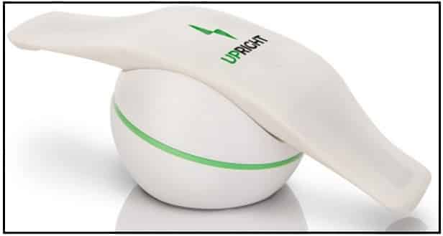
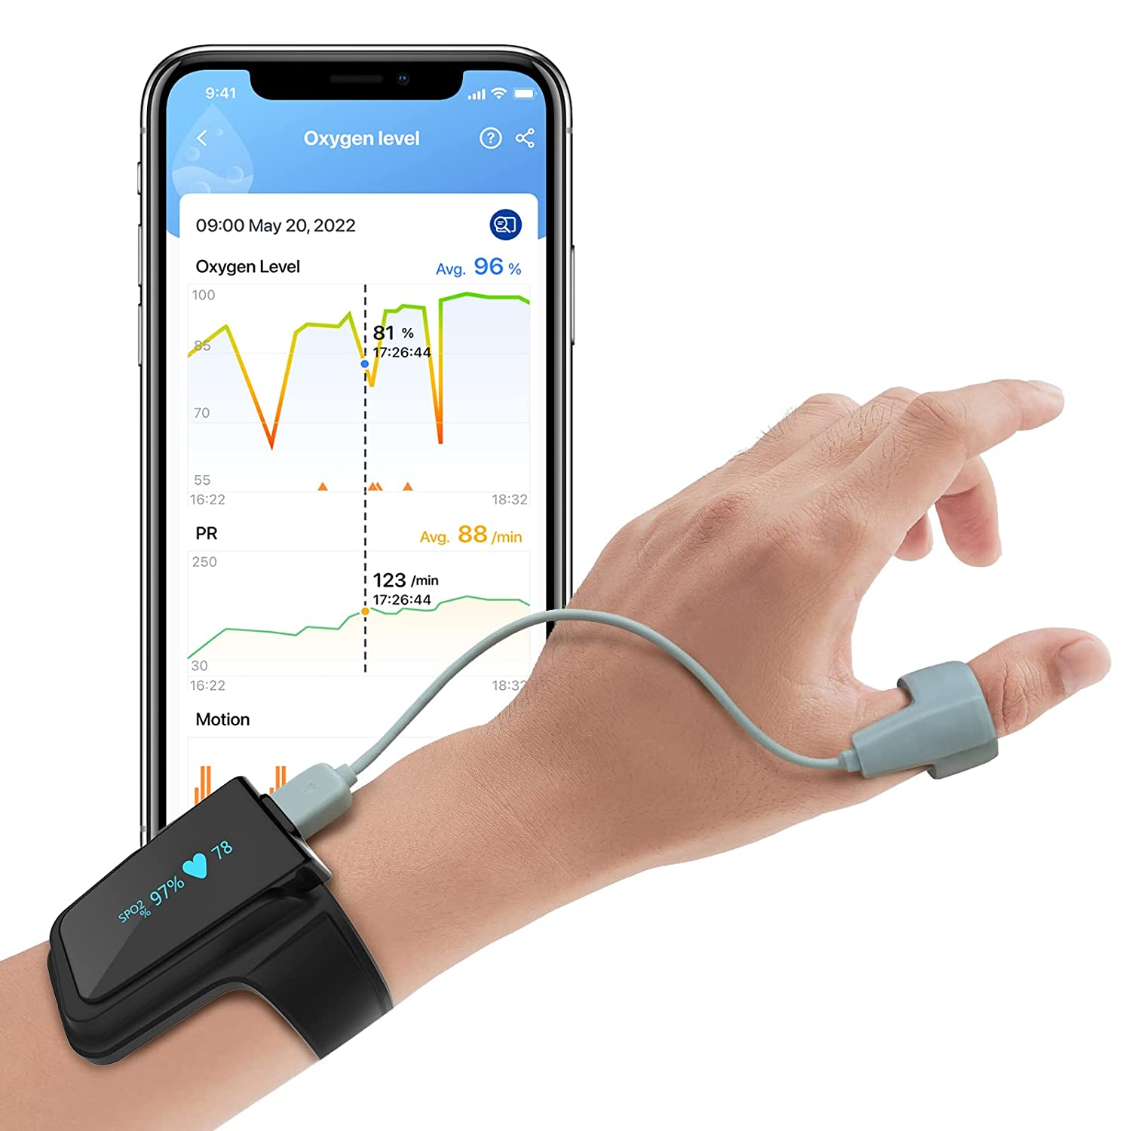
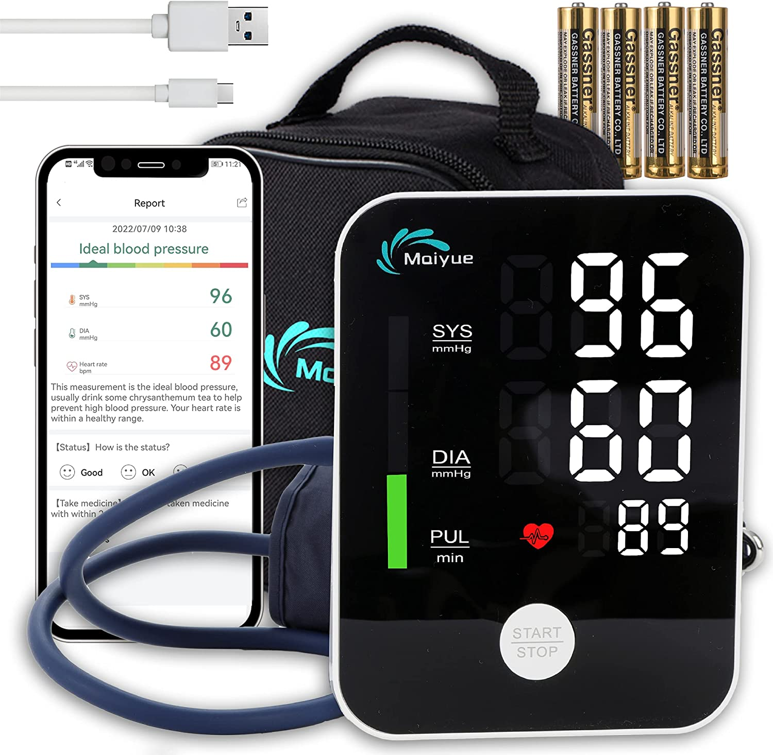


Population Health and Digital Health Promotion

Slide 6
Aims
To gain a critical understanding of advanced topics in health promotion and knowledge to align digital health promotion to health promotion principles and values
To gain a critical understanding and knowledge of core concepts of relevant digital health technologies required for supporting healthcare and social care services and products for health promotion

Slide 7

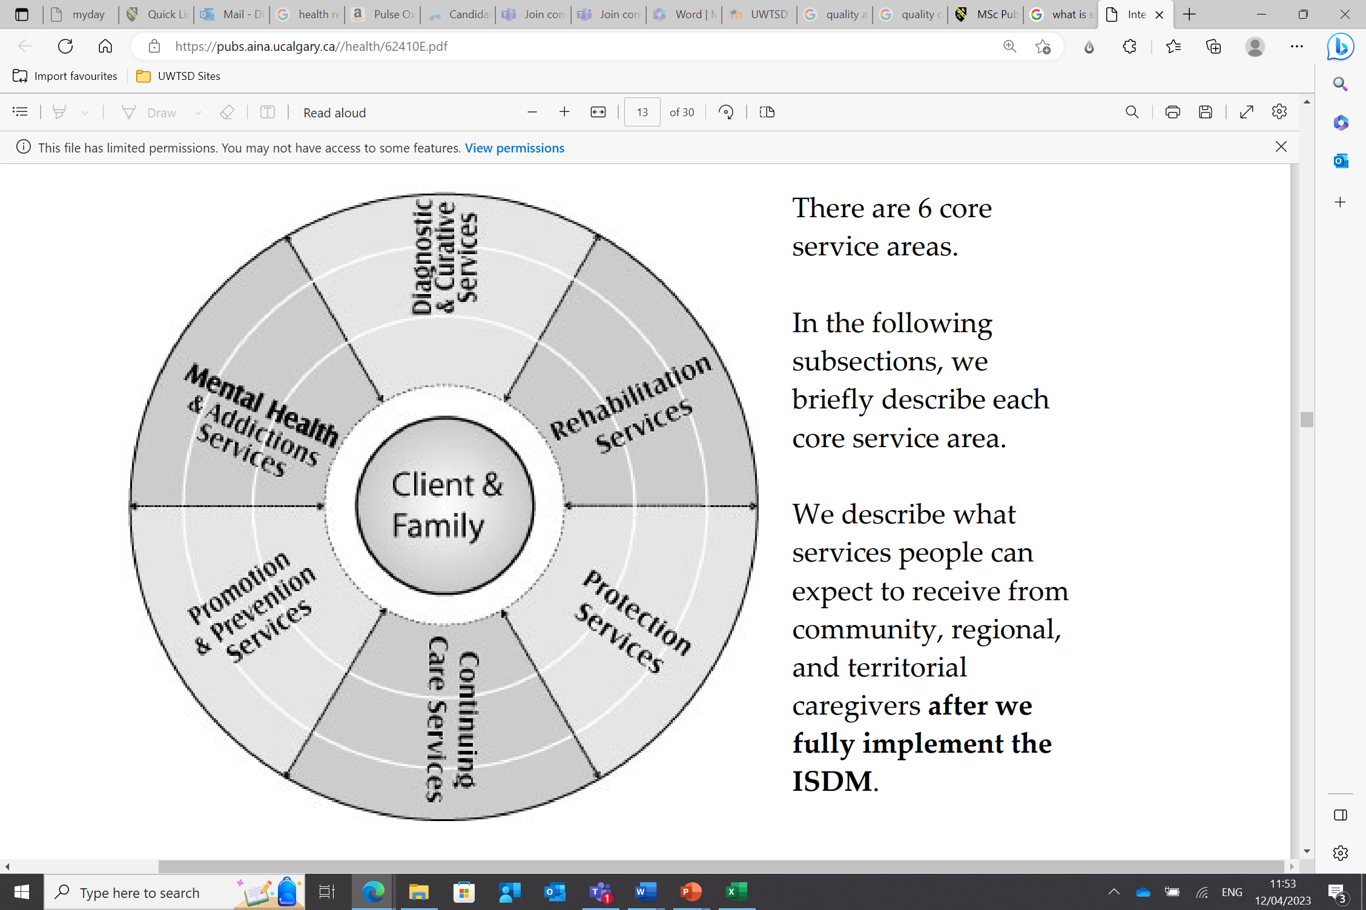
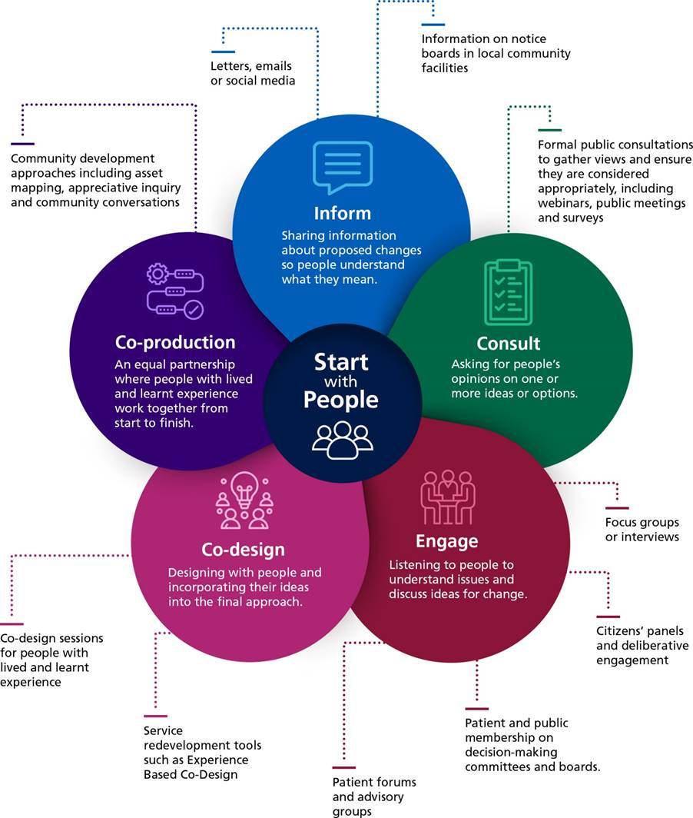
Service Integration and Partnership Working

Slide 8
Aims
To understand the philosophy of multidisciplinary partnership working in health and social care and its contribution to outcomes.
To develop contemporary management and leadership skills to enhance future integrative Public Health and Social Care working.

Slide 9
Selecting your 2 module
Respond to the email you will receive from London Assessment team (Bart Plange) before the deadline.
Wanting to change your first choice? Is possible before the deadline.
Connect your choice to your
  Dissertation topic
  Career

Slide 10
Dissertation ? → Career

Slide 11

Progression
Community Connector - to undertake work specifically in supporting individuals to engage in activity that improves their respiratory health and wellbeing.
Salary £25,000 - £26,906 per year. Salary dependent on skills, experience and knowledge
Public Health Support Officer - supporting the delivery of elements of the locally agreed strategy, such as preventing smoking uptake, treating tobacco dependency, regulating tobacco products and extending smoke-free environments.
Salary £32,955 - £39,933
Health Protection Practitioner - working to improve the uptake of programmes across the screening and immunisation agenda, addressing health inequalities, supporting high-risk groups, promoting the equity and access of services, delivering robust health protection campaign
Salary £29,160 to £42,618 a year
Notes:
Croydon University Hospital NHS Trust
Imperial College Healthcare NHS Trust and Chelsea Football Club Foundation

Slide 12
Progression
Health Advisor - Provide information and health education to clients, providing support and onward referral as required. Support patients. Independently manage own caseload.
Salary £40,701 to £48,054 a year – Full time
https://healthjobs.bmj.com/
Population Health Manager- responsible for embedding initiatives into communities, developing a clear evidence base which facilitates the commissioning of services by the NHS. To design and deliver work which addresses health inequalities and improves the health and wellbeing of patients, local residents and staff. Understanding of the role other sectors, e.g., sport, can play in supporting health and care.
Salary £42,471 - £50,364 a year - Full-time
https://uk.indeed.com
Notes:
Croydon University Hospital NHS Trust
Imperial College Healthcare NHS Trust and Chelsea Football Club Foundation

Slide 13

Are you able to make a choice?
Well done!
Any questions?

