Slide 1
DNS
Dr Tim Bashford

Slide 2
Introduction
Domain Name System (DNS) is a method of naming computers, and translating between these names and IP addresses.
People are generally bad at remembering numbers (e.g. IP addresses).
Domain names are far easier to remember. Google.com or 216.58.214.14.
DNS is hierarchical and decentralised.
  We contact a “chain” of servers to resolve each query.
Domains can be managed – might have shared logins, or remote computer management.
  This can be achieved using a Microsoft technology, “Active Directory”.

Slide 3



How Name Resolution Works
Name Resolution
Service
Computer44
1
Where is the Computer44 file?
192.168.1.200
2
3
Computer44

Slide 4
NetBIOS and DNS
DNS is also used to resolve names but on an Internet wide basis
Machine must check DNS name resolution before NetBIOS name resolution

Slide 5

2b
2a
DNS Response update cache
If no entry in cache send DNS Request
DNS Server
Client Resolver Cache/Hosts File
DNS
NetBIOS
Name Cache
WINS
Broadcast
Lmhost File
2c
Client
If no DNS Response, get address from NetBIOS
1
Salescomputer2
What is the
IP address for Salescomputer2?
2
192.168.1.35
3
Salescomputer2
Host name resolution is the process of resolving a host name to an IP address

Slide 6
DNS
Resolves text names (www.microsoft.com) into IP addresses
Hierarchical → name queries are passed up a “tree” of DNS servers until resolved
Name to IP address mapping stored in a database that is distributed amongst many DNS servers…because it is distributed
  Its size is unlimited → solving problem of very large host files
  Performance doesn’t degrade as number of servers increases
  Localizes update traffic
Portions of the Domain name space and domain name registration are the responsibility of InterNIC (Internet Network Information Centre)

Slide 7
Domain Namespace
Logical Tree called the domain namespace
Domain is a tree or subtree within the overall domain namespace
  Note: Active Directory Domains are completely different
Root domain = root node, unnamed(null) sometimes represented as a trailing period e.g. www.microsoft.com.
Top-level domain = indicates type of organization or geographical region
  .com = company
  .edu = educational
Second-level domain = Assigned and registered by InterNIC e.g. microsoft

Slide 8
Subdomain = additional domain registered with InterNIC
  Large companies can request multiple domains to represent different departments
  .sales.microsoft.com
Fully Qualified Domain Name (FQDN) = name which states with absolute certainty the location in the domain name space → maps to an IP address

Slide 9

Domain Namespace
Root Domain
net
com
org
Top-Level Domain
nwtraders
Second-Level Domain
west
south
east
Subdomains
sales
FQDN:
server1.sales.south.nwtraders.com
Host: server1

Slide 10

Domain Names
A host name is the DNS name of a device on a network
A fully qualified domain name (FQDN) is a domain name that uniquely identifies a machine in the domain namespace tree
Examples:
“.” Root
FQDN
msft
server1.nwtraders.msft.
nwtraders
Host Name
DNS Suffix
training
FQDN
server1.training.nwtraders.msft.
Server1 = 192.168.0.66
Host Name
DNS Suffix
Server1 = 192.168.0.67

Slide 11
Domain Names
Hierarchical structure
Machines can have the same names …. but within different domains
  server1.nwtraders.msft
  server1.training.nwtraders.msft

Slide 12
DNS Naming
The following characters are valid for DNS names:
A-Z
a-z
0-9
Hyphen (-)
The underscore (_) is a reserved character

Slide 13









Components of DNS
DNS database entries
DNS Clients
DNS Servers
Hosts domain
Resolves name Resolution
requests from clients
DNS Servers on the Internet
Root “.”
Resource
Record
.com
.edu
Resource
Record

Slide 14
DNS Query
A query is a request for name resolution to a DNS server. There are two types of queries: recursive and iterative
DNS clients and DNS servers both initiate queries for name resolution
An authoritative DNS server for the namespace (i.e. responsible for the domain) of the query will either:
  Check the cache, check the zone, and return the requested IP address
  Return an authoritative, “No”
A non-authoritative DNS server for the namespace (i.e. some other DNS server is responsible for the domain that the host is on) of the query will either:
  Forward the unresolvable query to a specific query server called a Forwarder
  Use root hints to locate an answer for the query

Slide 15




Root Hints
Root hints are DNS resource records stored on a DNS server that list the IP addresses for the DNS root servers that InterNIC maintains on the Internet
Cluster of
DNS Servers
Cluster of
Root (.) Servers
Root Hints
com
DNS Server
microsoft
Computer1
%SystemRoot%\System32\Dns\Cache.dns

Slide 16



Iterative Query
An iterative query is a query made to a DNS server in which the DNS client requests the best answer that the DNS server can provide without seeking further help from other DNS servers. The result of an iterative query is often a referral to another DNS server lower in the DNS tree.
Typically, an iterative query is made by a DNS server to another DNS server when a DNS client makes a recursive query.
Iterative Query
Local
DNS Server
Ask .com
1
Root Hint (.)
Iterative Query
Ask nwtraders.com
.com
Recursive query for
mail1.nwtraders.com
2
172.16.64.11
Iterative Query
Authoritative Response
Referrals
3
Computer1
nwtraders.com

Slide 17
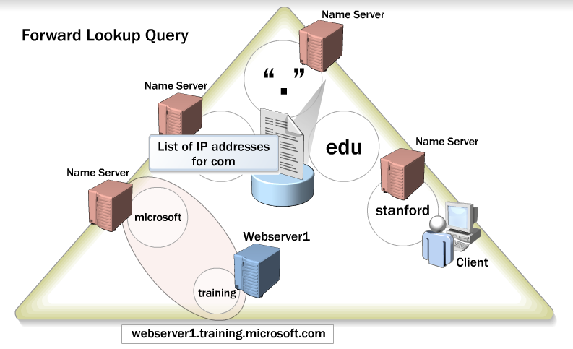
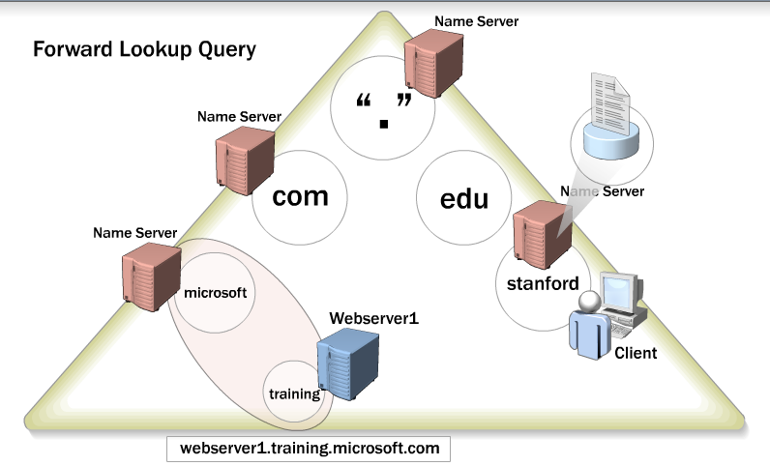
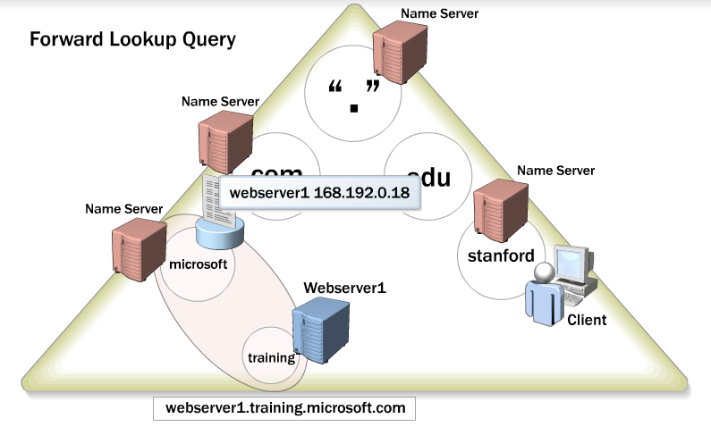
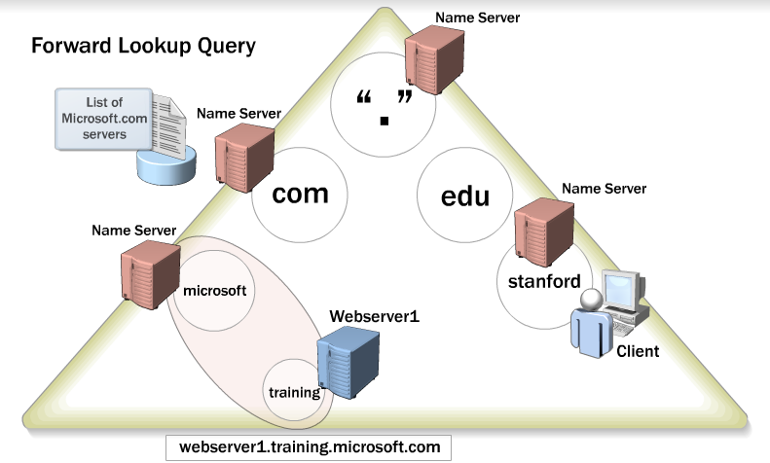
Forward Lookup Query
Recursion is a DNS function in which one DNS server issues several iterative DNS queries to other DNS servers while responding to a recursive query that a DNS client issues

Slide 18



Recursive Query
A recursive query is a query made to a DNS server, in which the DNS client asks the DNS server to provide a complete answer to the query
Cannot be redirected to another DNS server
Can only return IP address or domain not found
DNS server checks the forward lookup zone and cache for an answer to the query
Recursive query for
mail1.nwtraders.com
172.16.64.11
Database
Computer1
Local DNS Server

Slide 19
Recursive Query (Cont)
DNS Server
  Searches cache for matching record containing required IP address
  If not in cache, locates the authoritative DNS server for zone (which maybe itself)
  If found, the authoritative server searches DNS Zone database for record
  If not found, local DNS server uses Root Hints to get IP address of DNS root server
    Recursion: local DNS server works its way down DNS servers in the FQDN to find matching name
  If record not found, return record was not found

Slide 20
Authorative DNS Servers
The DNS servers reported back to the client by the parent domain
  .com domain provides a list of DNS servers for the Microsoft domain (i.e. microsoft.com.)
Can have more than one authorative DNS server for a domain
  The client/server picks one from the list
Recorded in the parent domain DNS Servers database as NS records

Slide 21


DNS Caching
Caching Table
Host Name | IP Address | TTL
clientA.contoso.msft. | 192.168.8.44 | 28 seconds
Where’s Client A?
ClientA is at 192.168.8.44
ClientA
Client1
ClientA is at 192.168.8.44
Where’s Client A?
Client2
Caching is the process of temporarily storing recently accessed information in a special memory subsystem for quicker access
Server caches answers to all queries (including top-level, second-level, etc) for a given time (TTL)

Slide 22
Caching (Cont)
Cache → store map of name to IP address
Negative cache → remember failed requests, prevent unnecessary requests being sent
Caching-only server
  Not authoritative for domain
  Make requests, cache responses and return results
  Do not have primary or secondary zone databases
  Initial Windows 2012 configuration
DNS client-side resolver caching
  Clients store results of DNS responses
  Only make requests to DNS server if match not found in client cache

Slide 23

Forwarders
Iterative Query
Forwarder
Root Hint (.)
Ask .com
Iterative Query
Ask nwtraders.com
.com
Recursive Query
172.16.64.11
Iterative Query
172.16.64.11
Authoritative Response
Recursive query for
mail1.nwtraders.com
WAN
nwtraders.com
Local
DNS Server
Computer1

Slide 24
Conditional Forwarding
Can set a DNS domain when configuring forwarding
“If you ever need to need to resolve a name for abcdef domain, then don’t go to the Internet – ask this server (forwarder)”
This is split-brain tool → you can define your own domain for your local network using this process → may even override an existing domain e.g. microsoft.com, for your local network

Slide 25





DNS Data
Namespace: training.nwtraders.msft
DNS Server
Resource records for the zone training.nwtraders.msft
Host name | IP address
DNS ClientA | 192.168.2.45
DNS ClientB | 192.168.2.46
DNS ClientC | 192.168.2.47
Zone File:
Training.nwtraders.msft.dns
DNS ClientC
DNS ClientA
DNS ClientB
A resource record (RR) is a standard DNS database structure containing information used to process DNS queries → name to IP address mappings
A zone is a range of IP addresses that this DNS server will be concerned about

Slide 26
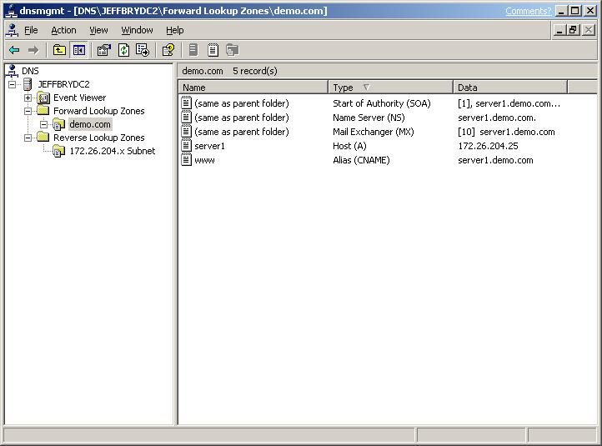
Resource Records & Record Types
A = host record
Record type | Description
A | Resolves a host name to an IP address
PTR | Resolves an IP address to a host name
SOA | The first record in any zone file
SRV | Resolves names of servers providing services
NS | Identifies the DNS server for each zone
MX | The mail server
CNAME | Resolves from a host name to a host name
Forward Lookup
Reverse Lookup
Start Of Authority (SOA)
An authorative DNS server for zone
Letters used in the ASCII zone file to identify record type

Slide 27
SOA Record
Start Of Authority (SOA)
First record in zone file
Identifies primary DNS server for zone
Specifies info for replication
  Serial number – use it to identify version if you change this record
  Refresh interval
  Retry interval
  Expiry values for zone

Slide 28
Zones
Zone file is the file on the DNS servers hard drive that contains all the information for a zone and the resource records contained therein
  Actually an ASCII file if not using Active Directory
Each zone has its own zone file (when not using Active Directory)
Before you can add resource records you must add them to a logical container called a zone

Slide 29
Zones
A DNS Server is authoritative for a zone if it hosts the resource records for the names and addresses that the clients request in the zone file.
Nwtraders
Domains
One zone multiple domains
DNS Server can also manage multiple zones
South
West
North
Each Active Directory domain needs its own zone (use the same name for DNS domain)
Sales
Support
Training
Zones

Slide 30


Zones | Description
Primary DNS | Read/write copy of a DNS database Authoritative copy or Zone database Records created and managed here
Secondary DNS | Read-only copy of a DNS database Backup server → fault tolerance Can’t edit records
Stub | Copy of a zone containing limited records Just identifies primary authoritative DNS server
Read/Write
Read-Only
Copy of
limited
records
Caching only server does not have zones

Slide 31
Zone Types
Zones come in two types
  Forward Look Up Zone
  Reverse Look Up Zone

Slide 32



Forward & Reverse Lookup
Forward lookup name
Namespace: training.nwtraders.msft.
Forward zone | Training | DNS Client1 | 192.168.2.45
 |  | DNS Client2 | 192.168.2.46
 |  | DNS Client3 | 192.168.2.47
Reverse zone | 1.168.192.in-addr.arpa | 192.168.2.45 | DNS Client1
 |  | 192.168.2.46 | DNS Client2
 |  | 192.168.2.47 | DNS Client3
DNS Server Authorized
for training
DNS Client2 = ?
Reverse lookup “name”
-- includes in-addr.arpa
192.168.2.46 = ?
DNS Client3
DNS Client1
DNS Client2

Slide 33
How DNS Zone Transfers Work
A DNS zone transfer is the synchronization of primary DNS zone data between secondary DNS servers
1
SOA query for a zone
2
SOA query answered
3
IXFR or AXFR query for a zone
4
IXFR or AXFR query answered
(zone transfer)
Secondary Server
Primary and
Master Server
Sends query to get its Start Of Authority (SOA) resource record

Slide 34
A primary DNS server stores the master copy of the zone data
  Controls changes to the zone data
A master server transfers zone changes to other DNS servers
  May also be the primary DNS server
Secondary server maintains a copy of the DNS zone data
AXFR → Entire zone transfer
IXFR → Incremental zone transfer
  keep track of changes since last update
  transfer just the incremental resource record changes

Slide 35
What Is an Active Directory-Integrated DNS Zone?
DNS zone type | Benefit
Non Active Directory-integrated zone | Does not require Active Directory
Active Directory-integrated zone | Stores DNS zone data in Active Directory and is thus more secure Uses Active Directory replication instead of zone transfers Allows only secure dynamic updates Uses multi-master instead of single master structure
An Active Directory-integrated DNS zone is a DNS zone stored in Active Directory

Slide 36
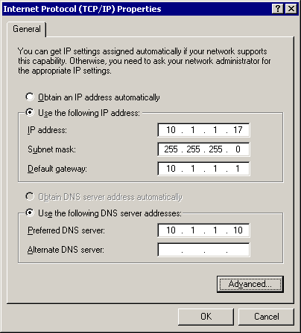
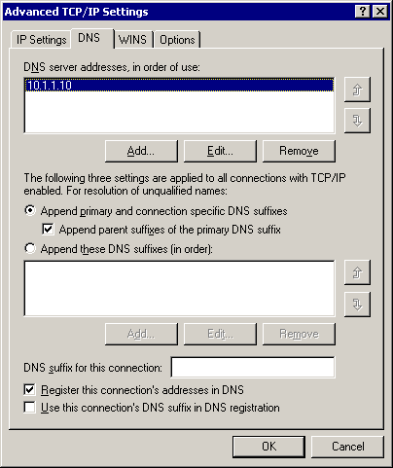
How Preferred and Alternate DNS Servers Work
(Client Settings)
3. Optionally, you can enter a whole list of alternate DNS servers
1. The preferred DNS server is the one that the client tries first
4. The preferred and alternate DNS servers specified on the Properties page automatically appear at the top of this list, and preferred and alternate servers are queried in the order they are listed
2. If the preferred server fails, the client tries the alternate DNS server

Slide 37


What Is Delegation of a DNS Zone?
The administrator, at the nwtraders.com level of the namespace, delegates authority for training.nwtraders.com and offloads administration of DNS for that part of the namespace
DNS server
training.nwtraders.msft
Training.nwtraders.com now has its own administrator and DNS server to resolve queries in that part of the namespace/organization
DNS server
training.nwtraders.msft
Delegation is the process of assigning authority over child domains in your DNS namespace to another entity by adding records in the DNS database

Slide 38
Active Directory
Active Directory allows us to manage users, computers, security principles and a range of other domain-related processes.
  We use it when we log in to computers. Why?
Again, a technology which makes life easier for the network administrator.
  Manage everything from a central point.
  Helps us keep things tidy – AD stores groups of things called “Organisational Units”.
Managed at a domain or subdomain level – when you set up AD, you specify a fully qualified domain name as the management level.

