Slide 1
Body Composition
Based on CH15 Kenney, Wilmore and Costill (2015) and ACSM Guidelines for Exercise testing and prescription (2018)

Slide 2
Body Composition and Health
Excess body fat, particularly when located centrally, is associated with:
  Hypertension
  Metabolic syndrome
  Type 2 diabetes
  Stroke
  Carciovascular disease
  Dislipidemia

Slide 3
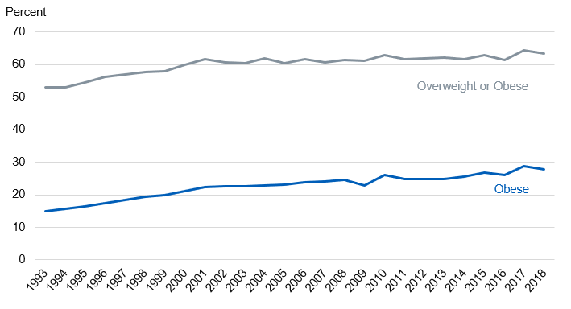
England adult statistics

Slide 4
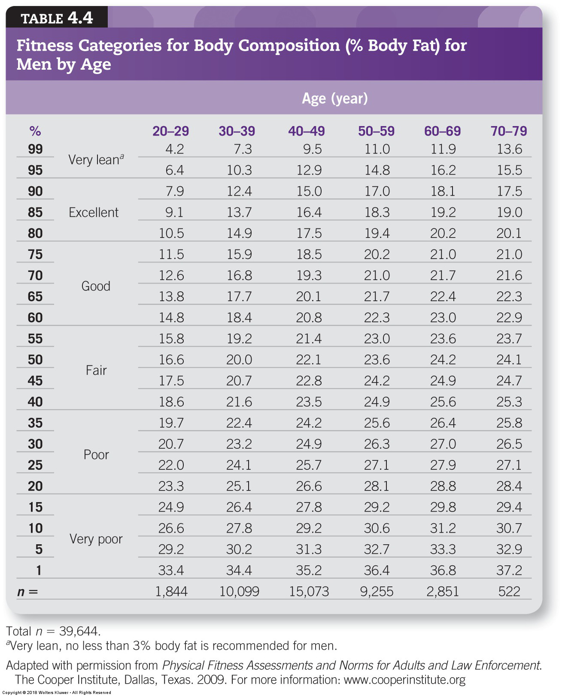

Slide 5
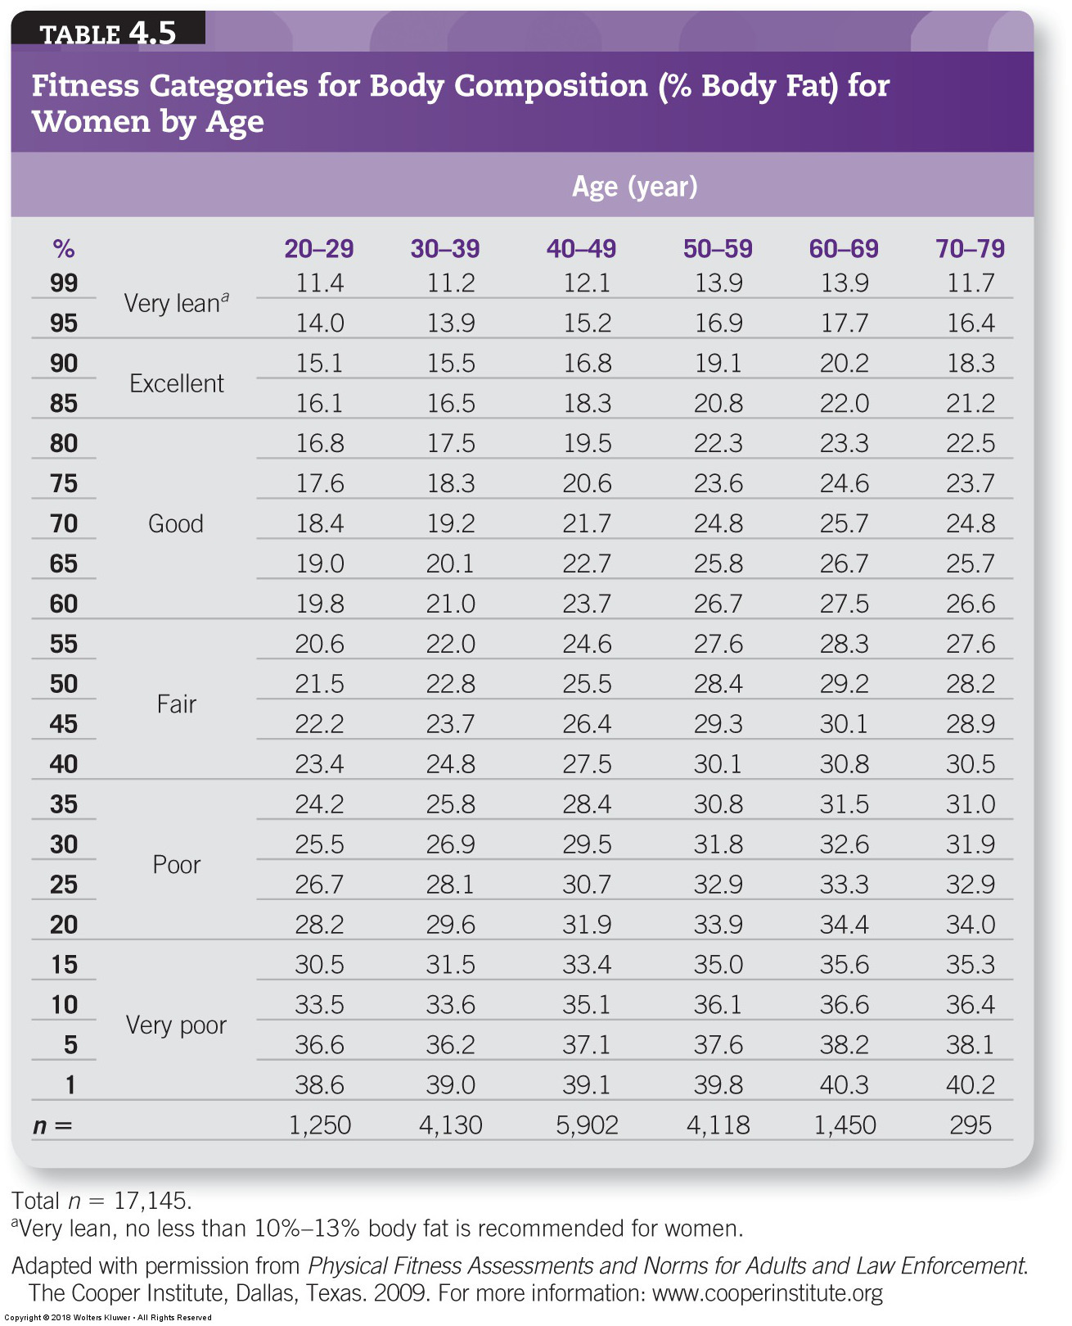

Slide 6
Ageing
Sarcopenia (loss of muscle mass as we age) can also be monitored through body composition assessment
A combination of loss of muscle and increase in fat mass can accelerate age-related decline.

Slide 7
Body Composition in Sport:
Sport Performance
Fat-free mass (includes muscle)
  Important variable for athletes to know
  – ↑ Good for power, strength, muscle endurance
  But bad for aerobic endurance (more mass to carry)
Relative body fat (percent body fat)
  Fat: dead weight but useful energy store
  Less fat usually = better performance
  Exceptions: sumo wrestler, swimmer, weight lifter

Slide 8
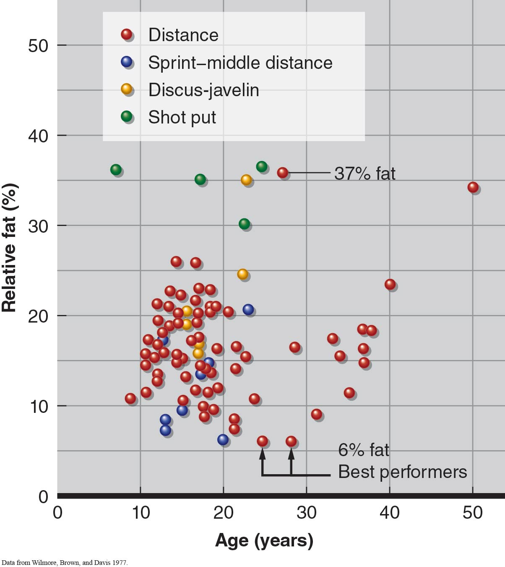
Figure 15.7

Slide 9
Body Composition in Sport: Risks With Severe Weight Loss (continued)
Bone mineral loss
  Serious consequence of athletic amenorrhea
  Anorexia → fracture rate 7 times higher
Female athlete triad
  Eating + menstrual + bone mineral disorders
  Seen with women in lean-physique, low-body-weight, or endurance sports
  Skating, dance, gymnastics, running, swimming

Slide 10
Body Composition in Sport:
Achieving Optimal Weight
Avoid fasting and crash diets
  Cause more water and muscle loss, less fat loss
  Ketosis accelerates water loss
Optimal weight loss: ↓ fat mass, ↑ FFM
  Moderate caloric restriction + exercise
  Caloric deficit ~200 to 500 kcal / day
  Lose no more than 0.5 to 1 kg / week
  When near goal, slow weight loss further

Slide 11
Assessing Body Composition
Body composition: body’s chemical and molecular composition
General models of body composition
  Chemical model
  Anatomical model
  Two-compartment model
  (continued)

Slide 12
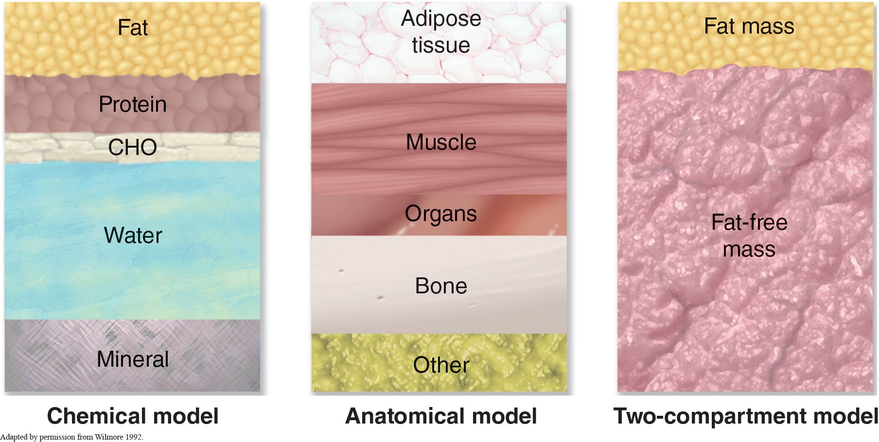
Figure 15.1

Slide 13
Assessing Body Composition (continued)
Provides more information
  Height and weight not enough to know fitness status
  – ↑ Percent body fat, ↓ performance
Body composition measured several ways
  Densitometry/hydrostatic weighing
  DEXA
  Air plethysmography
  Skinfold
  Bioelectric impedance
  (continued)

Slide 14
Assessing Body Composition (continued)
Densitometry: measures body density
  Hydrostatic (underwater) weighing
  Muscle heavier than water, fat lighter than water
  Most commonly used method
Limitations of hydrostatic weighing
  Lung air volume confounding
  Conversion of body density to percent fat
  Fat-free density varies among people
  (continued)

Slide 15
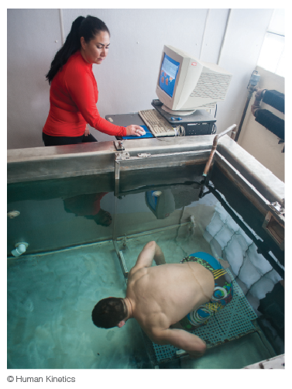
Figure 15.2

Slide 16
Assessing Body Composition (continued)
DEXA
  Dual-energy X-ray absorptiometry
  Quantifies bone and soft-tissue composition
  Precise and reliable but expensive and technical
Air plethysmography (Bod Pod)
  Another densitometry technique
  Air displacement (instead of water)
  Easy for subject, difficult for operator, expensive
  (continued)

Slide 17
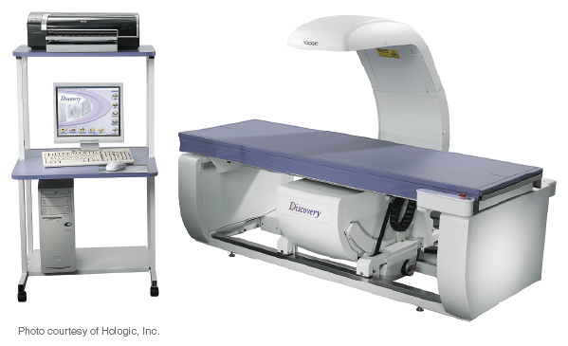
Figure 15.3a

Slide 18
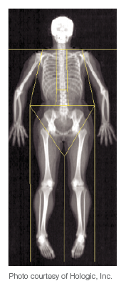
Figure 15.3b

Slide 19
Assessing Body Composition (continued)
Skinfold
  Most widely used field technique
  Measures thickness at a minimum of three sites
  Uses quadratic equations, reasonably accurate
Bioelectric impedance
  Electrodes on ankle, foot, wrist, hand
  Current passes from proximal to distal sites
  Fat-free mass good conductor, fat poor conductor
  Reasonably accurate, could be better

Slide 20
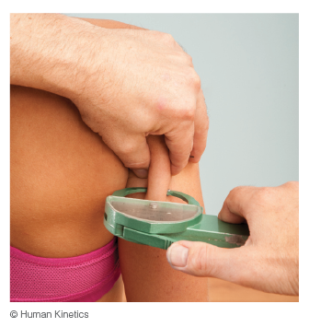
Figure 15.5

Slide 21
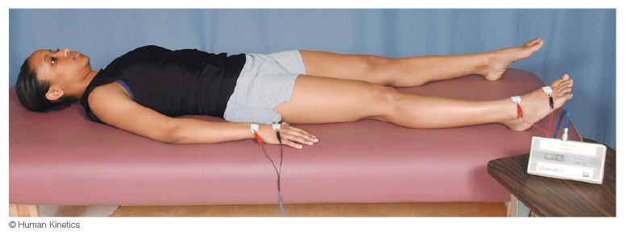
Figure 15.6

